Slide 1
Improving Video Pose Estimation with Deep Learning and Graphical Models
Sam Toyer
Supervisor: Anoop Cherian
https://github.com/qxcv/comp2560

Slide 2
Motivation
Pose estimation
Input video frame
Output pose
“Limbs”
Useful for:
Classifying clothing
Action recognition
Object detection and classification
“Joints”
“Skeleton”, or “pose”

Slide 3
Existing approaches
Treat pose as a graphical model
Performance improved by incorporating convolutional neural networks
Incorporate motion information by extending graphical model
Yang and Ramanan (2011)
Cherian et al. (2014)
Chen and Yuille (2014)

Slide 4
A hybrid approach
+
Stitch together a temporally consistent sequence of poses using Cherian et al.'s recombination method
Generate candidate poses in each frame with adapted Chen and Yuille detector

Slide 5
Pose model
Lower arm, type 1
18-part model used for pose estimation in each frame
Only use 7-part model for recombination
Lower arm, type 2
Lower arm, type 3
Head
Lower arm, type 4
Arm
Each limb has a “type” indicating its approximate orientation and length
Hips
18-part
7-part

Slide 6

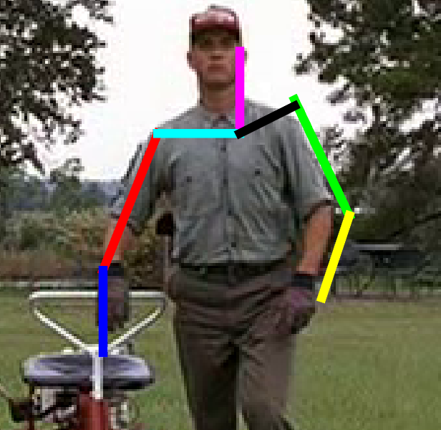
Per-frame candidate sets
Cost for pose with joint locations l and limb types t in image I
Costs for each joint from CNN
Costs for each limb and limb type
Lowest-cost poses
Near-identical poses removed

Slide 7
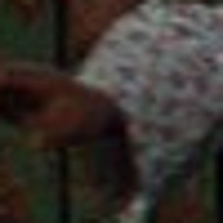
Convolutional neural networks I
Convolutional Neural Network (CNN) run over 227x227px crops of image to guess joint presence and limbs types
CNN
Wrist
Lower arm type 8
0.6936
Elbow
Upper arm type 8
Lower arm type 6
0.7927
Head
Neck type 7
0.6472

Slide 8
Convolutional neural networks II
Heatmaps
Ultimately produces heatmap over entire image for each joint
Joint 1
Joint 2
Input image
Joint 3

Slide 9
Recombination
Static image pose estimation produces set of poses for each frame
Choose best limbs from each frame's pose candidate set
Use flow-based costs for consistency with motion

Slide 10
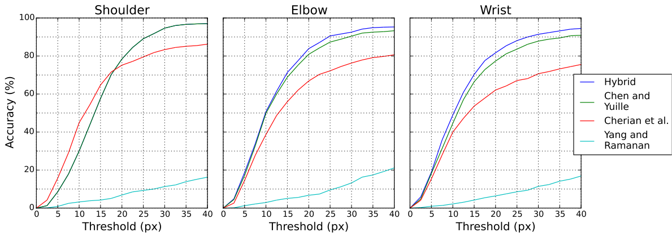
Results
Top: Performance on Poses in the Wild.
Left: A correctly localised sequence.

Slide 11
Discussion I
1
2
3
4
5
6
Challenging cases:
Clutter, especially limb-like clutter (1, 2) and foreground clutter (2)
Rapid motion (3, 5, 6)
Self-occlusion (4)

Slide 12
Discussion II
Performance is a huge issue:
Main culprit is CNN
CNN has to calculate 8347 channels (all limb type and joint presence combinations) for each pixel in the heatmap
CNN forward propagation and candidate set generation is repeated at 24 different scales
Stage | Time
Optical flow | 336.41s
CNN evaluation | 1712.87s
Candidate set generation | 159.21s
Recombination | 10.86s
Timing for 30 frame sequence. Used Intel Xeon E5-2620 CPU and NVIDIA K80 GPU.

Slide 13
Summary
  Hybrid approach:
    Generate set of candidate poses for each frame using CNN, graphical model (Chen and Yuille)
    Choose complete set of limbs for each frame to obtain temporally consistent sequence (Cherian et al.)
  Improves accuracy over either detector for fast-moving joints (elbow, wrist)
  Main challenge is performance

Slide 14
References
X. Chen and A. Yuille. Articulated pose estimation by a graphical model with image dependent pairwise relations. In NIPS, 2014.
A. Cherian, J. Mairal, K. Alahari, and C. Schmid. Mixing body-part sequences for human pose estimation. In CVPR, 2014.
Y. Yang and D. Ramanan. Articulated pose estimation with flexible mixtures-of-parts. In CVPR, 2011.

Slide 15
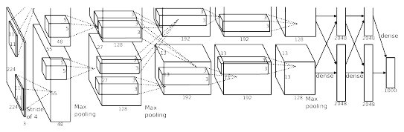

Convolutional neural networks
Convolutional Neural Networks (CNNs) obtaining excellent results in vision tasks
Trained using a variant of stochastic gradient descent to minimise some loss (e.g. softmax)
The architecture of AlexNet (top) and a visualisation of its learnt first-layer filters (bottom)

