Slide 1
THE NYC REAL ESTATE DATA WAREHOUSE
Instructions:
Give your presentation a name and be sure to put your group number in the placeholder.
This template will be use for the final delivery of your project
Group 1: Natan Bienstock, Randy Xia, Wen Chen

Slide 2
Agenda
Instructions:
Do not edit this slide
Overview
Project Requirements
Data Profile
Conceptual Architecture
Demo
Project Milestones & Timeline
Team Responsibilities
Challenges
Lessons Learned

Slide 3




Overview
Instructions:
Use this slide to describe your project in as brief as 3 sentences. Feel free to update this with graphics
Many investors find it challenging to navigate the NYC real estate market and get lost in the sea of data. We integrated NYC real estate sales data into one central location, making it easy to see historical sales in each zip code.
Many data sources
Data Warehouse
Data Visualization

Slide 4
Project Requirements
Instructions:
You do not need to edit this slide. This is a summary of the project requirements
1. Design, Document, & Plan
3. Test the Solution
Develop a conceptual design architectures
Develop data flow diagrams and data models
Define analytics concepts with bus matrix
Define ETL Instructions
Define data attributes
A prototype is to be test
Break-testing and optimization of the database may be necessary (use of indexes)
Ensure that error-handling scenarios are considered
2. Develop and Build
4. Present and Deliver
Develop the warehouse solution using Amazon Web Services as the platform
Include two data structures:
Structured dataset
Semi/Unstructured dataset
Integrations:
Batch/Migration
Real-time
Data Visualization
Code Repository (GitHub)
Deliver an executive presentation
Demo the architectural components
Demo the visualizations in a data visualization platform like Tableau

Slide 5

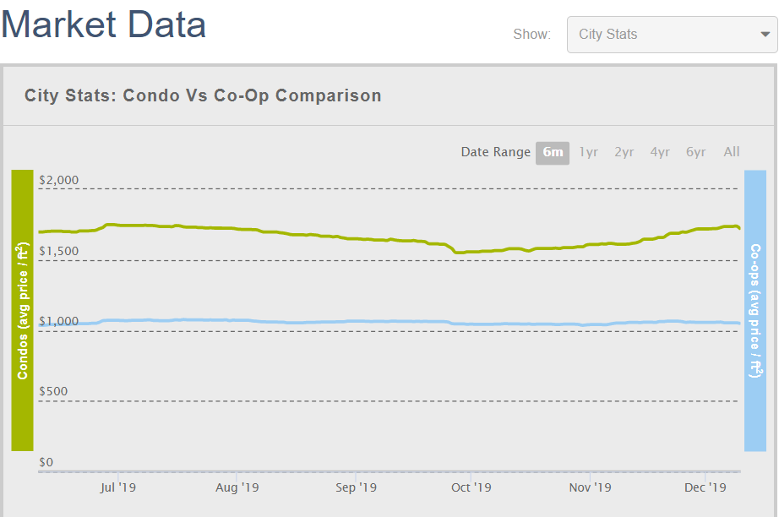

Data Profile: City Realty Market Data
Instructions:
Use this slide for every dataset you profile. You should summarize your datasets in these slides using basic statistics and information about the source and provenance of the data.
Dataset Summary
<<Show some basic summary statistics in this box. For example, how many addresses exist by zip code or how many terms exists by country. Ok to use a chart or graph here>>
Source of Information | Website (Scraped)
Number of Records | 339576 rows
Frequency of updates | Daily
Data type and structure | object, float, integer
Number of columns | 7 Columns
Granularity | Individual Sale
Descriptive Statistics

Slide 6
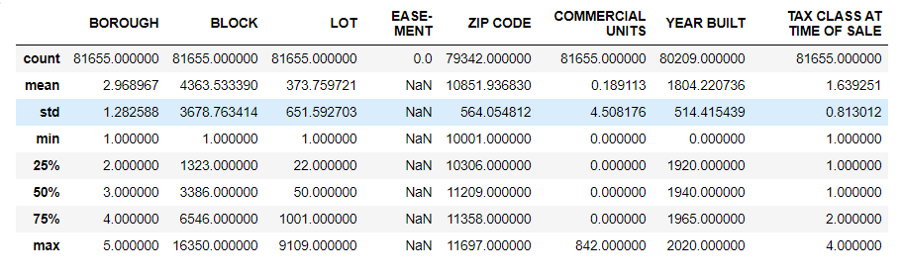
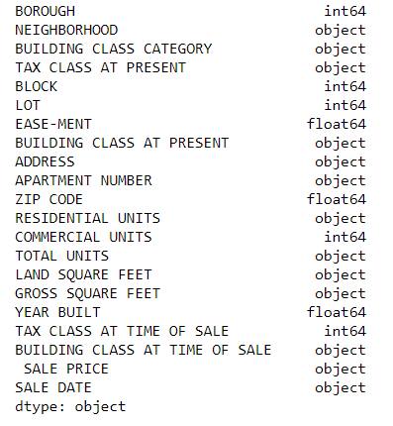
Data Profile: Rolling Sales Data
Instructions:
Use this slide for every dataset you profile. You should summarize your datasets in these slides using basic statistics and information about the source and provenance of the data.
Dataset Summary
<<Show some basic summary statistics in this box. For example, how many addresses exist by zip code or how many terms exists by country. Ok to use a chart or graph here>>
Source of Information | NYC Open data (API)
Number of Records | 81655 rows
Frequency of updates | Monthly
Data type and structure | integer, object, float
Number of columns | 21 Columns
Granularity | Individual Sale
Descriptive Statistics

Slide 7
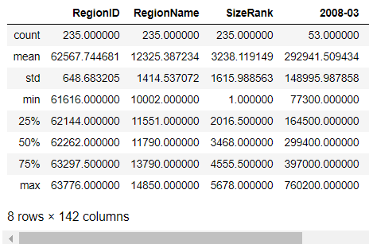
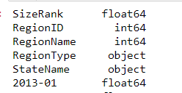
Data Profile: Zillow Median Home Sale Price
Instructions:
Use this slide for every dataset you profile. You should summarize your datasets in these slides using basic statistics and information about the source and provenance of the data.
Dataset Summary
<<Show some basic summary statistics in this box. For example, how many addresses exist by zip code or how many terms exists by country. Ok to use a chart or graph here>>
Source of Information | Zillow (csv)
Number of Records | 235 rows
Frequency of updates | Monthly
Data type and structure | object, float
Number of columns | 142 Columns
Granularity | Monthly Median Sales
Descriptive Statistics

Slide 8
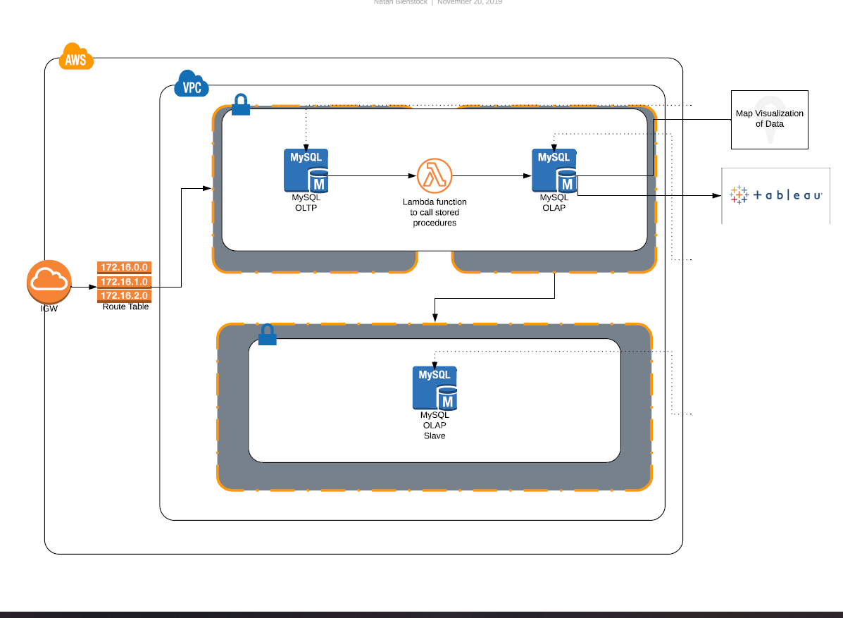
Conceptual Architecture
Instructions:
Use this slide to provide the conceptual architecture of your solution
In class we used Lucid Charts as an option to show the conceptual architecture, but I leave the decision to you
Notes:
Use AWS as Infrastructure
All Three databases share same VPC
OLTP and OLAP in same security group
Replica database in different security group
Use Tableau for Data Visualization

Slide 9









Instructions:
This is a placeholder. You do not need to edit, but you should plan to demo your solution at this point!
DEMO
https://rebrand.ly/NYC_Real_Estate

Slide 10





Project Milestones & Timeline
Instructions:
Update the timeline slide with the high-level milestones of your project
Highlight the key milestones and specify the key dates for completion.
You do not have to edit the last milestone!
Week 12
Week 15
Initial Business Profile & Data Sourcing
Study of client’s business and find potential data sources
Data Warehouse Test
Staging data is put in the data warehouse and initial data cleaning is performed
Deliver & Present
Present final solution to class
Determine peer score
Initial Data Profiling & Architecture
Data sources are profiled and architecture is built in AWS
Warehouse & Visualizations
Data warehouse is operational and Tableau dashboard built
Week 8
Week 14
Week 16

Slide 11

Team Responsibilities
Instructions:
Use this slide to provide the breakdown of the key responsibilities for the members of your group.
Who was responsible for what part of the project?
List the person and their responsibilities.
Natan Bienstock
GROUP 1
Data Profiling for Zillow and NYC data
Data architecture design
Data warehouse design and implementation
Visualization and dashboard design
Executive Presentation Slides
Randy Xia
Wen Chen
Design Documentation Lead
City Realty data acquisition
Upload scripts to move raw data to S3 locations
Initial study of real estate market
Locating potential data sources

Slide 12

Assumptions
Instructions:
Describe the assumptions made about your project that contextualize its limitations and constraints.
Feel free to edit/change this slide as much as necessary
1
2
All data sources would have the same grain
All data sources would have zip code
3
4
Real estate investors look at properties by zip code
The main distinction between buildings is commercial or residential

Slide 13

Challenges
Instructions:
Describe the top 3 challenges of your project and why they were a challenge
Acquiring data from City Realty website as it was hard to scrape the data
One team member leaving in the middle of the project due to a family emergency
Data cleaning and preparation was both more challenging and time-consuming than expected

Slide 14

Lessons Learned
Instructions:
Provide a few key lessons learned and describe how you might implement them if you had another opportunity to do the project all over again
The following are the key lessons learned from the project.
NEED TO KNOW WHAT YOUR DATA IS AND WHAT IS AVAILABLE
Constant communication is Key
Time management
IT always tAKES longer THAN YOUR INITIAL ESTIMATE
Don’t mistake the weeds for the trees

Slide 15
Thank You! Any questions?

