Slide 1
基于医疗知识图谱的问答系统调研
徐佳龙
Page 1

Slide 2
目录
设计思路
用户交互方式
初步的计划
Page 2

Slide 3
设计思路
方案一：SPARQL知识检索(以知识图谱为主)
Fuseki是Jena提供的SPARQL服务器，支持SPARQL语言进行检索，可在单机和服务器端高效运行。
Page 3

Slide 4
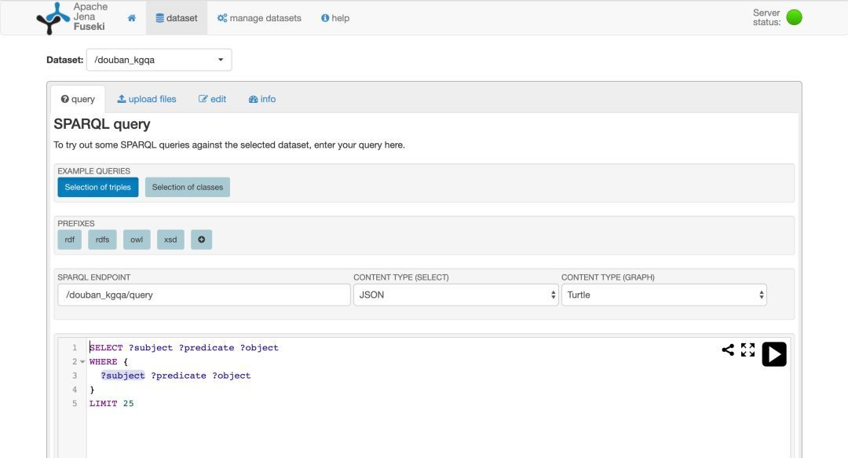
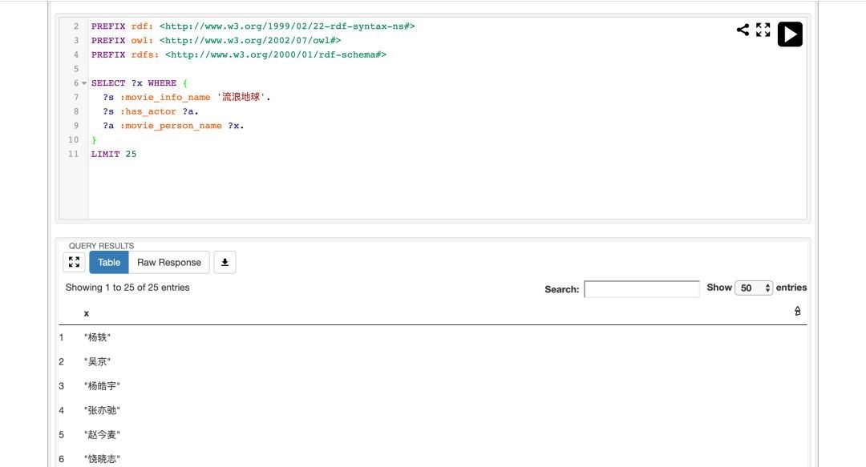
SPARQL知识检索
Page 4

Slide 5
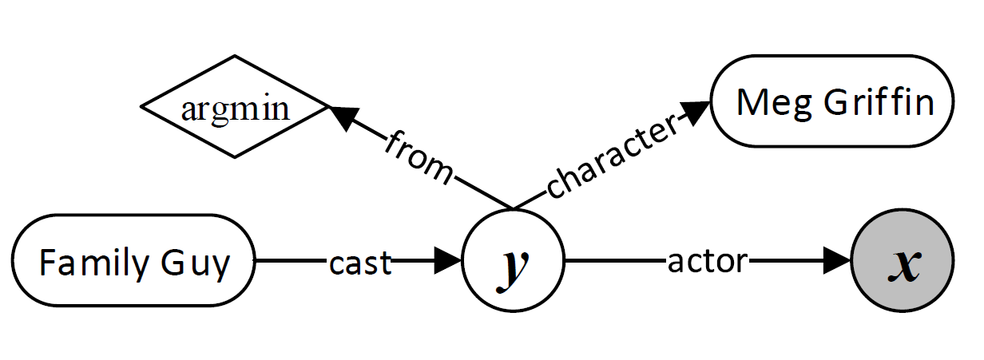
SPARQL知识检索
如何将自然语言问句转换得到SPARQL查询语句？
自然语言问题
逻辑形式
查询语句
Named Entity linking(命名实体链接)
更复杂的算法
Yih S W, Chang M W, He X, et al. Semantic parsing via staged query graph generation: Question answering with knowledge base[J].
Page 5

Slide 6
设计思路
方案二：词汇和语义相结合(以知识图谱为辅)
Franco-Salvador M, Kar S, Solorio T, et al. UH-PRHLT at SemEval-2016 Task 3: Combining lexical and semantic-based features for community question answering[J]. arXiv preprint arXiv:1807.11584, 2018.
Page 6

Slide 7
UH-PRHLT
Lexical(词汇)特征:
Cosine Similarity
Word Overlap
Noun Overlap
N-gram Overlap
Semantic(语义)特征:
Distributed representations of texts
Distributed word alignments
Knowledge graphs
Common frames(Framenet)
Page 7

Slide 8
UH-PRHLT
Distributed representations of texts.
We used the continuous Skip-gram model (Mikolov et al., 2013) of the word2vec toolkit to generate distributed representations of the words of the complete English Wikipedia.4 Next, for each text, e.g. question or comment, we averaged its word vectors in order to have a single representation of its content as this setting has shown good results in other NLP tasks (e.g. for language variety identification (Franco-Salvador
et al., 2015a) and discriminating similar languages (Franco-Salvador et al., 2015b)). Finally, the similarity between texts, e.g. question vs. comment, is estimated using the cosine similarity.
Distributed word alignments. The use of word alignment strategies has been employed in the past for textual semantic relatedness (Hassan and Mihalcea, 2011). Tran et al. (2015) employed distributed representations to align the words of the question with the words of the comment. A more recent work introduced the Continuous Word Alignment-based Similarity Analysis (CWASA) (Franco-Salvador et al.,
2016a). CWASA uses distributed representations to measure the similarity by double-direction aligning words of texts. In this work we selected as feature the similarity provided by CWASA between questions and comments.
Knowledge graphs.
A knowledge graph is a labeled, weighted, and directed graph that expands and relates the concepts belonging to a text. Knowledge Graph
Analysis (KGA) (Franco-Salvador et al.,
2016b) measures semantic relatedness between texts by means of their knowledge graphs. In this work we used the BabelNet (Navigli and Ponzetto, 2012) multilingual semantic network to generate knowledge graphs from questions and comments, and measured their similarity using KGA.
Page 8

Slide 9
其他思路
方案三：信息抽取(Information extraction)
Named Entity recognition(命名实体识别)
方案四：向量建模(vector modeling)
Dong L, Wei F, Zhou M, et al. Question answering over freebase with multi-column convolutional neural networks[C]//Proceedings of the 53rd Annual Meeting of the Association for Computational Linguistics and the 7th International Joint Conference on Natural Language Processing (Volume 1: Long Papers).
Page 9

Slide 10
用户的交互方式
百科
智能问答
联系医生
Page 10

Slide 11
初步的计划
做更多的调研，在9月内决定具体方案
11月底做出一个能运行的模型(时间包括有可能的重新选择模型)
12月底嵌入平台
(未知) 获取语料的时间？是否需要本人自己手编整理？
Page 11

Slide 12
Thank You
Page 12

