Slide 1
Variational Reasoning for question Answering with Knowledge Graph
算法组-徐佳龙
Page 1

Slide 2
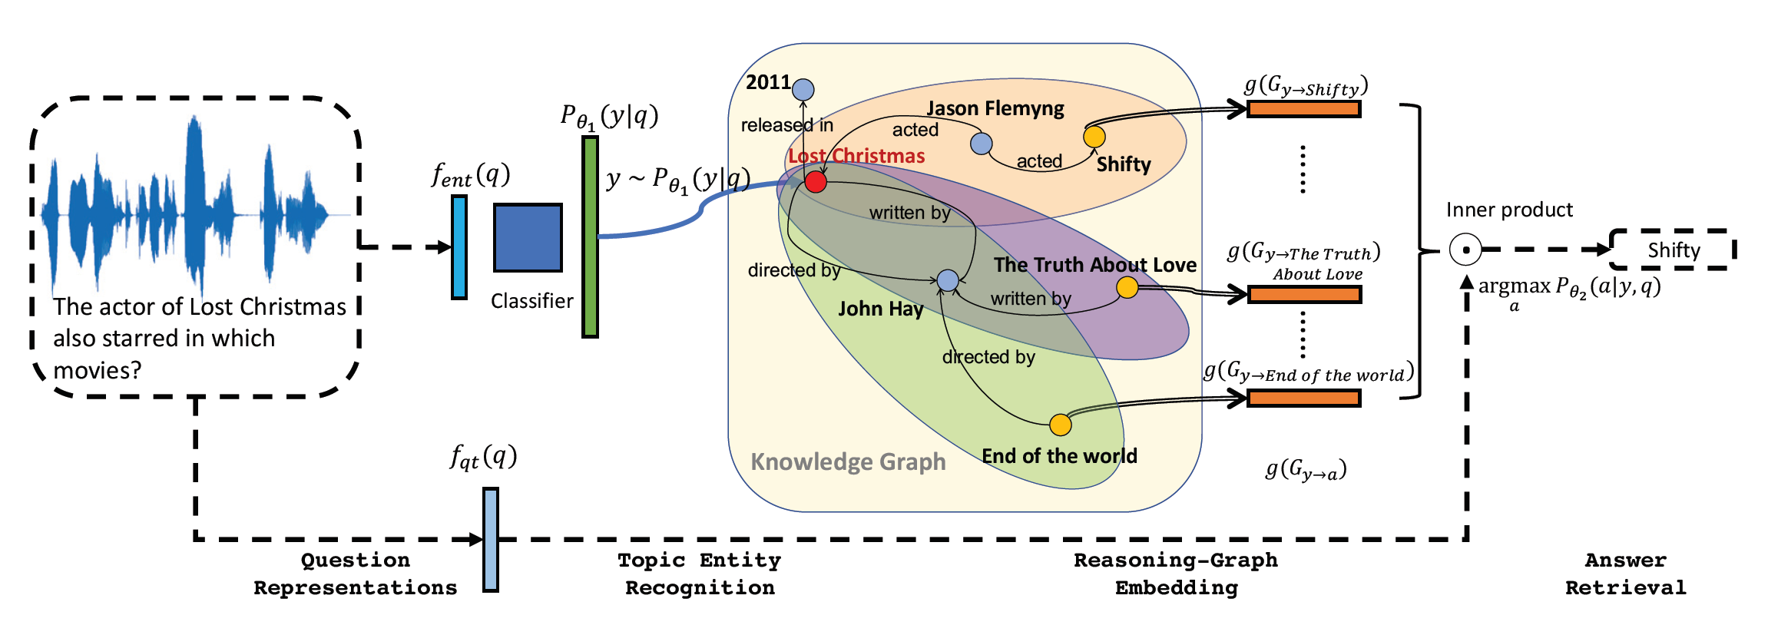
系统结构
Page 2

Slide 3
模块
Module for topic entity recognition: Recognizing the topic entity y (or the entity mentioned in the question) is the first step in performing logic reasoning over the knowledge graph. We denote the topic entity as y, and model the compatibility of this entity with the question qi as a probabilistic model Pθ1 (y|qi), which shows the probability of the KG entity y being mentioned in the question qi.
Module for logic reasoning over knowledge graph: Given the topic entity y in question qi, one need to reason over the knowledge graph to find out the answer ai. Thus we model the likelihood of an answer ai being correct given entity y and question qi as Pθ2 (ai|y, qi).
Page 3

Slide 4

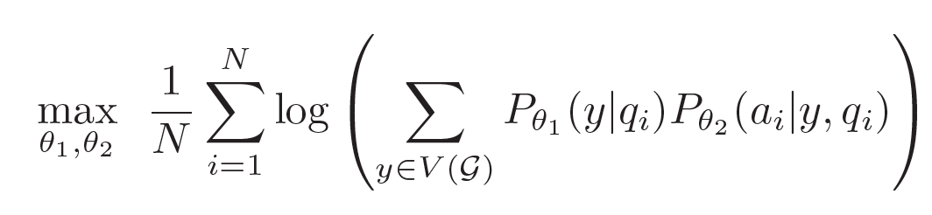
问题描述
With the two probabilistic components above, we model the probability of answer ai being correct given question qi as , which sums out all possibilities of the latent variable.
Page 4

Slide 5

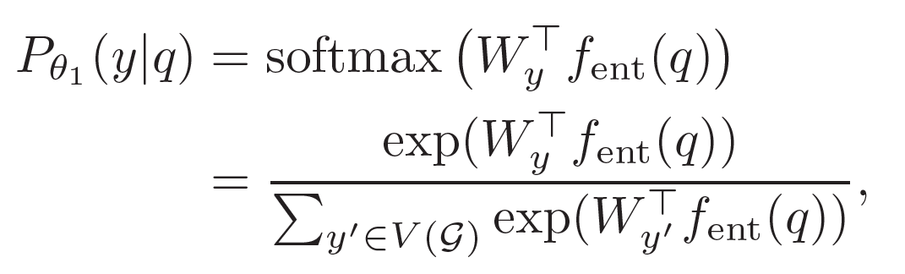

Probabilistic module for topic entity recognition
Michael could either be the name of a movie or an actor.
we use a neural network which can represent the question q in a d dimensional vector. Depending on the question form (text or audio), this neural network can be a simple embedding network mapping bag of-words to a vector, or a recurrent neural network to embed sentences, or a convolution neural network to embed audio questions. Thus the probability of having y in q is
where are the weights in the last classification layer.
Page 5

Slide 6
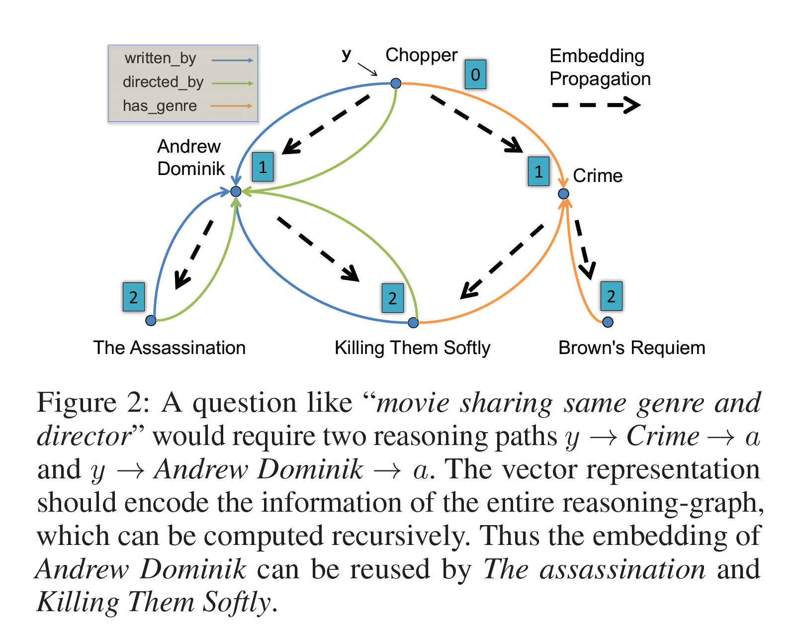
Probabilistic module for logic reasoning over knowledge graph
We assume the maximum number of steps (or hops), T, of the logic reasoning is known to the algorithm. Starting from a topic entity y, we perform topological sort (ignoring the original edge direction) for all entities within T hops according to the knowledge graph.
Page 6

Slide 7




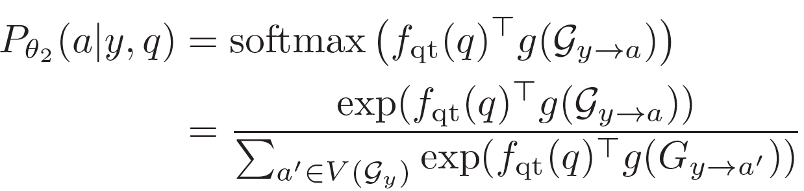
Probabilistic module for logic reasoning over knowledge graph(part 1)
Reasoning graph to a. Given a potential answer a in the scope Gy, we denote a to be the minimum subgraph that contains all the paths from y to a in Gy. Thus we will learn a vector representation (or embedding) for Gya, denoted as
More specifically, suppose the question is embedded using a neural network fqt(·) : q → Rd, which captures the question type and implies the type of logic reasoning we need to perform over knowledge graph. Then the compatibility (or likelihood) of answer a being correct can be computed using the embedded reasoning graph Gy a and the scope Gy as
Page 7

Slide 8
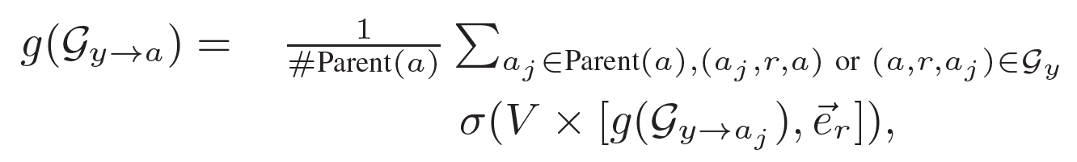






Probabilistic module for logic reasoning over knowledge graph(part 2)
Joint embedding reasoning graphs. More specifically, we propose a “forward graph embedding” architecture. The embedding of the reasoning graph for a is computed recursively using its parents’ embeddings:
where er is the one-hot encoding of relation type r ∈ R, V ∈ Rd×(d+| are the model parameters, σ(·) is a nonlinear function such as ReLU, and #Parent(a) counts the number of parents of a in Gy. The only boundary case is g(Gy→y) = when y = a. Overall, computing the embedding g(Gy→a) for all a takes O(|V (Gy)|+|E(Gy)|) time, which is proportional to the number of nodes and edges in the scope Gy.
Page 8

Slide 9
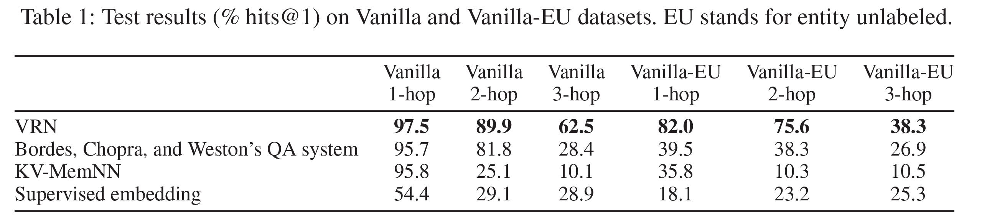
result
Page 9

Slide 10
创新点
先进的推理方式，从实验结果来看效果非常好
摒弃了传统的NLP算法，不需要做实体提取、实体对齐、实体链指等等操作
开放性大，没有规定网络结构，只给出了算法，可操作空间大
Page 10

Slide 11
局限性
完全没有系统细节，不知道他们用什么神经网络得到的这个结果。
文章后半部分还有大量的算法来训练网络参数（例如加入增强学习），调整系统准确率，使得复现工作量更大。
Page 11

Slide 12
Thank You
Page 12

