Slide 1
四级写作

Slide 2
1.Insight into writing test
2.Following outline
3.Without outline
4.Cartoon
5.Letter

Slide 3
考试要求
时间：30mins
字数：120-180 words
权重：15%
分值：106.5

Slide 4
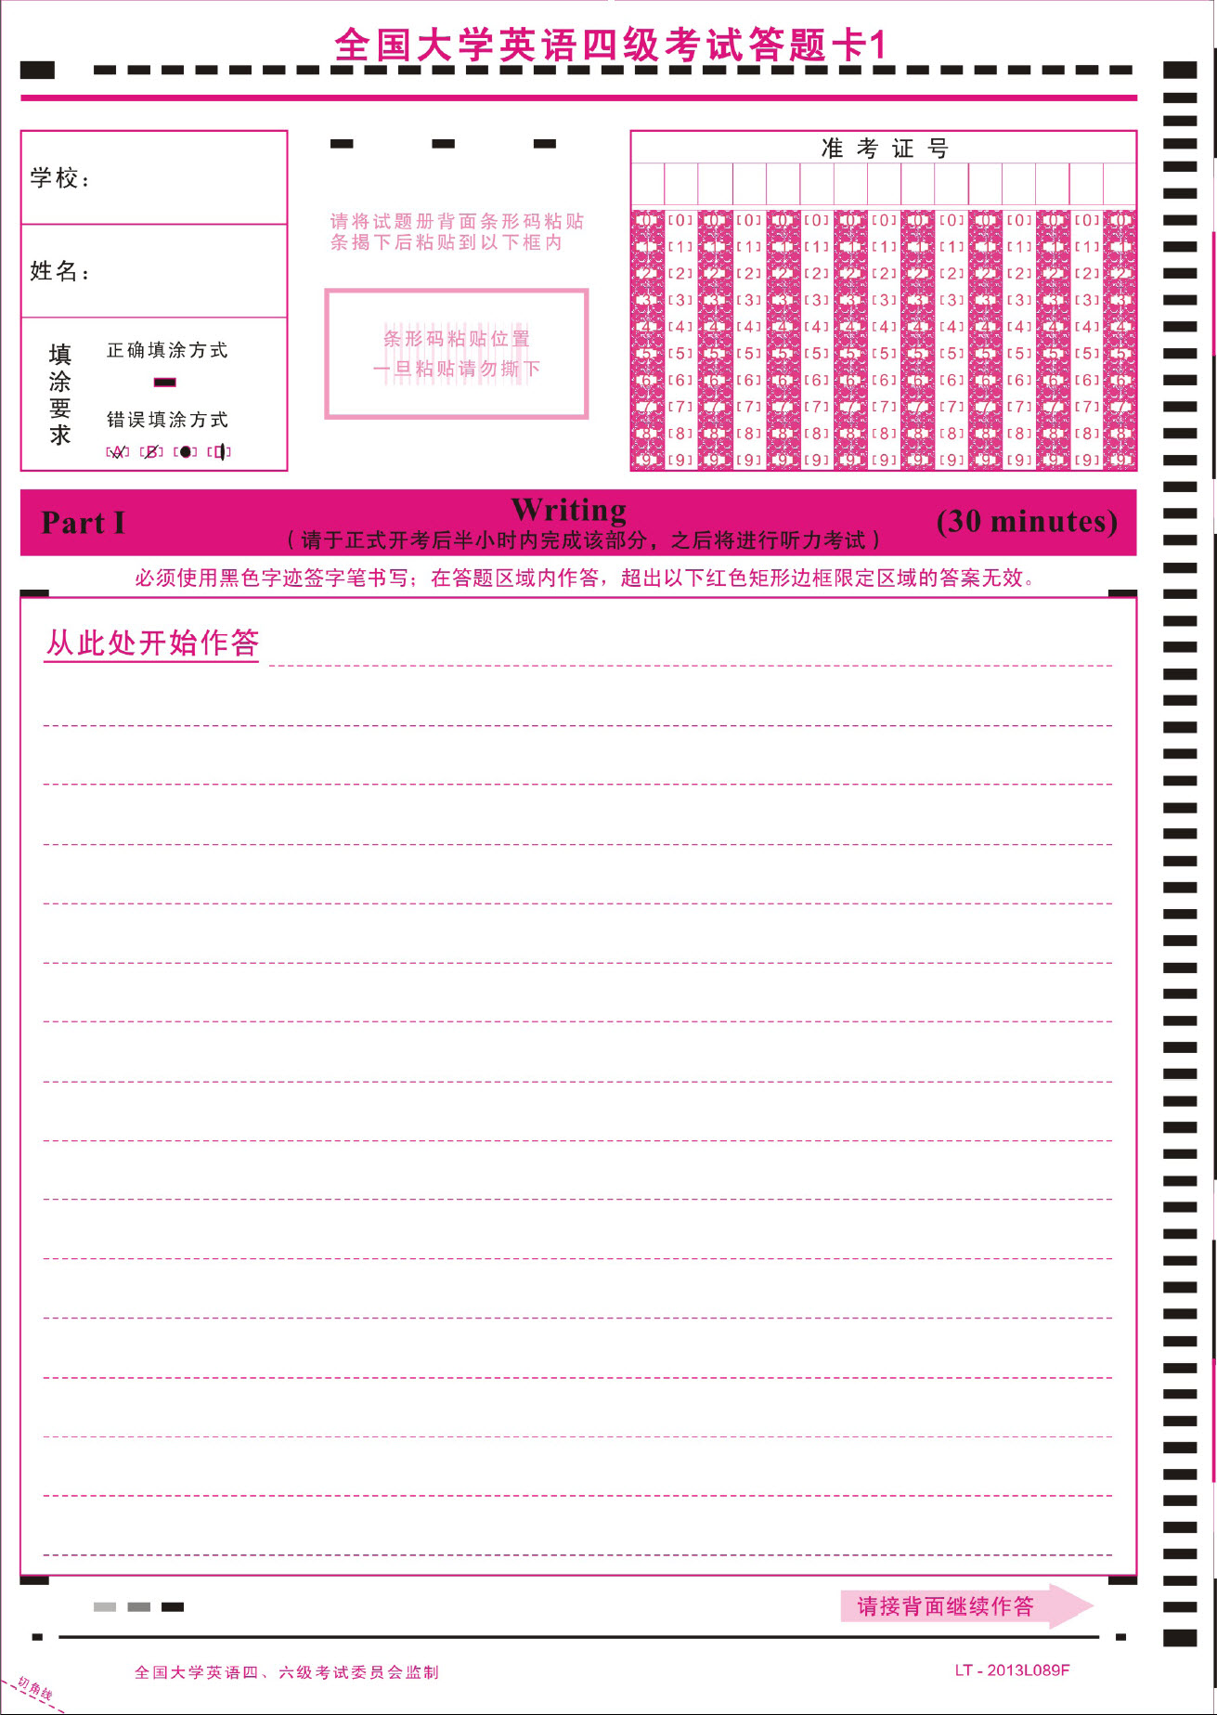
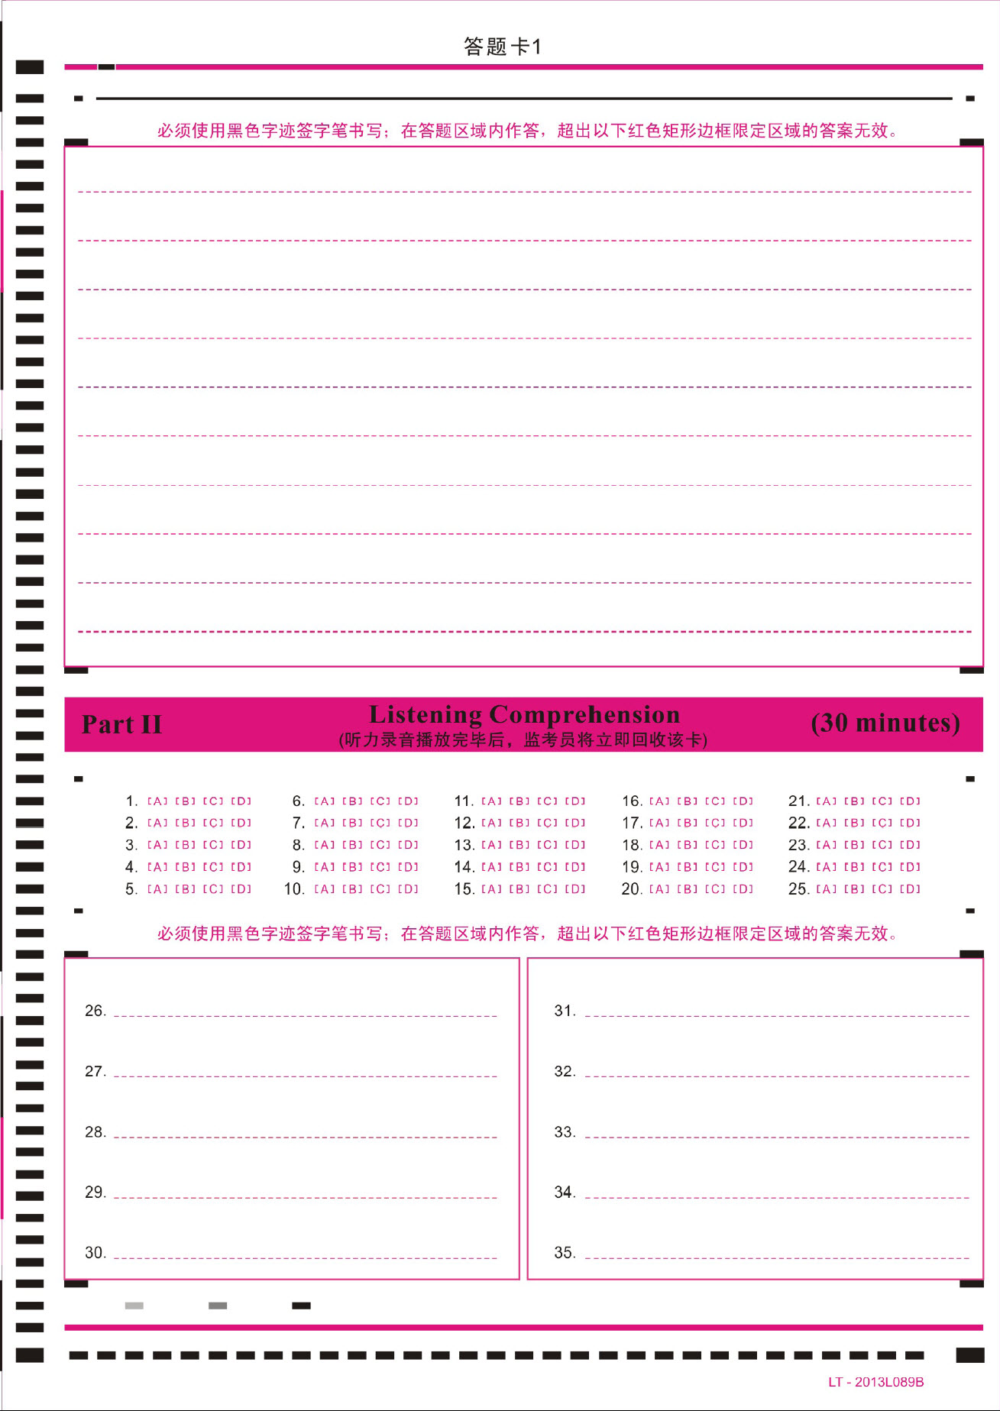

Slide 5
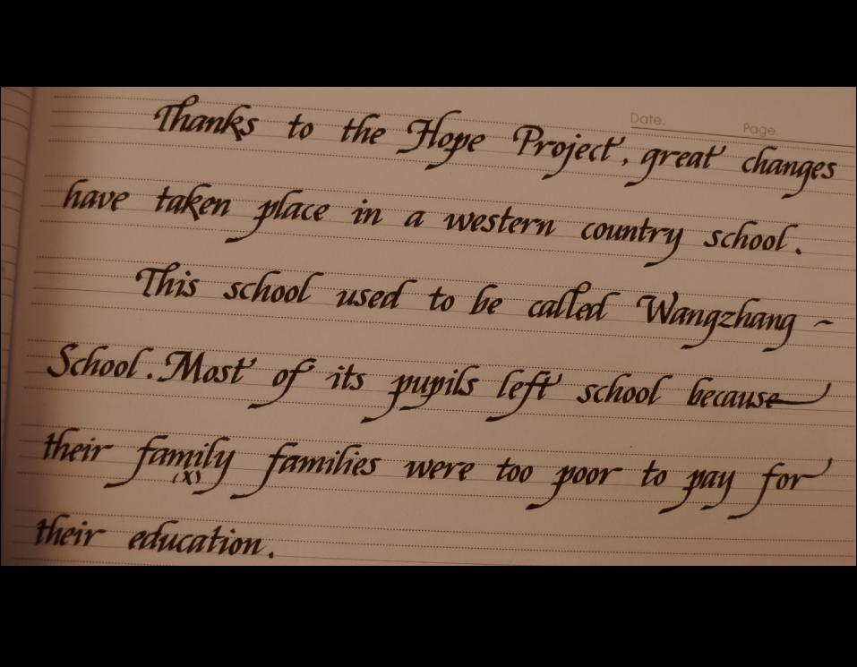
书写

Slide 6
Following outline1
Directions: for this part, you are allowed 30 minutes to write a short essay on the topic of Online Shopping following the outline below. You should write at least 10 words but no more than 180 words.
1.目前网络购物成为一种时尚
2.网络购物有不少好处，但也有不少问题
3.我的建议

Slide 7
Following Outline 2
Directions: For this part, you are allowed 30 minutes to write a short essay on the topic of On Excessive Packaging following the outline below. You should write at least 120 words but no more than 180 words.
1.目前许多商品存在过度包装的现象
2.出现这一现象的原因
3.我对这一现象的看法和建议

Slide 8
Without Outline 1
Directions: For this part, you are allowed 30 minutes to write a short essay entitled Nothing Succeeds without a Strong Will by commenting on the humorous saying,” Quitting smoking is the easiest thing in the world. I’ve done it hundreds of times.”
You should write at least 120 words but no more than 180 words.

Slide 9
Without Outline 2
Directions: For this part, you are allowed 30 minutes to write a short essay on the following topic. You should write at least 120 words but no more than 180 words.
Suppose a foreign friend of yours is coming to visit your hometown/China/campus, what is the most interesting place you would like to take him/her to see and why?

Slide 10
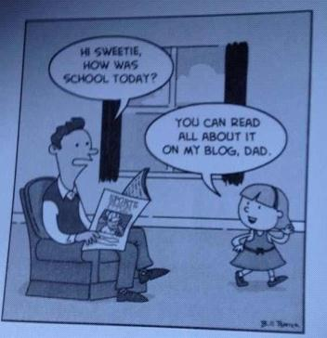
Cartoon
Directions: For this part, you are allowed 30 minutes to write an essay. You should start you essay with a brief description of the picture and then express your views on technology and communication. You should write at least 120 words but no more than 180 words.

Slide 11
Letter
Directions: For this part, you are allowed 30 minutes to write an announcement to welcome students to join the club. You should write at least 120 words following the outline given below:
1.本社团的主要活动内容
2.参加本社团的好处
3.如何加入本社团

Slide 12
主题
教育：theoretical knowledge, practical skills, critical thinking
科技：with just a click of mouse, convenience,
be isolated from the real world
环保：raise public’s green awareness,
encourage low carbon lifestyle
生活：broaden one’s horizon, experience various cultures

Slide 13
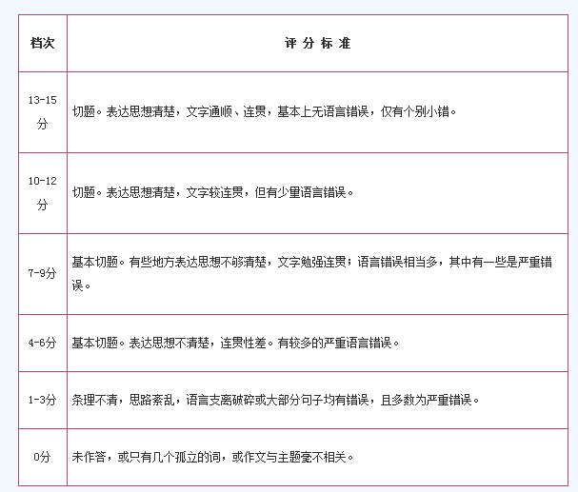
评分标准

Slide 14
官方真正想表达的是：
“基本切题，但有些地方表达不够清楚；文字勉强连贯；语言错误相当多，其中有一些是严重错误。”

Slide 15
真正的评分标准
13-15分
内容：切题，完全回应题目中的所有要求（例如题目如果给出三点提纲，则文章内容要完全一一对应包含），文章内容重心分布合理。
逻辑：段落间逻辑推进合理，句子间逻辑连贯通顺，恰当使用逻辑连接词。
词汇：用词准确、自然，单词搭配地道，基本无用词不当或单词拼写错误。
语法：正确、恰当、灵活使用各种语法及句子结构，基本无语法错误和标点错误。

Slide 16
语法问题 ——
三种经典写作语法硬伤
We pass CET-4 is very important.
There are many people like watch TV.
Play computer games is a very popular relax activity.

Slide 17
语法问题 ——
三种经典写作语法硬伤
Teachers can help students, students can help each other.

Slide 18
语法问题 ——
三种经典写作语法硬伤
Protecting environment is important. Because it is associated with everyone’s health.

Slide 19
语法真经
Some people think that…, because …
Many people think that playing video games is good to children because they believe that it can promote intellectual development.

Slide 20
语法真经
If/When…, …, which( and this)…
If oil price goes up, people will drive less, which can reduce pollution.

Slide 21
语法真经
…that/who…
Advertising is a bridge that connects the demand and supply.

Slide 22
语法真经
… and …
Teachers can communicate with students face-to-face.

Slide 23
所谓的“模板”
模板适用于一下话题：手机、网络、计算机、等(mobile phone, network, computer, etc.)
___has been playing an increasing role in our day-to-day life. It has brought us a lot of benefits while it can create some serious problems as well.
___ have allowed us to do a lot of things more easily and quickly. For example, we can communicate freely by ___ with people from all over the world. It takes only a few seconds to get a message across wit the cost substantially lower than that of ___. Also, an enormous amount of information can be accessible through the ____. A fantastic world will be open to us just by ____.
All in all, we cannot live without ___ now. Surely, ____ has a lot of advantages, but at the same time we must try to find out new ways to cope with the problems that will arise as it becomes a natural part of our lives.

Slide 24
事故发生后，_____ 高度重视，立即启动相关应急预案，____ 应当即作出批示，要求不惜一切代价搜救 ____ 人员，全力抢救伤员，查明事故原因，积极做好善后工作，并注意搜救人员安全。____ 当晚赶到事故现场指挥搜救，接着连夜前往___ 看望伤员，随后马不停蹄召开_____，安排部署施救和善后工作。
目前，现场搜救工作仍在紧张有序进行中，广大人民群众情绪基本稳定。经过____的努力，____工作取得全面胜利，涌现出一批____集体和____个人，总结表彰大会将于______进行。

Slide 25
模板句传说：
With the development of technology,…
Every coin has two sides.
Nowadays, more and more people are concerned about…

Slide 26
提纲式议论文模板
段落 | 句子 | 内容 | 逻辑框架模板
第一段开题 | 第1句 | …,and… | 翻译文中第一句话，稍加拓展
第二段正方 | 第2句 | some people think… | 正方观点
 | 第3句 | …,and … | 论据1+论据2
第三段反方 | 第4句 | Those who hold the view that …may argue that… | 反方观点+论据1
 | 第5句 | Moreover, … | 论据2
第四段 个人观点 | 第6句 | In my view, … | 个人观点
 | 第7句 | (Meanwhile)… | 进一步说明

Slide 27
Following outline1
Directions: for this part, you are allowed 30 minutes to write a short essay on the topic of Online Shopping following the outline below. You should write at least 10 words but no more than 180 words.
1.目前网络购物成为一种时尚
2.网络购物有不少好处，但也有不少问题
3.我的建议

Slide 28
Online Shopping
Online shopping has already become more and more popular, and many people enjoy it
Online shopping has brought us many benefits. It saves transportation time and cost, and since the cost of running a virtual shop is much lower than that of the traditional one which needs to pay rent and hire more employees, the products online are generally cheaper.
Some people think that online shopping is not a good model because they believe that fancy pictures and advertisement on websites can mislead consumers, and the quality of the product is hardly guaranteed. Moreover, customers’ personal information may be illegally collected during online transaction and abused by some companies.
In my view, E-business such as online shopping is an irreversible trend in this information age. In order to encourage its development, governments should set guidelines for the commercial websites and enact laws to protect the customers’ interests as well.
(155 words)

Slide 29
思考：
像模板吗？
难度词汇：illegally, transaction, abuse, irreversible

Slide 30
Directions:
For this part, you are allowed 30 minutes to write a short essay on the topic of Recreational Activities following the outline below. You should write at least 120 words but no more than 180 words.
1.娱乐活动多种多样
2.娱乐活动可能使人们受益，也可能有危害性
3.作为大学生，我的看法

Slide 31
Nowadays, various recreational activities have made our lives colorful and diversified, and people have more options to spend their leisure time.
Some activities are certainly beneficial to us. At the weekend, we invite our friends to sing Karaoke together, play bowling, or go to cinema for watching 3D movie. All these can help us relax and recharge after a week of intense study and busy work.
On the other hand, some recreational activities are actually harmful. Some people play online games all night long; others spend long time drinking in the pubs. Those behaviors do no good to mental and physical health of individuals.
As a student, we should learn to distinguish the proper entertaining activities from the potentially harmful ones. And we should also bear in mind: most things in moderation would be healthy.

Slide 32
真题
Directions: For this part, you are allowed 30 minutes to write short essay on the topic of Due Attention Should Be Given to Spelling following the outline below. You should write at least 120 words but no more than 180 words.
1.如今不少学生在英语学习中不重视拼写
2.出现这种情况的原因
3.这种现象导致的结果

Slide 33
提纲式说明文模板
段落 | 句子 | 内容 | 逻辑框架模板
第一段开题 | 第1句 | It seems to be an increasingly widespread phenomenon/concern that… | 描述现象
 | 第2句 | I think A and B are responsible for this. | 表明原因
第二段原因 | 第3句 | In the past, … | 描述过去
 | 第4句 | However, this is no longer the case. | 转折
 | 第5句 | Nowadays,… | 描述现在变化的原因
第三段 影响 | 第6句 | Of course, this issue is bringing some negative effects( to sb/sth/our society) | 影响
 | 第7句 | … | 具体描述

Slide 34
It is a noticeable phenomenon that most students do not pay enough attention to English spelling. I think the change of communication style is one of the reasons.
In the past, students used pen and paper to write letters, notes and their assignments. This is no longer the case. Nowadays, they often use computers or laptops or tablets to do their homework, and some software like Microsoft Office has spelling correction function. Even if students input a wrong word, it can be recognized by the computer and automatically changed into the correct form. Therefore, English spelling seems not so important.
In my view, this issue is bringing some negative effects. Paper based writing cannot be completely replaced by computers in a short time, and wrong spelling may cause misunderstanding during communication.

Slide 35
反思：
例子？尽量举国际化、时尚化、具体化的例子

Slide 36
Directions:
For this part, you are allowed 30 minutes to write a short essay on the topic of How Should Parents Help Children to Be Independent? Following the outline below. You should at least 120 words but no more than 180 words.
1.目前不少父母为孩子包办一切
2.为了让孩子独立，父母应该…

Slide 37
无提纲式写作：
Directions: For this part, you are allowed 30 minutes to write a short essay entitled Nothing Succeeds without a Strong Will by commenting on the humorous saying,” Quitting smoking is the easiest thing in the world. I’ve done it hundreds of times.”
You should write at least 120 words but no more than 180 words.

Slide 38
无提纲式
段落 | 句子 | 内容 | 逻辑框架模板
第一段开题 | 第1句 |  | 背景引言
第二段讲道理 | 第2句 | 简单句 | 第一中心
 | 第3句 | This is because… This means that … When/if… | 论据
第三段举例子 | 第4句 | Moreover… | 第二中心
 | 第5句 | For example,… | 举例
 | 第6句 | … | 例子解释
第四段结论 | 第7句 | (Overall,)… | 总结
注：如果题目中出现俗语，第一句话则采用的方式：As the saying goes “…”, 这句话告诉的道理.

Slide 39
As a humorous saying goes “Quitting smoke is the easiest thing in the world. I have done it hundreds of times”, it reminds everyone what a significant role a strong will plays in our life.
A strong will is a great power. When you want to achieve something, you may encounter many problems and obstacles in the path, and a strong will can make you stay motivated and keep going even after repeated failures.
Moreover, a strong will make people focus on their goal and resist attempts. For example, some smokers who plan to give up smoking find it very difficult, and they cannot refuse an offer of a cigarette by their friends. This is simply because their will is not strong enough.
Nothing succeeds without a strong will. Just remember, where there is a will, there is a way.

