Slide 1
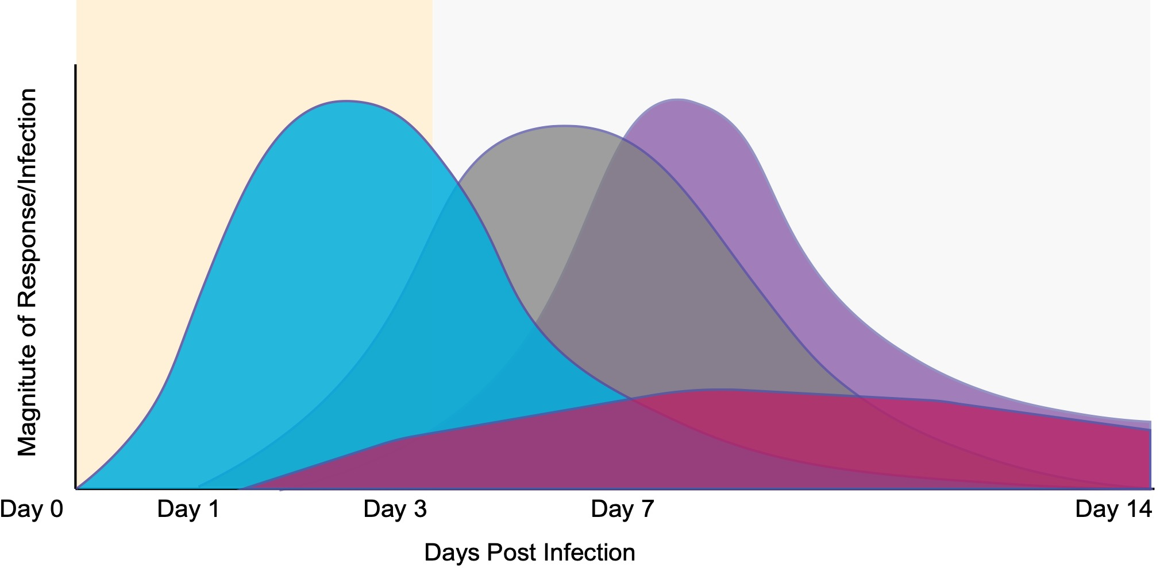
Host innate immune response at a glance
Pathogen-specific Signature
What is the first wave of transcription response to infection?
Do host response do different pathogens differently?
What dictates the difference?
Adaptive Immune
Response
Pathogen Signature
Innate Immune
Response
Clinical Symptoms
Host infected

Slide 2
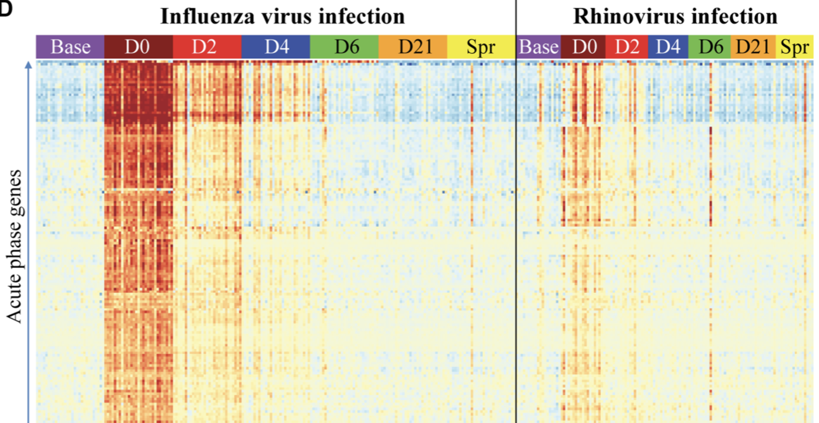
Host innate immune response has the potential to forecast an ongoing viral infection
Zhai, 2015 PLOS Pathogens

Slide 3

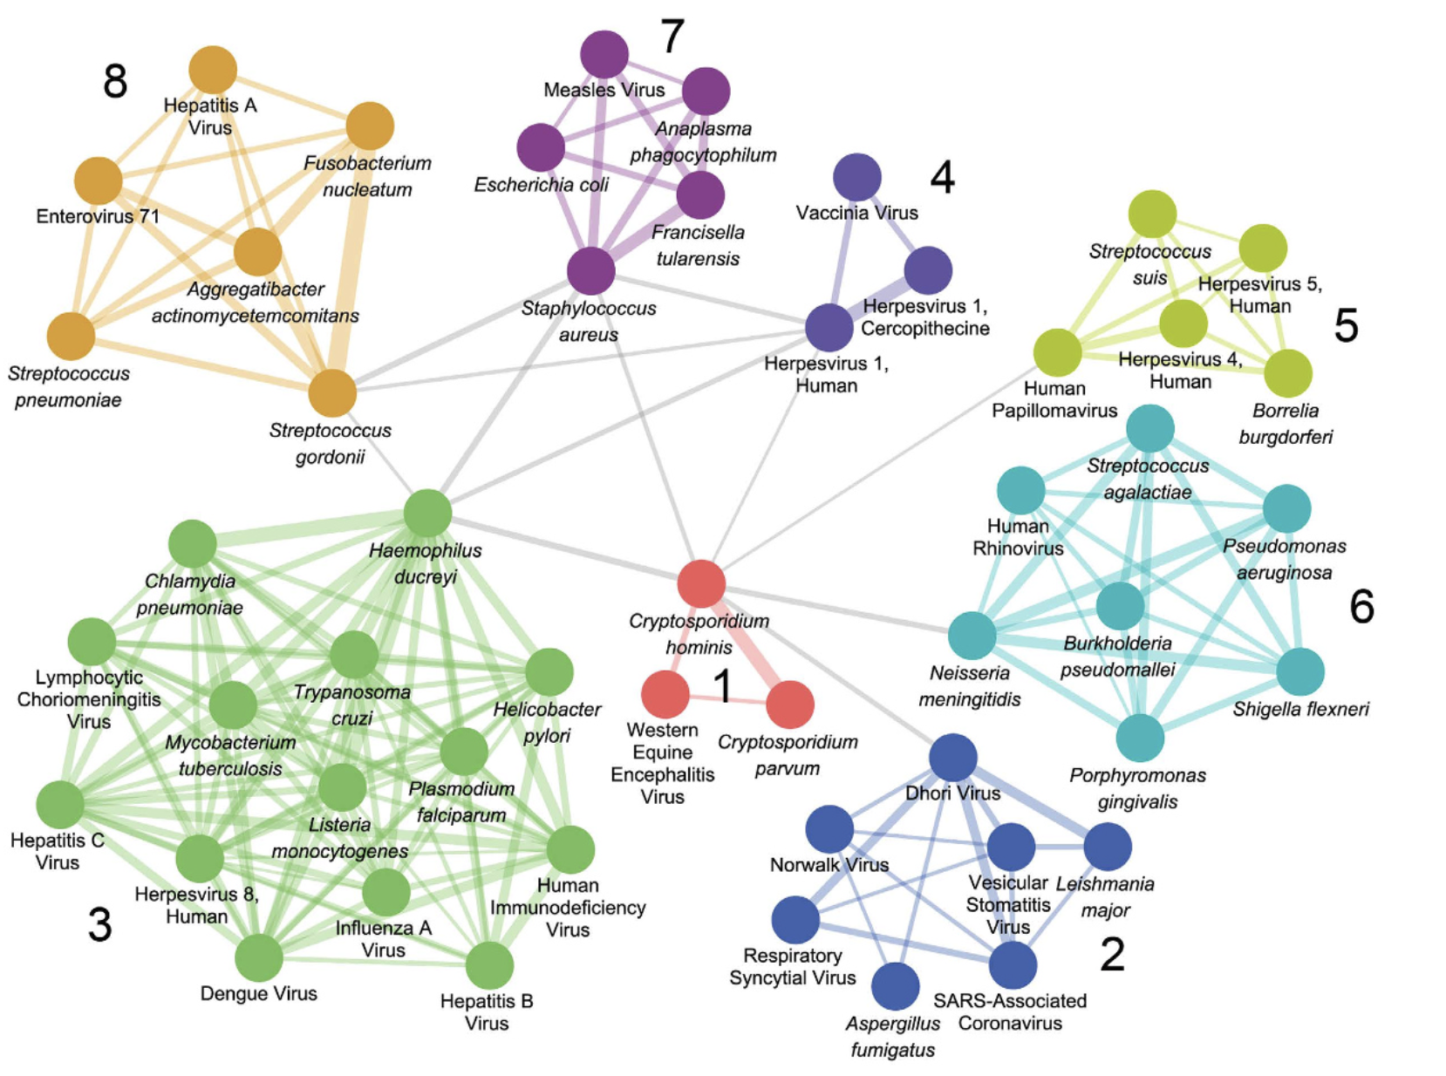

Slide 4
Summary of meta-analysis datasets used to generalize host response to viral infection
Notes:
S

Slide 5
Proposed pipeline for meta-analysis using virus infection RNA-seq datasets to infer host transcriptional patterns

