Slide 1
CNN(In my Understanding)
A “smaller” but “larger” version of Linear Layer.
It seperated the original “Linear” layer into many many “smaller but same” ones, let them to do the easy job(less computation) on smaller 3x3(or bigger 5x5) sections.
the key idea is to let “networks” pay attention on relation of data that near each other instead of the whole image(pixels far apart is always not able to provide any evidence to classify the image object).
similar relationship between CPU and GPU?(1 clever person versus many idiots)
It can extract multiple simpler feature maps at same time by different kernels
Also it can take dynamic shape of input!!!! much better than linear

Slide 2
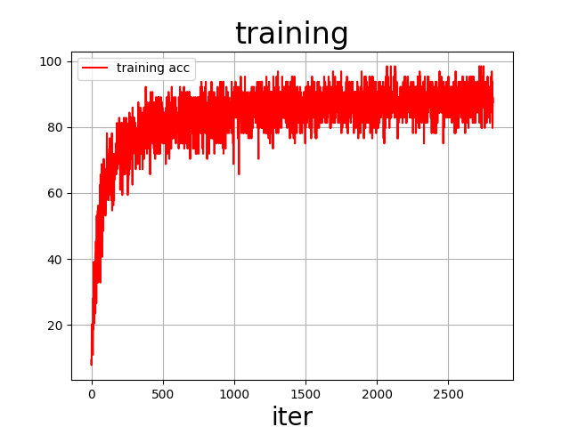
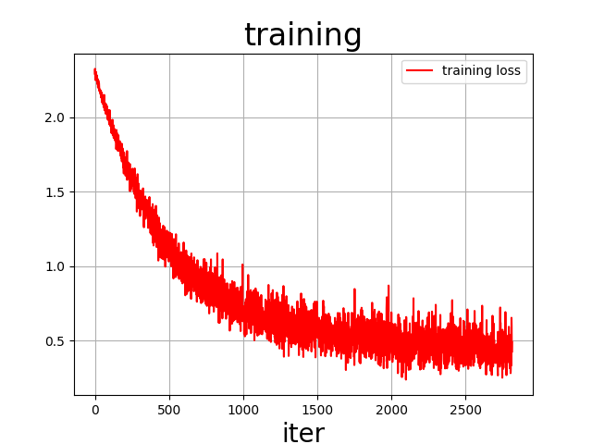
CNN(textbook)
Conv2d(1,16,kernel_size=3,padding=1)
Tanh
Flatten
Linear(16*28*28, 10)
loss = CrossEntropyLoss
optimizer = SGD
lr=0.001
epoch=3
Accuracy on test images: 89 %

Slide 3
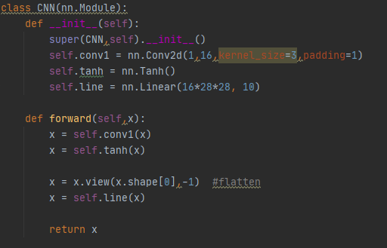


Slide 4
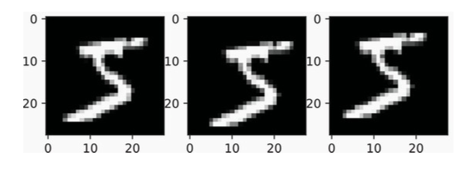
Problem(textbox)
if image moved, it can not classify it correctly as before(bad translation invariance)
example:
Original Img Class 5 Prob: 0.4313212
Lower Right Img Class 5 Prob: 0.47640046
Uper Left Img Class 5 Prob: 0.13921638

Slide 5
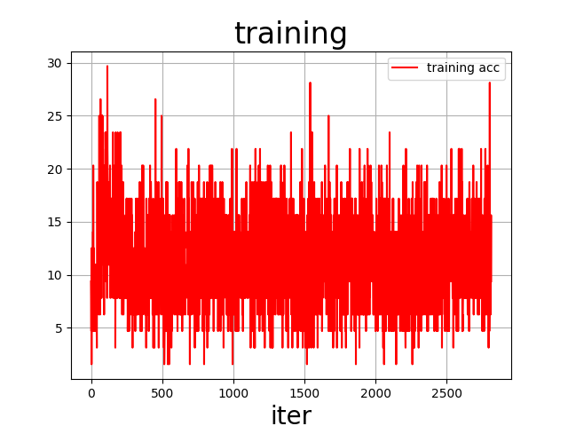
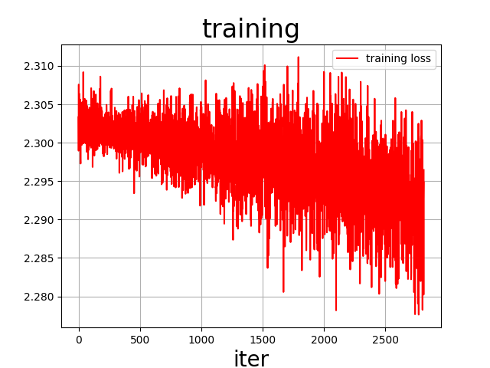
CNN-pooling(textbook)
3 x Conv2d 3x3 k=16
Tanh
3 x Conv2d 3x3 k=32
Tanh
Linear(32*28*28, 10)
loss = nn.CrossEntropyLoss()
optimizer = SGD
lr=0.001
epoch=3
Accuracy on test images: 11 %(what!? nani!???)

Slide 6
problems??
but the loss is still decreasing,
try to add epoch?
increase lr?

Slide 7
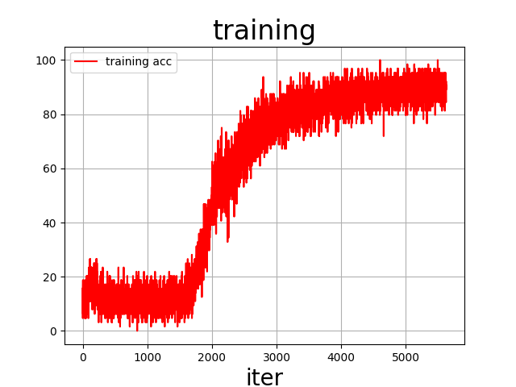
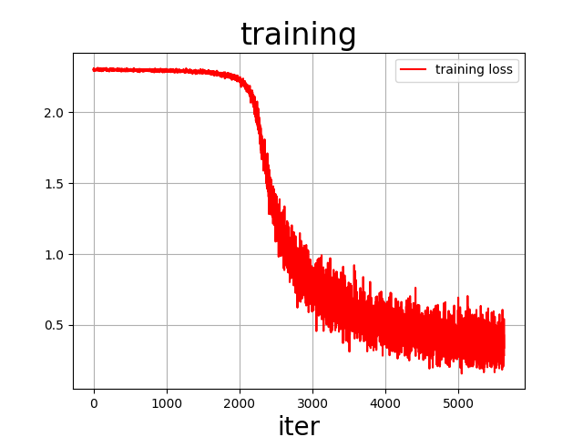
CNN-pooling2
3 x Conv2d 3x3 k=16
Tanh
3 x Conv2d 3x3 k=32
Tanh
Linear(32*28*28, 10)
loss = nn.CrossEntropyLoss()
optimizer = SGD
lr=0.002(double!)
epoch=6(double!)
Accuracy on test images: 90 %(yes! much better)

Slide 8
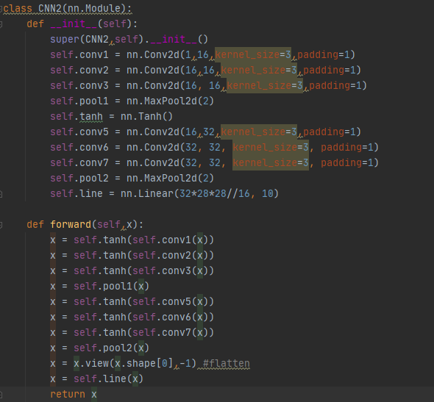

Slide 9
Why maxpooling works?(my understanding)
Thats because maxpooling will make image smaller, and then the object(number) in image will become closer to the “middle”(absolute middle, not relative)
(the object will always be selected as it is bigger than black pixels).
for same numbers in different positions, they will have similar result at their position as they are same object, while they are closer and closer to the middle of the image.
which means the final feature image of them is becoming more and more similar.
then they are likely to be classified into the same class.
(but it may lose some information?)

Slide 10
Translation invariance
Origin Img Class 6 Prob: 0.9933202
Lower Right Img Class 6 Prob: 0.9824239
Uper Left Img Class 6 Prob: 0.94973546
all them are likely to be classified into same class(Yeah!! much better)

Slide 11
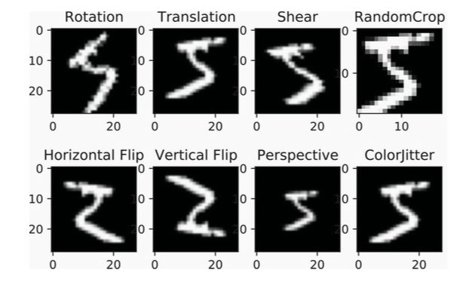
Other transformation?

Slide 12
Performance
Accuracy 30 degree rotated test images: 76 %(bad)
Accuracy 0.5x1.5 scaled test images: 68 %(bad)
Accuracy 0.33x0.66 translated test images: 15 %(maybe moved out of the screen)
Simple Solution: add transformed data into train dataset.
Problem: what if it is reversed version of 9 and 6, require human to relabel the data.

Slide 13
Next plan
Use AE or VAE to get latent space to extract different feature maps.
Try to explore a way to combine different feature maps to get a better one.
Produce some transformed MINST data for training.

Slide 14
Question
Is it possible to express CNN in a form of Linear?
Why maxpooling works?
after multipie 3x3 Conv2d, each data will include info that in bigger screen(5x5 in double 3x3, 7x7 in triple 3x3)
will it cause some kinds of problems like ”overfitting” when you use too many Conv2d layers?
the data near the original middle pixel will be “conv2d”ed multiple times, will the information about it become more useful or less useful?

