Slide 1
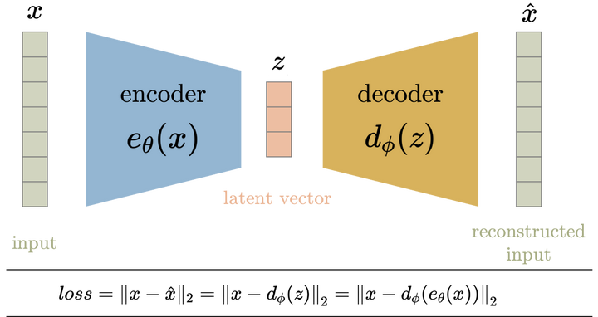
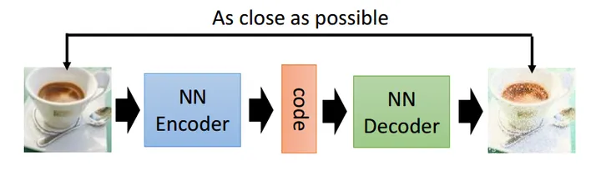
AE-Autoencoder
a model that can
compress(encoder) image from high dim-data into low-dimension latent space.
(high-resolution 3-channel colorful image to 1-channel gray image)
reconstruct(decoder eigen) latent space data back to image with little difference.

Slide 2
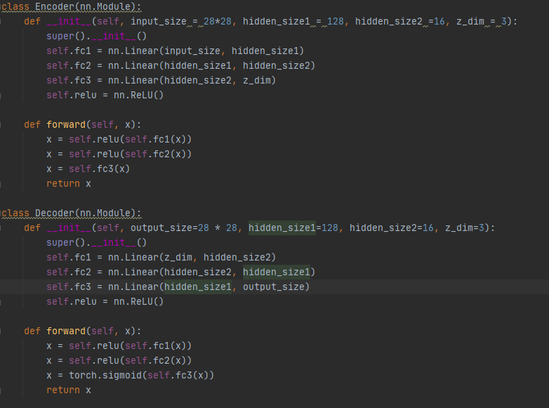
Simple AE
epoch=10
batch_size=100
optim=Adam
lr=0.005
loss=MSE/BCE

Slide 3
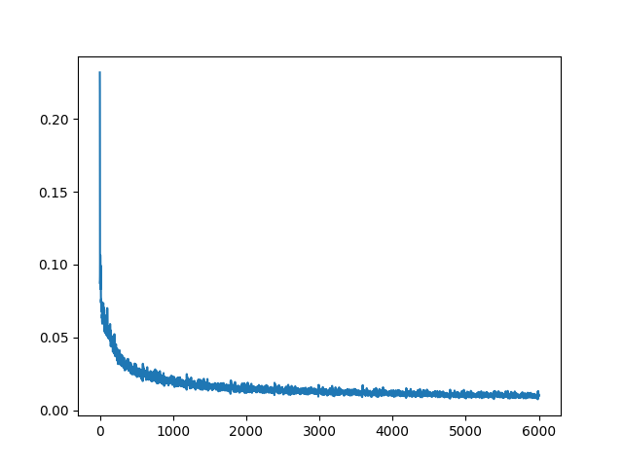
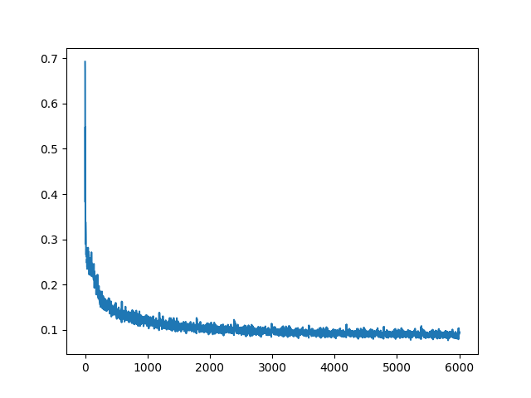
loss
MSE BCE

Slide 4
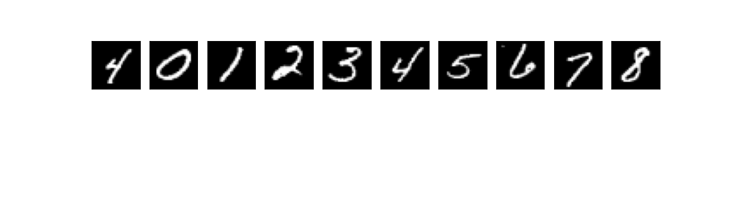
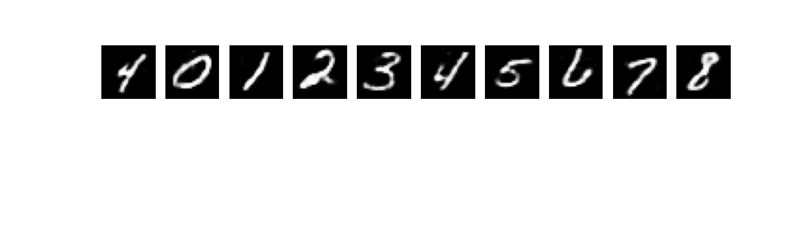

Image vs AE image(training set)
Original
AE(MSE)
AE(BCE)

Slide 5
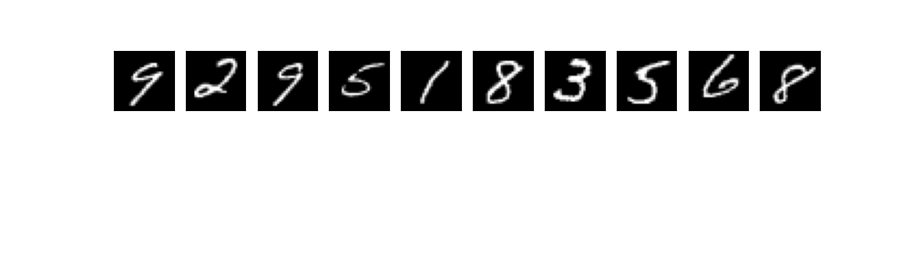
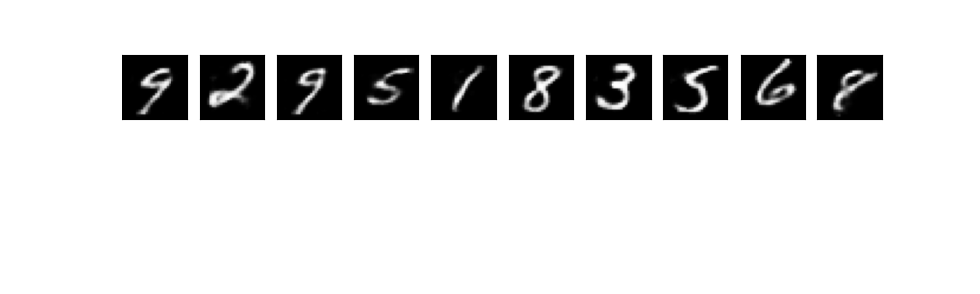
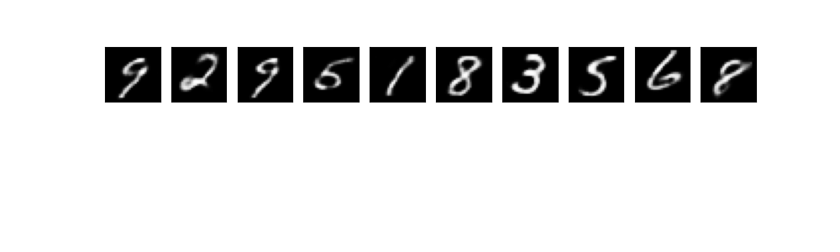
Image vs AE image(test set)
Original
AE(MSE)
AE(BCE)

Slide 6
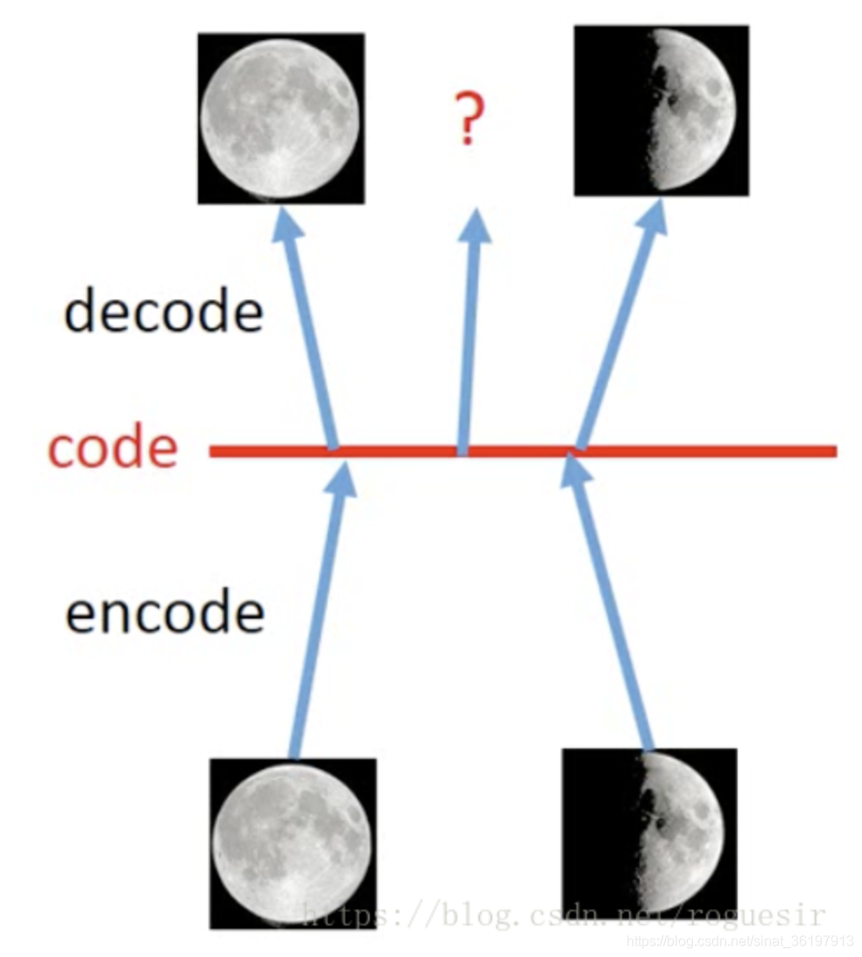
Problem
when a new input with new feature(maybe some confused number looks like both 5 and 6)comes, it may generate something that is meaningless(not any number).
Because the latent space is no regularized, the model does not know what is the image “between” 5 and 6, and how to draw it.

Slide 7
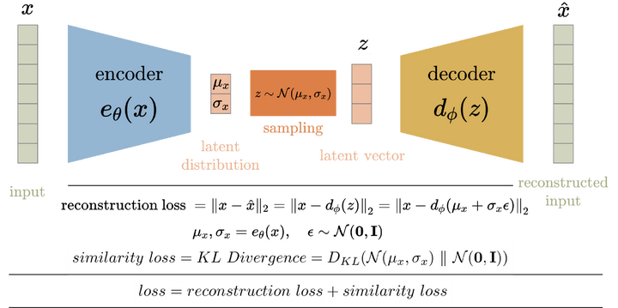
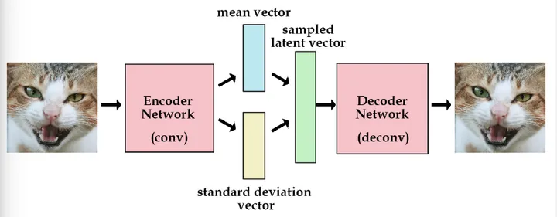
VAE
Instead of encode to latent space data, VAE encode image into the latent distribution,
and then generate a sample that use to decode to reconstruct image.

Slide 8


Kullback-Leibler Divergence
metrics used to represent the difference(or similarity) between two distribution.

Slide 9

Inception Score
InceptionV3 model: an image classifier with 1000 classes trained on ImageNet
Inception Score: KL-Divergence between
Generated Image x distribution P(x|y) (0.95,0.01,0.01,0.01,0.02)
ImageNet y distribution P(y) (0.2, 0.2, 0.2, 0.2, 0.2)

Slide 10
Frechet Inception Distance
use InceptionV3 activations
calculate 2 “gaussian” distributions’ mean and covariance.
use Frechet Distance method to calculate the difference between 2 Image sets.

Slide 11
Plan next
implement VAE, reparameterization,
try CNN structure in VAE/AE.
use FID to evaluate vae generated Mnist.(?)
use VAE latent space for CNN-classfier.(just like Stable Diffusion)

Slide 12
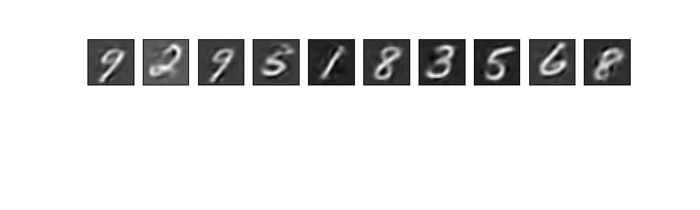
Question
why use Sigmoid? why is this happening if we dont use it?
activation: make non-linearity/ else only matmul which is linear

