Slide 1
different VAEs
simple linear vae
2 linear layers for encoder/decoder
deeper linear vae
3 linear layers for encoder/decoder
deeper CNN vae
conv2d for encoder
transposed conv2d for decoder

Slide 2
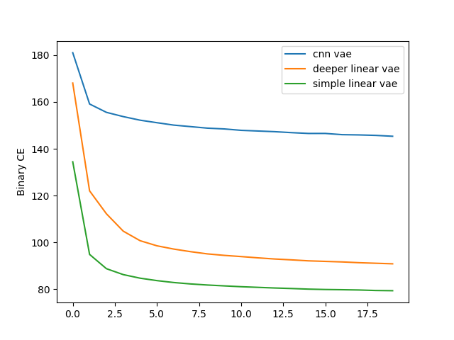
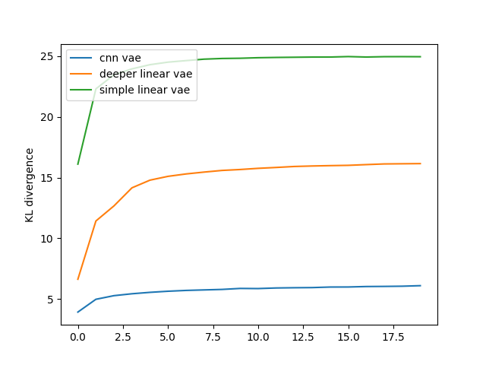
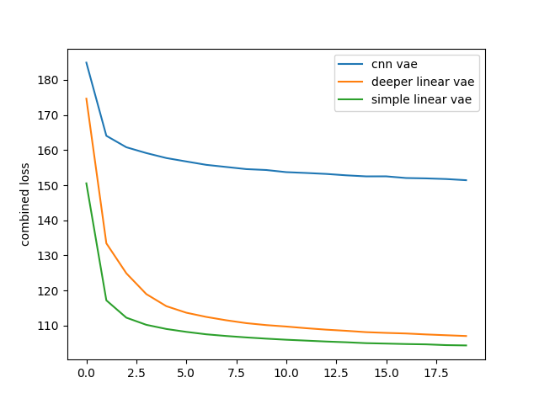
train loss
BCE KL-Divergence BCE+KLD
(compare with N(0,1))

Slide 3
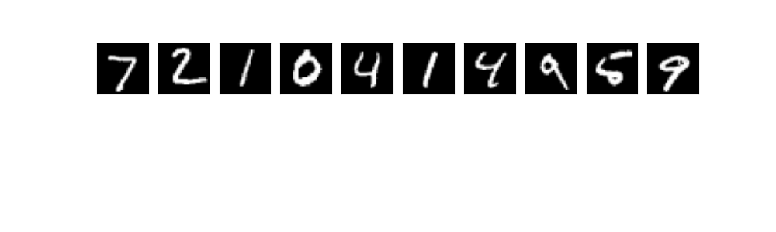
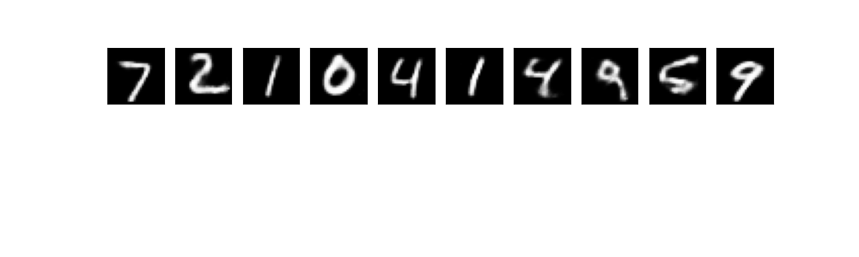
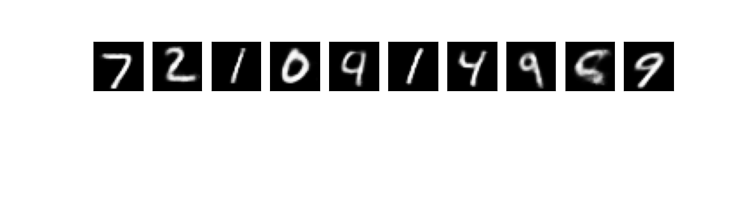

generated images
original
simple linear
deeper linear
new vae

Slide 4
Improved VAE
input(784=28*28)
output(784=28*28)
latent
Linear(784,400)
Linear(400,784)
combine 2 latent channels
using Linear(2,1)
Linear(400,200)
Linear(200,400)

Slide 5
