Slide 1
INF 421: STRAIGHT-LINE UPWARD GRID DRAWINGS MINIMIZING EDGE CROSSINGS
Benxin ZHONG
Yiming QIN

Slide 2
Contents
How to check the validity of a drawing / compute crossing number
How to generate a valid drawing
How to decrease crossing number?
Force-directed method
Local-Heuristic methods
Comparison between algorithms
Conclusion
Reference

Slide 3
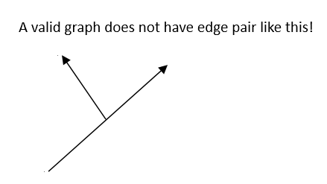
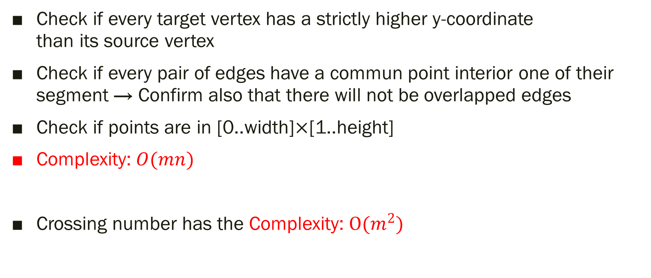
1 Check the validity of a drawing
Check if every target vertex has a strictly higher y-coordinate than its source vertex
Check if every pair of edges have a commun point interior one of their segment → Confirm also that there will not be overlapped edges
Check if points are in [0..width]×[1..height]
Complexity: $O(mn)$
Crossing number has the Complexity: $O(m^{2})$

Slide 4
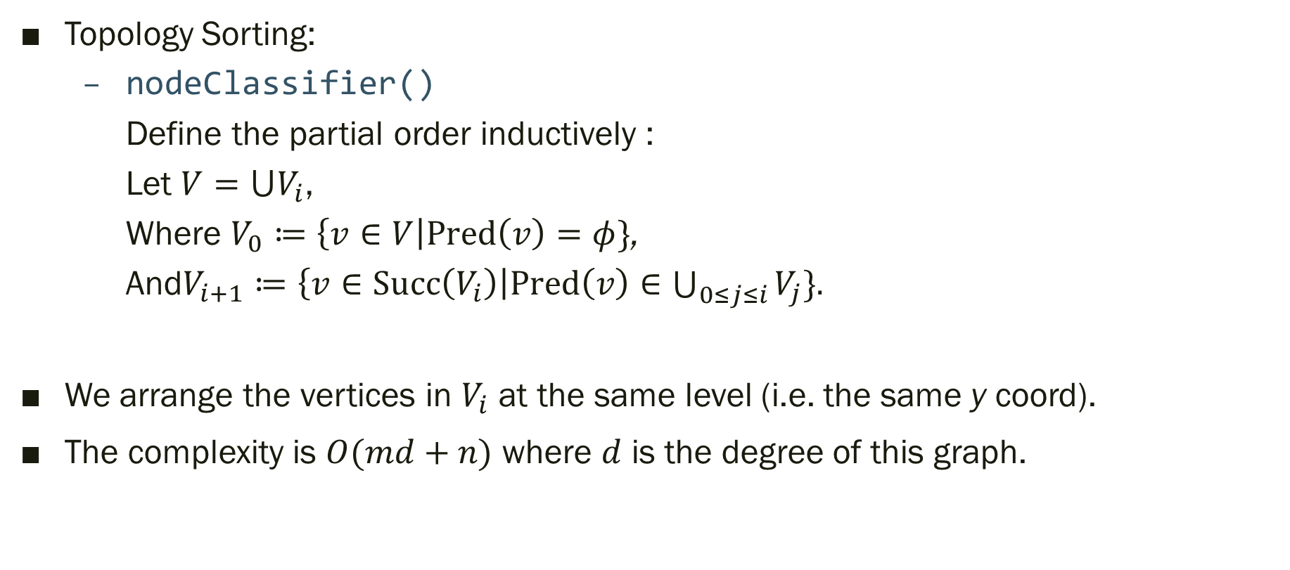
2 Generate an Initial Valid Layout
Topology Sorting:
nodeClassifier()
Define the partial order inductively :
Let $V=⋃V_{i}$,
Where $V_{0}≔\left\{v∈V\right|Pred\left(v\right)=φ\}$,
And$V_{i+1}≔\left\{v∈Succ\left(V_{i}\right)\right|Pred\left(v\right)∈\bigcup_{0≤j≤i}{V_{j}}\}.$
We arrange the vertices in $V_{i}$ at the same level (i.e. the same y coord).
The complexity is $O(md+n)$ where $d$ is the degree of this graph.

Slide 5
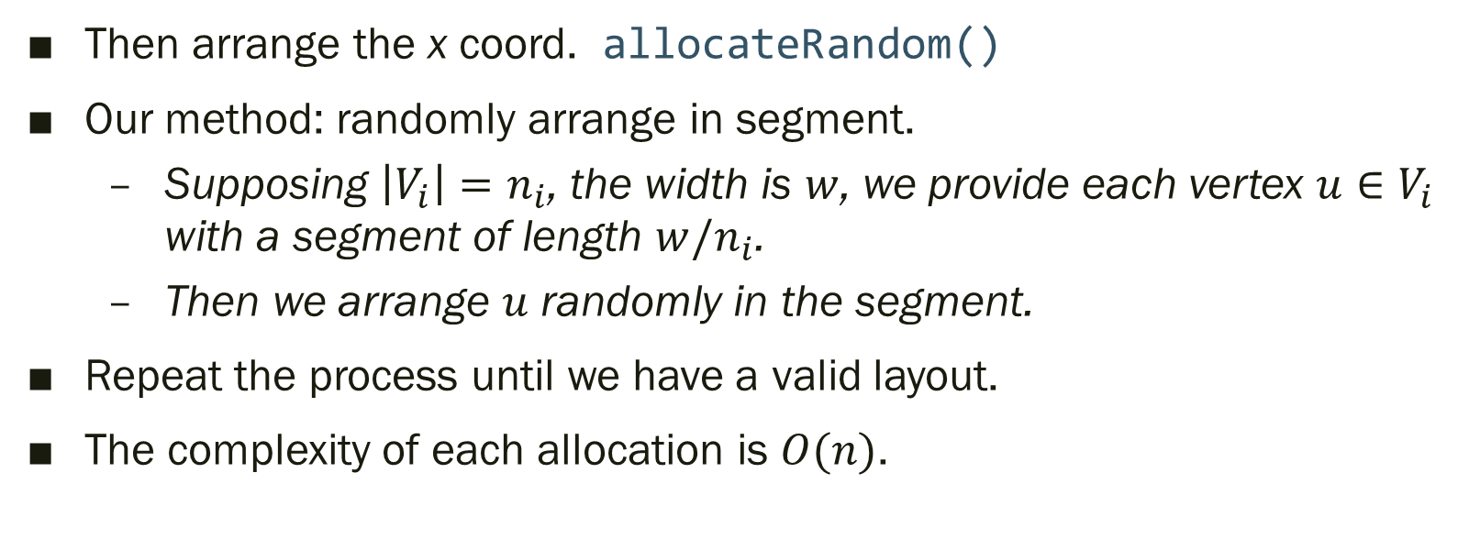
2 Generate an Initial Valid Layout
Then arrange the x coord. allocateRandom()
Our method: randomly arrange in segment.
Supposing $\left|V_{i}\right|=n_{i}$, the width is $w$, we provide each vertex $u∈V_{i}$ with a segment of length $w/n_{i}$.
Then we arrange $u$ randomly in the segment.
Repeat the process until we have a valid layout.
The complexity of each allocation is $O(n)$.

Slide 6
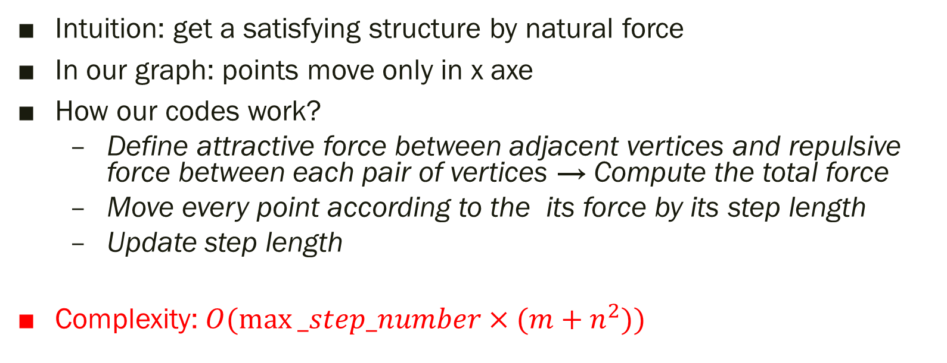
3.1 Force-directed Algorithm
Intuition: get a satisfying structure by natural force
In our graph: points move only in x axe
How our codes work?
Define attractive force between adjacent vertices and repulsive force between each pair of vertices → Compute the total force
Move every point according to the its force by its step length
Update step length
Complexity: $O(max⁡_step_number×(m+n^{2}))$

Slide 7
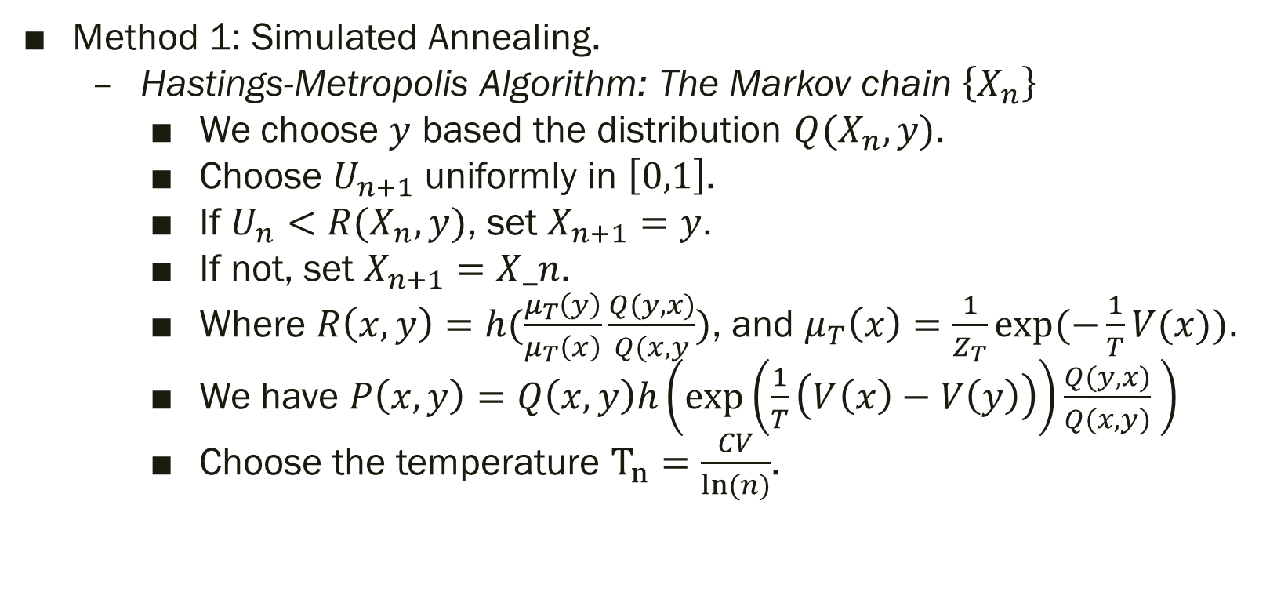
3.2 Local Heuristic Method
Method 1: Simulated Annealing.
Hastings-Metropolis Algorithm: The Markov chain $\left\{X_{n}\right\}$
We choose $y$ based the distribution $Q(X_{n},y)$.
Choose $U_{n+1}$ uniformly in $\left[0,1\right]$.
If $U_{n}<R(X_{n}, y)$, set $X_{n+1}=y$.
If not, set $X_{n+1}=X_n$.
Where $R\left(x,y\right)=h(\frac{μ_{T}\left(y\right)}{μ_{T}\left(x\right)}\frac{Q(y,x)}{Q(x,y})$, and $μ_{T}\left(x\right)=\frac{1}{Z_{T}}exp(−\frac{1}{T}V(x))$.
We have $P\left(x,y\right)=Q\left(x,y\right)h\left(exp\left(\frac{1}{T}\left(V\left(x\right)−V\left(y\right)\right)\right)\frac{Q(y,x)}{Q(x,y)} \right)$
Choose the temperature $T_{n}=\frac{CV}{ln(n)}$.

Slide 8
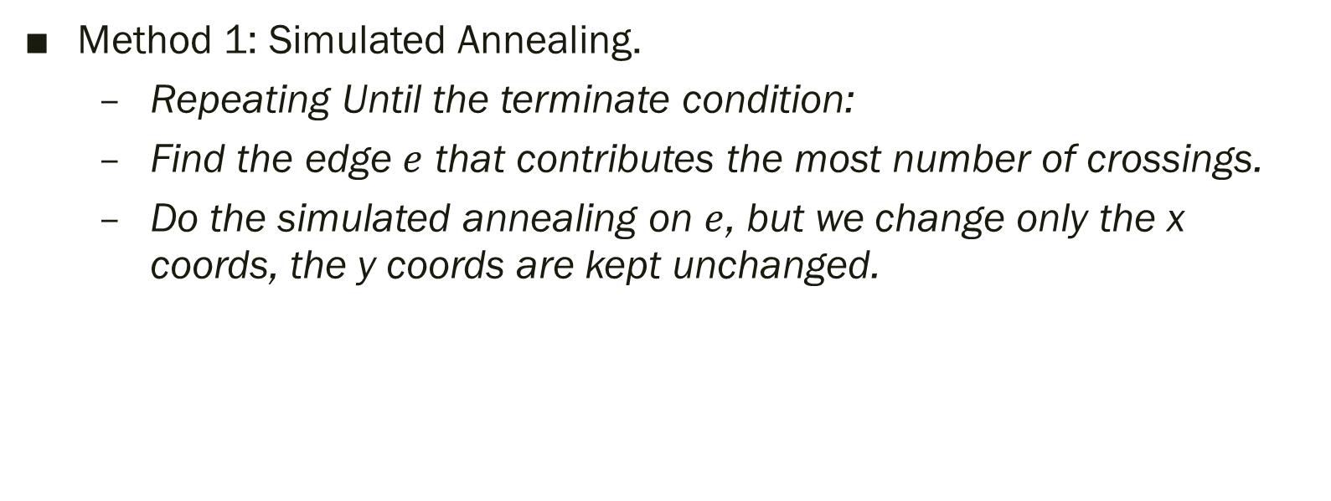
3.2 Local Heuristic Method
Method 1: Simulated Annealing.
Repeating Until the terminate condition:
Find the edge $e$ that contributes the most number of crossings.
Do the simulated annealing on $e$, but we change only the x coords, the y coords are kept unchanged.

Slide 9
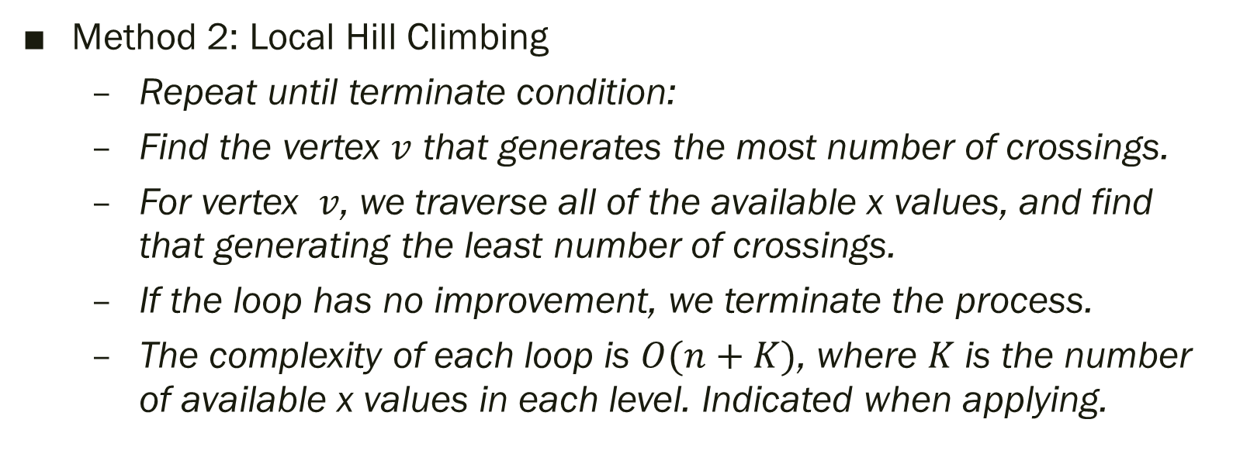
3.2 Local Heuristic Method
Method 2: Local Hill Climbing
Repeat until terminate condition:
Find the vertex $v$ that generates the most number of crossings.
For vertex $v$, we traverse all of the available x values, and find that generating the least number of crossings.
If the loop has no improvement, we terminate the process.
The complexity of each loop is $O(n+K)$, where $K$ is the number of available x values in each level. Indicated when applying.

Slide 10
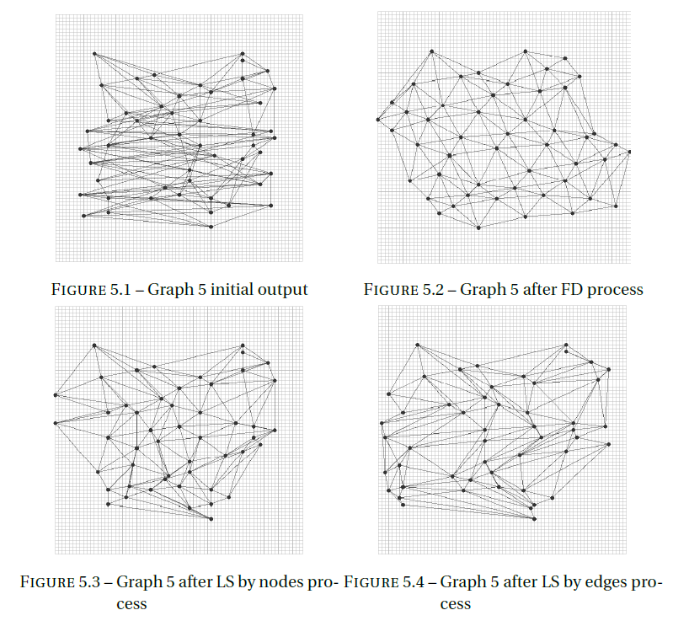
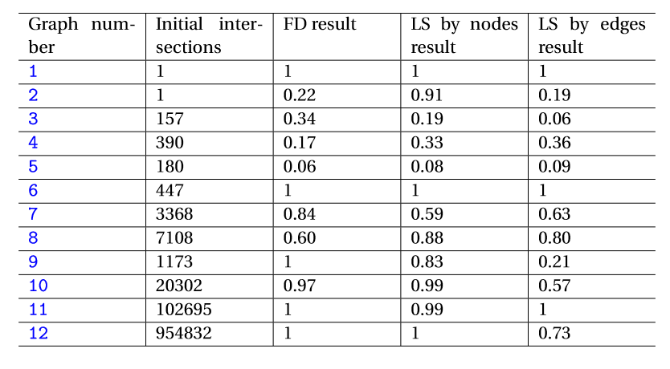
4.1 Performance Comparison
LS by edges algorithm is the best
FD algorithm has very good performance with ideal graph structure
Some graph can not be improved by any algorithm

Slide 11
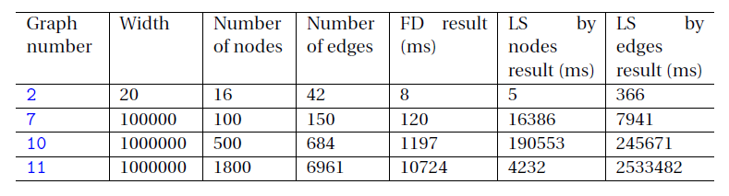
4.2 Complexity Comparison
FD algorithm has the best complexity performance
LS by edges algorithm has catastrophic complexity with huge graph
LS algorithm could end when it thinks it can not improve the algorithm after traverse all neighbor graph

Slide 12
Conclusion
Heuristic algorithm
Force-Directed algorithm
Local-Heuristic algorithm
Simulated annealing
Hill climbing
Randomized Algorithm
Initial valid layout generating
Metropolis–Hastings in Local-Heuristic algorithm

Slide 13
References
Hu, Y. (2006). Efﬁcient, high-quality force-directed graph drawing. The Mathematica Journal,10(1).
graphdrawing.org. (2019). Graph drawing contest. Consulté le 2020-12-30, sur http:// mozart.diei.unipg.it/gdcontest/contest2020/contest.html
Bodineau, T. (2019). Application aux algorithmes stochastiques In Modélisation de phénomènes aléatoires : introduction aux chînes de Markov et aux martingales. pp 97-109, École Polytechnique.

