Slide 1
VISTA: Find what you see
BY TEAM VISTA:
Quanzeng You
Jianbo Yuan
Lam Tran
Yukun Liu
Jonathan Wong

Slide 2
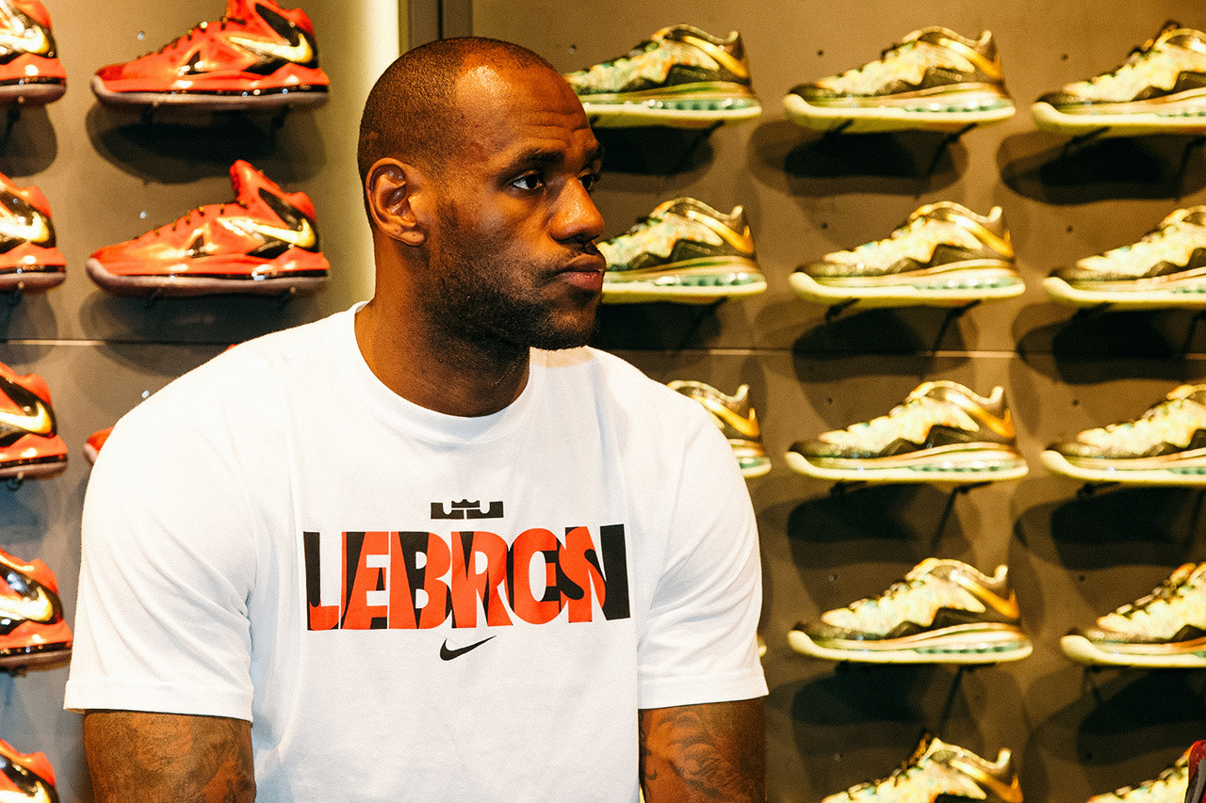
What can VISTA do?
You met Lebron James one day and you found that he is wearing a nice shirt, and you want to get it. How can you find it online? Take a picture of him and search the shirt using VISTA. VISTA can provide you online shopping information of clothes that you searched by taking a picture of it.

Slide 3
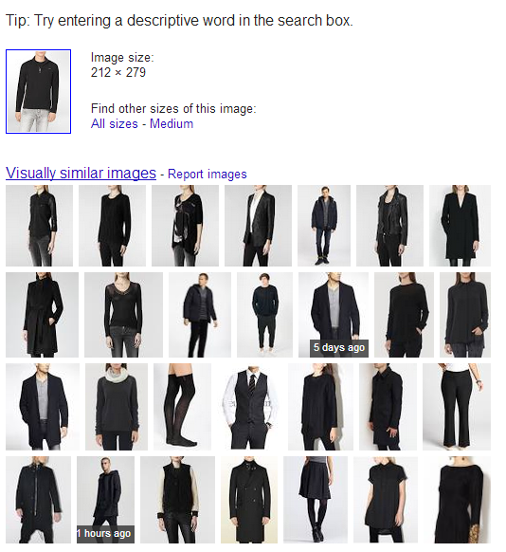
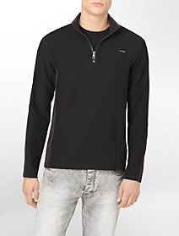
Why shouldn’t we just use Google image?

Slide 4
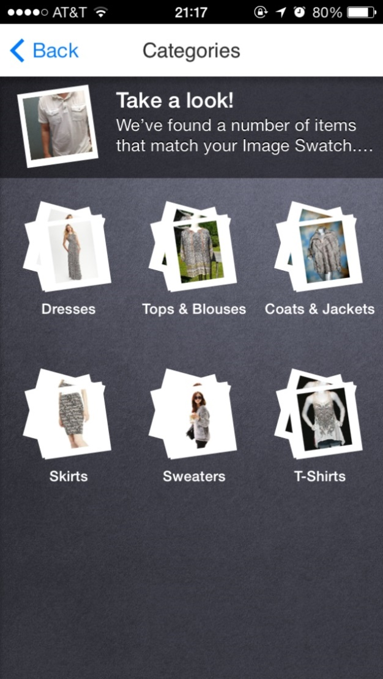
How about ebay fashion?
Binds background into your search.

Slide 5
Needfinding

Slide 6
Survey Summary
51 Responses

Slide 7
When browsing a site, do you look for clothing products based on which method?

Slide 8
When using a search bar, do you find it difficult to search for the item you want?

Slide 9
For the people answered “Yes”, we asked them to specify the problem

Slide 10
Do you prefer searching for clothing products via images?

Slide 11
These are the features people wanted to see in our image search app

Slide 12
Our Solution
Our goal was to build an image intelligent Android app that offered an easier alternative for users to search for clothes. With our app, the user can take a photo that can be compared with our database to find matching clothes and where to buy them.

Slide 13
Prototype Iterations

Slide 14
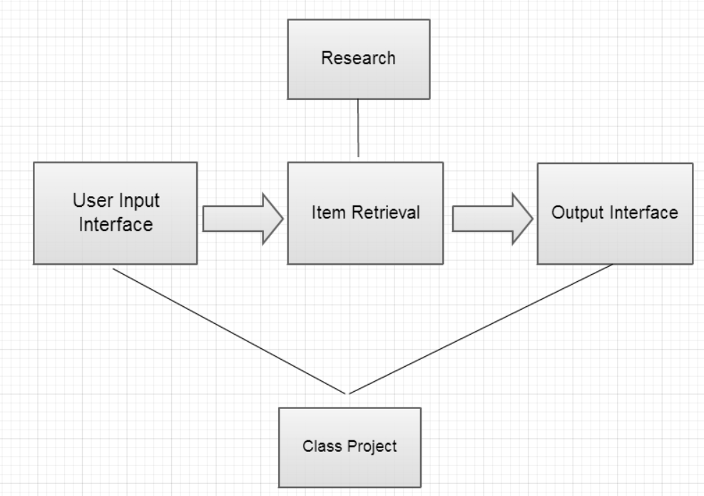
Overview of Project

Slide 15
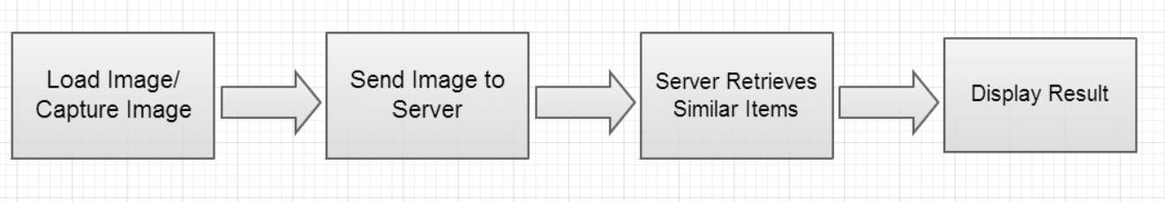
Demo on our webpage
https://sites.google.com/site/hcivista/prototypes/prototype-iteration

Slide 16
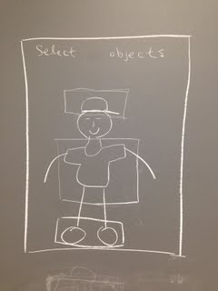
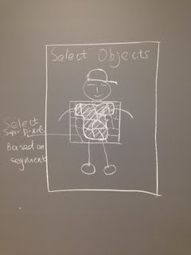
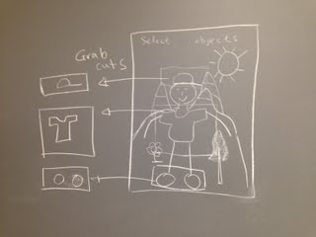
Paper Prototype

Slide 17

Prototype 1.0
Picture from URL, Camera, or Gallery
OpenCV Integration
Server Integration

Slide 18
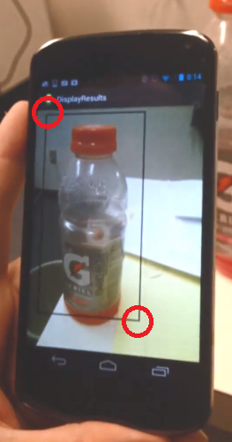
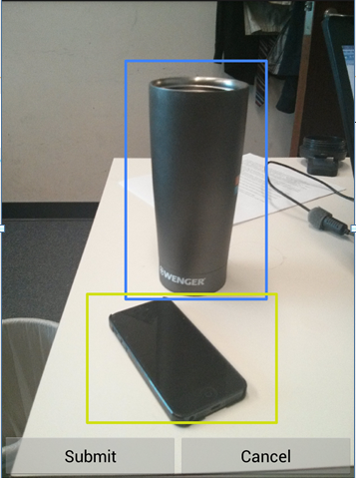
Prototypes 2.0
User selects bounding box by
- Clicking on two points.
- Dragging finger on screen.

Slide 19
Prototypes 2.1
Edit and Delete bounding box with gestures.

Slide 20
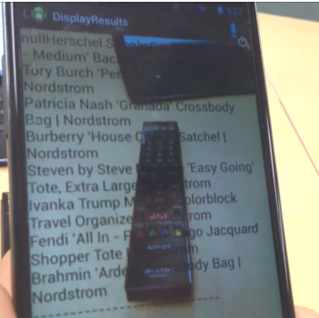
Prototype 2.2
Server integration
Find item with bounding box image.

Slide 21
Input Interface Test
Vista Lab (Prof. Jiebo Luo)
7 P.h.D (Excludes Quanzeng You and Lam Tran)
4 Master Students (Exclude Jianbo Yuan)
Our Interface VS Camfind
In favor of Camfind (8 to 0).
Our interface requires more user interactions.

Slide 22
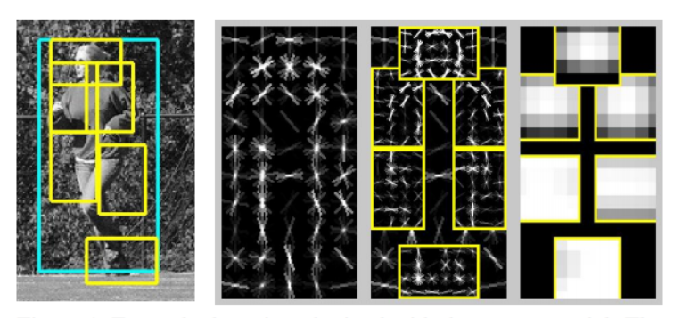
Prototype 3.0
Automate bounding box selection with object detection.

Slide 23
Prototype 3.1
Use voice recognition to find object.

Slide 24
Iteration Demo
https://sites.google.com/site/hcivista/prototypes/prototype-iteration

Slide 25
Live Demo

Slide 26
Q&A
Thank you!

