Slide 1
VISTA: Find what you see
BY TEAM VISTA:
Quanzeng You
Jianbo Yuan
Lam Tran
Yukun Liu
Jonathan Wong

Slide 2

What can VISTA do?
You met Lebron James one day and you found that he is wearing a nice shirt, and you want to get it. How can you find it online? Take a picture of him and search the shirt using VISTA. VISTA can provide you online shopping information of clothes that you searched by taking a picture of it.

Slide 3
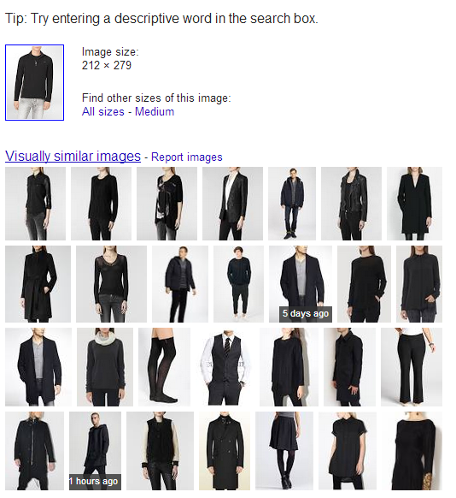

Why shouldn’t we just use Google image?

Slide 4
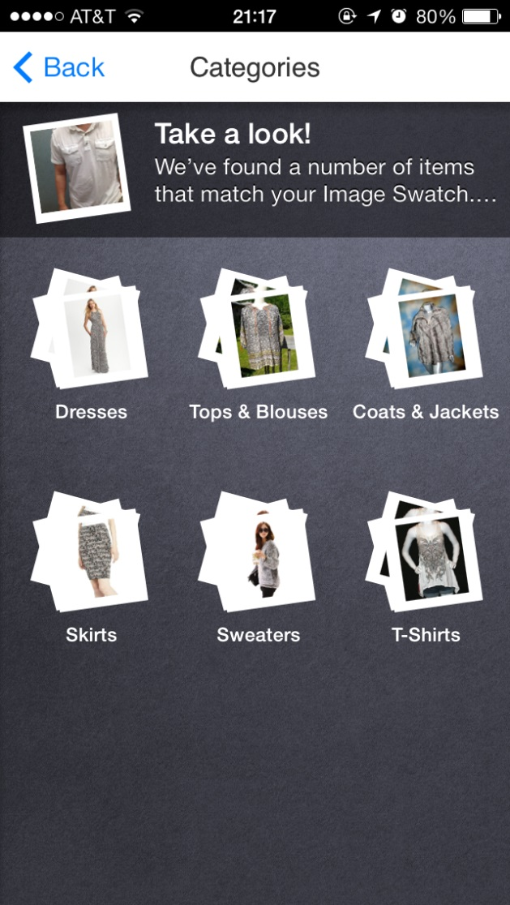
How about ebay fashion?

Slide 5
Needfinding

Slide 6
When browsing a site, do you look for clothing products based on which method?

Slide 7
When using a search bar, do you find it difficult to search for the item you want?

Slide 8
For the people answered “Yes”, we asked them to specify the problem

Slide 9
Do you prefer searching for clothing products via images?

Slide 10
These are the features people wanted to see in our image search app

Slide 11
Our Solution
Our goal was to build an image intelligent Android app that offered an easier alternative for users to search for clothes. With our app, the user can take a photo that can be compared with our database to find matching clothes and where to buy them.

Slide 12
Prototyping

Slide 13
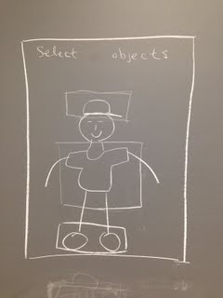
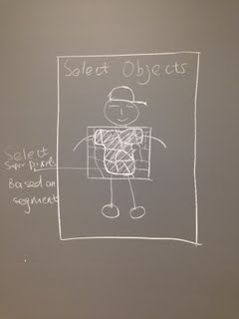
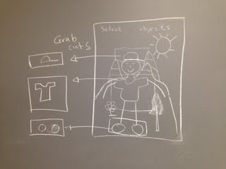

Slide 14
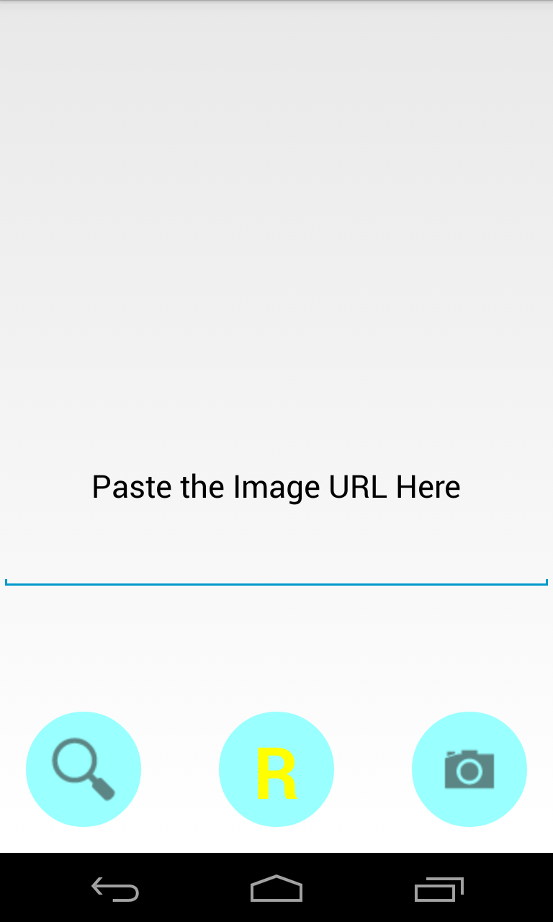
Working prototype 1.0
Use the built-in camera app to take a picture.
Send the picture to the server.
Accept an image URL and download the image from the given URL.

Slide 15
Working prototypes 1.1
We add the OpenCV to the app.
Now we can select pictures as input from our gallery.
User click on the screen, then a bounding box will appear.

Slide 16
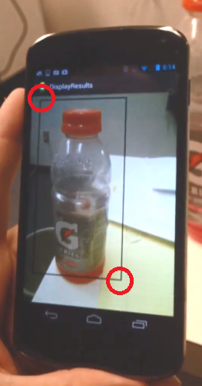
Working prototypes 2.0
We add the bounding box into android app. Currently, you can select an interested area by clicking the top left corner and the bottom right corner of an area.

Slide 17
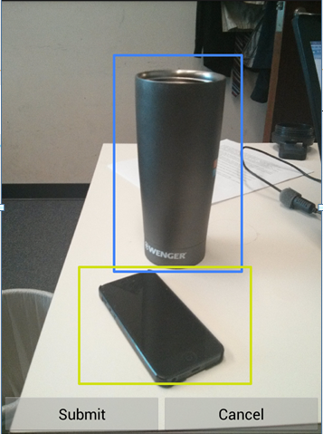
Working prototypes 2.1
Currently, we can select part of the image by consecutive clicks or drag on the screen.

Slide 18
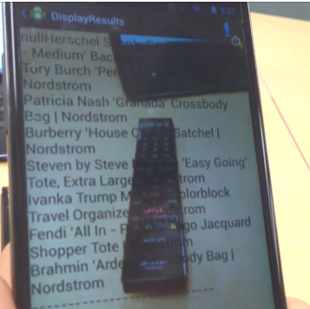
Working prototypes 3.0
Add the bounding box selection into the app. We can double click on the bounding box to select one and move it.
Test the communication between the server and the app.

