Slide 1
LAB on OJ
http://10.88.3.60/
1003 Exact Inference
– Exact Inference

Slide 2
Review on exact inference algorithm
Example: MaryCall, JohnCall in Ch14
Enumeration algorithm:
Step 1: Select the entries consistent with the evidence
Step 2: Sum out hidden vars to get joint of Query and evidence
Step 3: Normalize
Elimination algorithm:
Make factors
Join all factors and eliminate all hidden vars.

Slide 3
Review on exact inference algorithm
Example: MaryCall, JohnCall in Ch14
Enumeration algorithm:
Def enumeration_ask(X, e, bn):
Def enumeration_all(X, e, bn):
Elimination algorithm:
Def elimination_ask(X, e, bn):

Slide 4
Problem description – sample in
P(Earthquake = -)
P(Burglary = + | John = +, Mary = +)
******
Burglary
0.001
***
Earthquake
0.002
***
Alarm | Burglary Earthquake
0.95 + +
0.94 + -
0.29 - +
0.001 - -
***
John | Alarm
0.9 +
0.05 -
***
Mary | Alarm
0.7 +
0.01 –
B
E
A
J
M

Slide 5
Problem description – sample out
probability by enumeration: 1.0
probability by elimination: 1.0
**********
probability by enumeration: 0.28
probability by elimination: 0.28
**********

Slide 6
Classes
class BayesNet: used in building the BayesNet
def __init__(self, node_specs=[]):
def add(self, node_spec):
def variable_node(self, var):
def variable_values(self, vars):
class BayesNode: used in building the BayesNet
"""A conditional probability distribution for a boolean variable, P(X | parents). Part of a BayesNet."""
def __init__(self, x, parents, cpt):
def p(self, value, event):

Slide 7
Classes
class ProbDist: used in the computation for probability distribution
def __init__(self, varname='?', freqs=None):
def normalize(self):
class Factor: used in elimination algorithm
def __init__(self, variables, cpt):
def pointwise_product(self, other):
def sum_out(self, var):
def p(self, e):
def normalize(self):

Slide 8
Procedure
First read the input and bulid bn = BayesNet()
by bn.add((node, parents, cpt))
Discuss (1) joint/ marginal distribution
(2) conditional distribution
(1): def joint_probability():
Call enumerate_all() and elimination_ask() respectively
(2): def conditional_probability():
Call enumerate_ask() and elimination_ask() respectively

Slide 9
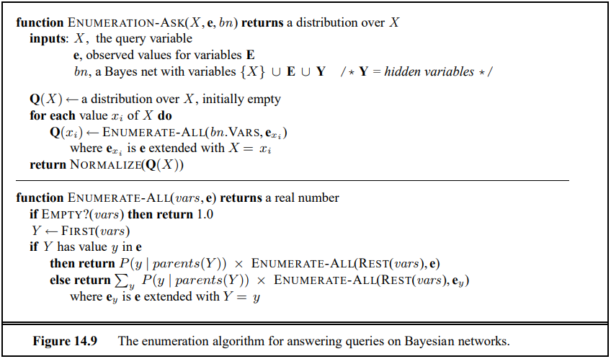
pseudocode
Enumeration algorithm
You can use Ynode.p()

Slide 10
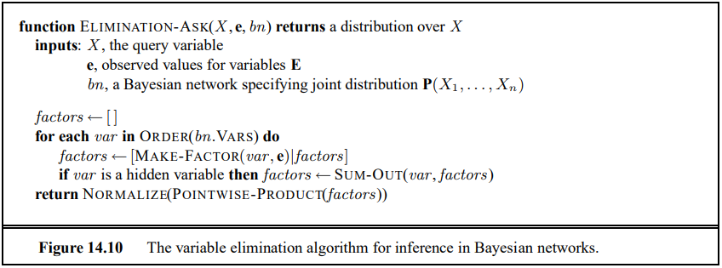
pseudocode
Elimination algorithm
Actually, this is an “append” operation
How to express this statement?

