Slide 1
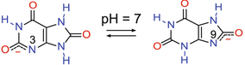
Diketo-enol
[DKE-N₃]⁻
89%
Diketo-enol
[DKE-N₉]⁻
11%
NH₄UH Crystal
NH₄⁻

