Slide 1

Caching long lasting queries

Slide 2
Serve It Fresh and Fast

Slide 3
Serve It Fresh and if we are not Fast fast enough – Cache It
Rules of caching on the back end:
Do not cache
Cache is last resort
Before caching consider the followings...

Slide 4
Serve It Fresh and Fast
It : what is the use pattern of the data we need to serve?
Can we say that the most recent?
Can we say that the most frequently used?
Can we broadcast change?
Or neither of those above?

Slide 5
Serve It Fresh and Fast
It : what is the identity of the data we serve regarding the data source?
Can be identified (eg. PK)
A unique entity in a set that is a product of functions like aggregate/max/min/avg etc.

Slide 6
Serve It Fresh and Fast
Fresh : what is the allowed difference of the data we serve regarding the data source?
Do we have to serve the latest and greatest
Or we can let the user trigger an action?
What latency can we permit?

Slide 7
Serve It Fresh and Fast
Fast : which system component is identified as ‘slow’?
Where should the optimization take place?
Can a change in the architecture/data model result in better optimization?

Slide 8
Side note on architecture and Fast
Generic software architecture with persistence according to application developers:
User input
The Application
Some DB

Slide 9
Side note on architecture and Fast
Generic software architecture with persistence according to database developers:
E_{(verything)}
Those applications
Our DB

Slide 10
Side note on architecture and Fast
Generic software architecture with persistence according to the USER:
Me
UI
My data

Slide 11
Side note on architecture and Fast
"Rem tene, verba sequentur. - Grasp the case, the words come themselves." (Cato Maior)
Spot the error in both:
E_{(verything)}
Those applications
Our DB
User input
The Application
Some DB

Slide 12
Side note on architecture and Fast
"Rem tene, verba sequentur. - Grasp the case, the words come themselves." (Cato Maior)
Transform data (hashing, mapping, etc.)
Perform calculations (statistics, normalization, unit conversion, etc.)
Prove data (e-mail format, etc.)
Encapsulate the implementation details providing interface (difference between entity and table structures/datatypes)

Slide 13
Serve It Fresh and Fast
Algorithms + Data Structures
Fast : which system component is identified as ‘slow’ and what is ‘slow’?
Last resort : Caching

Slide 14
Serve It Fresh and Fast – Caching

Slide 15
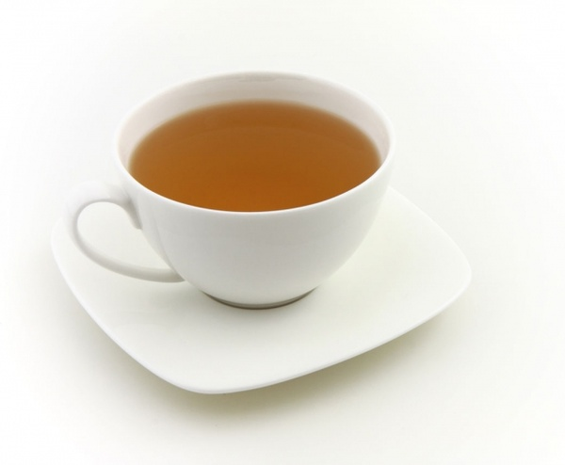
Thank you !
query_cache@thinkproject github

