Slide 1
OPTION 1 Expected Figure
delayTotal / faultsTotal
0.1
0.3
0.5
0.8
1
M / N

Slide 2
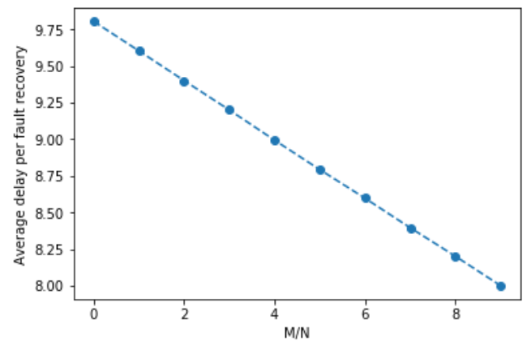
Option 1

Slide 3
OPTION 2 Expected Figure
I suggest to have just one variable for accuracy. In the current code there are:
1.) accuracy_fault_detection 2.) accuracy_rca
And there is one if for each.
I suggest to focus only in accuracy_rca. I understand the idea, but it will be hard to plot and show both accuracy, and I think accuracy_rca is more important to highligth.
delayTotal / faultsTotal
Current
if currFault.assocElement.monitored == True:
accuracy_fault_detection = random.random()
accuracy_rca = random.random()
if (accuracy_fault_detection < accuracyFaultDetection):
if (accuracy_rca < accuracyRCA):
delayTotal = delayTotal + D_3
C_R = C_R + 1
else:
delayTotal = delayTotal + D_2
C_D = C_D + 1
else:
delayTotal = delayTotal + D_1
C_M = C_M + 1
else:
delayTotal = delayTotal + D_0
Suggested
if currFault.assocElement.monitored == True:
accuracy_rca = random.random()
if (accuracy_rca < accuracyRCA):
delayTotal = delayTotal + D_2
C_R = C_R + 1
else:
delayTotal = delayTotal + D_1
C_M = C_M + 1
else:
delayTotal = delayTotal + D_0
0.1
0.3
0.5
0.8
1
accuracy_rca

Slide 4
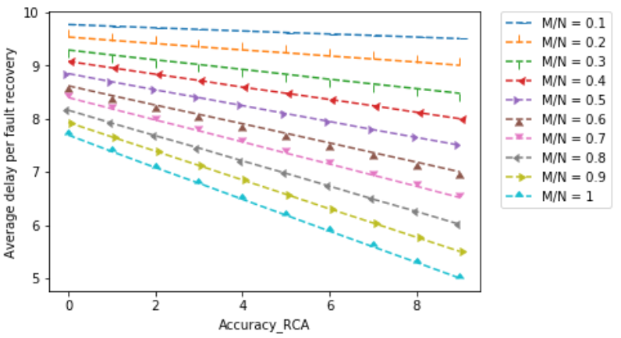
Option 2

Slide 5
OPTION 3 Expected Figure
Cumulative Value
delayTotal
Without changing M/N.
(M/N constant during the entire running simulation time)
With Changing M/N
(if C_R/faultsTotal > THRESHOLD_UP)
0.1*LASTTIME
e.g. 100
LASTTIME
e.g. 1000
Time

Slide 6
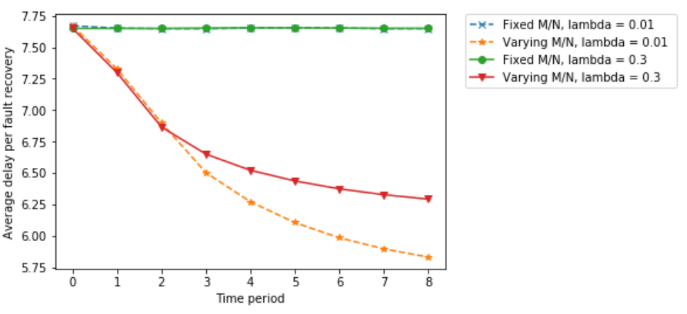
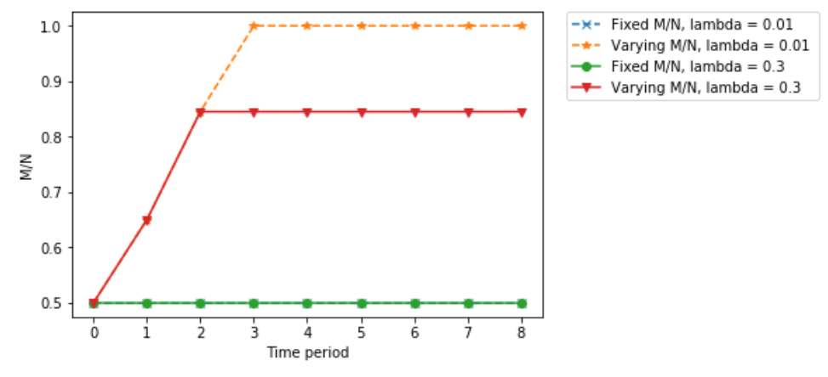
Option 3

Slide 7
OPTION 4 Expected Figure
Cumulative Value
delayTotal
Without propagation avoidance avoidance rate = 0
avoidance rate = 0.3
avoidance rate = 0.7
Perfect avoidance. All propagations are avoided
avoidance rate = 1
0.1*LASTTIME
e.g. 100
LASTTIME
e.g. 1000
Time

Slide 8
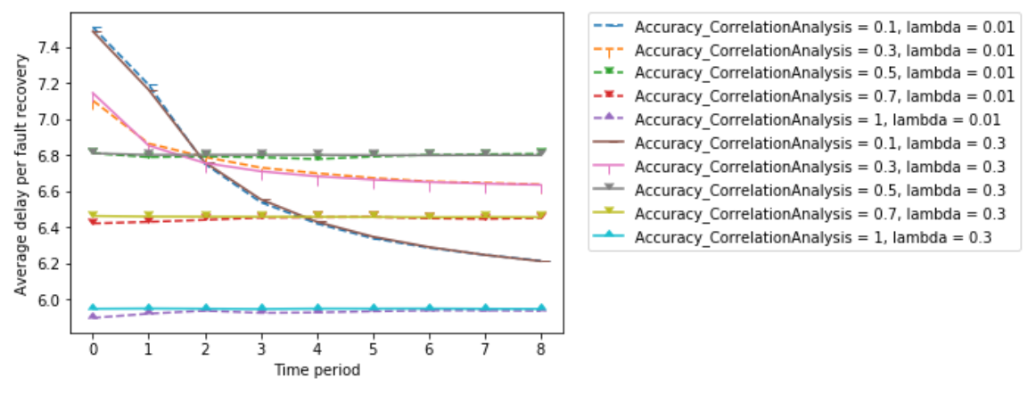
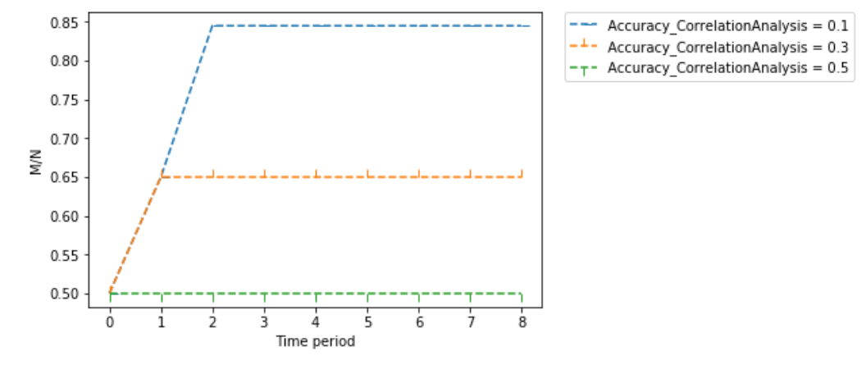
Option 4

