Slide 1
LinkedIn Company Followers Data Analysis
Qin Zhang
2/19/2019

Slide 2
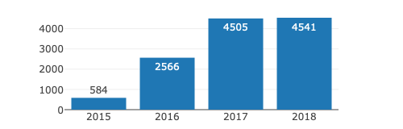
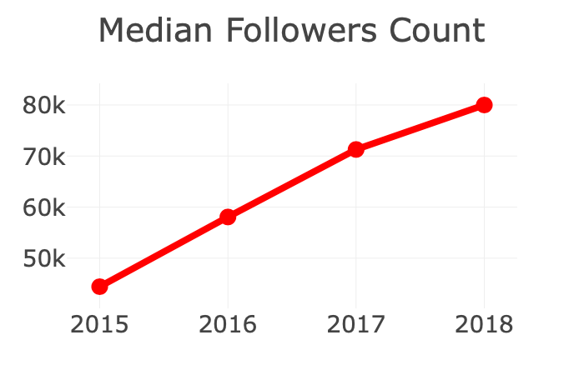
Motivation: Why LinkedIn company followers data is interesting?
Personal
Benefits to follow:
find connections, learn more for interview…
But, which companies to follow?
Data (source: Thinknum)
Large: 957MB 140 industries
4610 companies
New: 2015.9.14-2018.7.17
Company
Benefits to be followed:
showcase, generate new business, attract quality employees…
But,
enough followers?
followers increasing fast?
if not, how to increase followers?
encourage employees on platform?
80%

Slide 3
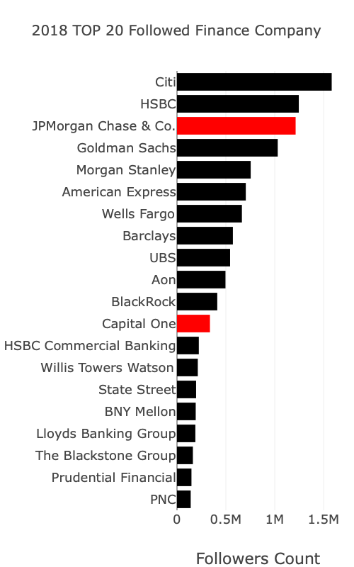
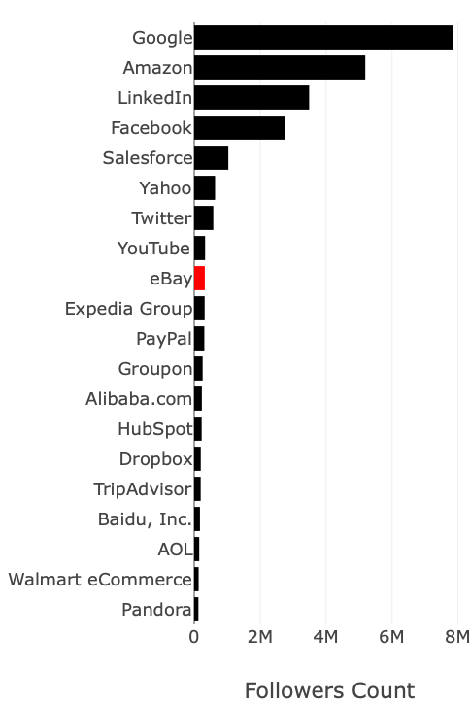
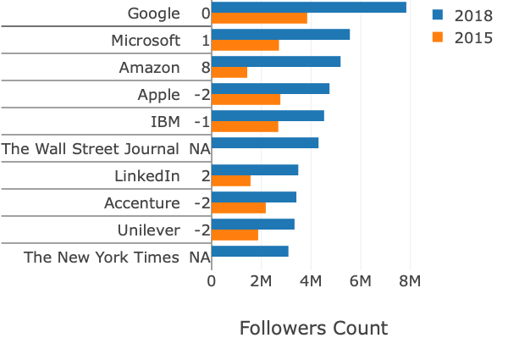
Personal: which companies to follow?
2018 TOP 10 Followed Company at LinkedIn
2018 TOP 20/268 Followed
Finance Company
2018 TOP 20/145 Followed
Internet Company

Slide 4
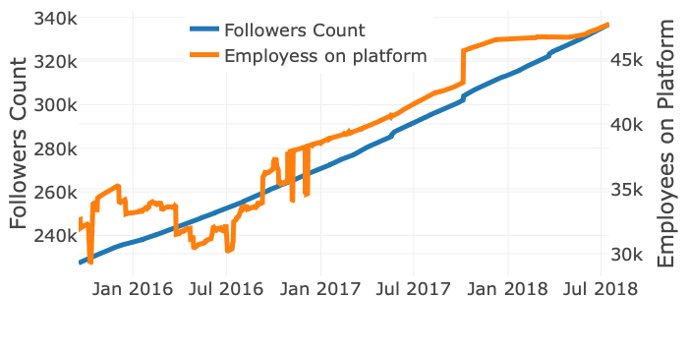
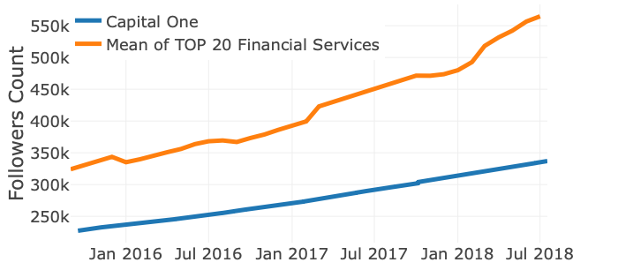
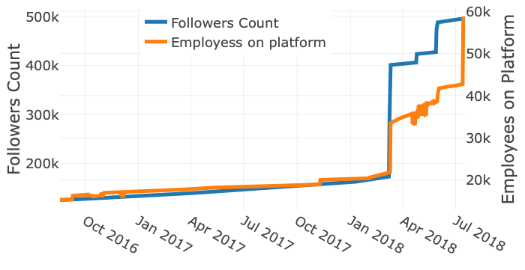
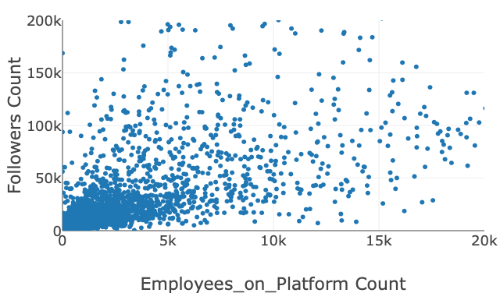
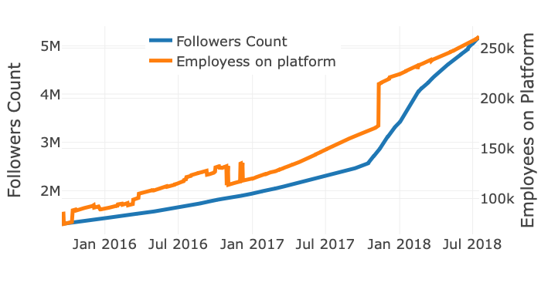
Company
enough followers?
followers increasing fast?
if not, how to increase followers?
encourage employees on platform?
Capital One: Rank 12 in Financial Services in 2018
Capital One
Aon
2018
2018
Amazon
Amazon

