Slide 1
ERDOS INSTITUTE · SUMMER 2026
Yue Wu · Freda Zhang
Can market signals improve delta hedging?
A controlled replication experiment on historical SPY paths
Notes:
Open with the question: can information we observe in the market improve a standard Black–Scholes hedge? Our answer is nuanced. VIX helps with large losses, but our more complex composite signal does not improve average error. We will show both the positive and negative result.

Slide 2
We test hedge inputs—not historical option execution
Can public, point-in-time signals reduce terminal replication error versus fixed-volatility Black–Scholes?
OBSERVED
SPY prices · VIX · volume · rates · sector returns
CONTROLLED
European-call payoff, maturity, moneyness, premium convention, and costs
No historical option bids, asks, or contract-level implied volatility
2
Notes:
First, be precise about scope. The SPY paths and market signals are real historical observations. The calls are standardized experimental claims, not downloaded historical option contracts. This lets us compare hedge rules fairly, but it means we are studying replication rather than actual option execution.

Slide 3
All four strategies use the same delta-hedging engine
FV-BS
ROLLING-BS
VIX-BS
MSA-DELTA
21-day realized volatility fixed at contract start
21-day realized volatility updated every hedge date
Daily VIX as an option-market volatility proxy
Rolling volatility × risk-state multiplier
Simple benchmark
Uses recent price information
Adds forward-looking market information
Combines seven market signals
Common premium · daily rebalancing · identical payoff · identical transaction costs
3
Notes:
All four methods use exactly the same Black–Scholes delta formula and the same daily rebalancing engine. Only the volatility input changes. FV-BS freezes realized volatility. Rolling-BS updates it. VIX-BS uses forward-looking market volatility. MSA-Delta combines seven signals into a risk-state multiplier. This common engine isolates the value of the volatility information.

Slide 4
MSA-Delta converts seven trailing signals into three risk states
RISK SCORE INPUTS
NORMAL
1.00× rolling volatility
30% VIX rank 20% VIX level 20% realized-volatility acceleration 10% volume shock 10% 63-day drawdown 5% XLK–SPY divergence 5% short-rate change
ELEVATED
1.15× rolling volatility
STRESS
1.40× rolling volatility
Every input at date t uses only information available at or before t.
4
Notes:
Here is the composite model. We standardize seven trailing variables and combine them with fixed weights. VIX rank receives the largest weight, followed by VIX level and realized-volatility acceleration. Training-period quantiles classify normal, elevated, and stress states. The selected validation rule multiplies rolling volatility by one, one point one five, or one point four. No future data enters the score.

Slide 5
Stress signals matter most away from the money
EXAMPLE CONTRACT
NORMAL STATE
STRESS STATE
S = 100 · K = 105 21 trading days · r = 3%
σ = 20%
σ = 28%
Δ = N( [ln(S/K) + (r + σ²/2)τ] / (σ√τ) )
Δ = 0.220
Δ = 0.297
BUY 0.077 MORE SHARES PER OPTION
5
Notes:
This worked example shows the mechanism. Consider a 21-day call with spot one hundred and strike one hundred five. In a normal state, twenty percent volatility gives delta zero point two two zero. A stress multiplier raises volatility to twenty-eight percent and delta to zero point two nine seven, so the hedge buys about zero point zero seven seven additional shares per option. For an at-the-money option, however, this volatility change barely moves delta. That is one reason the composite rule can help some contracts without improving the overall average.

Slide 6
The held-out test spans 1,149 controlled claims per strategy
3
3
5
maturities
moneyness levels
trading days between starts
MATURITY 10 · 21 · 42 trading days
Observed SPY path → controlled European-call payoff
STRIKE / SPOT 0.95 · 1.00 · 1.05
COSTS 0 · 5 · 10 bps in sensitivity tests
6
Notes:
We avoid drawing a conclusion from one contract. The held-out grid crosses three maturities and three strike-to-spot ratios, with new episodes every five trading days. That produces one thousand one hundred forty-nine claims for each strategy. We also rerun the comparison at zero, five, and ten basis points of transaction cost.

Slide 7
The test period remains untouched until final evaluation
TRAIN
VALIDATE
TEST ONCE
2016–2020
2020–2022
2022–2024
Scale features and estimate risk thresholds
Choose one of three predeclared MSA settings
Compare 1,149 contracts per strategy
7
Notes:
The chronology is the key leakage control. Training estimates scaling and thresholds. Validation selects one of only three predeclared MSA settings. We then refit on training plus validation and evaluate the test period exactly once. The final test contains one thousand one hundred forty-nine contracts per strategy.

Slide 8
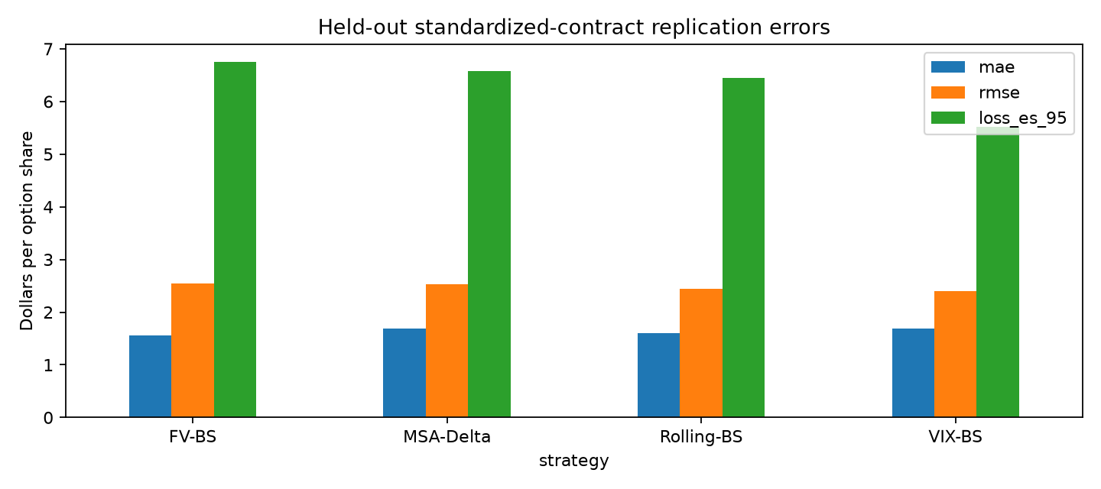
No single hedge wins on every error metric
1.552
FV-BS has the lowest MAE
2.399
VIX-BS has the lowest RMSE
Average accuracy favors simplicity; large-error control favors forward-looking volatility.
8
Notes:
These are the main held-out results. Fixed-volatility Black–Scholes has the lowest mean absolute error at one point five five two. VIX-BS has the lowest root mean squared error at two point three nine nine. That means the simplest rule is best on the typical absolute miss, while VIX performs better when large errors receive more weight. MSA-Delta does not win either headline metric.

Slide 9
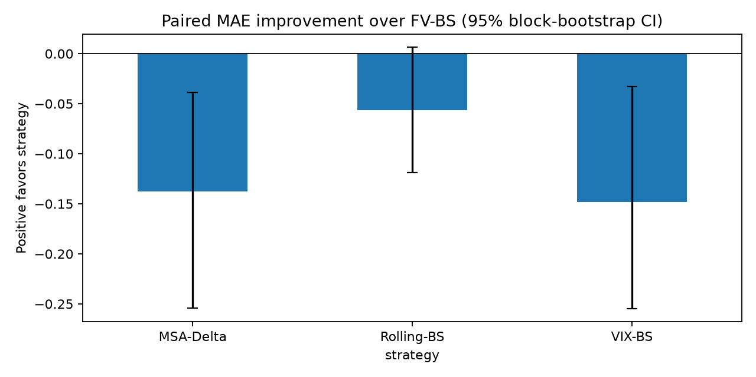
VIX helps most where losses are largest
5.52
Paired MAE improvement over FV-BS
VIX-BS 95% loss expected shortfall
6.75
FV-BS 95% loss expected shortfall
Positive would favor the strategy · 95% moving-block bootstrap CI
9
Notes:
Tail risk tells a more favorable story for VIX. Its ninety-five percent loss expected shortfall is five point five two, versus six point seven five for FV-BS. But the bootstrap chart is deliberately sobering: positive bars would mean lower MAE than FV-BS, and all point estimates are negative. The Rolling-BS interval crosses zero; VIX and MSA do not. So VIX improves tail behavior, not average absolute error.

Slide 10
The ranking survives reasonable transaction-cost changes
TRANSACTION COST
LOWEST MAE
LOWEST RMSE
Interpretation
0 bps 5 bps 10 bps
FV-BS 1.456 FV-BS 1.552 FV-BS 1.745
VIX-BS 2.394 VIX-BS 2.399 VIX-BS 2.510
Fixed volatility remains best for average absolute error. VIX remains best for squared error across all cost assumptions.
Results are also reported separately for all 9 maturity × moneyness combinations.
10
Notes:
This ranking is not an artifact of our five-basis-point assumption. At zero, five, and ten basis points, FV-BS retains the lowest MAE and VIX-BS retains the lowest RMSE. We also report every maturity and moneyness cell separately in the repository, so the pooled result is not the only evidence.

Slide 11
The useful signal is simpler than the model we designed
Forward-looking volatility improves tail-risk control—but more signals do not guarantee a better hedge.
KEEP
REJECT
NEXT
VIX-BS as the strongest tail-risk benchmark
A blanket claim that complexity improves hedging
Test contract-level option data when available
Questions
11
Notes:
Our conclusion is not that signals are useless. Option-market information from VIX clearly helps control large errors. The conclusion is that additional complexity did not add robust average-error value. We would keep VIX as the strongest tail-risk benchmark, reject a blanket complexity claim, and next test contract-level option quotes when licensed data become available. Thank you—we welcome questions.

