Slide 1
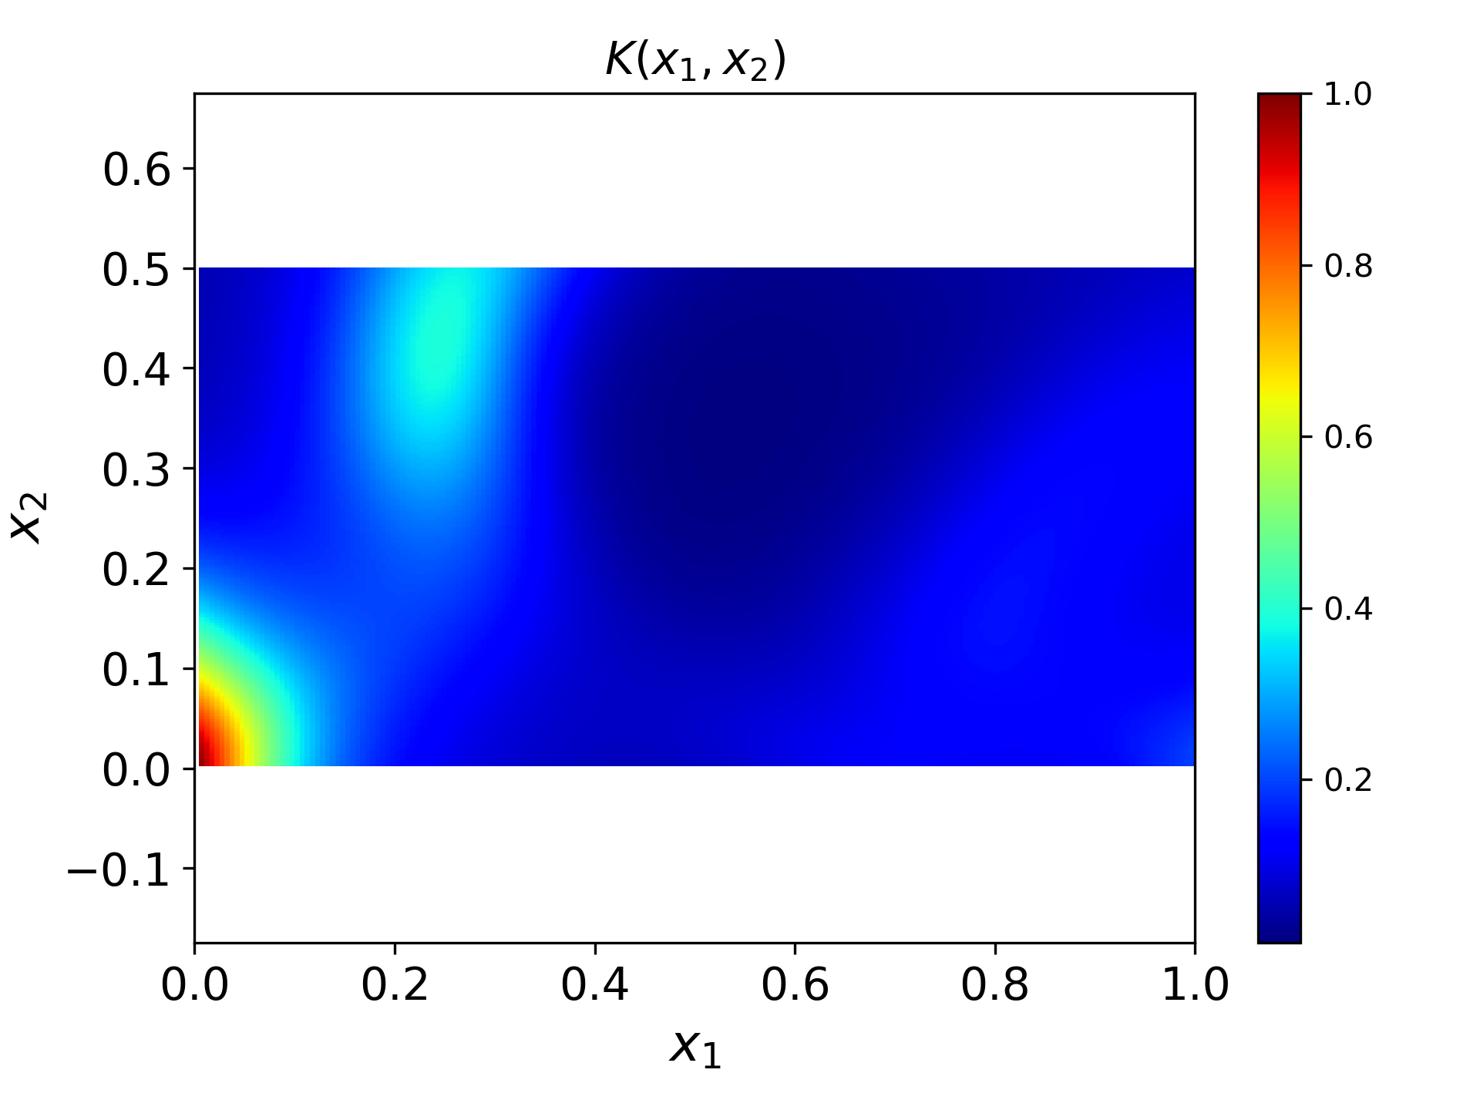
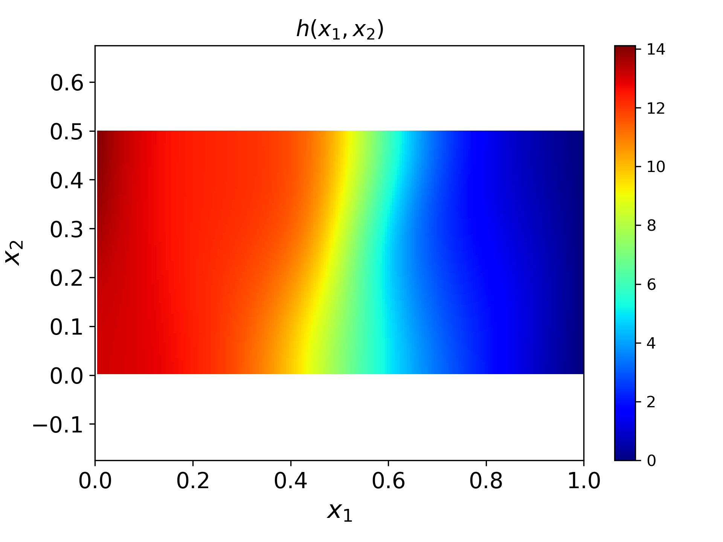
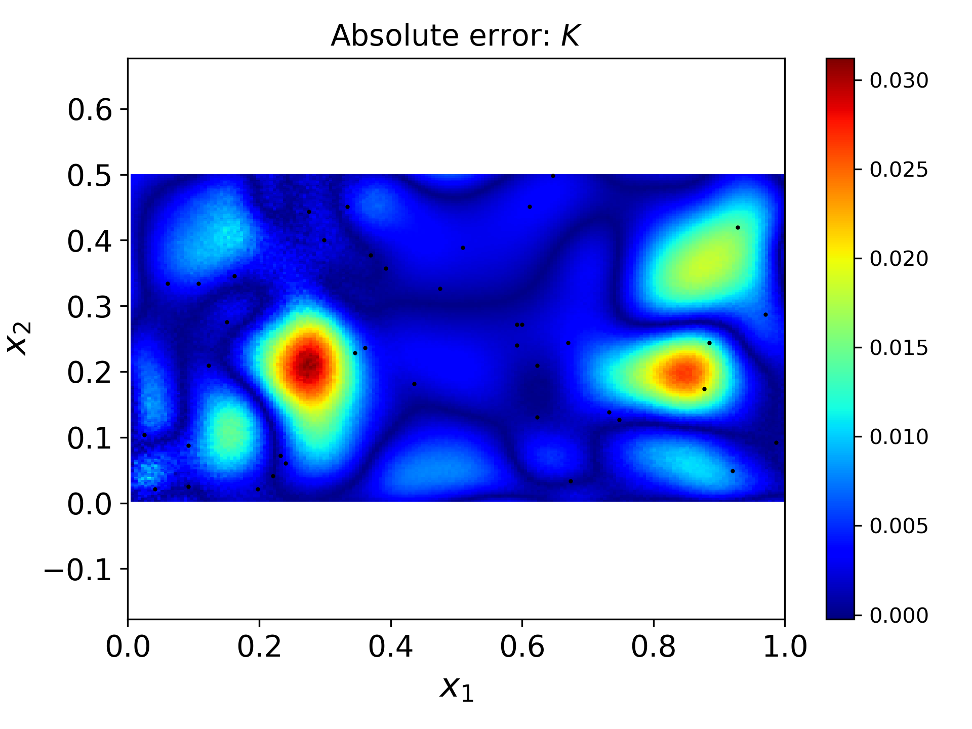
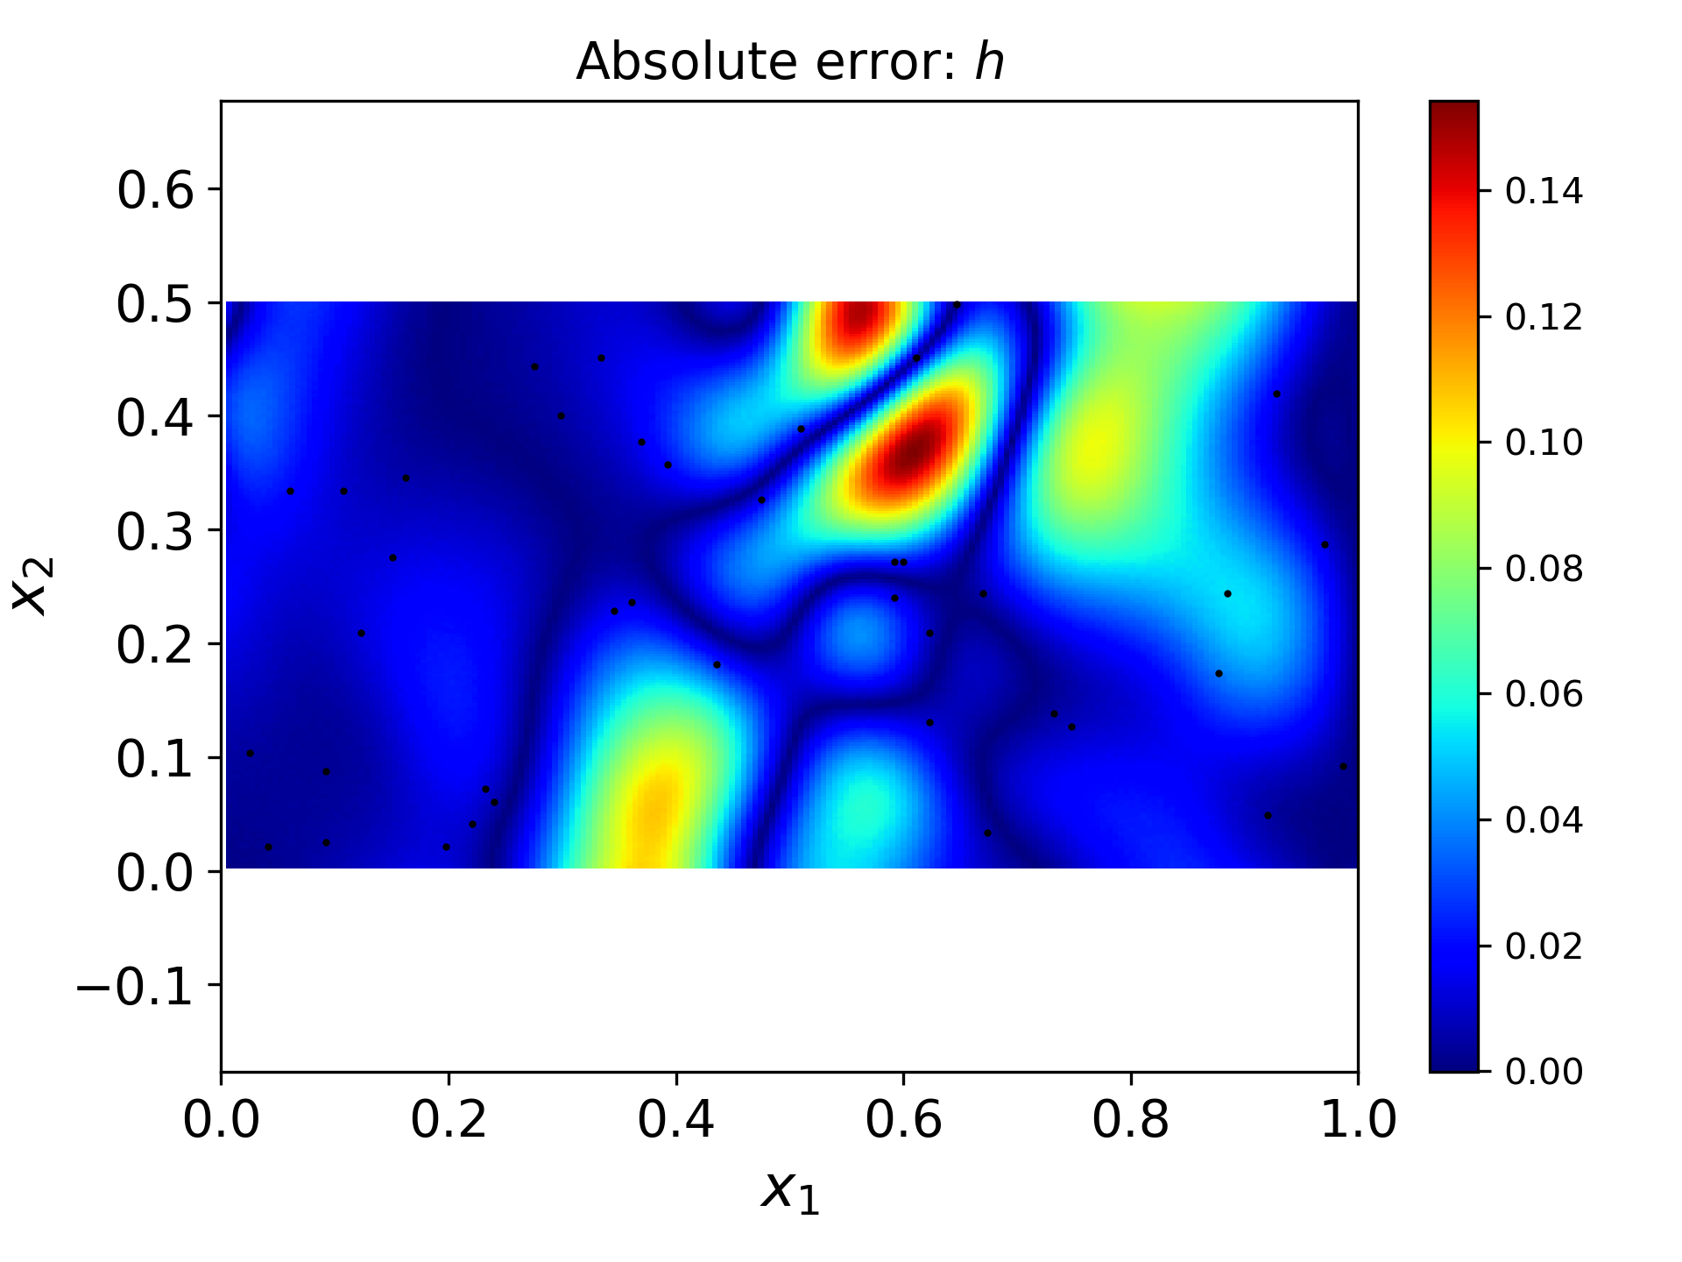
PINN Data Assimilation for K estimation with time-dependent concentration measurements
Nk = Nh = 40, Nc = 100 (Linx_ts0520_op2m400i30w_bf_lr2e4_nc56_nt39fc20k_Kh40C100)
Error k: 4.238471e-02 | Error k-mean: 6.470986e-02 | Error k-inf: 3.121693e-02
Error h: 4.538801e-03 | Error h-mean: 8.290857e-03 | Error h-inf: 1.543632e-01
Notes:
12/07
Main Code: /Users/heqi220/Dropbox/PNNL/workdir/MsDINN-CAD-dyn/main_MsDINN_dyn_bwADE.py
Output folder: /Users/heqi220/Dropbox/PNNL/workdir/MsDINN-CAD-output/dyn_v3_iCAD/test_ts42_new
Run: run_MsDINN_dyn-linx-iCAD-ds42-ts0520-newtest1207
Linx_ts0520_op2m400i30w_bf_lr2e4_nc56_nt39fc20k_Kh40C100
Error k: 4.238471e-02 | Error k-mean: 6.470986e-02 | Error k-inf: 3.121693e-02
Error h: 4.538801e-03 | Error h-mean: 8.290857e-03 | Error h-inf: 1.543632e-01
Time: 0.5 min
Error c: 6.946099e-02 | Error c-mean: 7.004025e-02 | Error c-inf: 3.375027e-02
Time: 1.0 min
Error c: 4.624000e-02 | Error c-mean: 4.692776e-02 | Error c-inf: 2.529909e-02
Time: 1.5 min
Error c: 4.342949e-02 | Error c-mean: 4.437648e-02 | Error c-inf: 2.436852e-02
Time: 2.0 min
Error c: 3.759761e-02 | Error c-mean: 3.869854e-02 | Error c-inf: 1.935234e-02
Time: 2.5 min
Error c: 3.198350e-02 | Error c-mean: 3.317682e-02 | Error c-inf: 1.441965e-02
Time: 3.0 min
Error c: 2.799019e-02 | Error c-mean: 2.927520e-02 | Error c-inf: 1.299866e-02
Time: 3.5 min
Error c: 2.539468e-02 | Error c-mean: 2.679451e-02 | Error c-inf: 1.231601e-02
Time: 4.0 min
Error c: 2.346039e-02 | Error c-mean: 2.498523e-02 | Error c-inf: 1.146948e-02
Time: 4.5 min
Error c: 2.167394e-02 | Error c-mean: 2.331196e-02 | Error c-inf: 1.072233e-02
Time: 5.0 min
Error c: 1.991601e-02 | Error c-mean: 2.164691e-02 | Error c-inf: 1.050872e-02
Time: 5.5 min
Error c: 1.836903e-02 | Error c-mean: 2.018852e-02 | Error c-inf: 1.055665e-02
Time: 6.0 min
Error c: 1.728630e-02 | Error c-mean: 1.922330e-02 | Error c-inf: 1.050403e-02
Time: 6.5 min
Error c: 1.673468e-02 | Error c-mean: 1.884270e-02 | Error c-inf: 1.037844e-02
Time: 7.0 min
Error c: 1.649587e-02 | Error c-mean: 1.881917e-02 | Error c-inf: 1.020471e-02
Time: 7.5 min
Error c: 1.623326e-02 | Error c-mean: 1.877729e-02 | Error c-inf: 1.000864e-02
Time: 8.0 min
Error c: 1.575109e-02 | Error c-mean: 1.848590e-02 | Error c-inf: 9.805125e-03
Time: 8.5 min
Error c: 1.511782e-02 | Error c-mean: 1.801416e-02 | Error c-inf: 9.612564e-03
Time: 9.0 min
Error c: 1.458500e-02 | Error c-mean: 1.765640e-02 | Error c-inf: 9.438428e-03
Time: 9.5 min
Error c: 1.436808e-02 | Error c-mean: 1.768135e-02 | Error c-inf: 9.464916e-03
Time: 10.0 min
Error c: 1.447606e-02 | Error c-mean: 1.811772e-02 | Error c-inf: 9.564919e-03
Time: 10.5 min
Error c: 1.474725e-02 | Error c-mean: 1.877901e-02 | Error c-inf: 9.644048e-03
Time: 11.0 min
Error c: 1.500055e-02 | Error c-mean: 1.944008e-02 | Error c-inf: 9.694831e-03
Time: 11.5 min
Error c: 1.512781e-02 | Error c-mean: 1.995539e-02 | Error c-inf: 9.718719e-03
Time: 12.0 min
Error c: 1.509920e-02 | Error c-mean: 2.027385e-02 | Error c-inf: 9.714057e-03
Time: 12.5 min
Error c: 1.493416e-02 | Error c-mean: 2.040825e-02 | Error c-inf: 9.682049e-03
Time: 13.0 min
Error c: 1.467314e-02 | Error c-mean: 2.040230e-02 | Error c-inf: 9.626378e-03
Time: 13.5 min
Error c: 1.436006e-02 | Error c-mean: 2.030861e-02 | Error c-inf: 9.564331e-03
Time: 14.0 min
Error c: 1.403312e-02 | Error c-mean: 2.017617e-02 | Error c-inf: 9.510329e-03
Time: 14.5 min
Error c: 1.372173e-02 | Error c-mean: 2.004520e-02 | Error c-inf: 9.437731e-03
Time: 15.0 min
Error c: 1.344658e-02 | Error c-mean: 1.994616e-02 | Error c-inf: 9.348622e-03
Time: 15.5 min
Error c: 1.322197e-02 | Error c-mean: 1.990216e-02 | Error c-inf: 9.379921e-03
Time: 16.0 min
Error c: 1.305895e-02 | Error c-mean: 1.993275e-02 | Error c-inf: 9.463443e-03
Time: 16.5 min
Error c: 1.296878e-02 | Error c-mean: 2.005885e-02 | Error c-inf: 9.542717e-03
Time: 17.0 min
Error c: 1.296557e-02 | Error c-mean: 2.030673e-02 | Error c-inf: 9.618402e-03
Time: 17.5 min
Error c: 1.306782e-02 | Error c-mean: 2.071049e-02 | Error c-inf: 9.704043e-03
Time: 18.0 min
Error c: 1.329815e-02 | Error c-mean: 2.131191e-02 | Error c-inf: 9.785479e-03
Time: 18.5 min
Error c: 1.368136e-02 | Error c-mean: 2.215738e-02 | Error c-inf: 9.856975e-03
Time: 19.0 min
Error c: 1.424132e-02 | Error c-mean: 2.329284e-02 | Error c-inf: 9.918308e-03
Time: 19.5 min
Error c: 1.499736e-02 | Error c-mean: 2.475749e-02 | Error c-inf: 9.968316e-03
Time: 20.0 min
Error c: 1.596181e-02 | Error c-mean: 2.657919e-02 | Error c-inf: 1.004274e-02

Slide 2

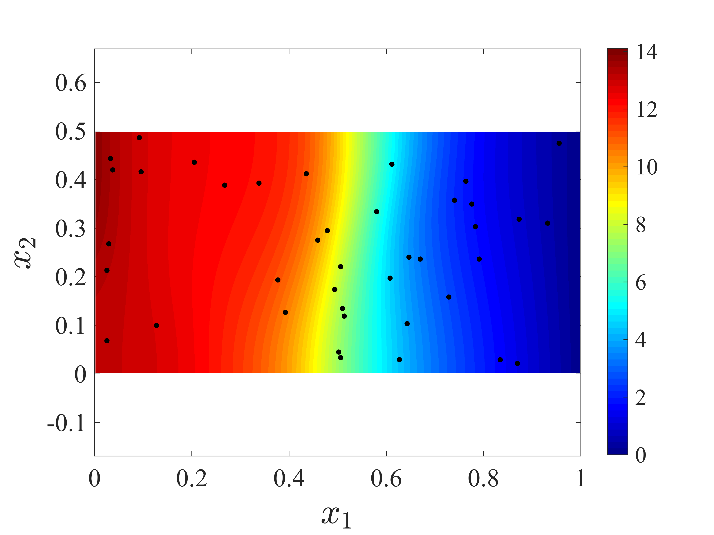
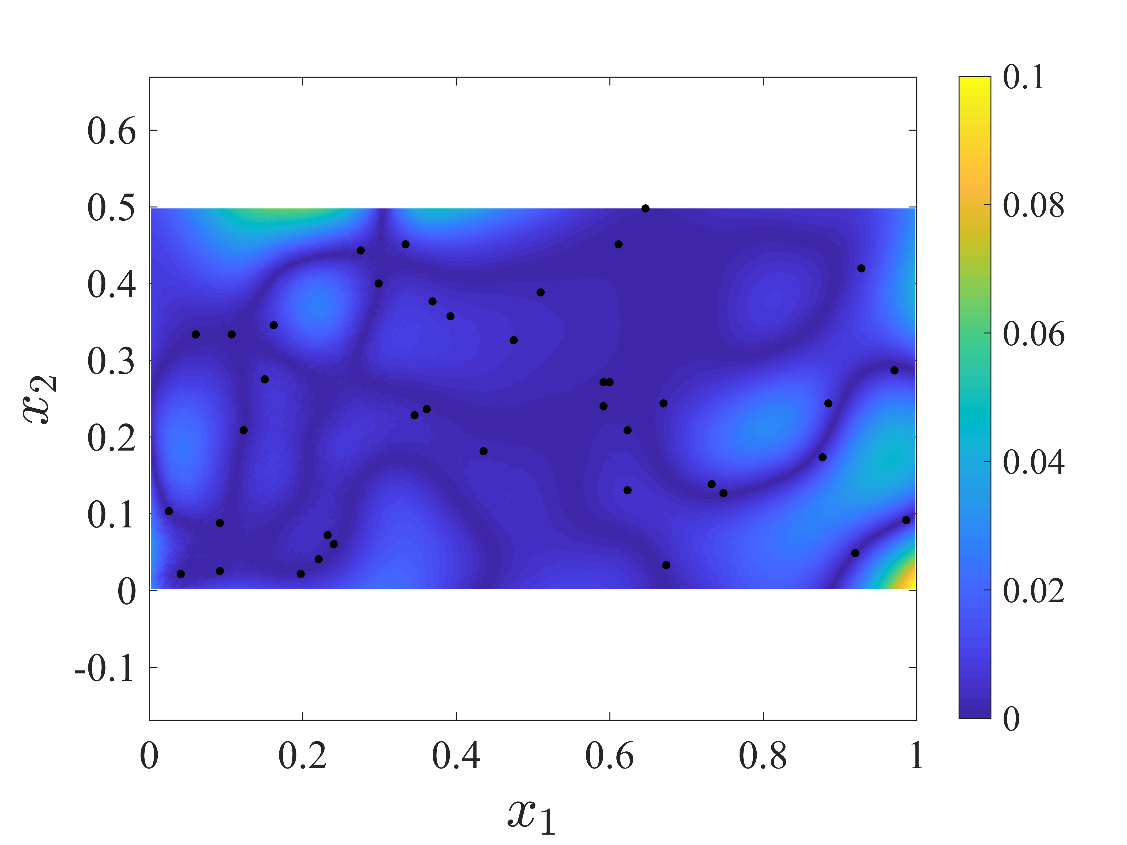
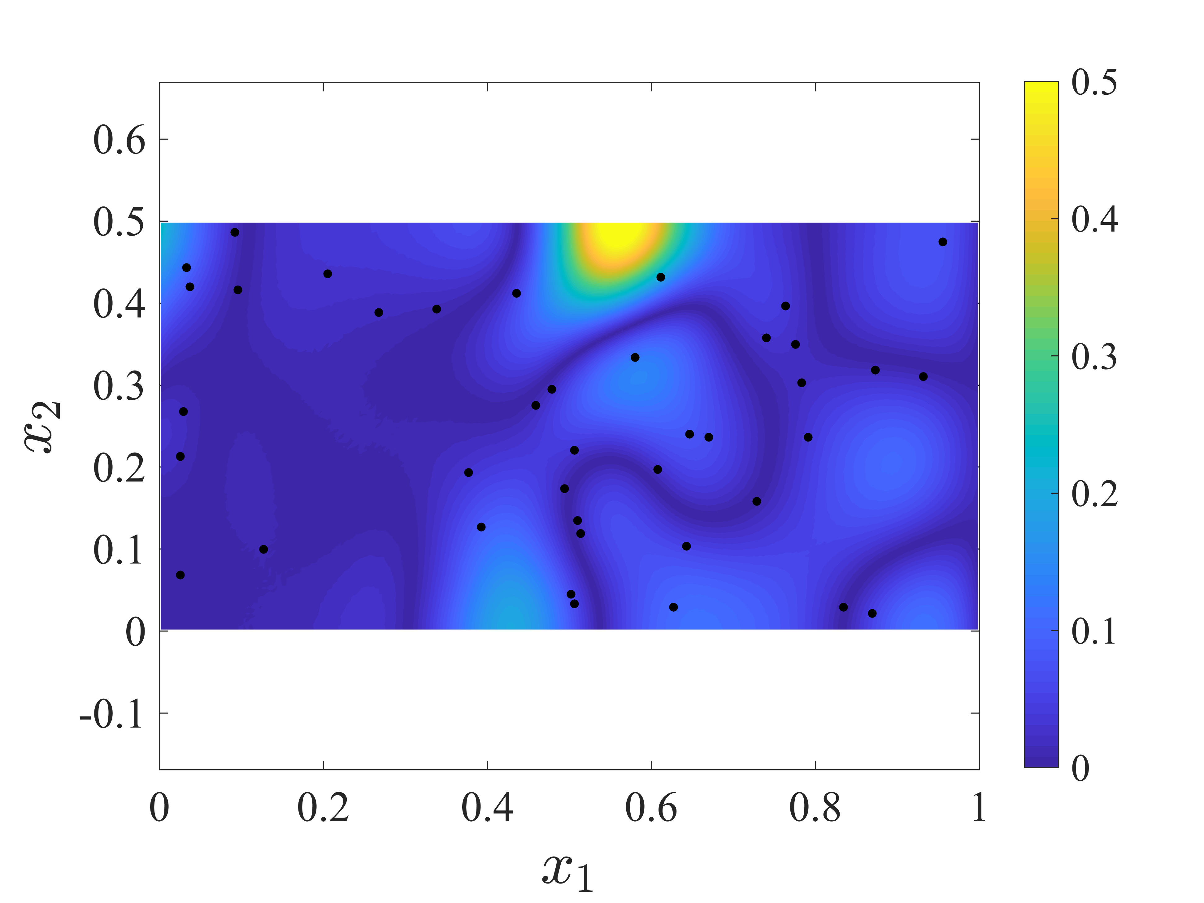
PINN Data Assimilation for K estimation with steady concentration measurements
[Nk=Nh=40, c100, Nf=1000, Nfc = 1000, S0
map_k__r111_k40_h40_f1000_s0_c100_fc1000_pred
Error k: 6.619395e-02
Error h: 6.860466e-03
Error C: 1.140092e-02
map_k__r111_k40_h40_f1000_s0_c100_fc1000_pred
map_h__r111_k40_h40_f1000_s0_c100_fc1000_errors
Notes:
Folder: /Users/heqi220/Dropbox/PNNL/workdir/MDINN-CAD-revised/Result_MPINNs/sec4/paper_plot2D_ds42
In original manuscript:
Fold: Group_Code/PINN-CAD-master-v6s4/Results_PINN_random
Ds42:
See OneNote: PINN-v6s4-random/Results-ds42[done]
CADn_v6s4_ds42_ts3_pro1_nn636_opt7m1m_lr2e4_conv2e4_mea22_lt15(used40)

