Slide 1
New York City Taxi Fare Prediction
Zhibing Huang
Tianyi Tang
Zhizhou Qiu

Slide 2
Overview
Introduction
Dataset Processing
Model Selections
Model Realization
Results & Summary

Slide 3
Brief Introduction
In our project, we are tasked with predicting the fare amount (inclusive of tolls) for a taxi ride in New York City given the pickup and dropoff locations.
While we can get a basic estimate based on just the distance between the two points, this will result in an RMSE of $5-$8, depending on the model used. Our challenge is to do better than this using Machine Learning techniques!

Slide 4
Dataset Introduction:
Features
pickup_datetime - timestamp value indicating when the taxi ride started.
pickup_longitude - float for longitude coordinate of where the taxi ride started.
pickup_latitude - float for latitude coordinate of where the taxi ride started.
dropoff_longitude - float for longitude coordinate of where the taxi ride ended.
dropoff_latitude - float for latitude coordinate of where the taxi ride ended.
passenger_count - integer indicating the number of passengers in the taxi ride.
Target
fare_amount - float dollar amount of the cost of the taxi ride. This value is only in the training set; this is what you are predicting in the test set and it is required in your submission CSV.
Source:
https://www.kaggle.com/c/new-york-city-taxi-fare-prediction/data
data size is 55M rows but we only use 10M rows since we can’t run all data in our own computer

Slide 5
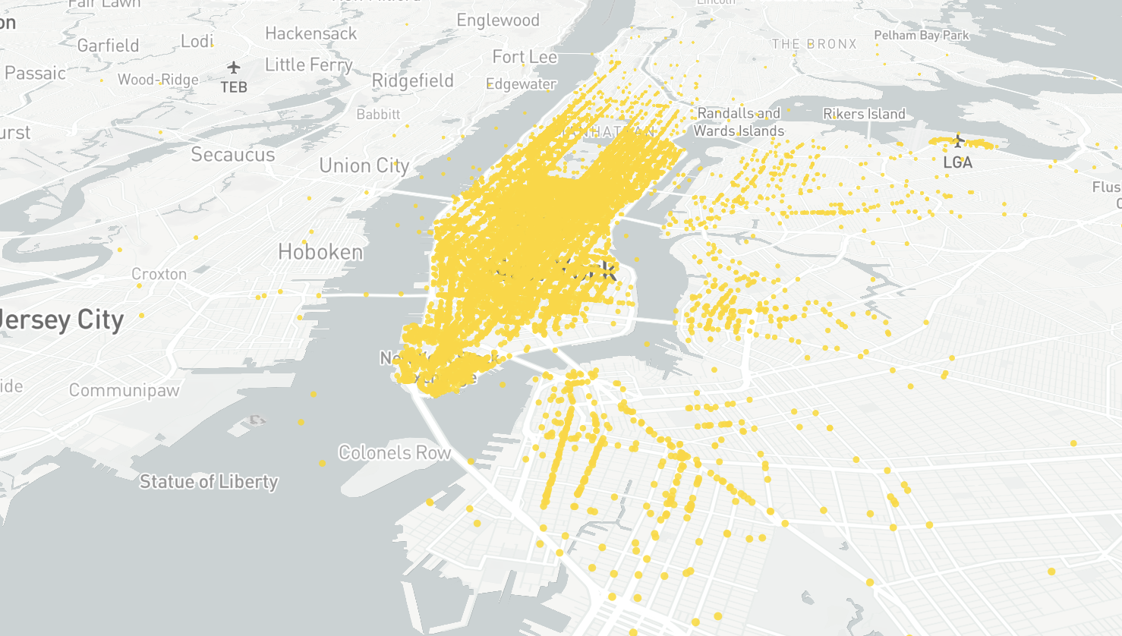
Dataset Introduction:
Pick up locations in NYC

Slide 6
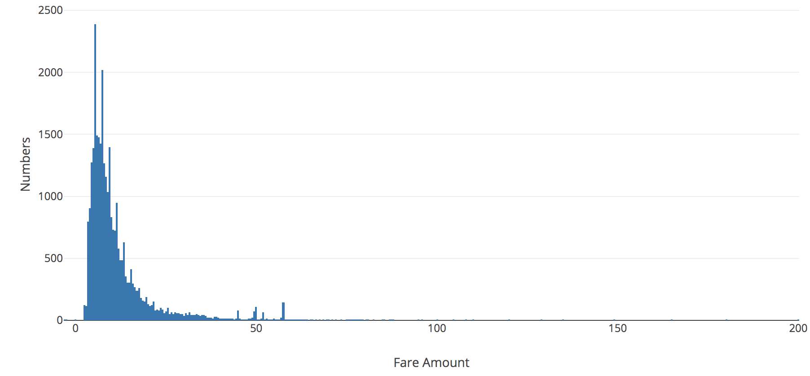
Dataset Introduction:
Fare Value Distribution

Slide 7
Data Cleaning
Some rows are NaN.
Some fare amount is negative.
Some coordinates are far away from New York City.
Some coordinates are located in water.
Some passenger count is greater than 6.

Slide 8
Data Cleaning
Old size: 10,000,000
New size(without NaN): 9,999,931
Old size: 9,999,931
New size(diff longitude & latitude no to large): 9,979,187
Old size: 9,979,187
New size(fare_amount > 0): 9,978,783
Old size: 9,978,783
New size(in NYC): 9,787,199
Number of trips in water: 2025
Old size: 9,787,199
New size(Not in Water): 9,785,174
Old size: 9,785,174
New size(reasonable passenger count): 9,750,645

Slide 9
Feature Engineering
Compute absolute latitude and longitude difference respectively
Compute euclidean distance and manhattan distance of abs_diff_latitude and abs_diff_longitude
Abstract year, month, day, hour and week-day from original feature pickup-data time
Delete unuseful features: pickup_datetime, pickup_latitude, pickup_longitude, dropoff_latitude and dropoff_longitude
Keep useful features: abs_diff_latitude, abs_diff_longitude, euclidean distance, manhattan distance and time informations for model input

Slide 10
Input Features
fare_amount float64
passenger_count int64
abs_diff_longitude float64
abs_diff_latitude float64
euclidean float64
manhattan float64
year int64
month int64
day int64
hour int64
weekday int64

Slide 11
Model Selections
Linear Regression: Based on the absolute longitude and latitude value to predict the fare amount by using linear regression.
XGBoost: It’s one of the gradient boost method called eXtreme Gradient Boost used for supervised Machine Learning. The weak learner used in XGBoost is generally the decision tree.
LightGBM: In order to reduce bias of this problem, we decided to try Gradient descent boosting tree model called Lightgbm with faster training speed and higher efficiency.
Neural Network: We also tried deep learning method for this problem.

Slide 12
Training Model - Linear Regression
In our model, we firstly take the absolute longitude/latitude as our input features. By calling numpy.linalg.lstsq function to return the least-squares solution to a linear matrix equation. Afterward we take all features as inputs.
Model parameters: None

Slide 13
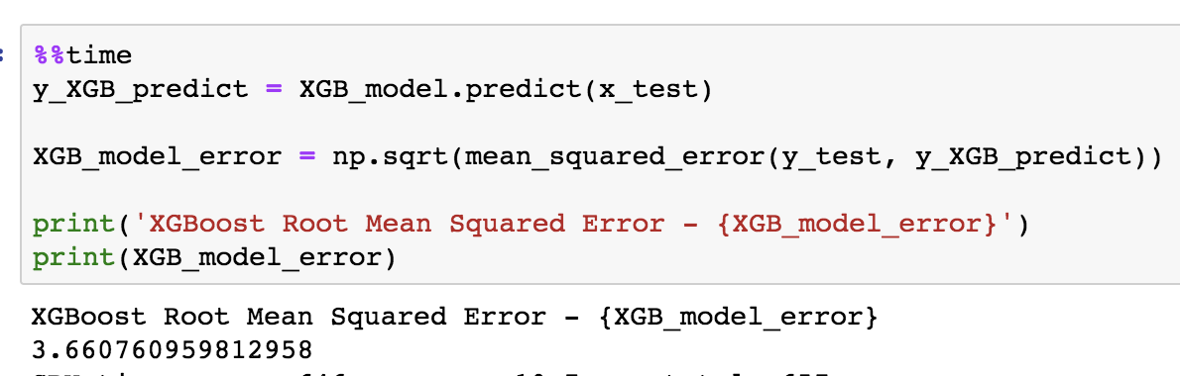
Training Model - XGBoost
In our model, we firstly take the absolute longitude/latitude as our input features. By separating the data into 99% training and 1% validation to get the validation loss. Afterward we take all features as inputs.
Model parameters: learning_rate=0.3,max_depth=6, n_jobs=-1, silent=False

Slide 14
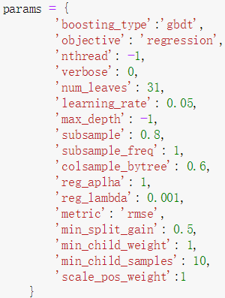
Training Model - LightGBM
In LightGBM model, we continue to take the
processed data as the input. The training dataset
is divided into two parts, the training part and
the Grid Search validation part.
Via Grid Search, we can finally get the approximate
optimal parameters for lightGBM.

Slide 15
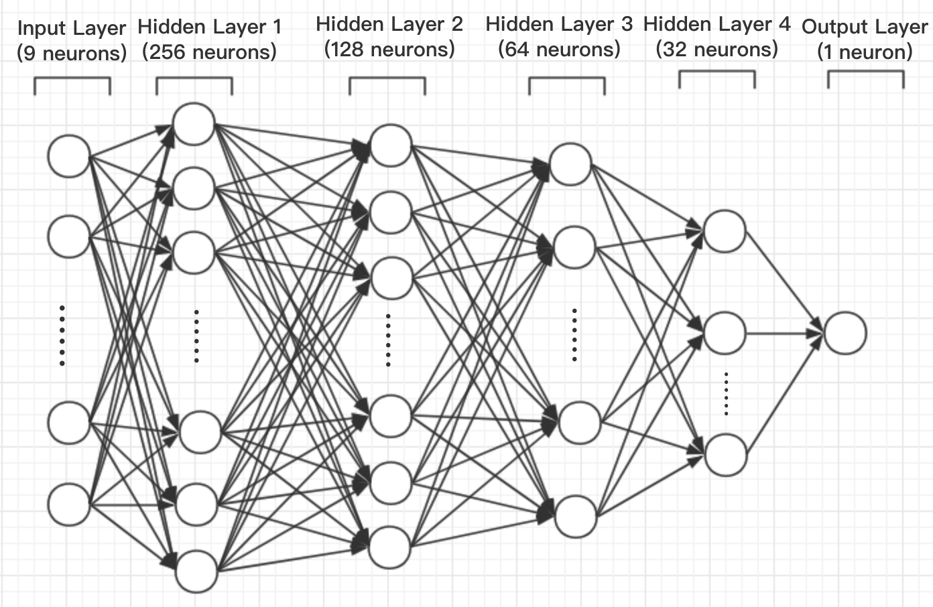
Training Model - Neural Network
NN Structure: 1 Input Layer, 3-4 Hidden Layer(Activation function: ReLU), 1 Output Layer(activation function: Linear)
(With two input features, the NN is relatively smaller.)
Loss Function: Mean Squared Error(MSE)
Optimizer: Adam

Slide 16
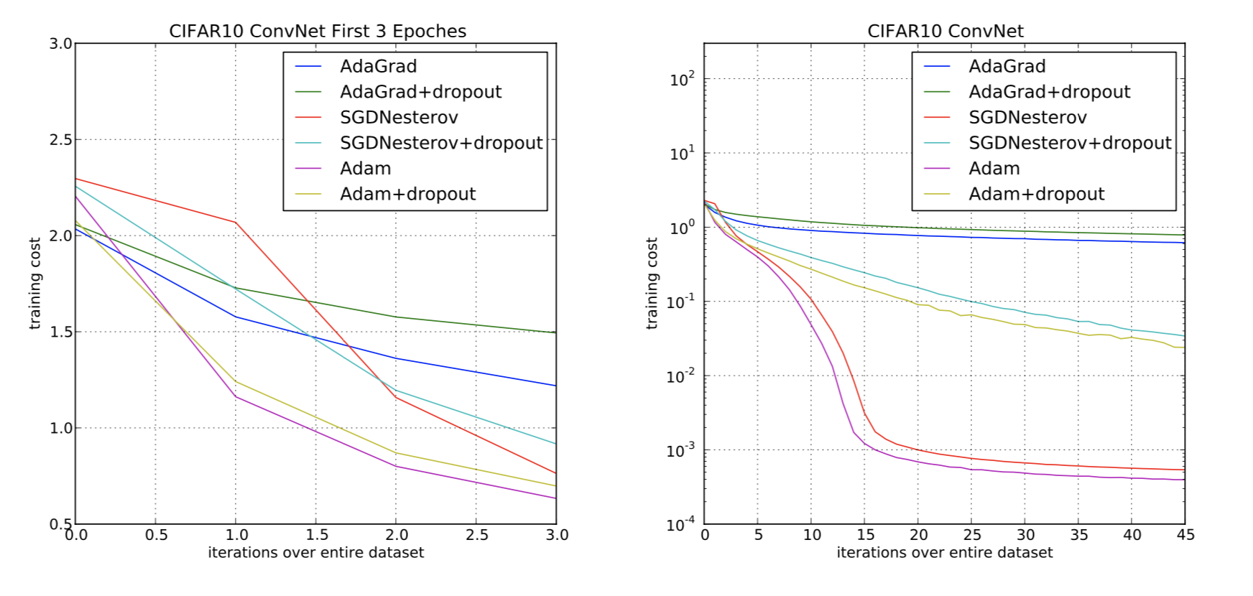
NN-Adam Optimizer
Adam is an algorithm for first-order gradient-based optimization of stochastic objective functions, based on adaptive estimates of lower-order moments. The method is straightforward to implement, is computationally efficient, has little memory requirements, is invariant to diagonal rescaling of the gradients, and is well suited for problems that are large in terms of data and/or parameters.
Adam is designed to combine the advantages of two recently popular methods: AdaGrad and RMSProp.
Figure:
Convolutional neural networks training cost
Training cost for the first three epochs
Training cost over 45 epochs

Slide 17
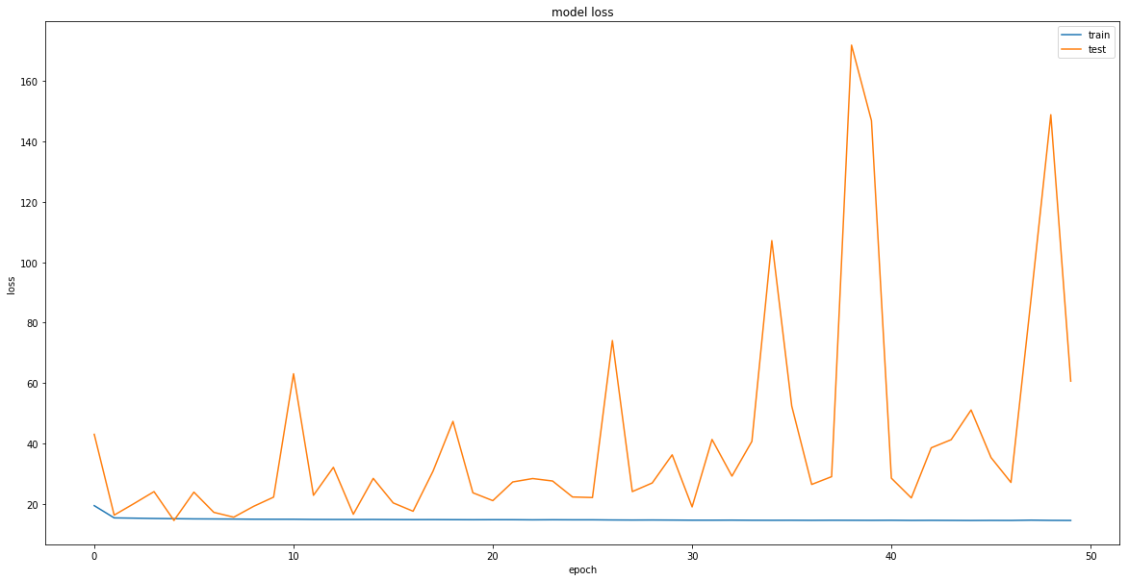
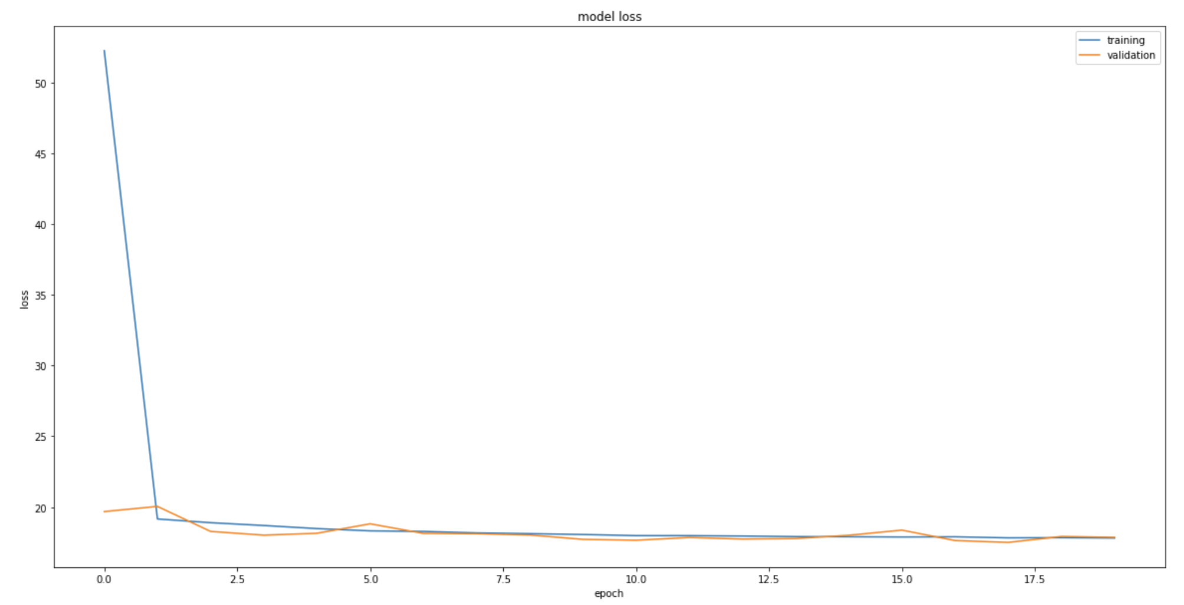
Training Model - Neural Network
batch size = 256
batch size = 3000

Slide 18
Training Model - Neural Network
Proportion of Validation Set | Score
10% | 3.69
5% | 3.64
1% | 3.61
Learning Rate | Epoch | Score
0.01 | 20 | 4.07
0.01 | 30 | 3.60
0.01 | 50 | 3.78
0.001 | 20 | 3.61
0.001 | 30 | 3.63
0.001 | 50 | 3.56
Notes:
The performance of the NN model is increasing with the reduction in quantity of the Validation Set, learning rate and Epoch.

Slide 19
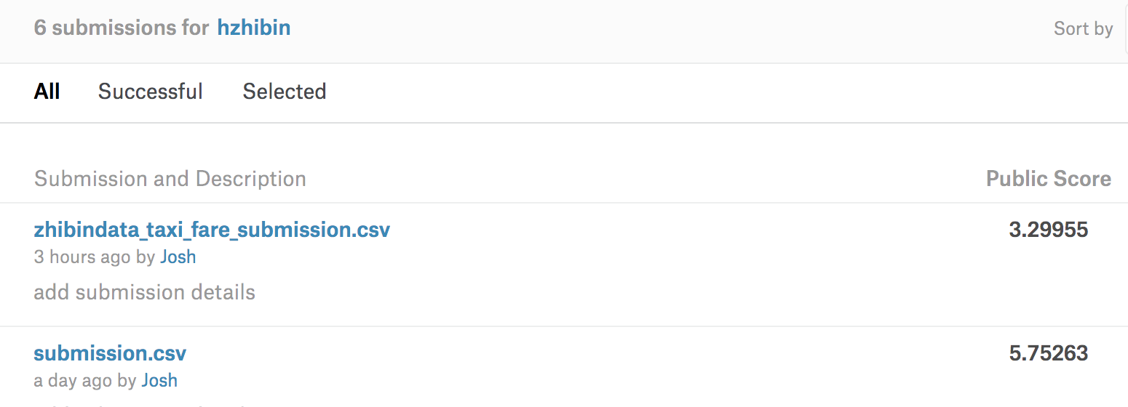
Results
Linear and XGBoost Results: (The Best Score on Kaggle is around 3)

Slide 20

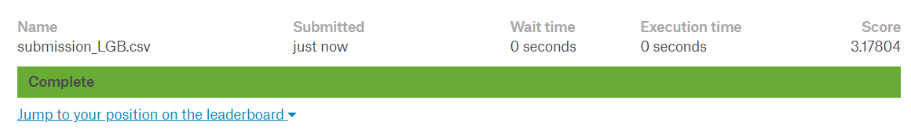
Results
Lightgbm Results: (With 1000 rounds)
Scores(only abs_diff)
Scores(all features)

Slide 21
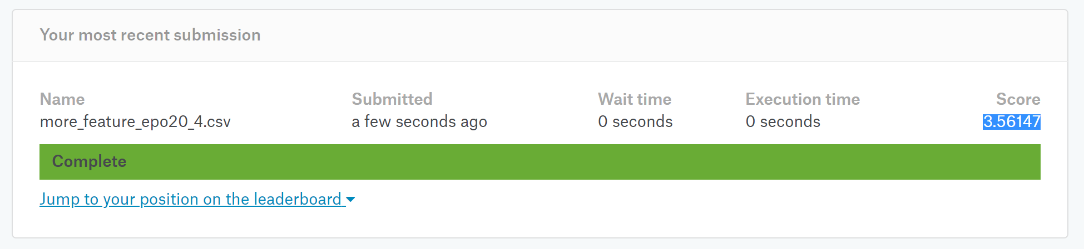
Results
Neural Network Results:

Slide 22
Results
Models | Score(only abs_diff) | Score(all features)
Linear Regression | 5.75 | 5.63
XGBoost | 3.78 | 3.29
LightGBM | 3.65 | 3.17
Neural Network | 4.32 | 3.56
LightGBM Model results in the best score among our four models.

Slide 23
Thank you!

