Slide 1
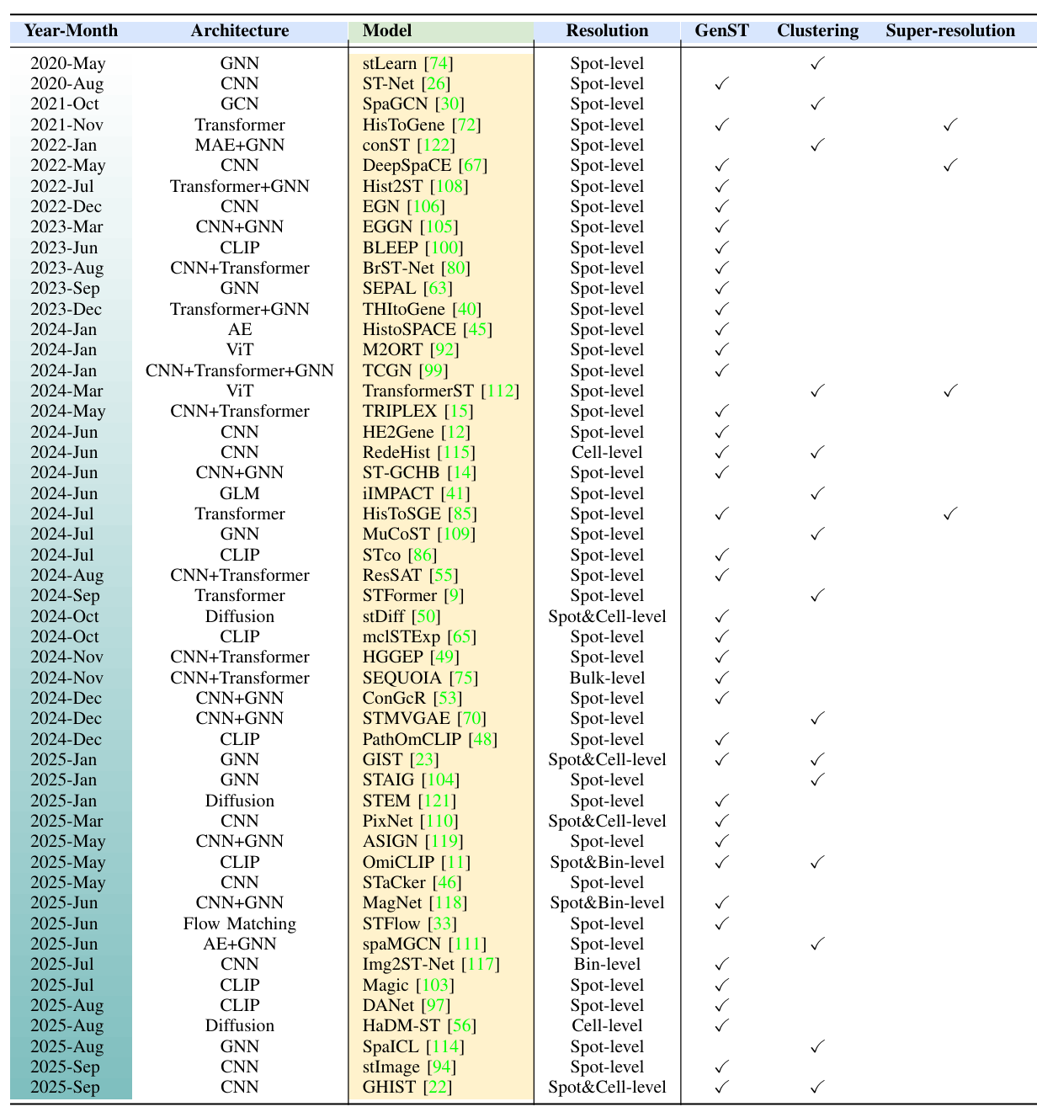
预测空间基因表达
Notes:
Computer Vision Methods for Spatial Transcriptomics: A Survey

Slide 2
预测空间基因表达
时间 | 简称 | 论文标题 | 内容
2020 | STNet | Integrating spatial gene expression and breast tumour morphology via deep learning | DenseNet121-全连接层
2021 | HisToGene | Leveraging information in spatial transcriptomics to predict super-resolution gene expression from histology images in tumors | ViT-MLP
2022 | Hist2ST | Spatial Transcriptomics Prediction from Histology jointly through Transformer and Graph Neural Networks | Convmixer-Transformer-GNN-ZINB
2022 | EGN | Exemplar Guided Deep Neural Network for Spatial Transcriptomics Analysis of Gene Expression Prediction | ViT+EB模块（往中间层加入相似patch的特征和表达信息）-注意力回归头
2023 | THItoGene | THItoGene: a deep learning method for predicting spatial transcriptomics from histological images | 动态卷积+capsule network-ViT-GAT-MLP
2023 | BLEEP | Spatially Resolved Gene Expression Prediction from H&E Histology Images via Bi-modal Contrastive Learning | 对比学习（ResNet50编码图像、MLP编码基因），检索相近的表达并线性组合
2024 | mclSTExp | Multimodal contrastive learning for spatial gene expression prediction using histology images | 对比学习（DenseNet121编码图像、Transformer编码基因），检索相近的表达并线性组合
2025 | OmiCLIP | A visual–omics foundation model to bridge histopathology with spatial transcriptomics | 基因转换为句子进行对比学习
2025 | FmH2ST | FmH2ST: foundation model-based spatial transcriptomics generation from histological images | 双分支结构：PathoDuet（PFM）提取slice和spot特征-dual graph；CNN+ViT-GAT提取spot细粒度特征；两分支注意力融合
2026 | HistoPrism | HistoPrism: Unlocking Functional Pathway Analysis from Pan-Cancer Histology via Gene Expression Prediction | 跨癌种基因表达预测，提出GPC基准：UNI（PFM）-跨注意力把癌种条件注入-Transformer-MLP

Slide 3
预测Pathway Expression
时间 | 简称 | 论文标题 | 内容
2026 | PEaRL | PEaRL: Pathway-Enhanced Representation Learning for Gene and Pathway Expression Prediction from Histology | 对比学习：UNI编码图像；transformer编码pathway
2025 |  | Digital Modeling of Spatial Pathway Activity from Histology Reveals Tumor Microenvironment Heterogeneity | UNI2-h（PFM）-RidgeCV/随机森林
2025 | DeepPathway | DeepPathway: Predicting Pathway Expression from Histopathology Images | 对比学习：ResNet18+H-optimus-0（PFM）编码图像；

Slide 4
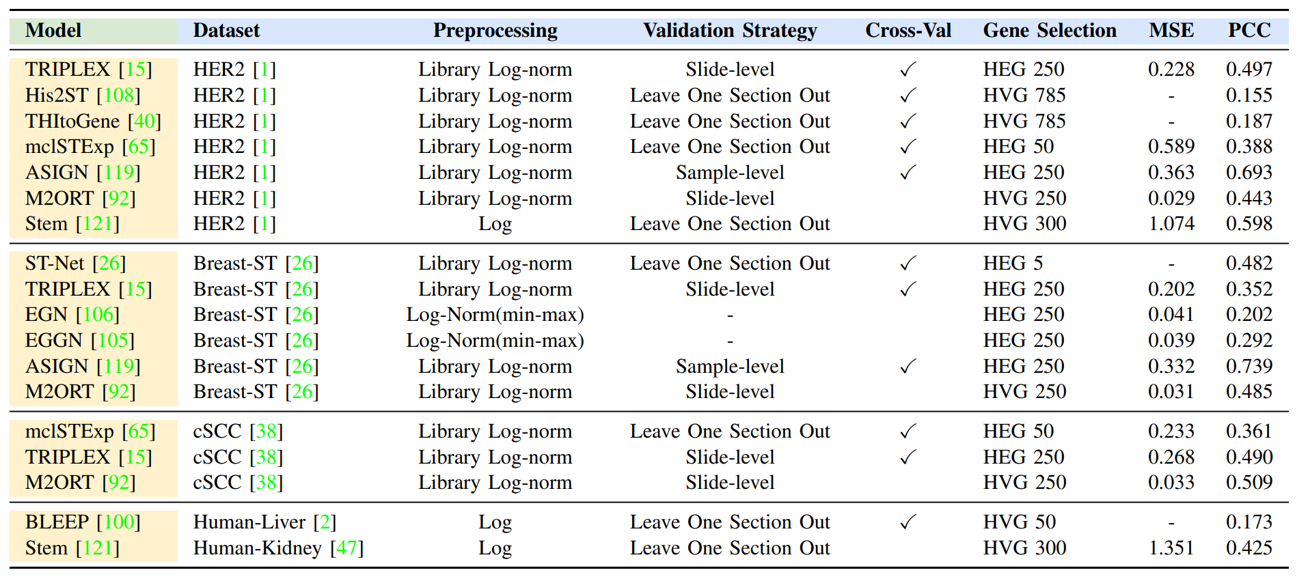
实现与评估指标
Notes:
预处理：对数变换；归一化-对数变换。
验证策略：采用切片级（slide-level）划分进行交叉验证，将同一样本的不同切片视为独立的训练与验证单元；Leave-One-Section-Out保留一个切片作为验证集，其余切片用于训练；样本级（sample-level）划分，确保同一样本的所有切片仅出现在训练集或验证集中的一方。
基因选择：高表达基因HEG；高变异基因HVG。

Slide 5
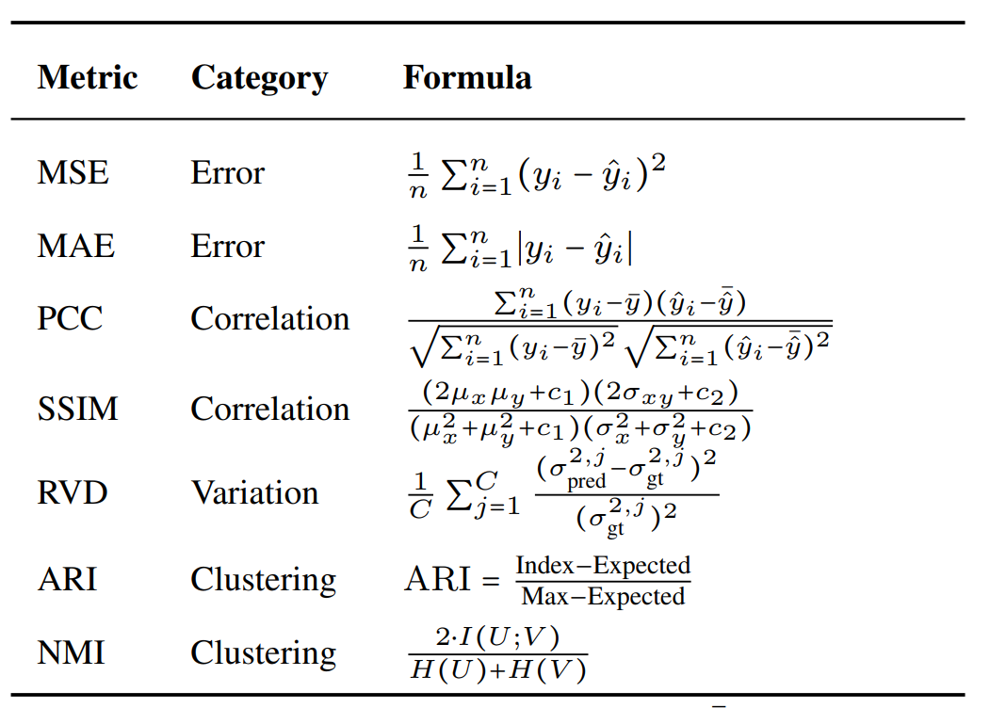
实现与评估指标
均方误差 MSE：衡量预测值与真实值之间的数值差异，对大误差敏感
平均绝对误差 MAE：对异常值更具鲁棒性，可提供平均误差的平衡估计
Pearson 相关系数 PCC：衡量预测表达与真实表达之间的线性相关性，判断模型是否能够捕捉基因表达空间趋势

