Slide 1
N-body Simulation
Kirushin I., Anisimov V., Bukhanov B., Peshkov A.

Slide 2

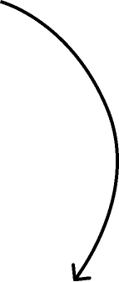

Intro
What is our project about?
To reach the maximum amount of bodies interacting on the screen
To observe gravitational interaction in complex systems of bodies

Slide 3

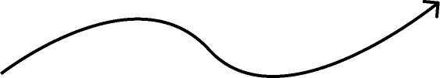
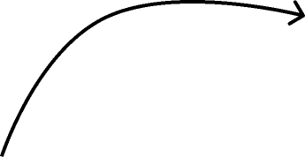


Relevance
Too complex or too simplified
What’s wrong with most gravitational simulators?
To combine scientific accuracy with user-friendly visualization
What we suggest

Slide 4

What are we going to implement?
Goal
To reach maximum N of objects which interaction can be calculated and visualizated
We’re going to implement a gravitational simulator with a graphical interface
What features will it have?
It will allow users to choose the scenery or set custom initial data and observe the gravitational interaction

Slide 5
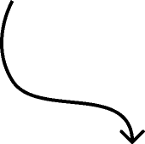
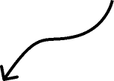
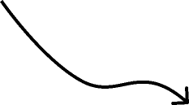


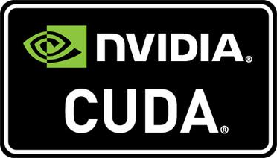
Tools
Programming language
Libraries and frameworks for development
CMake…
The library for 3D-graphic
Profilers…
The framework for parallel computations

Slide 6

Time changing
One of the most useful feature in our program will be the ability to change the time interval between events on a screen
It will allow users to see in more detail what’s happening at a specific moment

Slide 7
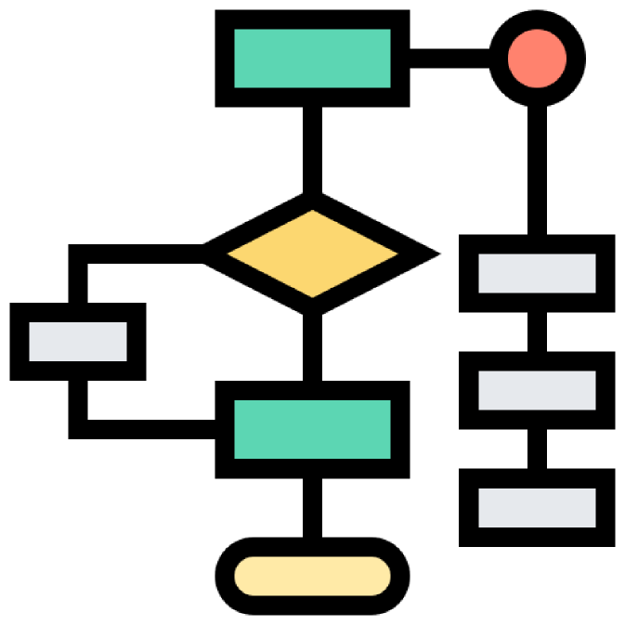
Algorithms
The second main idea is to test different calculating algorithms and compare their time of performing and accuracy
It will allow us to understand what algorithm is the most suitable for our application
We’re going to use C++ profilers to find out performance on test scenarios

Slide 8
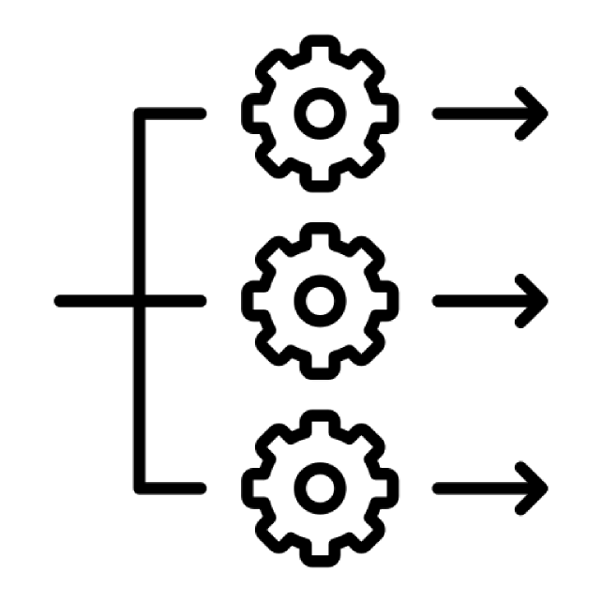
Parallel computations
The third main task is to implement parallel computations using CUDA
It will allow us to understand what is the maximum amount of objects which interaction we can calculate and show on a screen

Slide 9
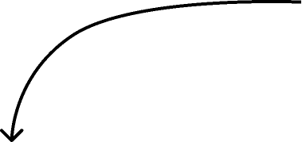
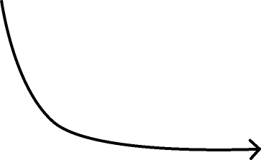
Current state
We implemented O(n^2)-algorithm
We implemented visualizer
We found out the maximum N that the application can calculate and visualize

