Slide 1


ONLINE PSYCHIATRY APPLICATION
Project Guide - Mrs. Divya Nimbalkar
Team Members :
Bhumi Avhad : 20102B2002
Sapana Survase: 20102B2005
Rahul Shewale : 20102A2003
Harsh Pandita : 19102A0040

Slide 2
OBJECTIVE
Psychiatry means the branch of medicine concerned with the study, diagnosis, and treatment of mental illness.
Online Psychiatry application is a web-application designed to help people facing various mental issues such as depression, anxiety, eating disorders, etc to connect with therapists online as well as have an access to a variety of mental health blogs.

Slide 3
PROBLEM DEFINITION
As the number of psychotherapists is not enough, it is necessary for people to be able to keep their mental wellness on their own.
Recent reviews of applications which are developed for mental health disorders shows that online therapists are distant from the client, it can be difficult for them to respond quickly and effectively.

Slide 4
PROPOSED SYSTEM
The ultimate aim is to provide an effective application which has the ability to give the solution or solve the problems via chatbot and if the situation is serious then assist the therapist.
For these the sentiment analysis will be referred in which the natural language processing, text analysis and computational linguistics to study subjective states of the text presented. Using datasets freely available online, we can train models(chatbot) and then use sentiment analysis to find out if the user’s response is positive, neutral or serious, and thus decide the response accordingly.

Slide 5
LITERATURE REVIEW
Digital Psychiatry - Curbing Depression using Therapy Chatbot and Depression Analysis
Published in: 2018 Second International Conference on Inventive Communication
Published by: Bhuvan Sharma, Harshita Puri, Deepika Rawat
Funding: The author(s) received no financial support for the research, authorship, or publication of this article.
The objective of this research is to devise a cognitive behavioural therapy system or a Therapy Chatbot capable of catering to the health and informative needs of a user. Also, the key focus is on the therapy element which detects the level of depression in a particular individual. This study is intended to target 300 million people worldwide.
The system not only detects the level of depression in an individual but also suggests remedies to lower the level of depression in an individual. This study uses python as the base language which can be integrated with android so as to serve as a messaging platform so that it can target a larger audience. It is designed in such a way that it can emulate a psychotherapist.

Slide 6
Chatbot and Conversational Agents in Mental Health
Published in: March 21, ‘19 PubMed, EmBase, PsycINFO, Cochrane, Web of Science, and IEEE Xplore
Published by: Aditya Vaidyam, Hannah Wisniewski, John Halamka, Matcheri Kashavan and John Torous.
Funding: The author(s) received no financial support for the research, authorship, and/or publication of this article.
The aim of this review was to explore the current evidence for conversational agents or chatbots in the field of psychiatry and their role in screening, diagnosis, and treatment of mental illnesses.From the selected databases, 1466 records were retrieved and 8 studies met the inclusion criteria.
Preliminary evidence for psychiatric use of chatbots is favourable. However, given the heterogeneity of the reviewed studies, further research with standardized outcomes reporting is required to more thoroughly examine the effectiveness of conversational agents. Regardless, early evidence shows that with the proper approach and research, the mental health field could use conversational agents in psychiatric treatment.

Slide 7
A neural network prediction model for a psychiatric application
Published in: 16-18 Aug, ‘05 Sixth International Conference on Computational Intelligence and Multimedia Applications (ICCIMA'05)
Published by: K.R. Linstrom, A.J. Boye
Funding: The author(s) received no financial support for the research, authorship, and/or publication of this article.
This paper presents a unique application of artificial neural networks used to predict the successful or unsuccessful completion of special education programming for students diagnosed with serious emotional disturbance (SED).
In this study, as is common in medical applications, there is an insufficient amount of input data for training and testing the neural network. Bootstrapping and noisy replication of the input data are two techniques used to attempt to compensate for this small amount of available data. While the results would have benefited if more data were available, the results show some promise in being able to correctly predict the successful or unsuccessful completion of SED programming with artificial neural networks, particularly as a diagnostic test.

Slide 8
Requirements
Languages Implemented: HTML,CSS,JS Python, Machine Learning (Deep learning), Neural networks
Libraries Imported: NLTK (Natural Language Toolkit), NumPy, TFLearn, TensorFlow, Random, JSon, Pickle, Lancaster Stemmer
Data-set: The dataset was from TechWithTim website about Deep Learning.

Slide 9
DFD
Online Psychiatry Application
USER
Ask Queries
Remedial treatment
(suggestions/directions )
Level 0

Slide 10
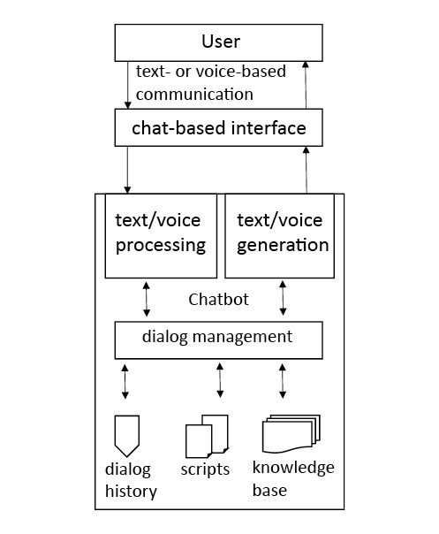
Graphical Representation of the technical implementation of chatbots

Slide 11
Limitations
Qualities specific to chatbots such as their multiple input and output modalities or engagement metrics, including attitude, acceptability, helpfulness, and satisfaction, require special consideration and specific guidelines that currently lack consensus.
In reporting of subject demographics, adherence and engagement measures, and clinical outcomes make it difficult to draw firm conclusions.

Slide 12
FUTURE SCOPE
Chatbots might be offered in the future to stabilize intervention effects, facilitate the transfer of the therapeutic content into daily life, and reduce the likelihood of relapse.
Chatbots could take over time-consuming psychother­apeutic interventions that do not require more complex therapeutic competence.
Combined with linguistic analyses such as sentiment analysis (a method for detecting moods), chatbots would be able to react to the mood of the users. This allows the selection of emotion-dependent response options and thematization of content adapted to the user's input or the forwarding of relevant information about psychological variables to the practi­tioner.

Slide 13
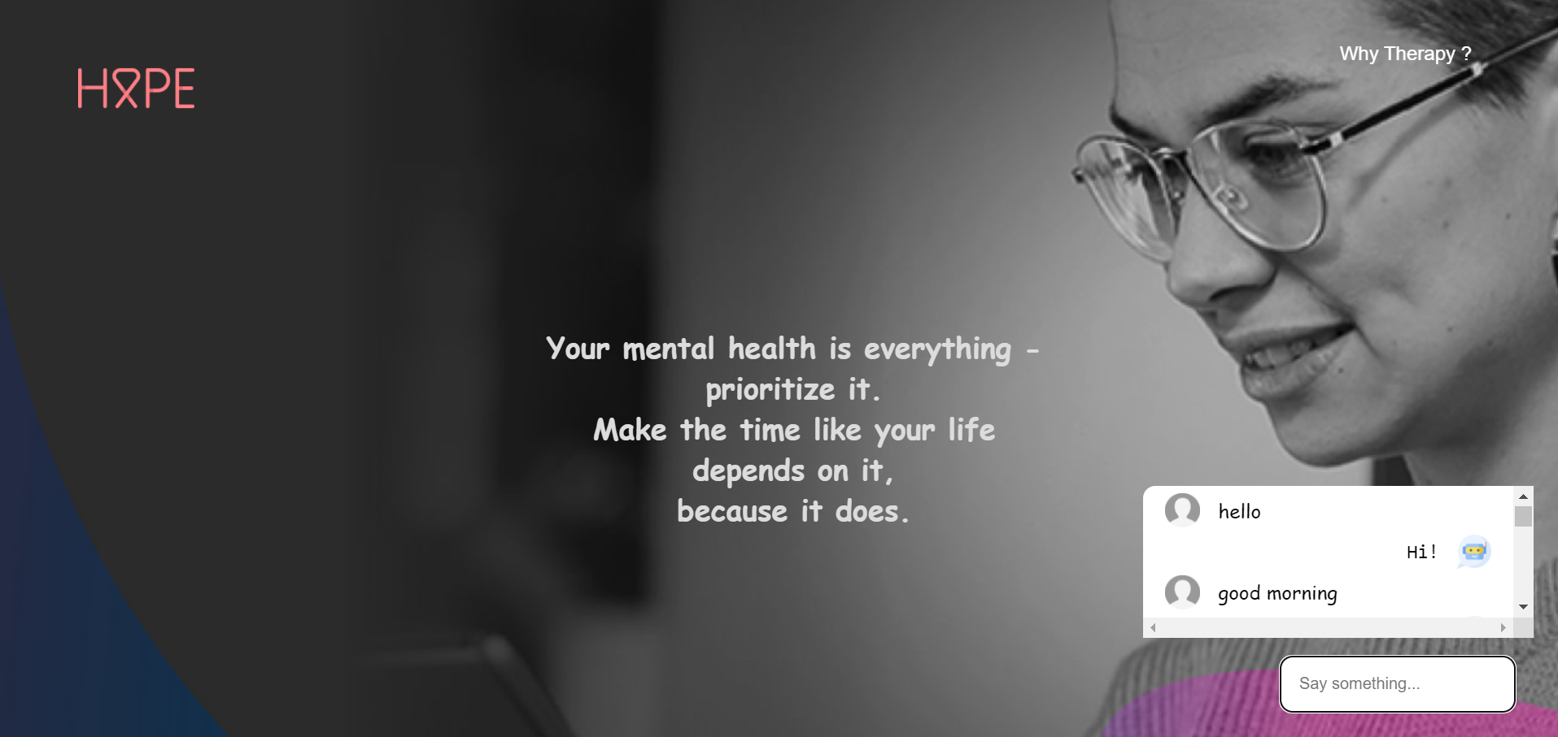
RESULT

Slide 14
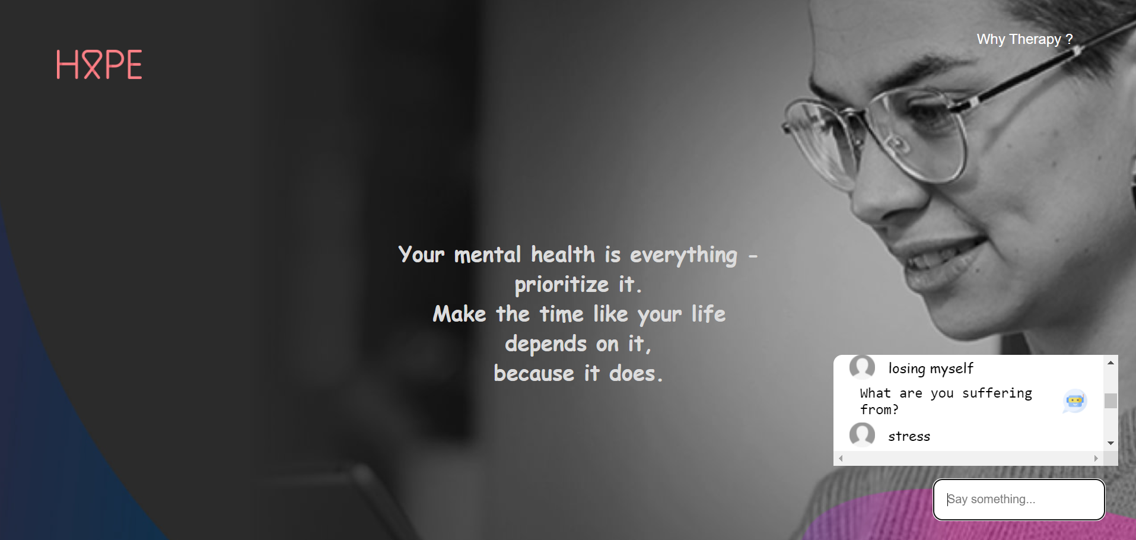

Slide 15


Slide 16
REFERENCES
DOCUMENTATION
Chatbots and Conversational Agents in Mental Health: A Review of the
Psychiatric Landscape.” The Canadian Journal of Psychiatry.
https://journals.sagepub.com/doi/full/10.1177/0706743719828977
Digital Psychiatry - https://ieeexplore.ieee.org/document/8472986
A neural network prediction model for a psychiatric application - https://ieeexplore.ieee.org/document/1540700/citations#citations
CHATBOT
Depression Therapy using Chatbot - https://www.facebook.com/Chatbot.Brad
DATASET
https://www.techwithtim.net
https://archive.ics.uci.edu/ml/datasets/Student+Performance

Slide 17
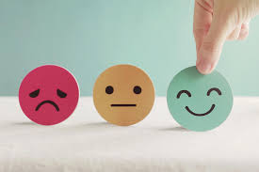
THANKS!
YOU’RE MORE THAN YOUR MENTAL ILLNESS …...

