Slide 1


AN AI-TOOL : HelpyChat
BY :
Lucky Verma (2115800014)
Piyush Upadhyay (2115800020)
Ritika Singh (2115800021)
Mentor : Subodh Srivastava

Slide 2
TABLE OF CONTENTS
Introduction
Features
Benefits
Working
Use Cases
Technologies Used
Conclusion

Slide 3
What is HelpyChat
HelpyChat is an AI chatbot that provides fast and accurate support to users seeking information. Its advanced AI technology quickly understands user input and responds in real-time. HelpyChat's suggestion feature predicts users' questions as they type, reducing errors and ensuring accurate information. This unique feature makes HelpyChat an essential tool for modern customer service. Users can get quick assistance without waiting for a human representative.

Slide 4
Features of HelpyChat
Real-time responses to user input.
Suggestion feature that predicts users' next question as they type and saves it for future use.
Can be integrated with various messaging platforms and websites.
Provides fast and accurate information, reducing the likelihood of errors.
Always available for assistance, eliminating the need to wait for a human representative to become available.

Slide 5
What is Benefits of HelpyChat?
Saves time by providing quick support : HelpyChat's ability to offer real-time responses and predict users' next questions means that users can get the information they need quickly and efficiently, without having to wait for a human representative to become available.
Always available for assistance: HelpyChat is available 24/7, eliminating the need to wait for business hours or for a human representative to become available.
Can be integrated with various messaging platforms and websites: HelpyChat can be integrated with various messaging platforms and websites, making it easy to use for both users and businesses.
Customizable to fit the specific needs of each use case: HelpyChat can be customized to fit the specific needs of each use case, ensuring that it provides the most relevant and useful information to users.

Slide 6
How HelpyChat works?
HelpyChat is a chatbot that uses OpenAI's natural language processing technology to understand and respond to user input.
Here are the key steps in how HelpyChat works:
User sends a message: The user types a message into the HelpyChat interface.
Natural language processing: HelpyChat uses OpenAI's natural language processing technology to analyze the user's message and understand its meaning. This involves breaking down the message into its constituent parts, such as words and phrases, and analyzing their relationships and context.
Intent recognition: Based on the natural language processing analysis, HelpyChat determines the user's intent. For example, if the user asks a question about a product, HelpyChat recognizes the intent as "product inquiry".

Slide 7
How HelpyChat works?
Response generation: HelpyChat generates a response based on the user's intent and any relevant information available. This may involve accessing a database of product information, providing customer support resources, or offering troubleshooting tips.
Response delivery: HelpyChat sends the response back to the user via the chat interface.
Overall, HelpyChat is designed to provide a seamless and intuitive chatbot experience for users, helping them quickly get the information or assistance they need.

Slide 8
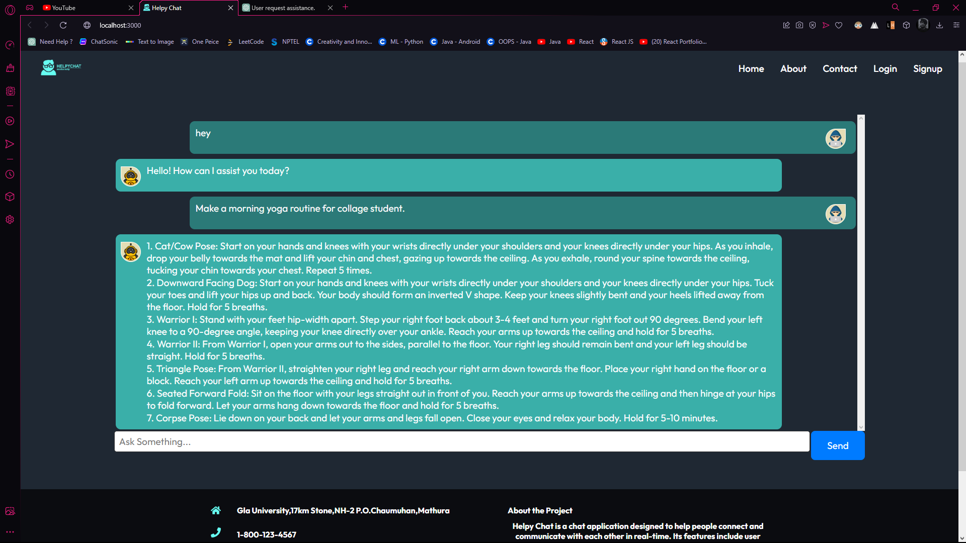

Slide 9
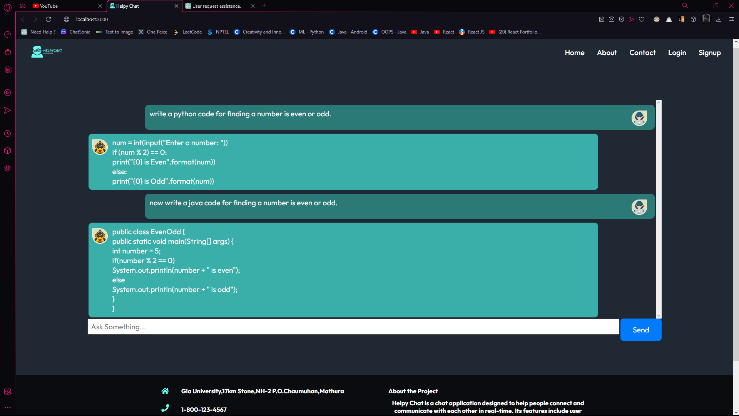

Slide 10
Use Cases for HelpyChat
Customer service
E-commerce
Healthcare
Travel and hospitality
Education
Human resources

Slide 11
Technologies Used :
Front-end : Html, CSS , JavaScript and React
Back-end : Express and NodeJS
Database : Mongo DB

Slide 12
Conclusion
HelpyChat is a cutting-edge AI chatbot that provides fast and accurate support to users seeking information or assistance. Its suggestion feature make it an essential tool for any modern customer service or support system. With its ability to continuously learn from user interactions, HelpyChat can improve its responses over time and become even more effective in providing support. The versatility and customization options of HelpyChat allow it to be used in various industries and scenarios, making it a valuable asset for businesses and organizations of all kinds. Overall, HelpyChat is a powerful tool that can help improve customer satisfaction, increase efficiency, and streamline operations.

Slide 13
Thank You

