Slide 1
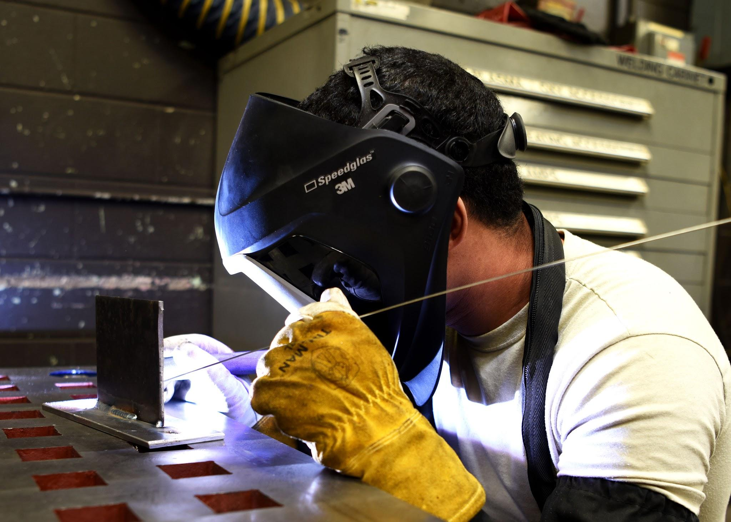


Copyright © 2024 - PartikelART
Industrial Data Science 2
Use Case III
PartikelART Solutions
GROUP 3

Slide 2
Group Details
Group Members
Ananya Pal
Harsh Yadav
Trung Quy Duc Huynh
Saptarsi Bhattacharya
Purvanshi Sharma
Raj Anilbhai Pawar
Mentor
Roman Möhle, M.Sc.
roman.moehle@ips.tu-dortmund.de

Slide 3
Table Of Contents
Introduction
Company Overview
Problem Statement
Solution
Our Approach
Project Flow
Exploratory Data Analysis
Future work
Summary
References

Slide 4
Introduction
Welcome to the use case analysis of PartikelART Solutions GmbH.
Main task is to analyze the challenges faced by PartikelART in technical cleanliness through digital solutions.
Particles within industrial settings can significantly impact product quality, operational efficiency, and overall safety. Therefore, accurate and efficient identification of these particles is important.
Our objective is to explore the details of image segmentation and classification techniques, understand their application in the context of technical cleanliness, and propose innovative solutions

Slide 5
Company Overview
Copyright © 2024 - PartikelART
Welcome to the use case analysis of PartikelART Solutions GmbH, a pioneering company at the forefront of technical cleanliness solutions.
Founded with a mission to digitize all aspects of technical cleanliness and generate knowledge from data, PartikelART combines expertise from the fields of technical cleanliness, industrial engineering, and quality assurance.
With a focus on digitalization, artificial intelligence, and image processing, PartikelART is revolutionizing the way industries approach cleanliness standards and quality control.

Slide 6
Problem Statement
In industries where precision and reliability are crucial, the presence of contaminants such as particles can lead to significant quality issues.
Traditional methods of identifying and mitigating particle sources are often time-consuming, inefficient, and prone to human error.
There is a clear need for innovative solutions that can quickly and accurately analyze cleanliness levels to ensure optimal product quality and operational efficiency.

Slide 7
Solution
Industries require advanced tools and techniques that can provide real-time, actionable insights into cleanliness levels.
To address the challenge of particle analysis, we use.
Pre trained model on our custom dataset.
You Only Look Once (YOLO)
Deep learning model
Convolutional Neural Network (CNN)

Slide 8
Our Approach
Data-driven Approach:
Leveraging existing datasets and real-world insights to inform our analysis and decision-making process.
Image Classification:
Utilizing advanced image processing and artificial intelligence techniques to classify particles and contaminants accurately.
For image processing, we aim to utilize YOLO and CNN models subsequently, and hence attempt to compare the results obtained from each, and finally choose the classification model that classifies the object(s) better. Further, based on the results, we improve the model efficiency, if required.

Slide 9
Project Flow
STEP 1
STEP 2
STEP 3
STEP 4
STEP 5
Data Pre-Processing and Splitting
Training Models
Optimization and Cross-validation
Evaluate Model Performance
Testing & Applications

Slide 10
Exploratory Data Analysis
Image dimensions and aspect ratios (YOLO - 640 x 640 px)
Labels composition
Bounding box sizes
Aspect ratios (for instance a lot of small particles / Overlapping particles)

Slide 11
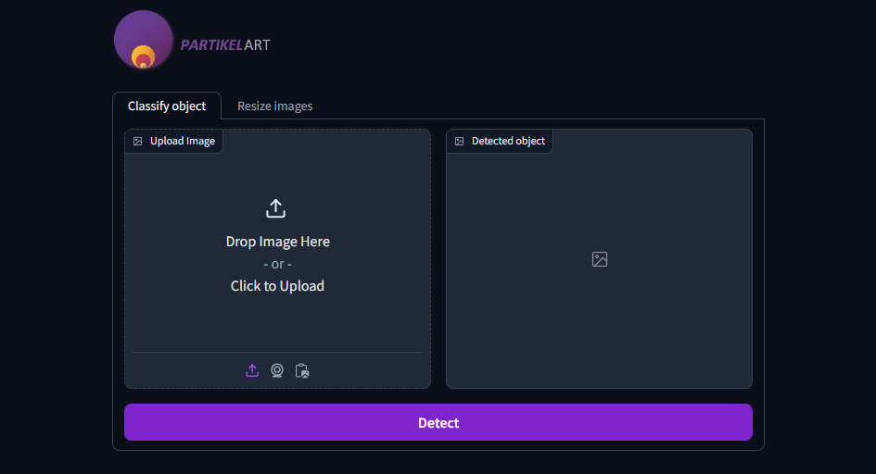
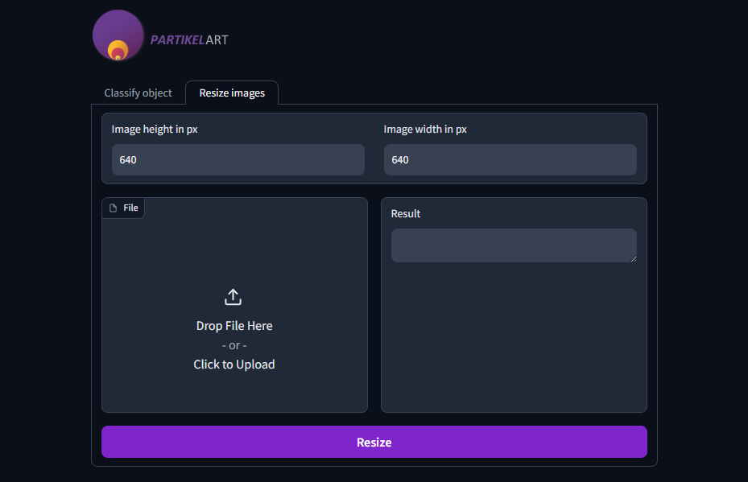
Exploratory Data Analysis

Slide 12
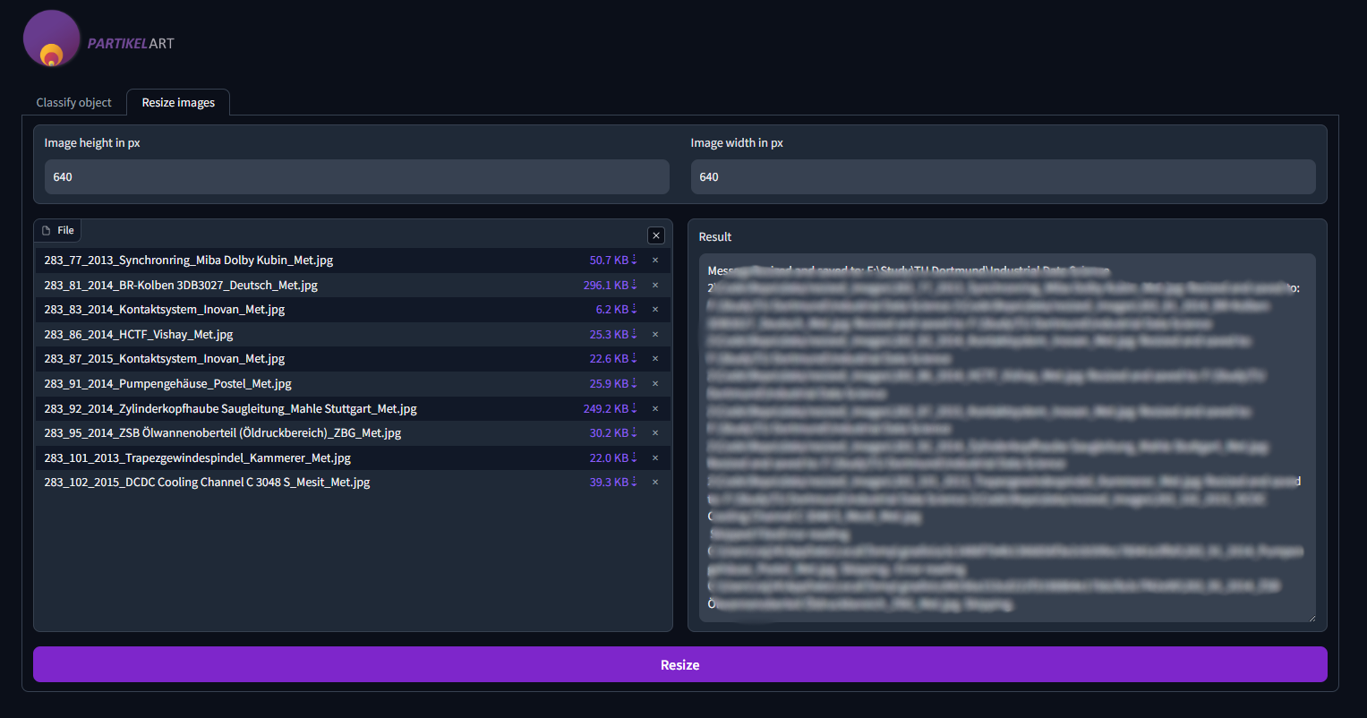
Exploratory Data Analysis

Slide 13
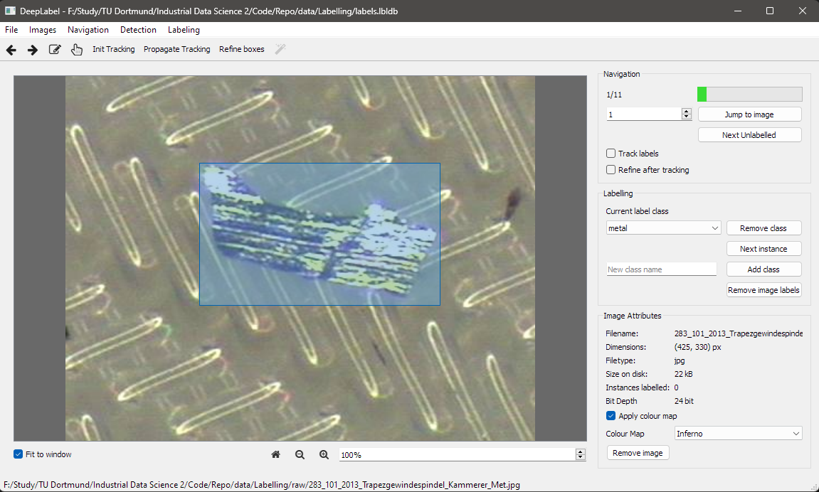
Exploratory Data Analysis

Slide 14
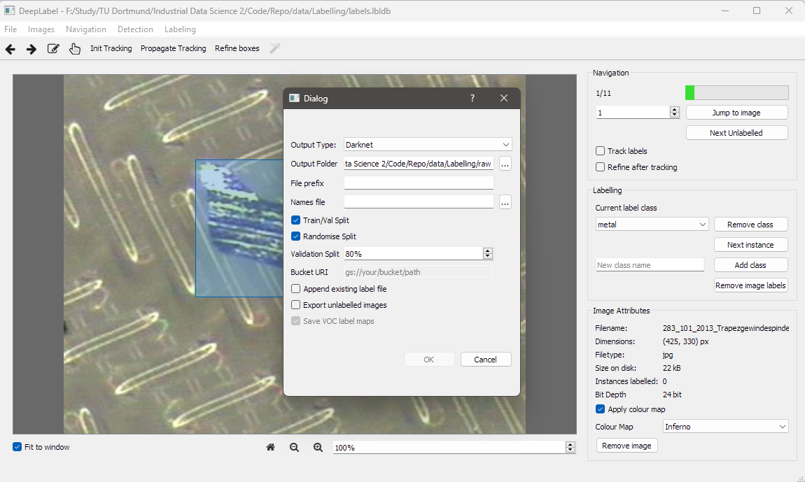
Exploratory Data Analysis

Slide 15
Future Work
Train and assess the results from Yolo and CNN models with tuning of hyperparameters.

Slide 16
Summary
PartikelART Solutions GmbH addresses challenges in technical cleanliness through digital solutions, aiming to identify and mitigate particle contamination affecting product quality, efficiency, and safety.
The problem statement highlights the urgency for innovative solutions to assess cleanliness levels accurately and swiftly, overcoming inefficiencies of traditional methods.
Our approach combines real-time insights with pre-trained models like YOLO and CNNs to analyze cleanliness levels effectively.
We leverage existing datasets for decision-making and enhance model efficiency through exploratory data analysis, focusing on image dimensions, label composition, bounding box sizes, and aspect ratios, particularly emphasizing YOLO's dimensions and particle characteristics.

Slide 17
References
https://opencv.org/
https://www.gradio.app/
jveitchmichaelis/deeplabel: A cross-platform desktop image annotation tool for machine learning (github.com)
Copyright Josh Veitch-Michaelis 2017 - 2024.

Slide 18
Q&A!

