Slide 1
METHOD REFERENCES

Slide 2
-> Method Reference is a shorthand way.
-> New way
Syntax
<class-name or instance name>::<method name>

Slide 3


Lambda expression without method reference.
Lambda expression with method reference.

Slide 4
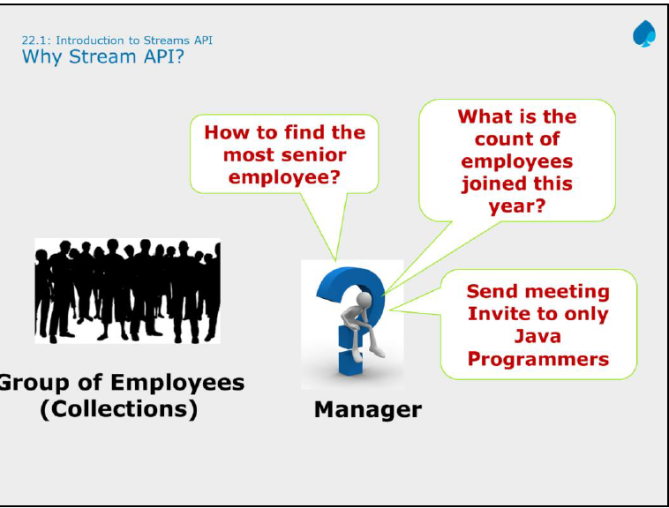

Slide 5

Stream in
Stream out

Slide 6
Stream API Characteristics
Not a data structures:
Designed for lambdas
Do not support indexed access
Can easily be output as arrays or Lists
Lazy
Parallelizable
Can be unbounded

