Slide 1
Linear & Nonlinear Mixed Effects Models
R. Alex Thompson

Slide 2
Quick review of a linear model
Main goal is to fit a regression line through an x,y plane
Extend to higher dimensions (e.g. multiple regression)
ANOVA is most common – fits linear models to categorical grouping variables and asks if they’re different
Linear models rest on an important assumption (among others):
Each observation is independent of the others

Slide 3
What’s meant by linear independence?
A change in one observation has no effect on another observation
P[X=x | Y=y] = P[X=x]

Slide 4
In ecology, linear independence isn’t always acheiveved
Repeated measurements
Monitor the same individual(s) through time
Treatment 1
Treatment 2
Treatment 3
1
4
7
2
5
8
3
6
9

Slide 5
In ecology, linear independence isn’t always acheived
Pseudo-replication
Because individuals are close together, they have some sort of spatial autocorrelation (like treating different branches on the same tree as independent of each other)
Comes up often in field observation studies or landscape-scale manipulations
First identified by Stuart Hurlbert in 1984; Pseudoreplication and the Design of Ecological Field Experiments, Ecol. Monographs
𝝆
- Distance +

Slide 6

Mixed Effects Models provide a convenient way of accounting for statistical violations
$\hat{y}= β_{0}+β_{1}x+ ε$
$\hat{y}= β_{0}+β_{1}x+$ b_{i}$+ ε$
Fixed vs. Random effects
Fixed effects are deterministic elements
These are a function of the observations (x,y)
Random effects represent an underlying structure not directly accounted for (i.e., individual or group-level variances)
intercept
slope
error
intercept
slope
Random effect
error

Slide 7
Marginal vs. Conditional Probabilities
Marginal probabilities basically imply we are only looking at a single variable – 1-dimensional perspective
X

Slide 8
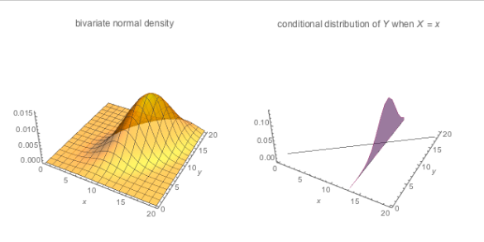
Marginal vs. Conditional Probabilities
Conditional probabilities let us ask how probabilities of observing a single variable change, given an observation from another variable that is not independent of X – n-dimensional perspective
If you don’t account for this ”random” effect, you’ll have biased results

Slide 9
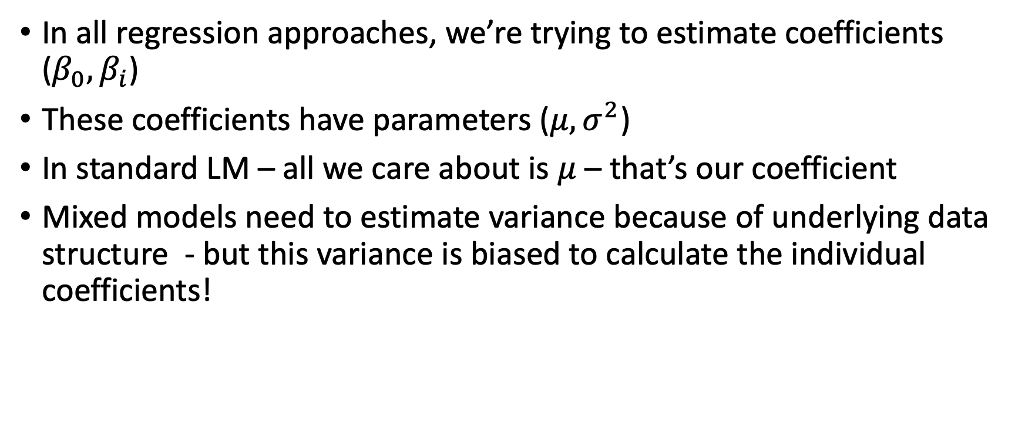
Mixed effects models improve parameter estimates
In all regression approaches, we’re trying to estimate coefficients ($β_{0},β_{i}$)
These coefficients have parameters ($μ,σ^{2}$)
In standard LM – all we care about is $μ$ – that’s our coefficient
Mixed models need to estimate variance because of underlying data structure - but this variance is biased to calculate the individual coefficients!

Slide 10
Mixed effects models improve parameter estimates
If I can correctly estimate parameters for each individual, I can then condition on these random effects
Conditioning = unbiased estimates of the overall response
LMMs take conditional probabilities of our random effects to get unbiased variance estimate
Read more at: https://towardsdatascience.com/maximum-likelihood-ml-vs-reml-78cf79bef2cf

Slide 11
Mixed Models in R
Linear Mixed Effects Models
Generalized Linear Mixed Effects Models
General Estimation Equations

Slide 12
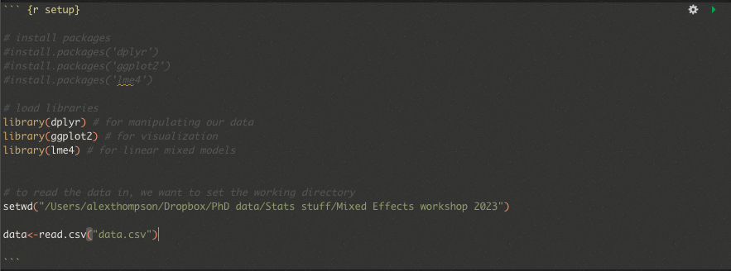
Getting started
Uncomment this section and run if you need to install these packages
Load the libraries so that we can use them
Finally, set working directory and read in the toy data

Slide 13

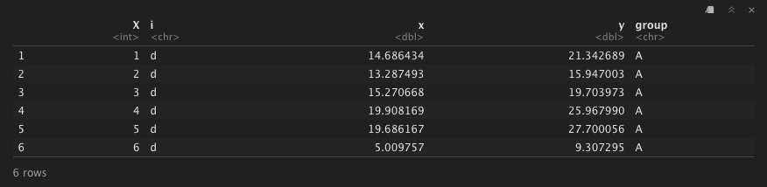
Let’s take a look at the data
A column of ID’s that correspond to each unique individual in the study
A grouping variable (i.e., treatment, site, etc.)
An independent variable
A dependent variable

Slide 14
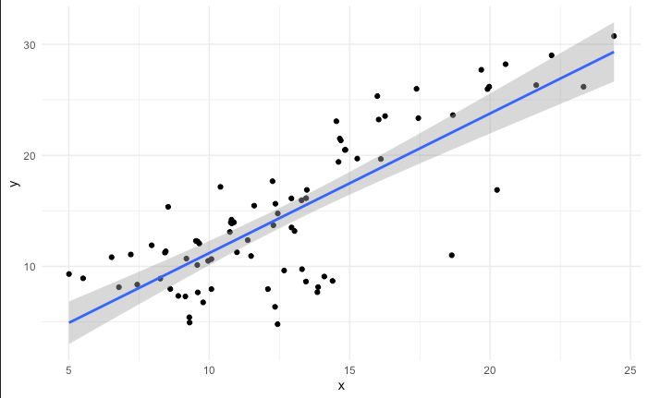

Slide 15
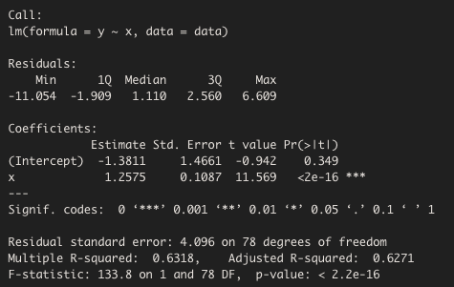

Slide 16
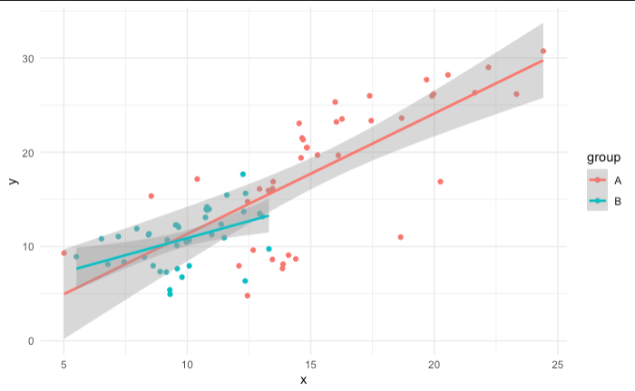

Slide 17
ANOVA
Are our groups different?

Slide 18

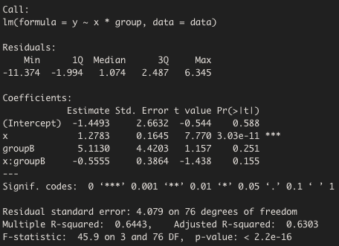
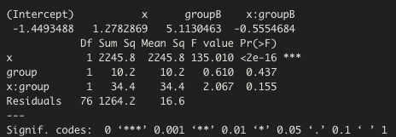
ANOVA
Are our groups different?

Slide 19
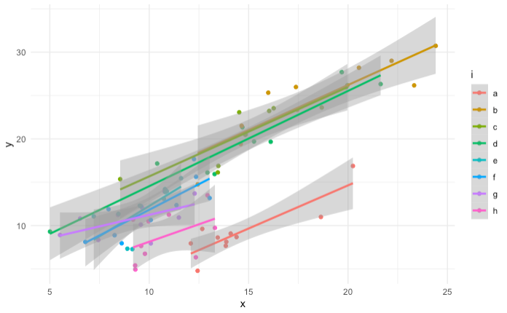

Slide 20
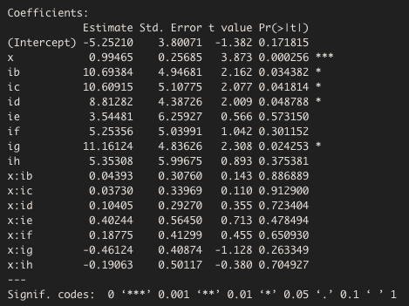
ANCOVA
Are our groups different, after accounting for some covariate?
No effect?

Slide 21
Why does ANCOVA say that interactions are not different, when they clearly are different?

Slide 22
Assumptions of ANCOVA
The covariate is numerical (ours is categorical)
Covariate and independent variable are independent
All the slopes are the same

Slide 23
Linear Mixed Effects Models
Takes fixed and random inputs
Like an ANCOVA, but we can specify slope and intercept (hence, the “random” part)

Slide 24
Linear Mixed Effects Models in R
fixed effect
Model name
Random effect
(1|random effect) says this is a random intercept model
Mixed effects model function from LME4

Slide 25
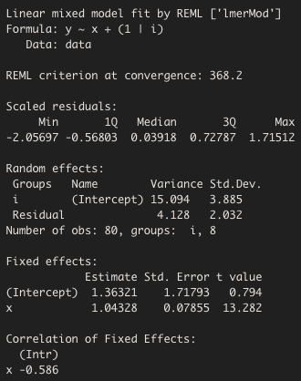
Mixed effects models are marginal estimates of the x,y relationships
All the variance in our model intercepts that are due to individual-level variation
Updated intercept & slope estimate after getting rid of all that extra individual variance

Slide 26
Mixed effects models are conditional estimates of the x,y relationships

Slide 27

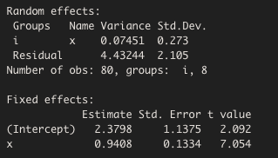
But what if the slopes are allowed to vary?

Slide 29

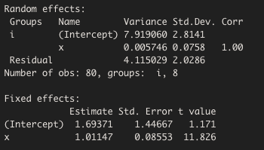
Slope + intercept random effect

Slide 30
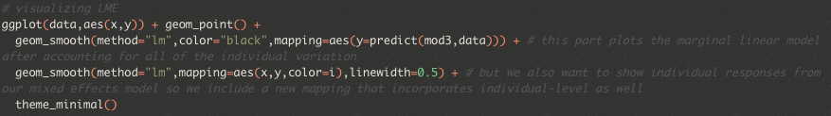
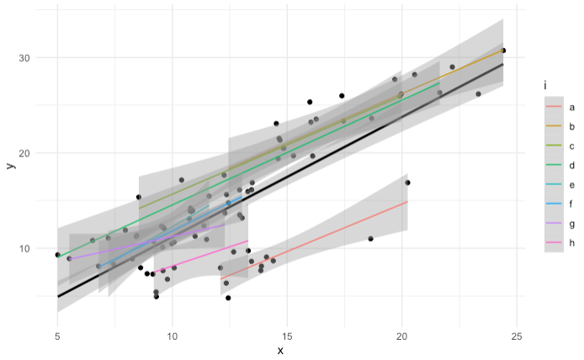
Visualizing mixed effects models

Slide 31
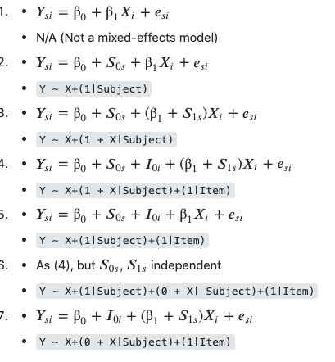

LMER syntax cheatsheet
Simple linear model
Mixed effects w/ random intercept
Mixed effects w/ random intercept & slope
Mixed effects w/ 2 random intercepts & 1 random slope
Mixed effects w/ 2 random intercepts & 1 random slope
Mixed effects w/ 1 random intercepts & 1 random slope

Slide 32
Generalized Linear Mixed Effects Models
When data is count or binomial data, we use generalized mixed effects models
Global change type drought kills trees frequently
Question: are some stands on Moscow mountain more vulnerable to drought-induced tree mortality than others?
Hypothesis: Trees near recently logged sites (exposed) will have more mortality than trees in closed stands or near streams
Methods: Set up 3 study sites and every month for 5 years, we count the number of dead trees
How do we test if sites are different?
Obvious spatial autocorrelation / pseudoreplication
Repeated measures
Temporal autocorrelation

Slide 33

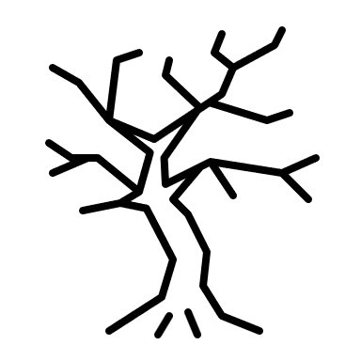
Generalized Linear Mixed Effects Models

Slide 34

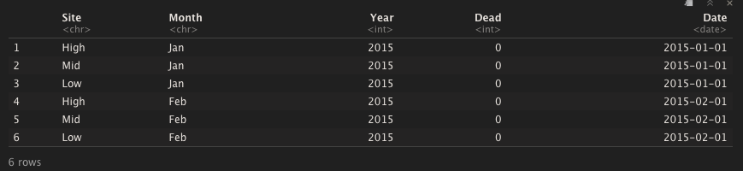
Taking a look at the data

Slide 35
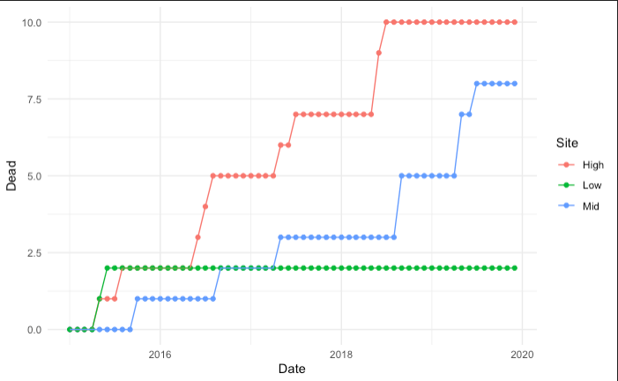
Tree mortality increases with time
More trees are dying in the high exposed plot than the other plots

Slide 36

What’s a generalized linear model?
Normal linear regression (even linear mixed effects models) assume the y variable is continuous (normal distribution)
Uses discrete distributions (poisson, negative binomial) to model discrete processes like count data
$$\ln{λ= β_{0}+β_{1}x}$$
$$y \sim Poisson(λ)$$

Slide 37

What’s a generalized linear model?
Normal linear regression (even linear mixed effects models) assume the y variable is continuous (normal distribution)
Uses discrete distributions (poisson, negative binomial) to model discrete processes like count data
$$\ln{λ= β_{0}+β_{1}x}$$
$$y \sim Poisson\left(λ\right)$$
$$y \sim Poisson(e^{β_{0}+β_{1}x})$$

Slide 38

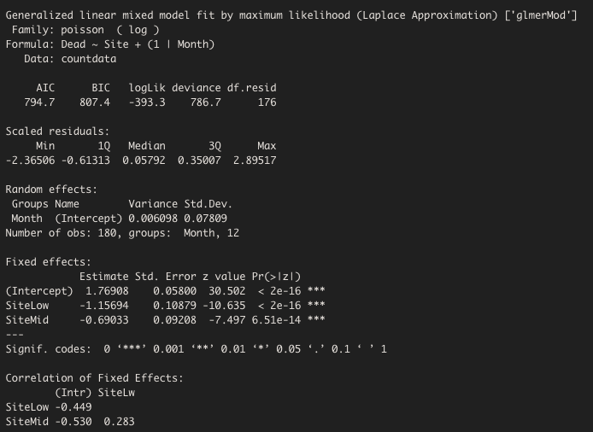
Fitting GLMs to our data in R

Slide 39

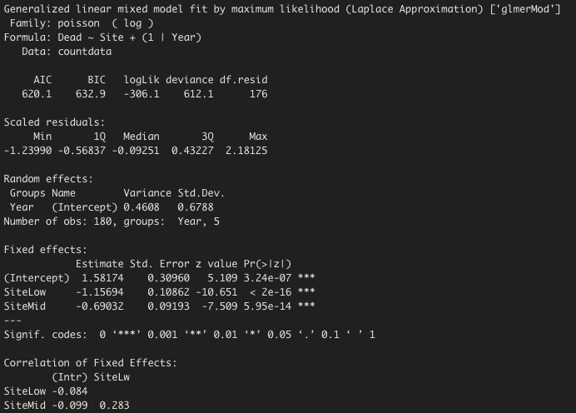
Fitting GLMs to our data in R

Slide 40

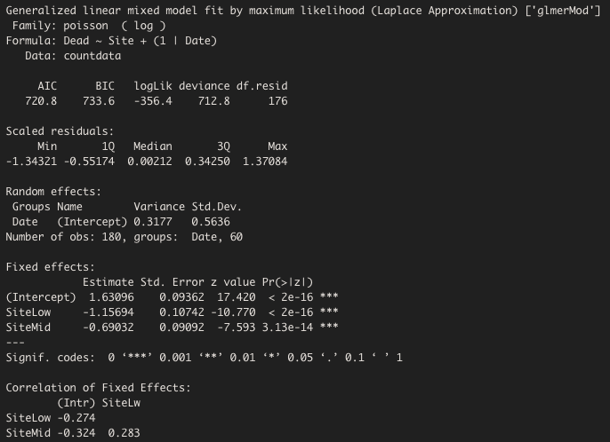
Fitting GLMs to our data in R

Slide 41
Akaike Information Criterion
Models should balance complexity with descriptive capacity
Assigns lower values to better models
Relative comparison – absolute values are meaningless outside of context
Month is random
Year is random
Date is random

Slide 42
Month is random
Year is random
Date is random

Slide 43
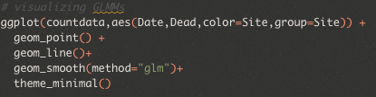
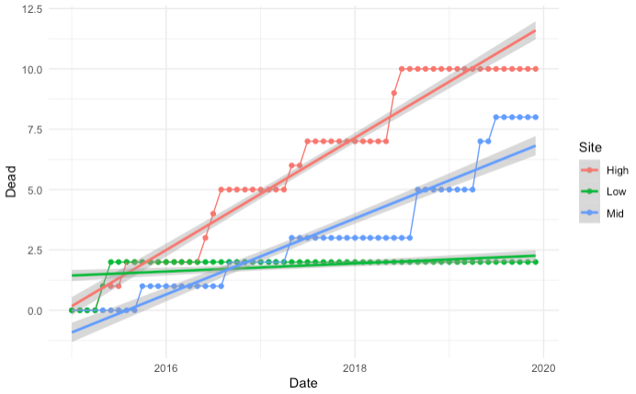
Visualizing GLMM

Slide 44
General Estimation Equations
What if we don’t care what each sub-group is doing, but we want to get rid of that underlying structure from our model?
GEE gives us the marginal parameter estimates, after removing the effect of group-level variance

Slide 45
General Estimation Equations

Slide 46
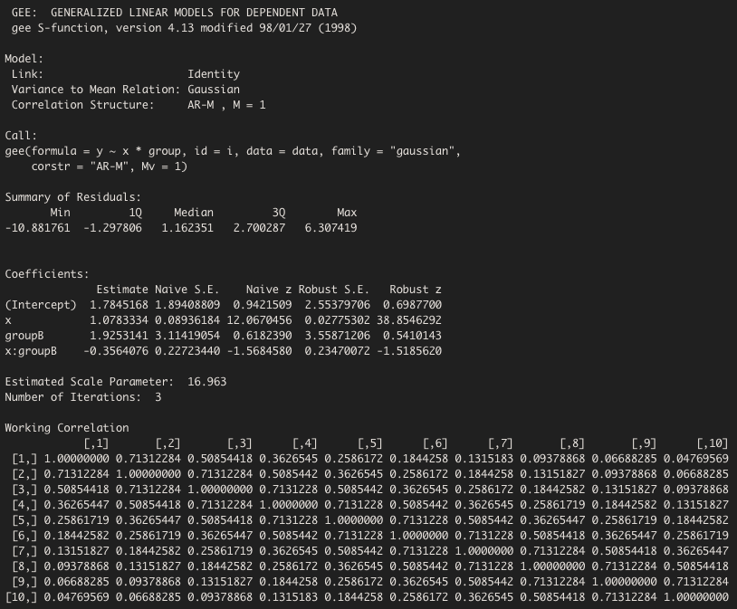
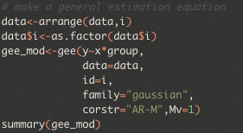
General Estimation Equations
Robust S.E. is robust! When N is large, this estimate is very good
When N is small, this tends to be an underestimate of the true standard error
What you’d get with a GLM

Slide 47
GEE
vs
LME

Slide 48



Review of linear models
$\hat{y}= β_{0}+β_{1}x+ ε$
Y
$$β_{1}$$
intercept
slope
error
$$β_{0}$$
X

Slide 49
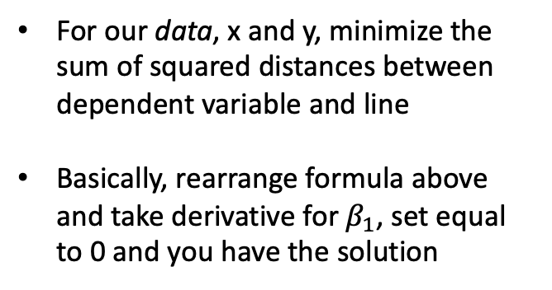
Review of linear models
$\hat{y}= β_{0}+β_{1}x+ ε$
Y
$$β_{1}$$
intercept
slope
error
For our data, x and y, minimize the sum of squared distances between dependent variable and line
Basically, rearrange formula above and take derivative for $β_{1}$, set equal to 0 and you have the solution
$$β_{0}$$
X

Slide 50
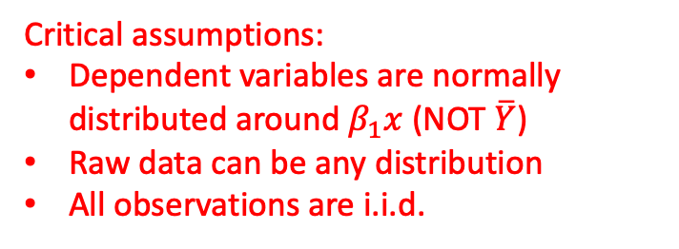

Review of linear models
$\hat{y}= β_{0}+β_{1}x+ ε$
Y
$$β_{1}$$
$$\hat{y}$$
intercept
slope
error
Critical assumptions:
Dependent variables are normally distributed around $β_{1}x$ (NOT $\overline{Y}$)
Raw data can be any distribution
All observations are i.i.d.
$$β_{0}$$
X

Slide 51
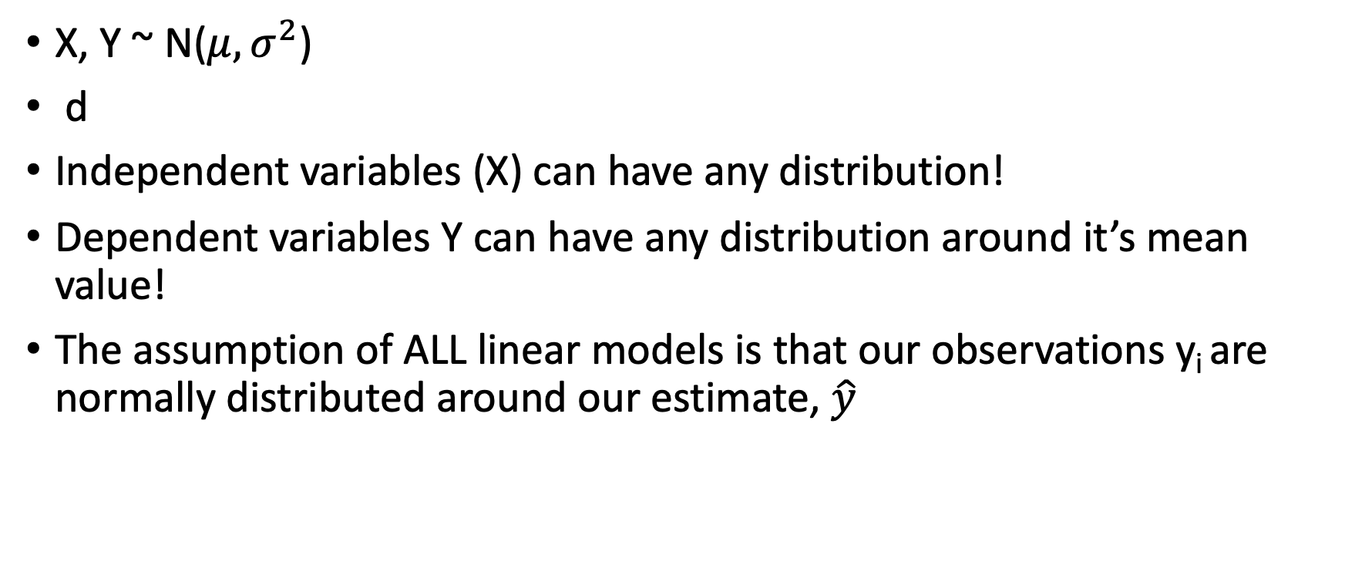
A quick note on normality assumptions
X, Y ~ N($μ,σ^{2}$)
d
Independent variables (X) can have any distribution!
Dependent variables Y can have any distribution around it’s mean value!
The assumption of ALL linear models is that our observations y_{i} are normally distributed around our estimate, $\hat{y}$

Slide 52



Normality assumptions are theoretical, and pretty damned robust
$$∞$$
y_{min}
$$\hat{y}$$
y_{max}
$$∞$$

Slide 53
Instead of testing that our data is normally distributed, we should test that our model residuals are normal(-ish)
$$∞$$
y_{min}
$$\hat{y}$$
y_{max}
$$∞$$

Slide 54
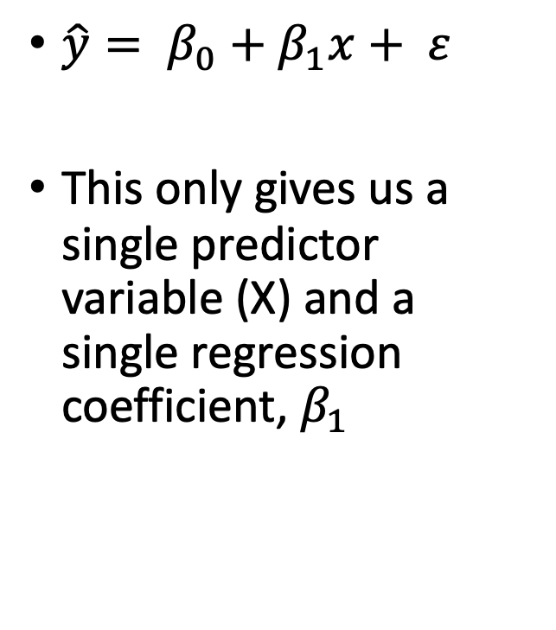
Why mixed effects models?
$\hat{y}= β_{0}+β_{1}x+ ε$
This only gives us a single predictor variable (X) and a single regression coefficient, $β_{1}$
Y
$$β_{0}$$
X

Slide 55
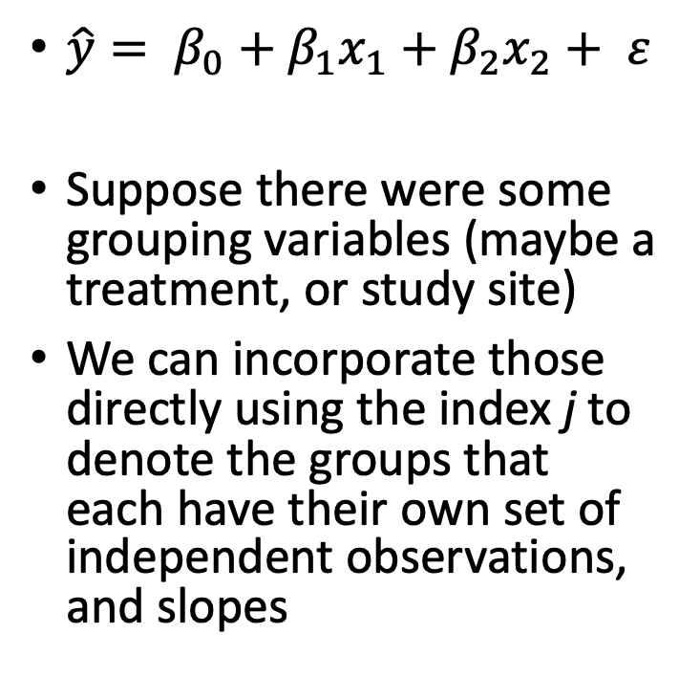
Why mixed effects models?
$\hat{y}= β_{0}+β_{1}x_{1}+β_{2}x_{2}+ ε$
Suppose there were some grouping variables (maybe a treatment, or study site)
We can incorporate those directly using the index j to denote the groups that each have their own set of independent observations, and slopes
g₁
Y
g₂
$$β_{0}$$
X

Slide 56
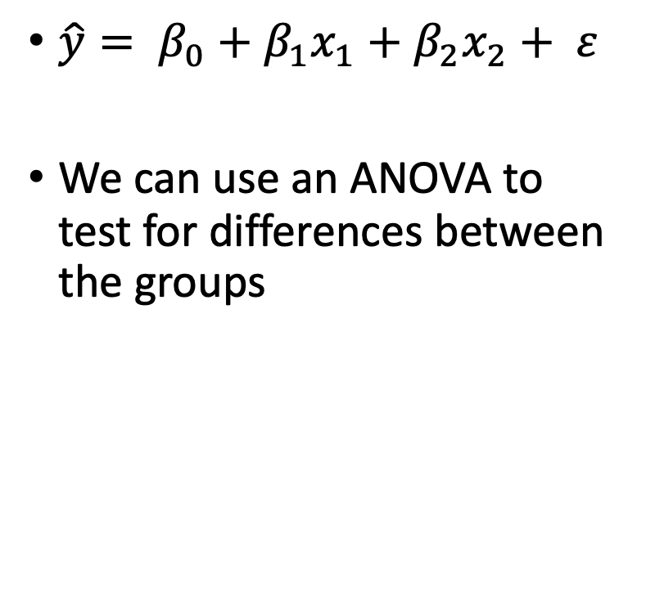
Why mixed effects models?
$\hat{y}= β_{0}+β_{1}x_{1}+β_{2}x_{2}+ ε$
We can use an ANOVA to test for differences between the groups
g₁
Y
g₂
$$β_{0}$$
X

Slide 57


ANOVA requires observations be statistically independent
g₁
Y
Y
g₂
$$β_{0}$$
X
$$β_{0}$$
X

Slide 58
How do we account for this to yield accurate parameter estimates?
g₁
Y
Y
g₂
$$β_{0}$$
X
$$β_{0}$$
X

Slide 59
Repeated-Measures ANOVA

Slide 60
Independent models are only viable when the # of individuals is small

Slide 61

What is a mixed-effects model?
$\hat{y}= β_{0}+β_{1}x_{1}+β_{2}x_{2}+ ε$ (linear model)
${\hat{y}}_{i,j}= γ_{0,j}+γ_{i,j}x_{i,j}+γ_{i,j}x_{i,j}+ ε$
Model takes into account variation within all observation (each i-th observation) within each group (the j-th individual)
Parameter estimate varies by grouping variable (individual)
intercept term is now random
Slope is random by group (individual)

Slide 62
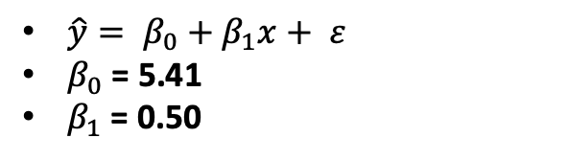
Example: Simulated Data
$\hat{y}= β_{0}+β_{1}x+ ε$
$β_{0}$ = 5.41
$β_{1}$ = 0.50

Slide 63
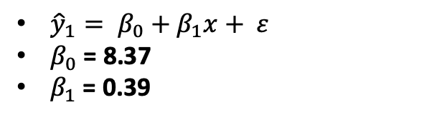
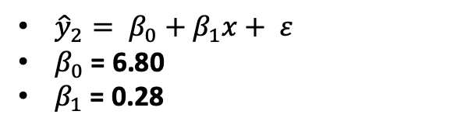
Example: Simulated Data
${\hat{y}}_{1}= β_{0}+β_{1}x+ ε$
$β_{0}$ = 8.37
$β_{1}$ = 0.39
${\hat{y}}_{2}= β_{0}+β_{1}x+ ε$
$β_{0}$ = 6.80
$β_{1}$ = 0.28
Do this with code here…

Slide 64
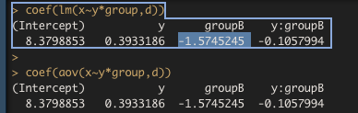

Example: Simulated Data

Slide 65
5 Assumptions of Analysis of Covariance
The regression is linear
Error variance is homogeneous
Error is independent
Error is normally distributed
Equal slopes

Slide 66
Linear Mixed Effects Models
Slopes & intercepts are treated as random variables
We can also account for repeated measures (lack of independence)

Slide 67
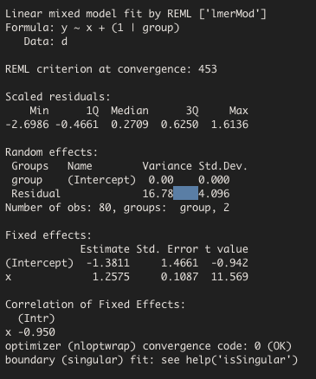
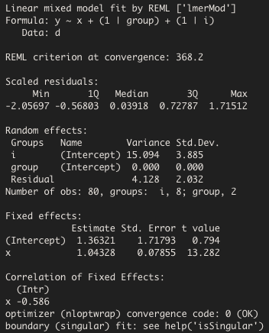
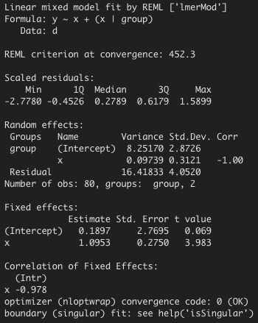
Results….
mix1
mix2
mix3

Slide 68
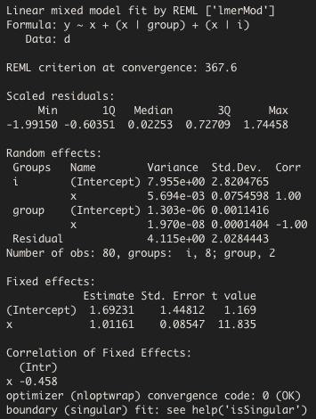
Results….
mix4

Slide 69
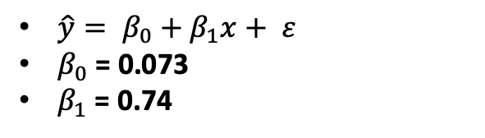
Example: Simulated Data
$\hat{y}= β_{0}+β_{1}x+ ε$
$β_{0}$ = 0.073
$β_{1}$ = 0.74

Slide 70
Repeated Measures ANOVA

Slide 71
ANOVA requires observations be statistically independent
Y
$$β_{0}$$
X

Slide 72
Why mixed effects models?
Mixed effects models essentially let us account for individual variation inside of the model
These are the “random effects” in a mixed effects model
Y
$$β_{0}$$
X

Slide 73
Questions?

