Slide 1

Final Presentation
By: Russell Ballard and Alonso Romero

Slide 2

The Data Set
Kaggle: https://www.kaggle.com/datasets/tysonpo/ice-cream-dataset/data
4 brands:
Ben & Jerry’s, Häagen-Dazs, Talenti, and Breyers
Contains two datasets:
Products: 241 data points
brand, key, name, subhead, description, rating, rating_count, ingredients
Reviews: 21,674 data points
brand, key, author, date, stars, title, helpful_yes, helpful_no, text, ingredients, texture, likes

Slide 3
The Data Set
Important points to note from author of dataset:
“The collection of reviews on the brand websites may not be representative of overall opinion, i.e. there may be review censoring or presence of fake reviews meant to help/harm the image of the brand” (Pond, 2020)
To combat this, the author, “intentionally chose brands that host some negative reviews on their website” (Pond, 2020)
Unilever owns Ben & Jerry’s, Breyers, and Talenti
Froneri owns Häagen-Dazs
“Talenti is distinguished from the other brands as they produce gelato” (Pond, 2020)

Slide 4

Data Analysis Question
Should Breyers introduce a new product of a flavor that would outperform their competitors, or improve an existing product to help boost their average rating?
Is ingredient content a useful predictor for Review Star Ratings?

Slide 5

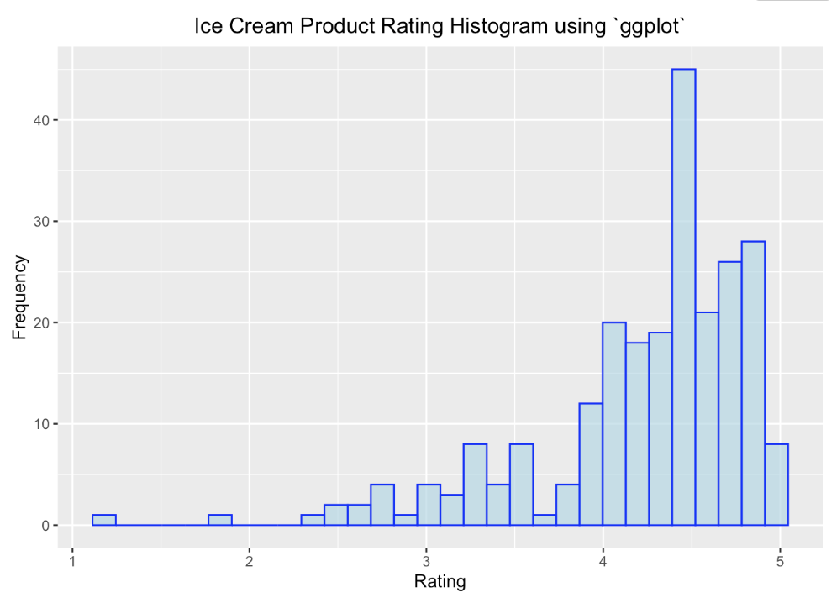
Exploratory Data Analysis
Based on this histogram, we see the overall ratings of all products across the 4 brands of ice-cream

Slide 6
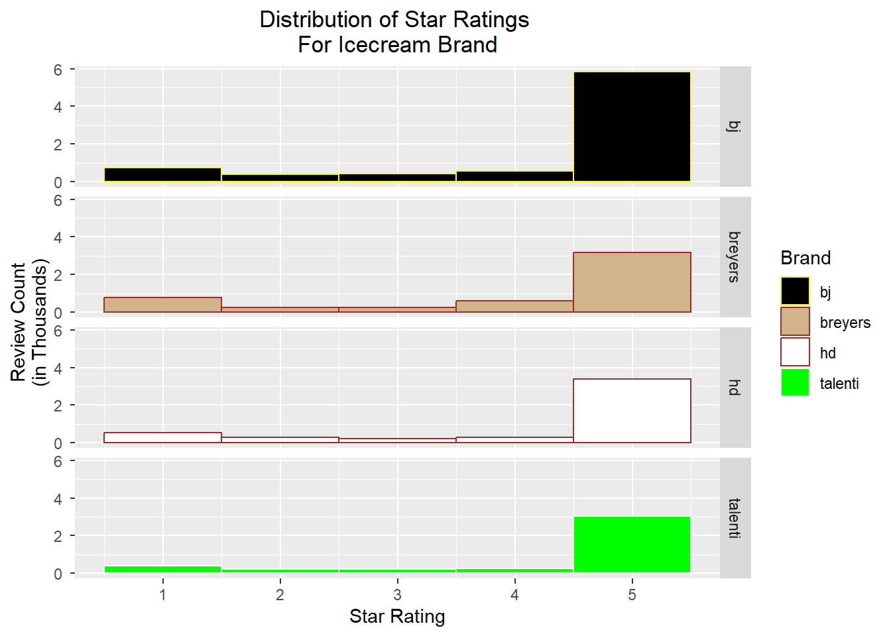
Exploratory Data Analysis
This faceted histogram confirms the annotators note that all the brands have a suspicious preponderance of 5 stars.
Breyers appears to have higher counts of non-5 star ratings and may be a more interesting candidate for further analysis.

Slide 7
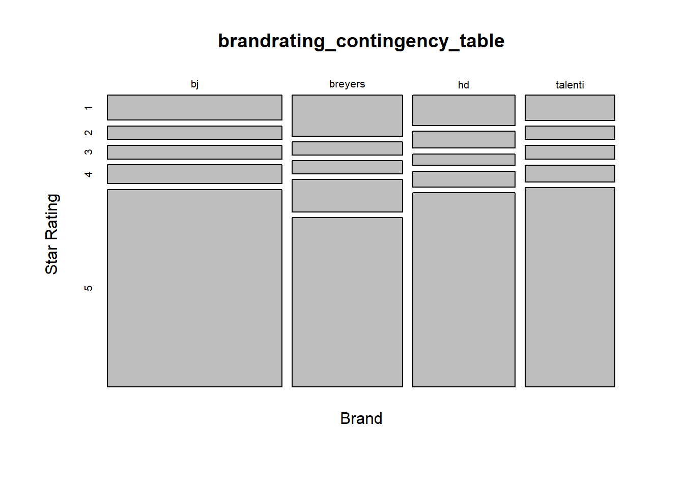
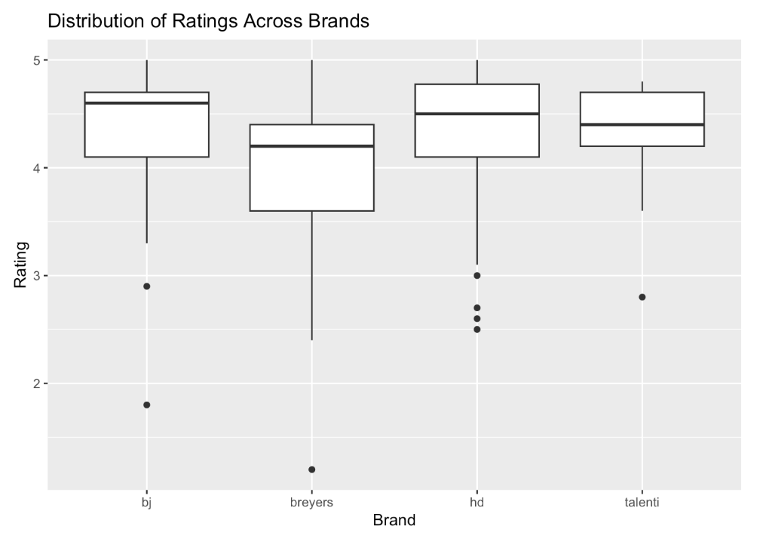
Exploratory Data Analysis
Another view of the brands-ratings. We see again that proportionally Breyers has a larger number of non-5 ratings than the others.

Slide 8
Mixed Model MCA-LDA
Feature Engineering Using
Multiple Correspondence Analysis
Multiple Classification Using
Linear Discriminant Analysis

Slide 9
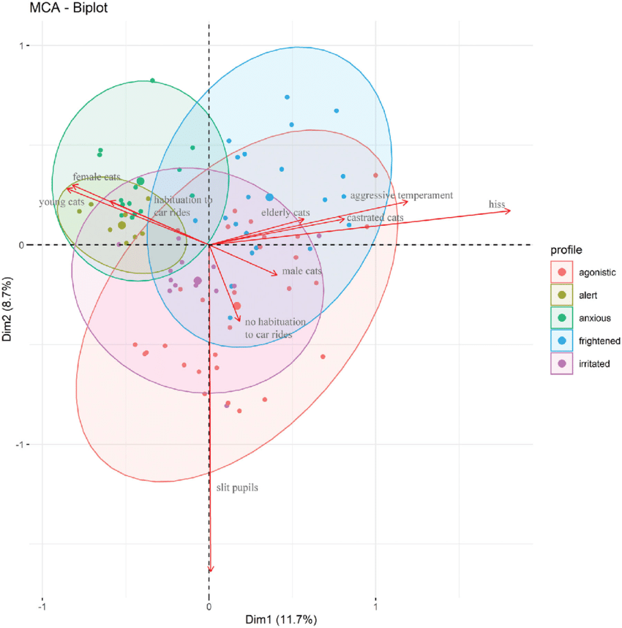
MCA Overview
Similar to PCA but applied to categorical variables.
Developed in the 1970s-80s as “homogeneity analysis”
For our icecream analysis we apply this method to reduce dimensionality of icecream ingredient content factors (~400 discrete ingredients) to 5 dimensions
(Sample MCA Biplot)

Slide 10
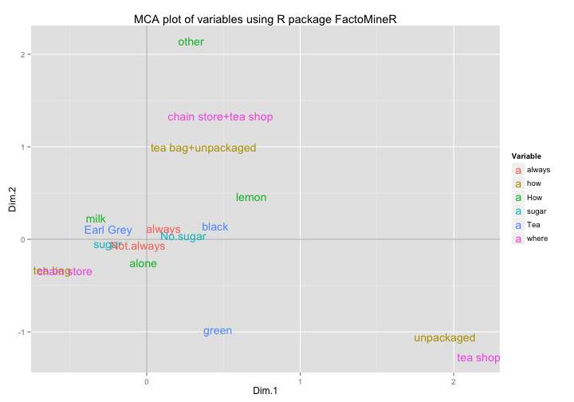
MCA in R - FactoMineR
In the course of project literature review, I encountered a blog maintained by UCBerkeley lecturer Gaston Sanchez.
He notes the robust features of the FactoMineR library and demos application to the tea sample dataset.
FactoMineR was written by François Husson, Julie Josse, Sébastien Lê and is maintained by Institut Agro Rennes-Angers
Issues were identified in the package, to be discussed in later slides.
(MCA plot using FactoMiner by Gaston Sanchez)

Slide 11
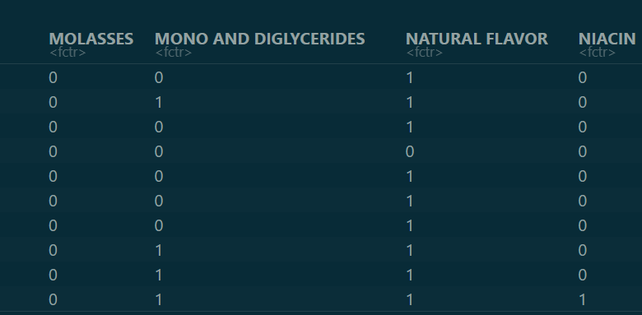
MCA in R - Preprocessing
In order to apply MCA to the data, the Ingredients field of the products training dataset was stripped of special characters, then tokenized with comma delimiting and further standardized with a manually prepared dictionary.
These vectors were converted to a one-hot encoded matrix of ingredient contents for each Breyers ice cream.
Ingredients which were present in only the training or test data were removed from consideration in order to ensure valid cross products in the prediction operation in FactoMineR. Admittedly, this will be a cause of model overfitting, but necessary in this case.

Slide 12
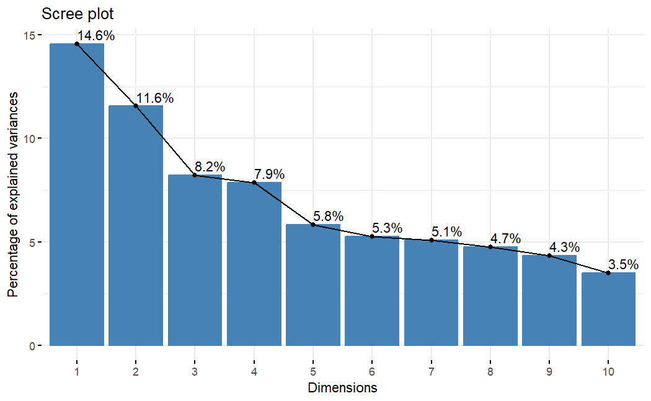
MCA in R - Fit
Applying MCA to the ingredients one-hot encoded matrix yields the facing scree plot.
We can see that roughly half of the variance in ingredient content can be reduced to 5 numeric features.
(MCA plot using FactoMiner by Gaston Sanchez)

Slide 13
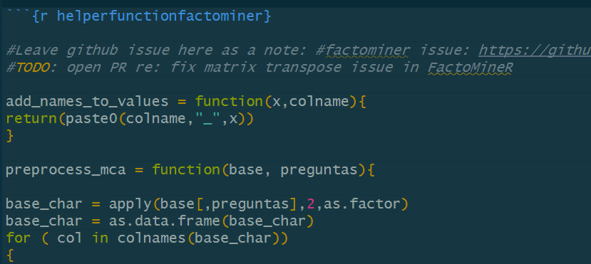
MCA in R - Predict ( And Uncovered Issues)
In the course of this analysis there were unexpected issues in the application of FactoMineR functions (somewhat unexpectedly as FactoMiner is accepted to CRAN)
With the inclusion of helper functions which aide in transposing the factor-matrix of the test data, we were able to successfully apply the trained MCA model to the test product-ingredient subset.
(Helper functions found in GitHub FactoMineR Issue.)

Slide 14
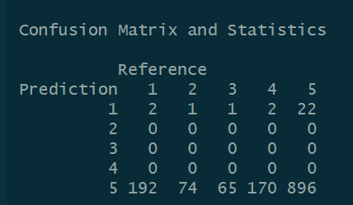
LDA With Engineered Features
Use dimension reduction feature engineering (MCA)
Apply these features to the Reviews data in a Linear Discriminant Analysis
Fit a model correlating ingredient content and rating.
(Fitted LDA Confusion Matrix on test set.)

Slide 15
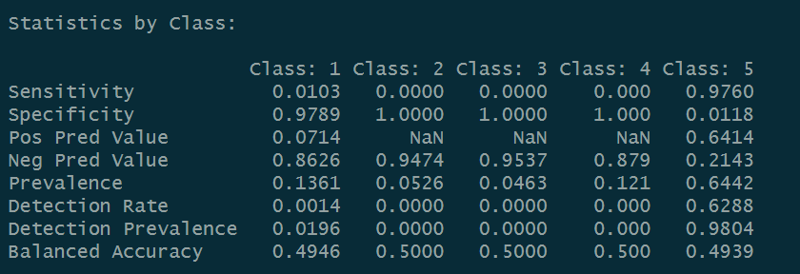
LDA With Engineered Features - Cont
Overall Model Accuracy: 63% , p-value of model 0.872 indicates not significant with these factors
Model sensitivity for ‘middle’ factors with low absolute counts is low, unable to predict these factors due to uneven factor weights.
Model will not misallocate into these middle classes. This bimodality and uneven feature weights proves itself to be intrinsic to the data and model

Slide 16

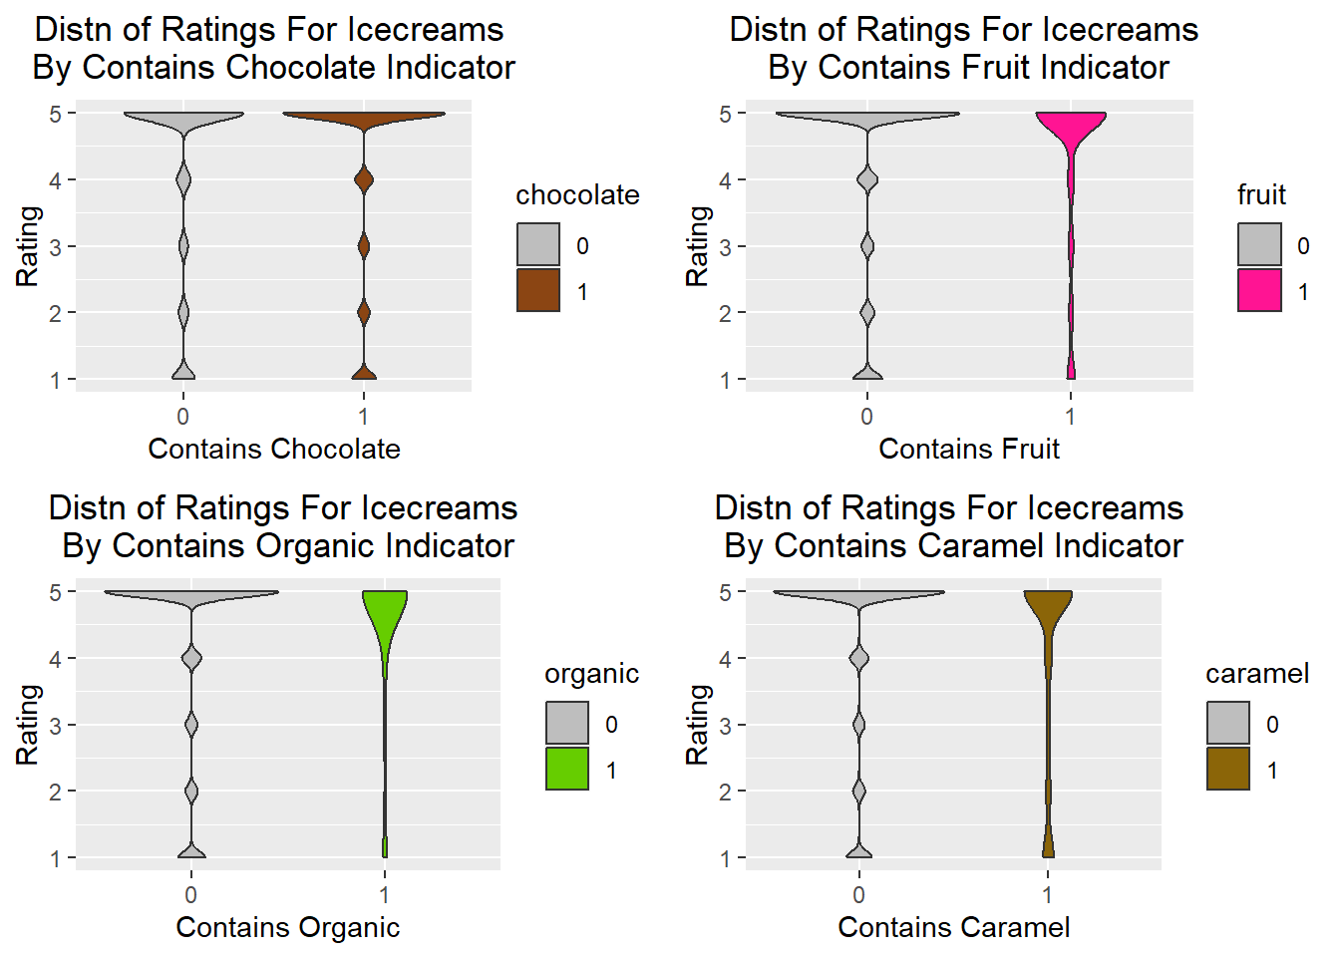
Ingredient Content
Here we see violin charts for prepared ingredient indicators.
These indicator variables were created using grepl
We see that the distributions for chocolate/non are similar, but there are differences in the others.

Slide 17
Modeling
In order to seek the answer to our data analysis question, we decided to create a linear regression model.
Rating ~ Brand + HAS_CARAMEL + HAS_CHOCOLATE + HAS_FRUIT + HAS_VANILLA + HAS_ORGANIC + IS_BAR

Slide 18
Modeling
Subsetting products across from all 4 brands with a 5 star rating, we get 8 products that achieved this high rating.
Out of the 8 products, we can see what ingredient group the product falls into:
Caramel: 1
Chocolate: 7
Fruit: 1
Vanilla: 6
Organic Ingredients: 0
Bar: 2
With this in mind, we can test our model for the best combination of ingredients

Slide 19
Model Testing
We conducted tests of different ingredient combinations in order for Breyers to achieve a high rating.
Out of all the combinations, the following results in the highest possible rating that the model can achieve, 4.35
Chocolate
Fruit
Organic Ingredients
Bar

Slide 20
Model Testing
Should Breyers improve an existing product to boost its ratings?
No, with the predicted results of the model, the results show that the ratings were rated lower than the ratings that Breyers achieved previously
Therefore, Breyers should introduce a new product

Slide 21
New Product Introduction
To make the new product, we needed to see the products that has the highest rating and take note of the ingredients
The specific products we will take a closer look at are Breyers Chocolate Ice Cream, Breyers Raspberry Cheesecake Gelato Indulgences, and Talenti’s Organic Chocolate Mousse Gelato
Breyers does not produce products with organic ingredients, Talenti was the only brand that produces organic products so we will base this ingredient group from them
For bar products, we have grouped all of Breyers bar products and extracted the most common ingredients for consideration

Slide 22
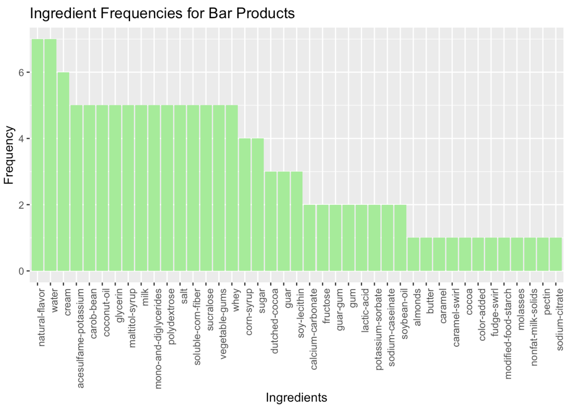
New Product Introduction

Slide 23
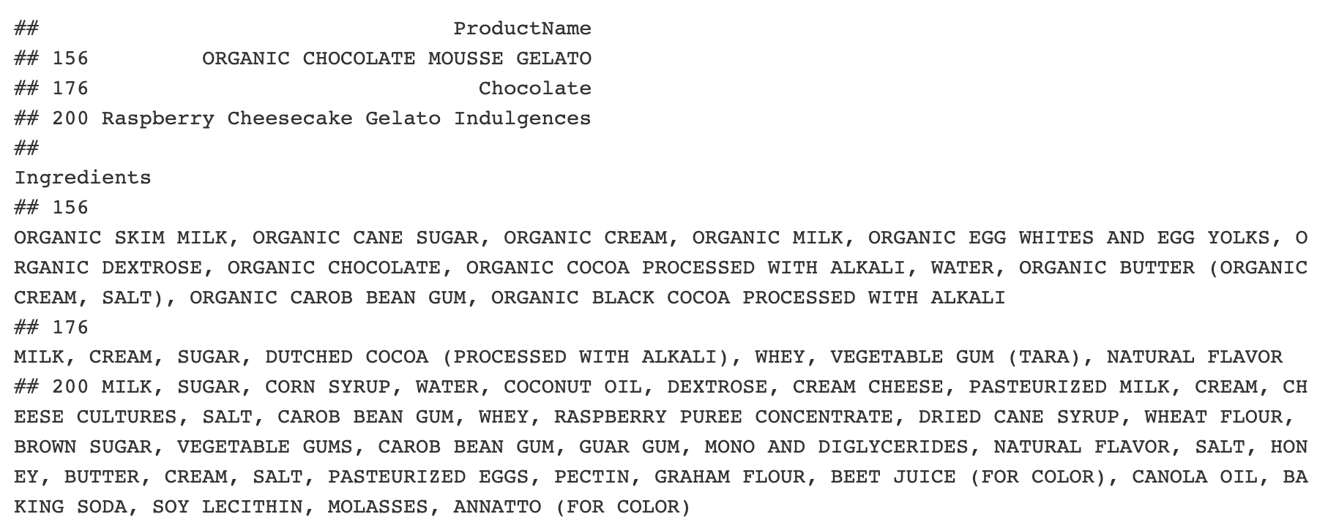
New Product Introduction
New Product Introduction

Slide 24
New Product Introduction
New Product Introduction
Altogether, we suggest that Breyers create the product Organic Chocolate Raspberry Bar to help improve their ratings
The ingredients:
Organic Milk, Coconut Oil, Water, Organic Cream, Organic Cane Sugar, Organic Chocolate, Natural Flavors, Organic Dextrose, Organic Butter, Raspberry Puree Concentrate, Organic Carob Bean Gum, Mono and Diglycerides, Whey, and Salt
Note: This is not an exhaustive list of ingredients to be used, this is based on what our model says would help get a high rating. Breyers can add or not use ingredients in order for the product to be up to their standards.

Slide 25
References
About Breyers History. (N.d.). Breyers. Retrieved March 12, 2024, from https://www.breyers.com/us/en/about.html
CarbSmart. (N.d). Breyers. Retrieved April 15, 2024, from https://www.breyers.com/us/en/products/carbsmart.html
Pond, T. (2020, Sept). Ice Cream Dataset. Kaggle. Retrieved March 11, 2024, from https://www.kaggle.com/datasets/tysonpo/ice-cream-dataset/data
Atkinson, W. (2023, April 28). Charting fields and spaces quantitatively: From multiple correspondence analysis to categorical principal components analysis - quality & quantity. SpringerLink. https://link.springer.com/article/10.1007/s11135-023-01669-w
Sanchez, G. (2012, October 13). 5 functions to do Multiple Correspondence Analysis in R. Visually Enforced. May 1, 2024, https://www.gastonsanchez.com/visually-enforced/how-to/2012/10/13/MCA-in-R/
Khoong, W. H. (2023, June 15). Dimensionality Reduction Techniques For Categorical & Continuous Data. Medium. May 1, 2024, https://medium.com/codex/dimensionality-reduction-techniques-for-categorical-continuous-data-75d2bca53100
kassambara. (2017, September 24). MCA - Multiple Correspondence Analysis in R: Essentials. May 1, 2024, http://www.sthda.com/english/articles/31-principal-component-methods-in-r-practical-guide/114-mca-multiple-correspondence-analysis-in-r-essentials/

