Slide 1
Interactive Visualization of Severe Weather Events Over Time
M. York, R. Ballard, A. Paladino
STAT6289 – Spatial
Spring 2025

Slide 2



Data Sources
NWS Weather Alerts 1950-2024
2020 TIGER Lines Census Tract Polygons
NHFL FEMA Flood Layer (?)

Slide 3
Data Extraction
NWS Bulk Extract – FTP load and collation of tabular severe weather event data for DC/MD/VA
TIGER LINES extract (Andrew – how are you extracting?

Slide 4
Preprocessing

Slide 5
Viz Overview

Slide 6
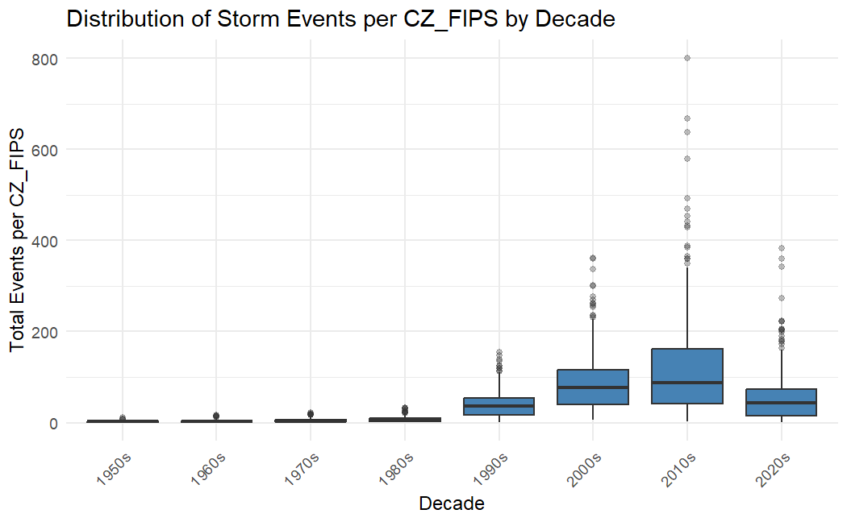
Total County Events By Decade
Multiboxplot with decade total events by CZ_FIPS (county code)
Observe distinct increasing trend in the number of severe events.
(2020s being a decade to-date total)

Slide 7
R Program Demo

Slide 8
Key Results and Findings

Slide 9
Citations
Ncei. (n.d.). Storm events database. National Centers for Environmental Information. https://www.ncdc.noaa.gov/stormevents/ftp.jsp

Slide 10
Thank You!
Questions?

Slide 11
Accessibility Guidelines
Use unique slide titles.
Use clear and accurate link text that tells the user where the link takes them.
Add alt-text to images.
Use the accessibility checker to review your presentation.

