Slide 1
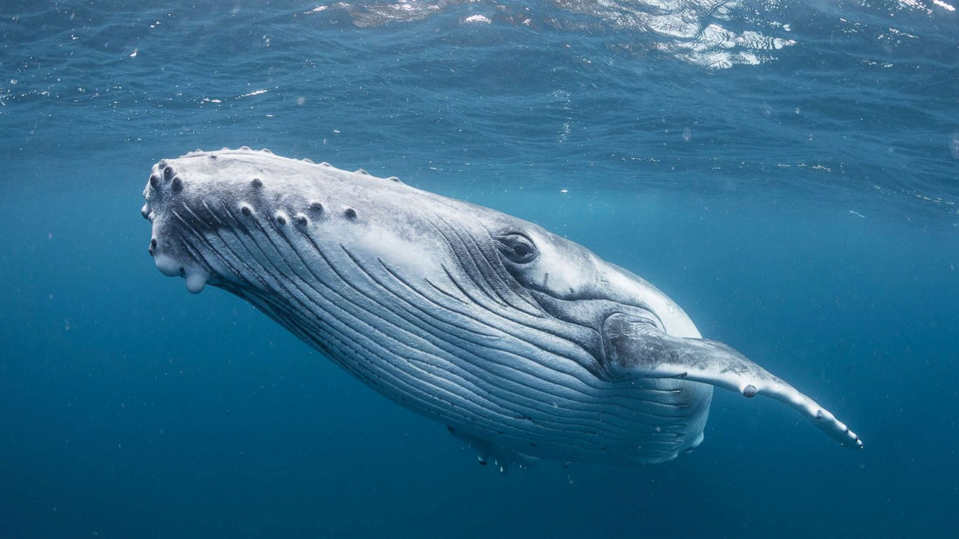
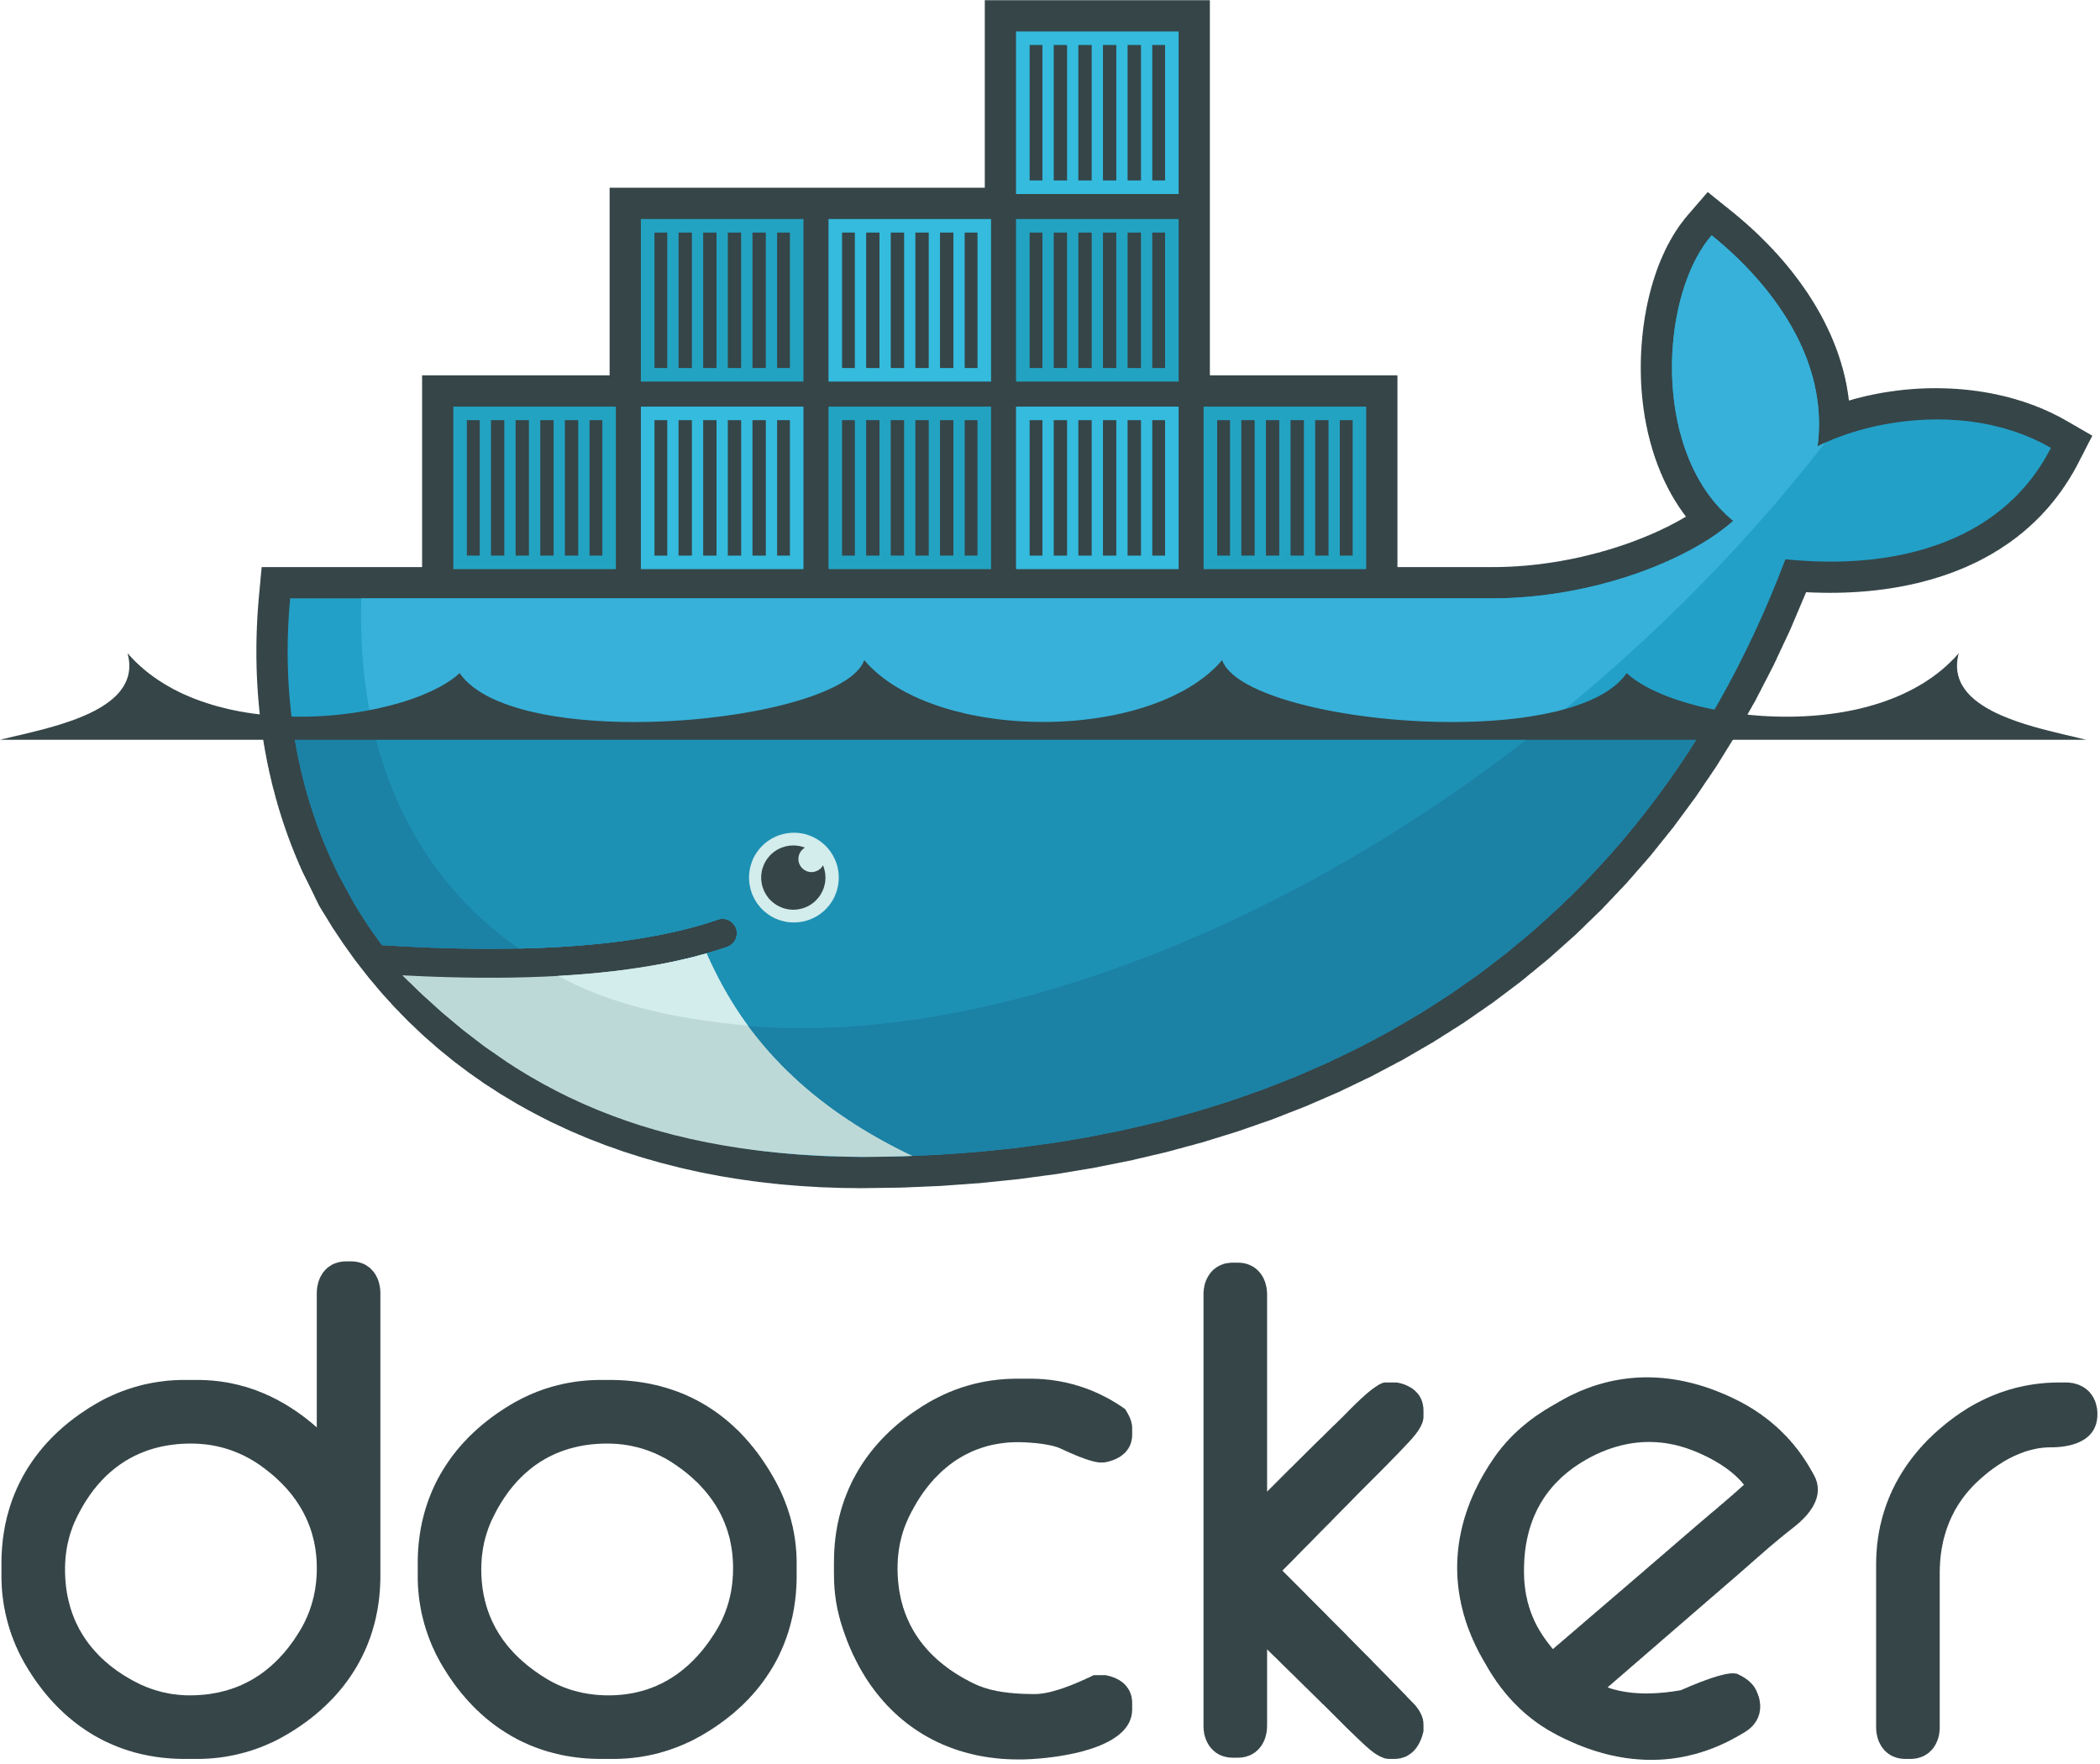
Docker for Data Science
Rebecca Davey Lead data scientist @ netacea

Slide 2




About Netacea
AI products that detect and mitigate threats from malicious, automated web traffic.
Credential stuffing
Web scraping
Card cracking
Inventory hoarding
Data science at Netacea:
Developing algorithms & models to cover range of automated threats
Work with real-time streamed data, external sources & historical views
Research & innovation through to engineering & MLOps

Slide 3
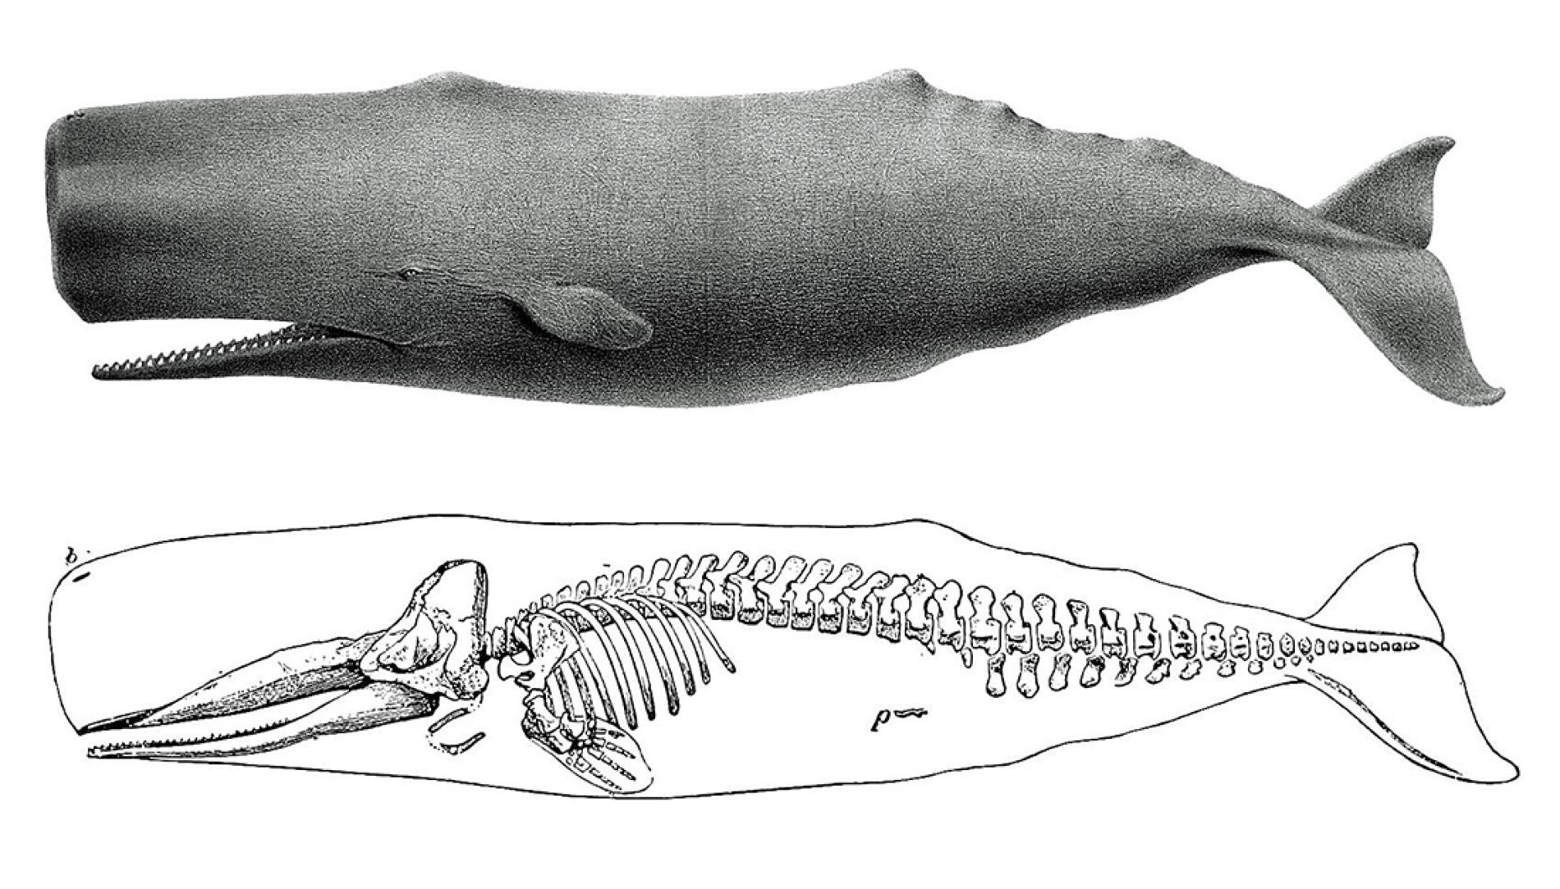
Docker overview
https://www.nationalgeographic.com/science/phenomena/2014/09/05/the-erotic-endurance-of-whale-hips/

Slide 4
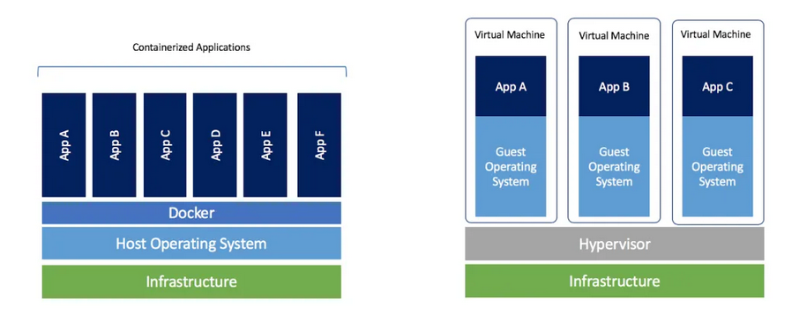
Basic definition
Docker is a software that enables you to create, run and manage containers.
A container is a silo of running software.
Like virtual machines, Docker allows you dev & execution environments that are isolated from the host machine.
Unlike VMs, they share an OS kernel which makes them much more lightweight.
Docker
VMs

Slide 5
Containerization – why?
Reproducibility
Collaboration
Machine hygiene
Portability
Deterministic software, independent of local environment & packages
Reduces barriers to collaboration, and images can be version controlled like code
Keep your own machine environment clean and untangled
Easy to upload/download and move across different machines

Slide 6
Docker in data science
Docker for development
Docker for deployment
Part 1 – development – managing the environment of a simple single container batch job
Part 2 – development – using multiple containers to develop a streaming pipeline
Part 3 – deployment – using Docker to deploy a real-time model and serve as a REST endpoint

Slide 7
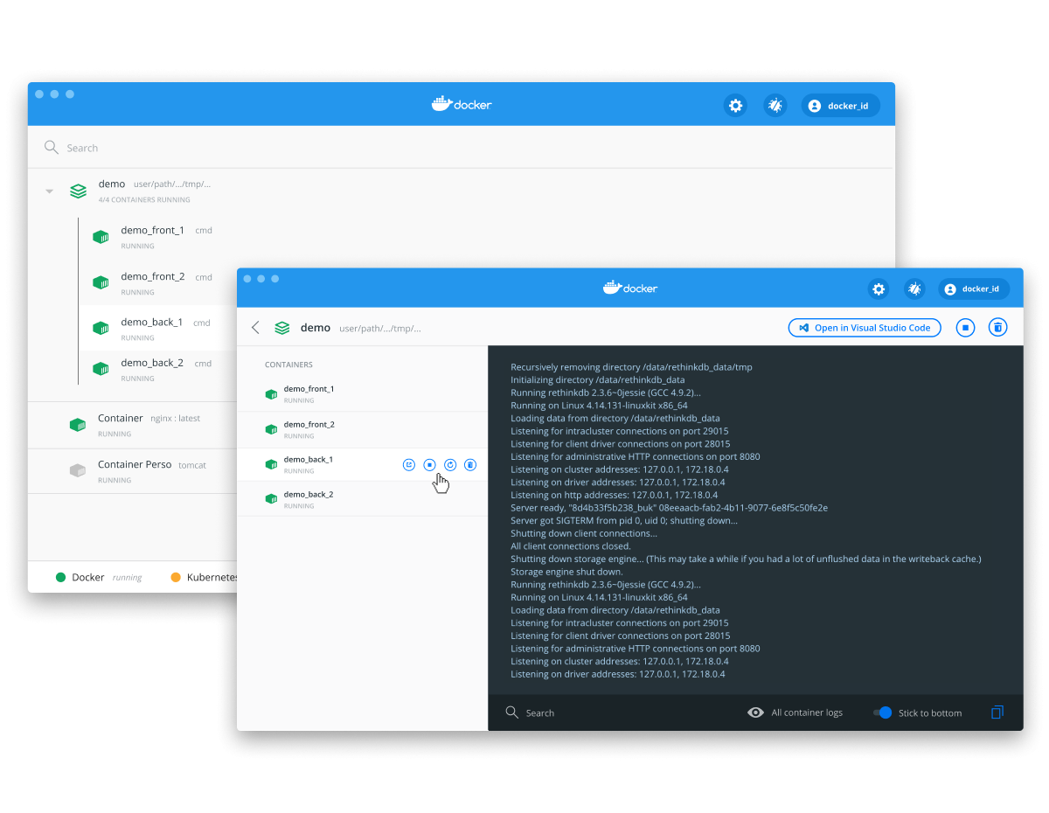
Getting started
To use Docker you need to be running a Docker Engine.
For Windows and Mac users:
Easiest = Docker for Desktop
Can also install from binaries. See https://docs.docker.com/engine/install/binaries/
For Linux users:
Install directly from DEB package – but you’ll need to manually maintain/upgrade, or
Install via setup of a Docker Repository. See https://docs.docker.com/engine/install/ubuntu/

Slide 8
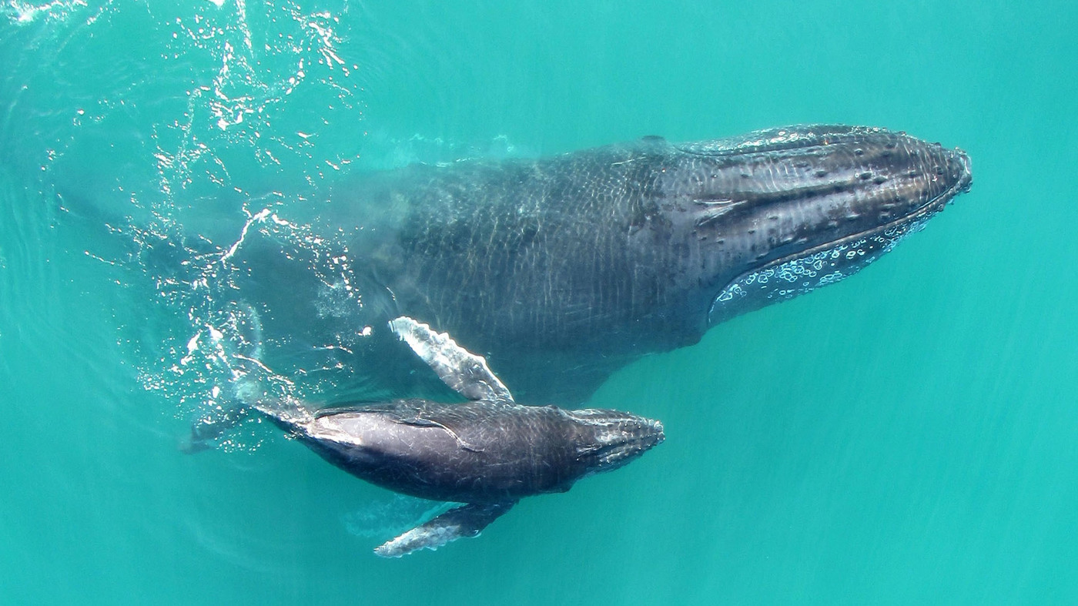
Docker for development
Part 1
A mother and calf humpback whale swim in the Exmouth Gulf in Western Australia - Fredrik Christiansen/Functional Ecology

Slide 9
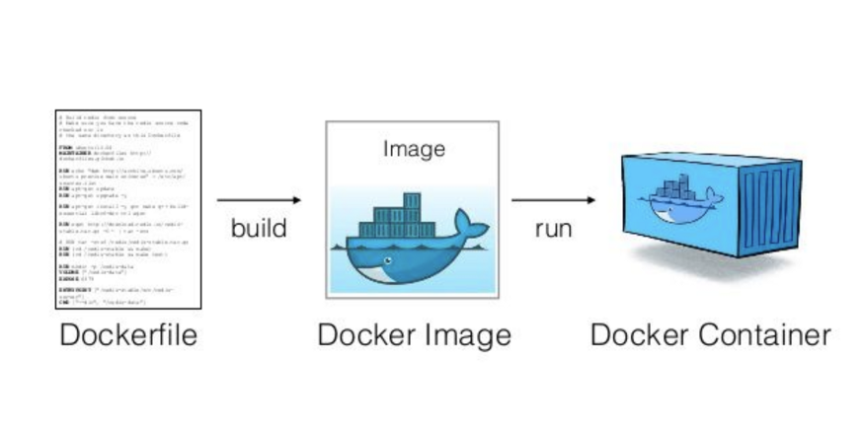
Images and containers

Slide 10
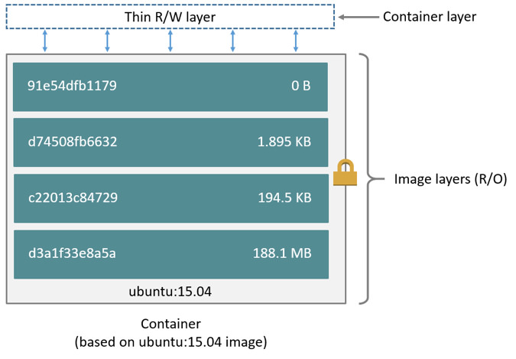
Images and layers
An image is built of layers on top of a base image.
Images and image layers form a tree.
Docker Hub: https://hub.docker.com/
What base image should I use?
If deploying in container: least effort
If not, replicate production environment
> docker images
show all images in your repository

Slide 11
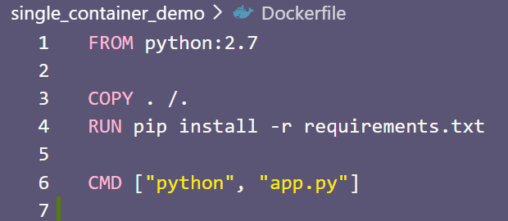
The Dockerfile
A Dockerfile is a recipe for combining some provided files and commands into a ready-to-go image.
Starting with a base image, the Dockerfile operations add image layers to build up your final container image.
CMD – give the container something to actually execute. Might also see ENTRYPOINT.
An example Dockerfile

Slide 12

docker build
An image is built by running docker build of a provided Dockerfile and context.
Path/URL: the context to be used to build the image. Can be current directory containing Dockerfile (.) or could be remote e.g. git repo…
docker build https://github.com/r-bex/docker-demos.git#main:single_container_demo
> docker build –t repo_name .
Use the current directory’s Dockerfile to build an image called repo_name

Slide 13
docker run
docker run IMAGEID = start a container running from the specified image
docker run will only work without extra args if image has CMD or ENTRYPOINT specified
Lots of useful OPTIONS to use here – look out for them in the demos
> docker run --rm IMAGEID
Start a container from IMAGEID and clean up the container after exiting

Slide 14
docker exec
docker run = launch a container from an image
docker exec = execute a command on an already running container
Can use to start bash shell inside a running container.
> docker exec –it CONTAINERID bash
Start a bash shell inside the container
> docker container top CONTAINERID
Show processes running inside container

Slide 15
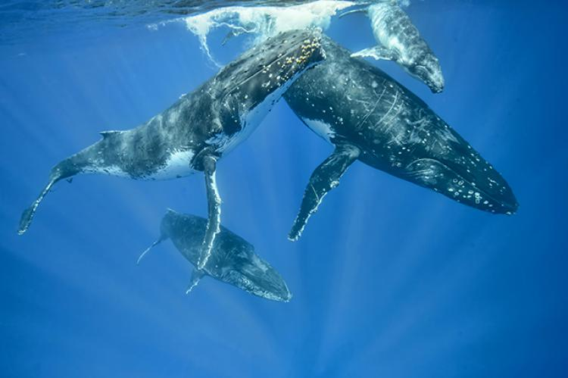
Docker for development
Part 2
https://xray-mag.com/content/tongas-humpback-whales

Slide 16

Multiple containers
Testing against your prod resources
Stream
Processor
Kafka
Simulating adjacent services in Docker containers
AWS S3
Want to work on StreamProcessor code and test it’s working properly – how?

Slide 17
Multiple containers
Stream
Processor
Kafka
AWS S3
Docker
localstack
Stream
Processor
Kafka
Container
Container
Container

Slide 18
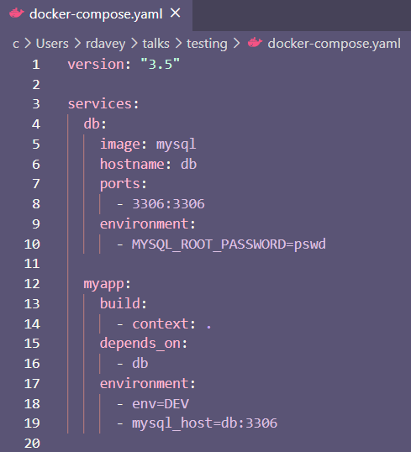
docker-compose
Use docker-compose.yaml file to build & run multiple interacting containers (services)
Contains info that you’d normally pass through with docker run to individual containers,
e.g. environment variables and port details
> docker-compose build
Rebuild images of all (unchanged) services
> docker-compose up/down
Start/stop all services running in containers

Slide 19

Docker and Apache Kafka
Apache Kafka = distributed pub/sub messaging platform
Kafka topic = a channel or category of message
Producers/consumers = communicate with brokers to write/read data from topic partitions
Commonly used for streaming data, due to…
High throughput
High durability of messages
Redundancy & reliability
Demo: predicting language of a tweet from a Kafka stream

Slide 20

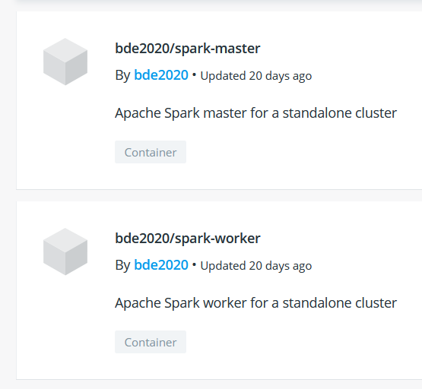
Docker and Apache Spark
Use docker-compose to spin up one container as a Spark master node and other container(s) as a Spark worker node
Can find pre-made images for Spark master and worker online, or could build your own...
Once running, can submit jobs by…
docker exec –it spark-master /bin/bash
spark-submit path/to/your/script.py

Slide 21

Docker for deployment
Part 3
Illustration: Katie Carey - www.canadianbusiness.com/small-business/6-land-a-whale

Slide 22
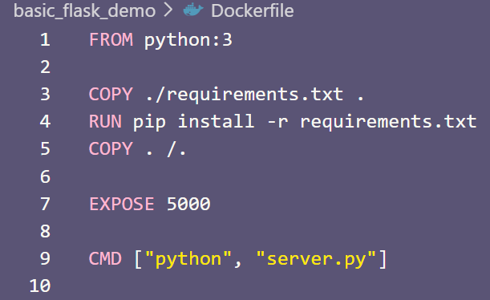
Serving a model directly with Flask
Flask is a lightweight webserver and app framework for Python
By default will accept requests on port 5000 -> expose in Dockerfile
Can route POST request to a particular path to a function that will use your model to predict from data
docker run –p 5000:5000 basic_flask_demo
Demo: animal classification behind REST endpoint

Slide 23

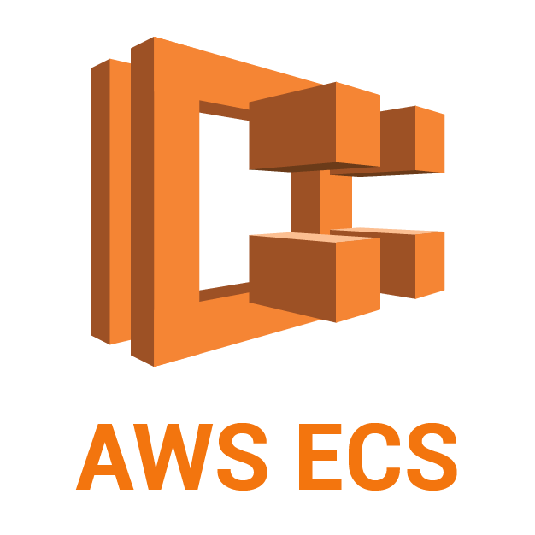
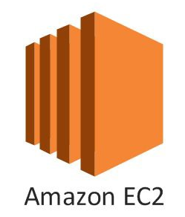
AWS - ECR and ECS
ECR = EC2 Container Registry.
Push your Docker images to this remote repository and then deploy on ECS = EC2 Container Service
Runs an image from ECR as a task on an EC2 cluster
Fargate – simplified execution of containers on EC2
Requires that tasks be stateless
But handles a lot of details like networking & security
EC2 cluster

Slide 24
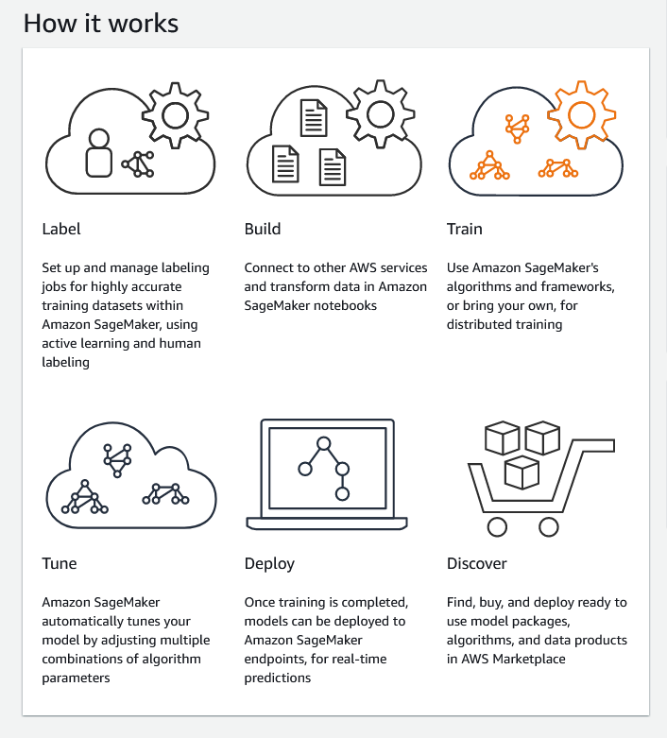
AWS - Sagemaker
Built to be a platform where you could carry out all aspects of data science work
Notebooks and ad hoc work
Ground truth labelling
Model training using OOTB or custom algos
Evaluation and deployment
Alternatively: bring your own model, and use purely for deployment – it uses ECR images!
Why use this over ECS or vice versa?
Cost vs convenience

Slide 25
Conclusions
Benefits of containerization in DS
* easier development & deployment of complex systems
* easier collaboration within & across teams
* fine control over environment and reproducibility
When should you consider Docker
* your development and production environments differ significantly
* you want to easily deploy ML models on the cloud
* you want to collaborate & share your pipelines with others

Slide 26


Thank you!
Questions?
Code: https://github.com/r-bex/docker-demos/
Docker docs: https://docs.docker.com/reference/
Docker cloud playground: https://www.docker.com/play-with-docker
Get in touch:
drop me an email rebecca.davey@netacea.com
find me on PyDataUK Slack
on twitter @suprahoopla

