Slide 1

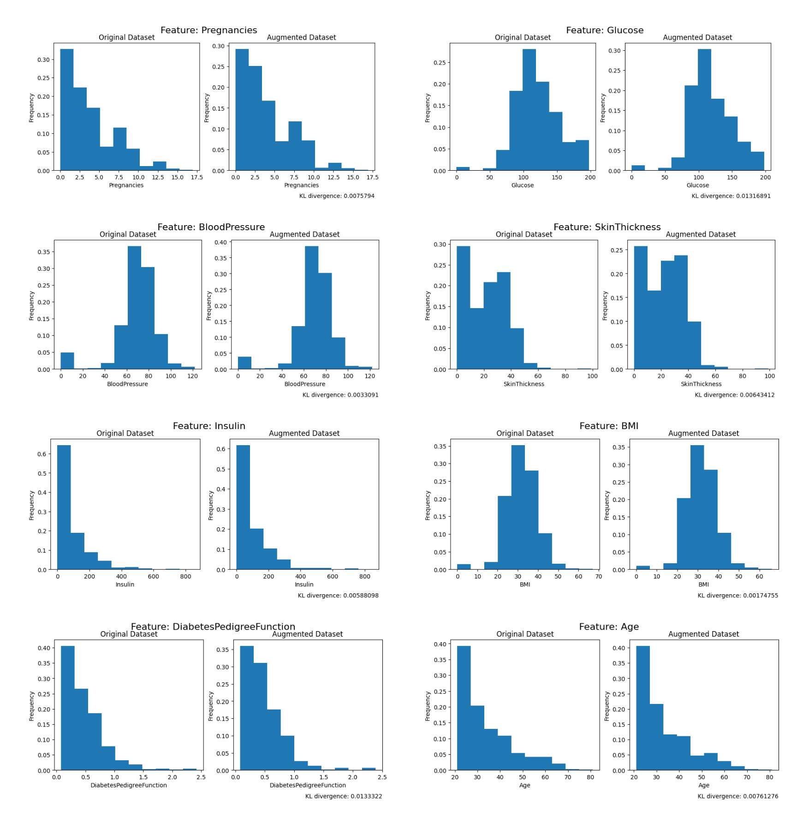
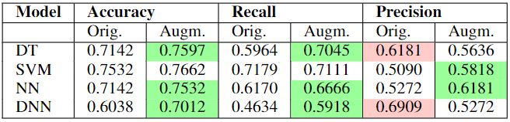
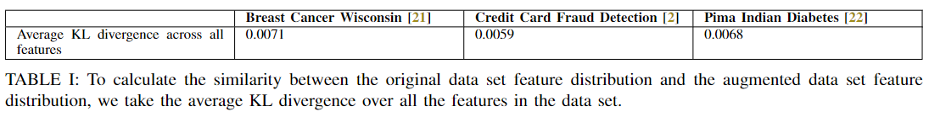
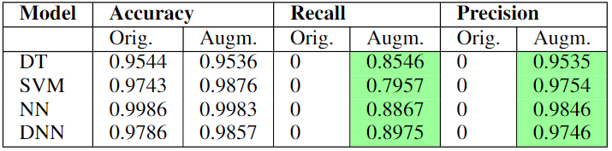
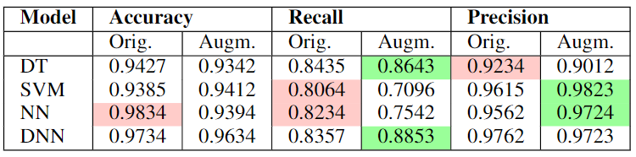
Dataset Augmentation for Machine Learning Tasks with Symbol Regression Program Synthesis
Ruchi Bhalani Department of Computer Science, College of Natural Sciences, The University of Texas.
Analysis
Introduction
Approach
Models perform better on the augmented data set compared to the original data set. This is likely because the extra samples allowed the models to properly learn the relationship between the features. Additionally, sampling from the minority class (Malignant) may have allowed for an increase in performance since underrepresented classes are often the more misclassified samples.
The severe class imbalance in the original Credit Card Fraud Detection data set results in mean precision and recall values of 0, since the models naively always predict the majority class.
Oversampling from the minority class using synthetic data by 10 times the original number of minority samples in the train set resulted in a dramatic increase in recall and precision, while maintaining accuracy. This signifies that the model is finally correctly classifying members of the minority class, and has learned the relationship between features rather than using heuristics to “cheat”.
Training on a fully synthetic data set and doubling the size of the train set resulted in relatively similar performance on both the original and augmented data sets, with no significant improvement or detriment to precision, accuracy, or recall.
This demonstrates that the synthetic data mimics the original data well enough that performance metrics stay relatively the same, while allowing us to circumvent the need for using potentially sensitive, private data, such as medical records, to train models.
The data augmenter goes through the original data set, and generates user-specified number of examples that has the same statistical profile and distribution as the original data set. For numerical data, a symbolic regressor is fit to the original data set to synthesize an expression that fits the distribution of the data set using the following architecture:
For categorical variable generation, hill-climbing search is a search algorithm used to go through large search spaces, such as that of the N-queens problem, and find a solution by allowing us to optimize a certain objective function.
We use hill-climbing algorithm to generate synthetic categorical variables for the data set. For each set of variables, the algorithm perturbs the distribution of the categorical variable by randomly swapping two values in the distribution. Then, it computes the correlation of the perturbed categorical variable with the numerical variables. if the correlation improves with the perturbation, the algorithm updates the categorical variable with the new distribution, and repeats this process for ten iterations.
CASE STUDY A: Insufficient Size
Data augmentation, the artificial creation of training data for machine learning, is a widely studied field across machine learning disciplines .
Increasing data set size: Useful for increasing the generalization capabilities of a model by making it more robust to overfitting,
Mitigating class imbalances: It is common for databases to have underrepresented classes. Classification tasks struggle with imbalanced datasets since the program would demonstrate a low error even if it misclassified all the minority class datapoints. Augmentation both increases the representation of the minority class and can help avoid overfitting and benefit generalization to unseen data.
Protecting privacy: Its possible that a data set contains sensitive information, and working on it directly leaves it vulnerable to data misuse. One possible approach to this issue is to avoid using original data to train the model and rather generate a synthetic data set on which to train the model.
Although there have been many ML-based models such as SMOTE and ADASYN, one potential downfall of these systems is that they may make models more prone to overfitting, where the model becomes too specialized to the train set and doesn't generalize well to a held-out test set (previously unseen data).
One novel potential approach to data set augmentation is by using a combination of machine learning techniques, genetic programming, and symbolic regression to synthesize new data entries that mimic the original data set. Symbolic regression aims at searching the space of mathematical expressions that best fit a given dataset. Genetic programming is a common method for performing symbolic regression that relies on the use of random constants to scale predictions. Standardized genetic programming works well on difficult problems with little need for data augmentation.
Therefore, for problematic datasets (severe class imbalances, too small to generalize), we propose symbolic regression using genetic program, a promising approach to synthesize programs that can generate new dataset entries that mimic the relationships and correlations in the original dataset.
This is framed as a synthesis from holes in programs, in which the unknown variables that make up the expression fit to the data set are the holes, or the "unknowns", that need to be synthesized by going through a search space.
Initialization:
Population size = 5000
Selection:
Tournament size = 50
Evolution:
P Crossover = 0.7
P Subtree Mutation = 0.1
P Hoist Mutation = 0.1
Termination:
Generations = 50
Stopping criteria = 0.01
Bloat:
Parsimony coefficient = 0.001
Maximum samples = 0.9
CASE STUDY B: Class Imbalance
Data Evaluation
Model Performance
We evaluate the original and augmented data sets on three different case studies using three benchmark data sets and evaluate the results using 5-fold cross validation on the following models: Decision Trees (DT), Support Vector Machines (SVM), Neural Networks (NN), and Deep Neural Networks (DNN). These models were chosen because they are known to be prone to overfitting.
CASE STUDY A: INSUFFICIENT DATA SET SIZE
We increase the size of the benchmark Breast Cancer Wisconsin (Diagnostic) Data Set – which only contains 569 total samples – by 150%.
CASE STUDY B: MITIGATING CLASS IMBALANCE
The benchmark Credit Card Fraud Detection data set only contains 492 fraudulent transactions out of 284,807 (0.172%). We generate synthetic minority class data.
CASE STUDY C: PROTECTING PRIVACY
We treat the benchmark Pima Indians Diabetes Database as a sensitive-information data set and train on a 100% synthetic data set generated from the original.
CASE STUDY A: Insufficient Size
CASE STUDY C: Privacy Protection
CASE STUDY B: Class Imbalance
Conclusion
Symbolic regression and hill-climbing algorithm seem to work relatively well at generating synthetic data that mimics the distribution and relationships of the original data sets.
This could be used to increase the size of data sets that contain an insufficient number of samples, mitigate severe class imbalances that are causing models to ignore minority classes, and protect data sets that contain potentially private or sensitive data.
Future work may include testing a larger number of data sets with even more extreme class imbalances or very few samples, and evaluate how performance differs. Additionally, we could run further experiments to evaluate how well the privacy of sensitive data sets is preserved from synthetic data generation.
In order to evaluate the quality of the augmented data set specifically in regards to how well it mimics the distribution of the original data set, we use a measure of Kullback-Leibler divergence, which quantifies in bits how close a distribution is to a candidate/model distribution.
A common technical interpretation is that the KL divergence is the coding penalty associated with selecting a distribution q to approximate the true distribution p.
Above we see a table of the average KL-divergence across all features for the 3 different data sets we will be evaluating, as well as a closer look at the feature distribution of the Pima Indians Diabetes Database.
CASE STUDY C: Privacy Protection

