Slide 1
Social Disparities of Health in California
Group 3: Kalpana Simhadri, Chase Maughan, Xincen Xi, Rachel Buchleiter
BMI 6016: Data Wrangling
Drs. Ram Gouripeddi and Kathy Sward
April 29, 2024

Slide 2
Background
Economic stability
Education access and quality
Health care access and quality
Neighborhood and built environment
Social and community context
A person’s health influenced by personal factors, family factors and community factors (Cantor et al., 2017)
Need for better understanding of this overall environment, outside of the healthcare setting
These factors are referred to as Social Determinants of Health (SDOH)
Five domains (n.d., Social Determinants of Health)
Notes:
Xincen
give examples of each domain, connect these to the variables that could be in a data set
Economic stability: income level
Education: highest level of education achieved
Health care access and quality: Insured, not insured, health risk behaviors such as smoking, alcohol use,
Neighborhood and built environment : air quality, distance to parks, walkability
Social and community context: race and ethnicity, physical activity

Slide 3
Objectives
Provide a harmonized data set that can be used to answer questions related to SDOH in California at the census tract level
Learning Objectives
Identify publicly available data can be used in analyses focused on social determinants of health
Identify and merge relevant variables associated with SDOH from publicly available data sources. Use the FACETS project for reference
Notes:
Xincen

Slide 4
Potential research Questions
Variables
Healthcare insurance
Race (categorical)
Ethnicity (categorical)
Sex (M/F) (categorical)
Education (ordinal)
Income (ordinal)
County (categorical)
Air Quality (continuous)
Risk behavior (categorical)
Is there correlation between health insurance, income and educational attainment in CA?
Are health risk behaviors (tobacco use, alcohol use, sedentary lifestyle) more prevalent by gender or county or census tract?
Are there any significant correlations between race/ethnicity and lack of health insurance coverage in specific census tracts of Los Angeles County?
Are there any correlations in health risk behavior by race or ethnicity?
Notes:
Xincen

Slide 5
Data Selection
U.S. Census Bureau/Centers for Disease Control (CDC)
Environmental Protection Agency (EPA)
National Environmental Public Health Tracking Network
Demographic data
Air Quality data from monitoring network
Prevalence of life and health risk factors
Non-English speakers
PM5 concentration
Access to parks
Total population
Sex (M/F)
Age
Race
Ethnicity
Disability
Fertility
Health Insurance
Unemployment
Ozone level in air
Cancer risk
Additional air quality measures
Alcohol use
Obesity
Physical activity
Sleep
Smoking status
Depression among adults
Routine doctor visits
Unemployment
Social vulnerability index (SVI)
Data for the year 2020, in California, down to census tract level, FIPS
Notes:
Xincen
Census Bureau and CDC (far left box)
From CDC, Demographics data , year 2020
Geographical location: CA, census tract level, FIPS.
Variables: total population, gender, age, race, ethnic groups,
% of population who speak language (other than English) at home.
Disability, fertility, health insurance details , number of people unemployed
Environmental Protection Agency (middle box)
Environmental protection agency, air quality , year 2020
Geographical location: CA, census tract level, FIPS
Available at: Download EJScreen Data | US EPA
Variables: PM5 concentration (inhalable particulate matter), ozone level in air, and other variables related to air quality , cancer risk etc are included
CDC-NEPHTN-National Environmental Public Health Tracking Network (far right box)
SDOH Factors :
Access to parks within 1 or ½ mile distance
Life risk factors: crude prevalence, adults >= 18 years, CA state, all census tract, 2020
Alcohol use: prevalence of binge drinking
Overweight & obesity: crude prevalence of obesity
Physical activity: no leisure time for physical activity
Sleep: less than 7 hours
Smoking: prevalence of current smoking
Crude prevalence of depression among adults >= 18 years
Crude prevalence of doctor visits for routine check up among adults >18 years
Number of people >=16 years unemployed
Social vulnerability index (SVI)

Slide 6
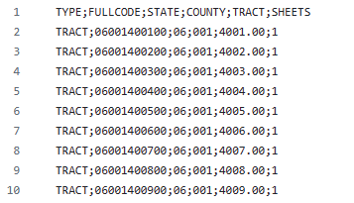
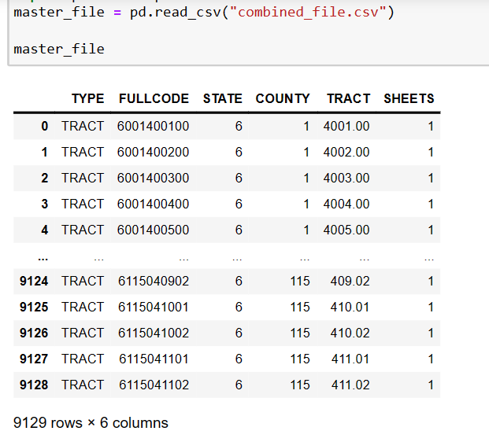
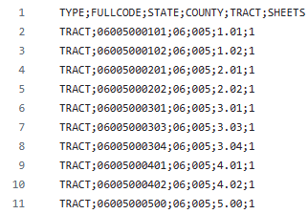
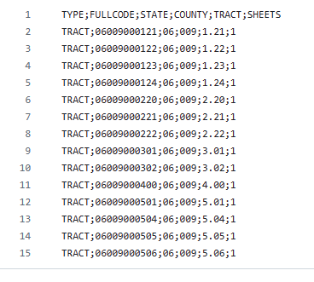
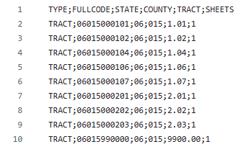
DATA WRANGLING
US census: FIPS codes

Slide 7
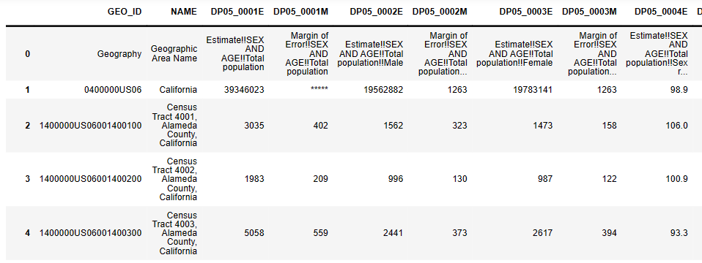
ACS data: Gender, race, ethnicity, education attainment, disability status, health insurance related variables
Notes:
Xincen
give examples of each domain, connect these to the variables that could be in a data set
Economic stability: income level
Education: highest level of education achieved
Health care access and quality: Insured, not insured, health risk behaviors such as smoking, alcohol use,
Neighborhood and built environment : air quality, distance to parks, walkability
Social and community context: race and ethnicity, physical activity

Slide 8
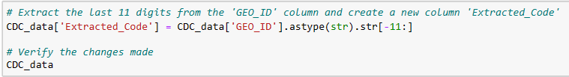
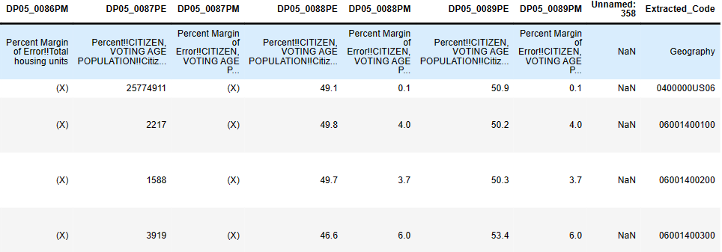
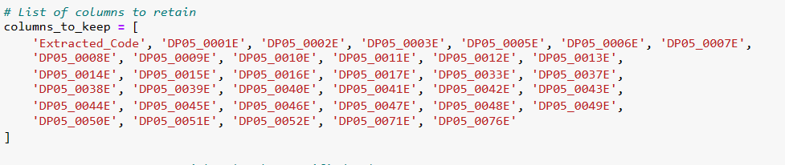

Slide 9
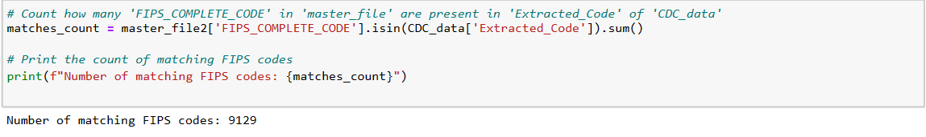
Notes:
Xincen
give examples of each domain, connect these to the variables that could be in a data set
Economic stability: income level
Education: highest level of education achieved
Health care access and quality: Insured, not insured, health risk behaviors such as smoking, alcohol use,
Neighborhood and built environment : air quality, distance to parks, walkability
Social and community context: race and ethnicity, physical activity

Slide 10
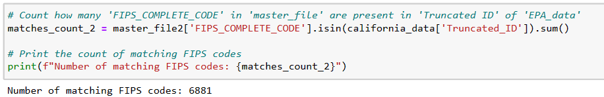
EPA air quality data:
Available for all the states, at census tract level
Extracted only for California state
Truncated the FIPS code to retain only 11 digits.
Notes:
Xincen
give examples of each domain, connect these to the variables that could be in a data set
Economic stability: income level
Education: highest level of education achieved
Health care access and quality: Insured, not insured, health risk behaviors such as smoking, alcohol use,
Neighborhood and built environment : air quality, distance to parks, walkability
Social and community context: race and ethnicity, physical activity

Slide 11
Master File (FIPS)
FIPS Code Format: 11 digits (e.g., 06001400700, 06001400800).
EPA File
FIPS Code Format includes sub-tracts (e.g., 06001400801, 06001400802).
Not all FIPS codes from the EPA data directly matched the master file.
The granularity of the EPA data led to missing matches for 2,248 FIPS codes from the master file.
Aggregation Attempt:
Aimed to aggregate sub-tract data by taking mean values for broader census tract matches.
Dataset reduced to only 3,000 rows

Slide 12
Challenges:
Granularity Variance: The subdivision identifiers within FIPS codes (the last several digits) exhibited variable lengths and complexity.
06001402801
06001402802
06009000501
06009000504
06009000505
06009000506
Diversity in the last one digits complicated aggregation
Notes:
Xincen

Slide 13
Decision on matched data:
Retained the 6,881 rows that had direct matches between the master file and the EPA dataset
Approximately 2,200 rows lacked direct matches due to the granularity issues previously described.
Implemented data imputation techniques for these missing rows
Notes:
Xincen

Slide 14
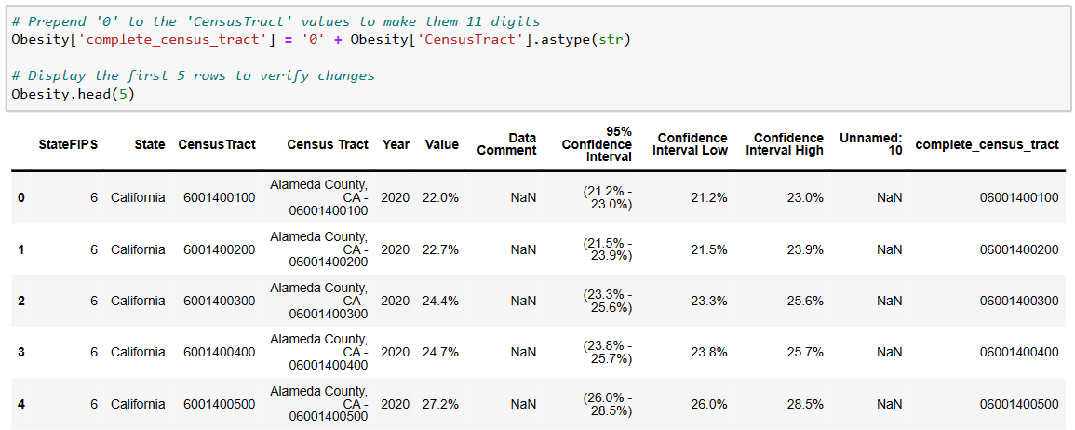
CDC/National Environmental Public Health Tracking Network Data
Smoking, binge drinking, physical inactivity, sleep < 7 hours, depression and obesity rates, no. of doctor visits. etc.

Slide 15
Final merged dataset: 58 variables related to SDOH
Variables | Source | Missing values
Male, female, Age groups: 5-9 years, 10-14 years,..up to 85 years and older. Race: Whites, Black or African American, Asian, Asian Indian, Chinese, Filipino, Japanese, Korean etc. Ethnicity: Hispanic and Latino Education attainment, Disability status, health insurance. Language spoken. Fertility rates, employment status etc. | ACS | No missing values
PM2.5, Ozone level, air toxins cancer risk, RHI | EPA | ~2,200
Smoking, drinking, sleep, obesity, doctor visits etc. | CDC/NEPHTN | ~2,200
Notes:
Xincen

Slide 16
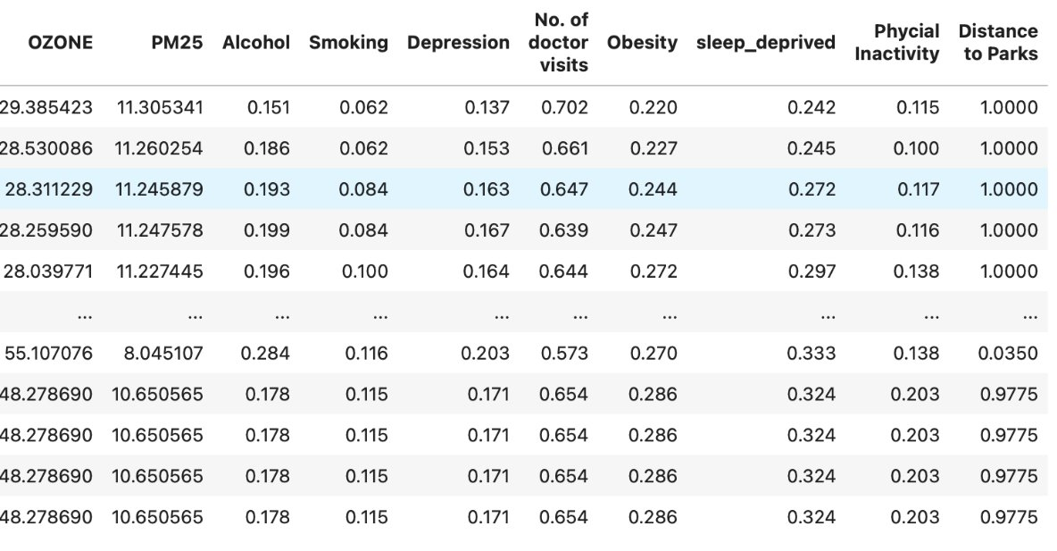
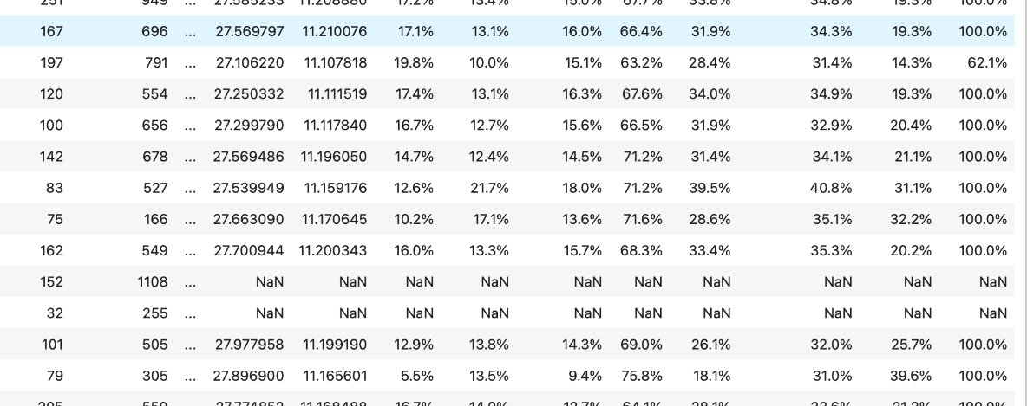
DATA IMPUTATION

Slide 17


Data Processing
Data cleanup
Data integration
Script development
Version control
Documentation
Notes:
Chase – summary of what we did

Slide 18
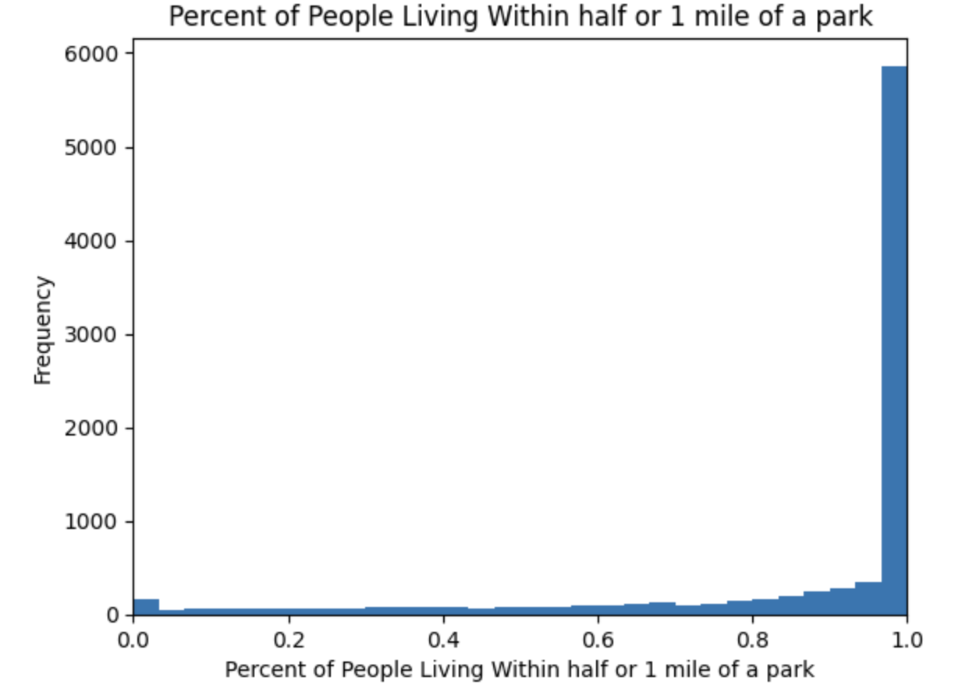
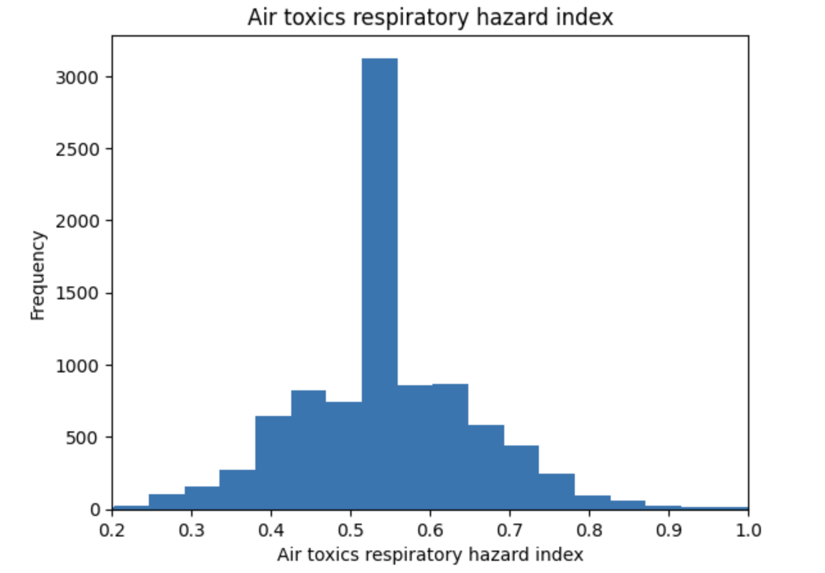
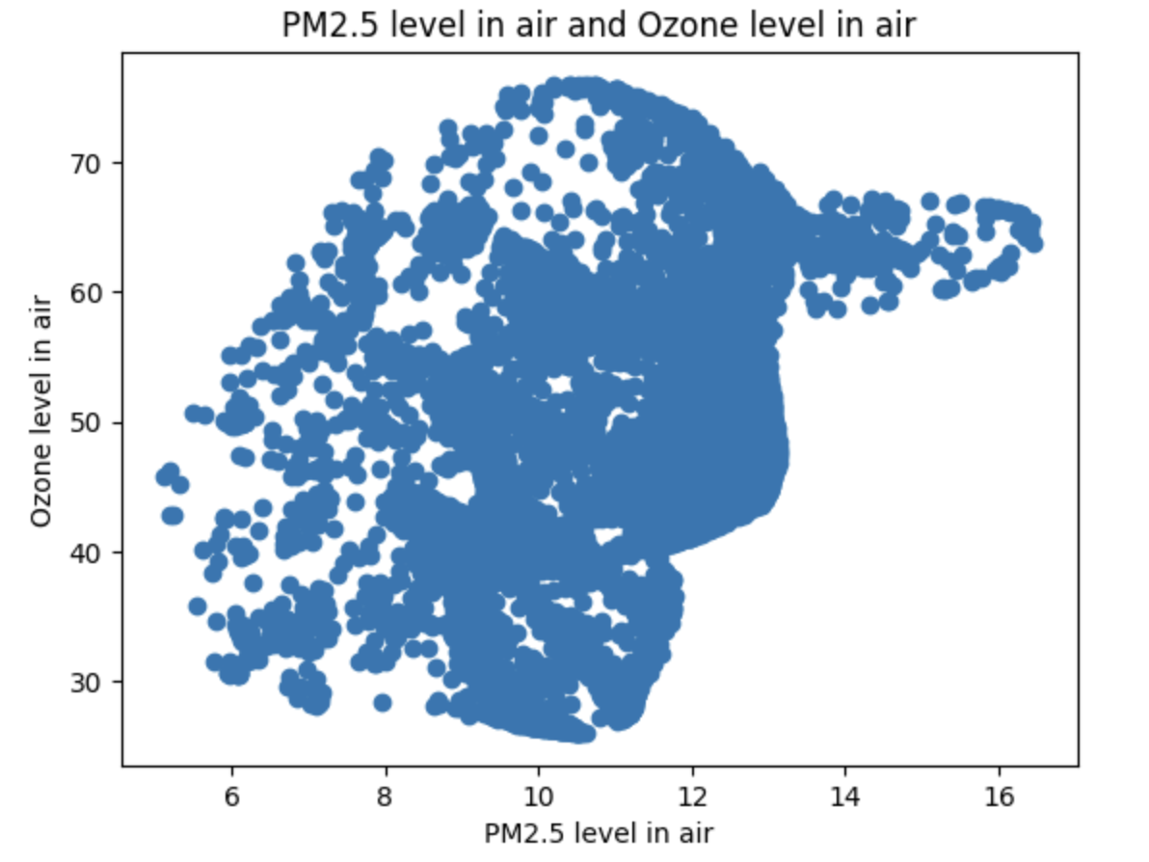
Descriptive statistics
Notes:
Chase

Slide 19
Limitations and Lessons Learned
Joining on census tract IDs – these were not all the same format
Different sources had different levels of granularity within the census tract
Time period the data was collected – some versions of the census bureau data had 1 year periods OR 5 year periods
Combining the different data sources to make it usable
Null values
String values
Formatting
Column names
Resolving errors in code
Notes:
Kalpana/Chase/Rachel?

Slide 20
Conclusion and future direction
There are nearly endless questions using SDOH related data!
Despite using domains defined by the CDC and data all sourced by government programs variations in the data remained, requiring data processing
Future work
Refine research question
Focus on select counties
Add more variables to analyze
Select an outcome of interest and dive deeper into analysis of variables with correlation
Expand geographical locations

Slide 21
References
Cantor, M. N., Chandras, R., & Pulgarin, C. (2017). FACETS: using open data to measure community social determinants of health. Journal of the American Medical Informatics Association, 25(4), 419-422. https://doi.org/10.1093/jamia/ocx117
Healthy People 2030, n.d. “Social Determinants of Health.” https://health.gov/healthypeople/priority-areas/social-determinants-health
Social Determinants of Health. U.S. Department of Health and Human Services. Retrieved April 24 from https://health.gov/healthypeople/priority-areas/social-determinants-health
Census Bureau Tables (DP05)
Environmental Protection Agency Download EJScreen Data | US EPA
National Environmental Public Health Tracking Network Data Explorer (cdc.gov)

