Slide 1
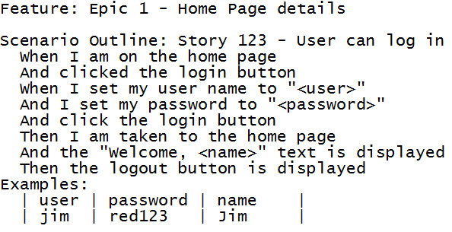
cuke_sniffer
What all might be wrong with this feature?

Slide 2
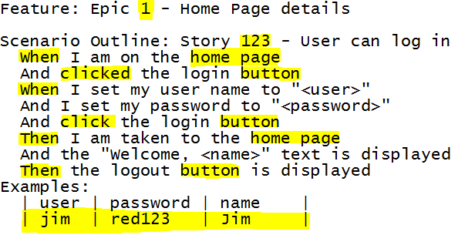
cuke_sniffer

Slide 3
cuke_sniffer
“Traceability”
Proper Given/When/Then order
Implementation phrases used
Scenario Outline with only one example

Slide 4
cuke_sniffer - Rules
Rules are categorized as:
  Fatal: will prevent the suite from executing
  Error: debugging errors
  Warning: readability/misuse of cucumber
  Info: Small improvements

Slide 5


cuke_sniffer – Fatal
There will be some overlap with the cucumber parser for errors, but there are also some errors that you wont catch unless you run the tests.
  Scenario Outlines with no attached Examples Table
  Recursive nested steps.

Slide 6

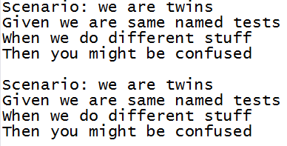
cuke_sniffer - Error
These will cause issues in debugging
  Scenarios with no name
  Scenarios with same names in a feature

Slide 7

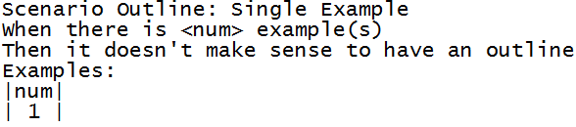
cuke_sniffer - Warning
This is where a bulk of the rules will be
Focuses on best practice
  Steps out of Given/When/Then order
  Scenario Example with only 1 example

Slide 8

cuke_sniffer - Info
Falls under pet peeves, forgivable rules.
  Too many tags on a scenario
  Nested step calls

Slide 9
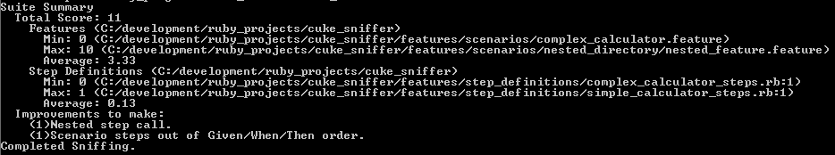
cuke_sniffer – output
Command Line

Slide 10
cuke_sniffer – output
SLIDES FOR HTML WHEN FINISHED

Slide 11
cuke_sniffer - use
Here you get a summary of the health of your project with a total score and min/max/average break down of your Features/Step Definitions.
The Improvements to make list is a composite list of every rule your project triggered sorted in descending order so you see the most occurring problems first.

Slide 12
cuke_sniffer - use
You can also pass parameters to cuke_sniffer
Specific folders:
  cuke_sniffer <features_folder> <step_definitions_folder>
Just a Feature file
  cuke_sniffer <feature_file>
With html output
  cuke_sniffer --out html

Slide 13

cuke_sniffer - use
You can also require the gem in a ruby file and use the objects directly

Slide 14
cuke_sniffer - customization
Available to use from ruby script
Turn off rules
Change the trigger value of rules
You also have the options of adding gem extensions for your own rules if they don't exist.

Slide 15
cuke_sniffer - Future
Add more rules for existing objects
User passed rules system
Xml output

