Slide 1

Latent Semantic Indexing
Applied to a dataset of
song lyrics

Slide 2

Project Overview
dataset & goal
Implementation of latent semantic index
Results & conclusions

Slide 3

Goal of the project
Create an application to retrieve songs given free-form text queries
Examples:
Find a song by remembering only a few words
Find a song that talk about some specific topics
Exploit latent semantic indexing in order to deal with concepts instead of terms and reduce the size of the problem

Slide 4

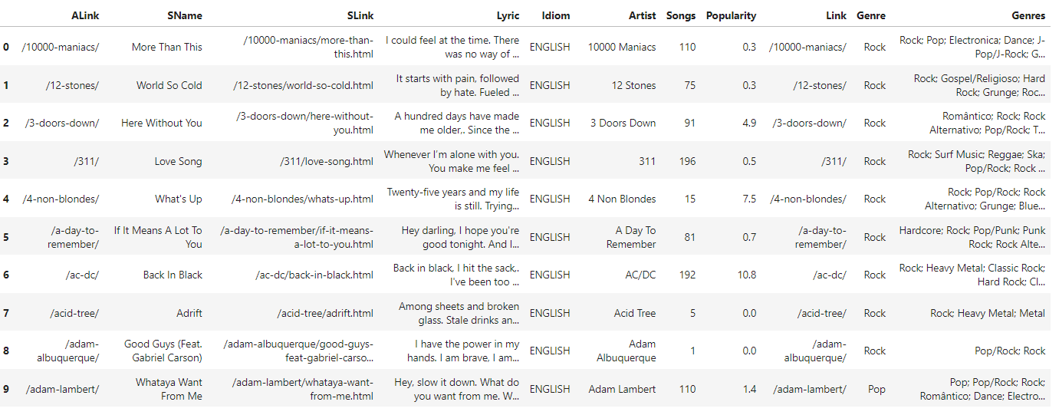
Dataset

Slide 5
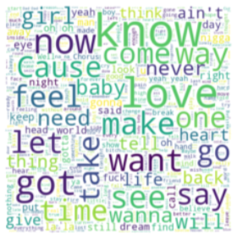
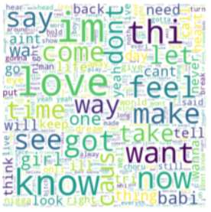
Dataset: Pre-Processing
The texts of the songs are cleaned, removing stop words and punctuation and performing stemming
Pre cleaning:
Post cleaning:

Slide 6




Implementation: Term-Document Matrix
Build a dictionary with all the terms associated to a list of songs that contain that term
From the dictionary, create a sparse matrix with the songs as columns and the terms as rows:
If a term i is present in the song j, then M[i,j] = 1
Otherwise M[i,j] = 0
Update the term-document matrix substituting the values of M[i,j] = 1 with the TF-IDF, where:

Slide 7
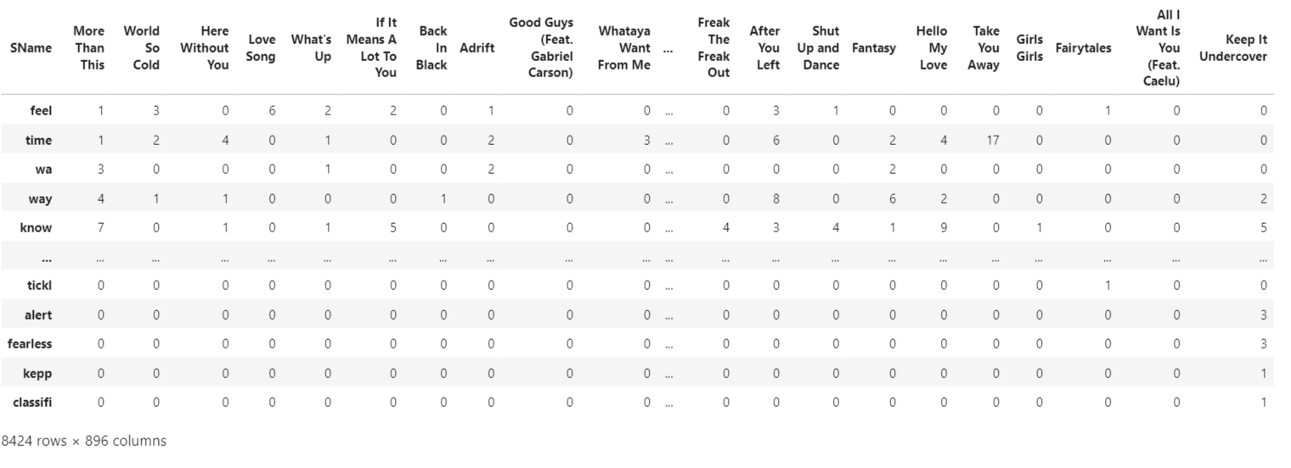
Implementation: Term-Document Matrix with frequency

Slide 8
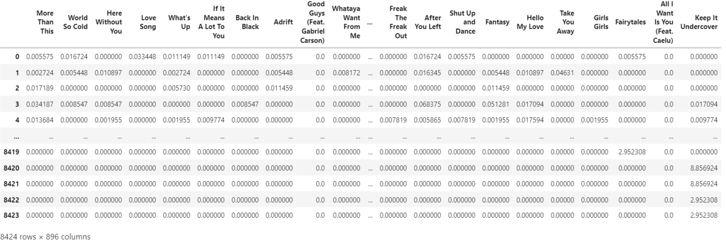
Implementation: Term-Document Matrix with TF-IDF

Slide 9
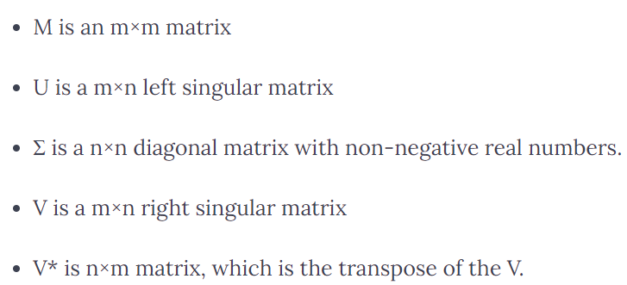
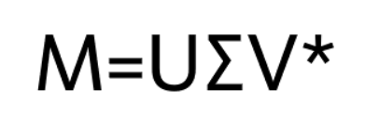
Implementation: Singular Value Decomposition
SVD is a matrix factorization method that represents a matrix in the product of two matrices:

Slide 10
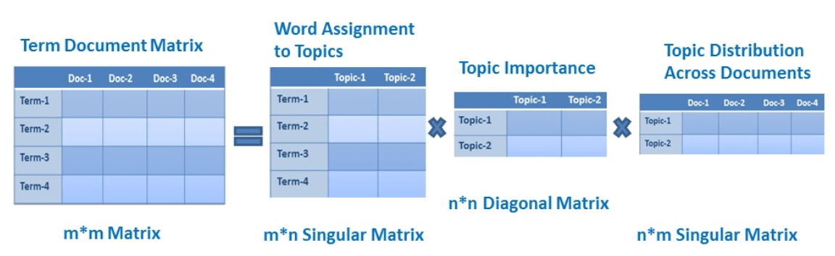
Implementation: Latent Semantic Index
Use SVD to decompose the Term-Document Matrix to learn latent concepts. The scipy.linalg.svd package is used.

Slide 11
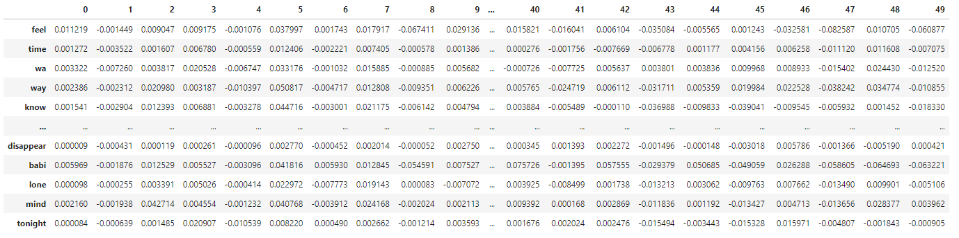
Implementation: Latent Semantic Index
U: term-concept matrix

Slide 12
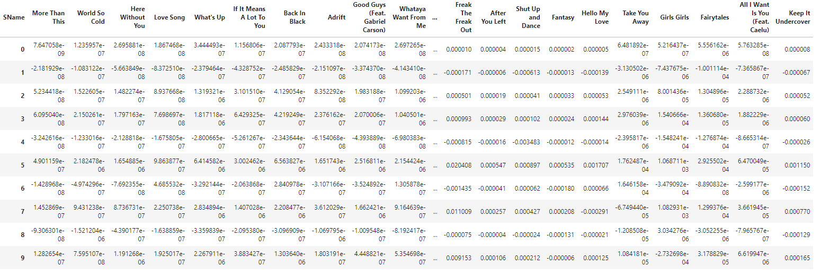
Implementation: Latent Semantic Index
V: document-concept matrix

Slide 13
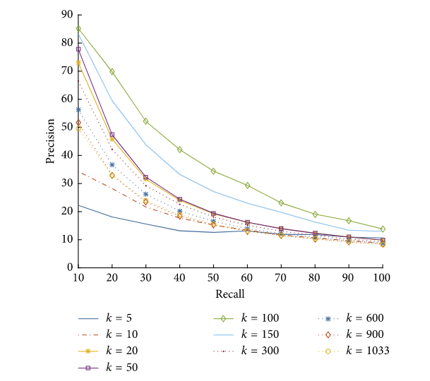
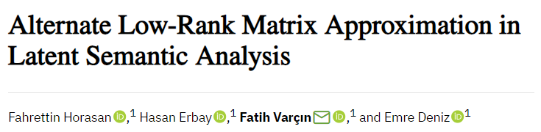
Implementation: Choosing the rank K
Considering the full text of a song ('Back In Black') as the query, different values of k are used and the smallest value of k for which the right song is considered the best match is chosen for the model
Idea of possible values of K:

Slide 14
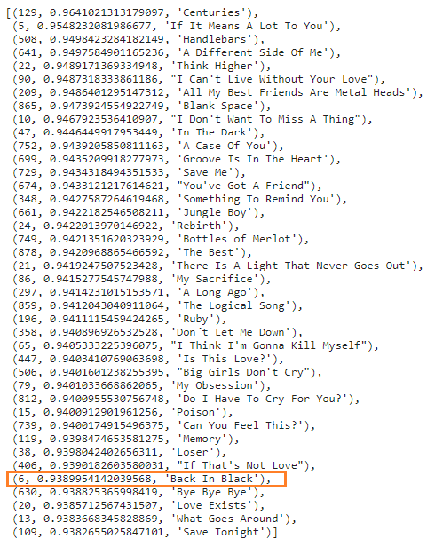
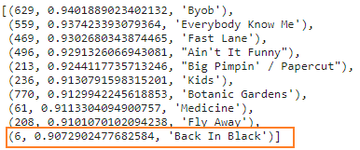

Implementation: Choosing the rank K
K = 10
K = 20
K = 60

Slide 15
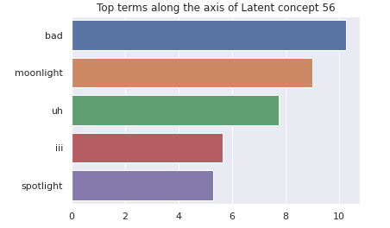
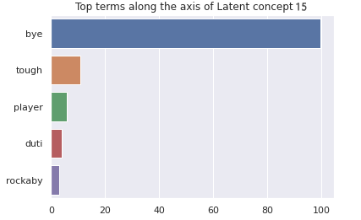
Implementation: Choosing the rank K
Each concept is represented by a list of terms and the weights that each term has on that concept. For example, the top 5 terms for concepts 56 and 15 are:

Slide 16

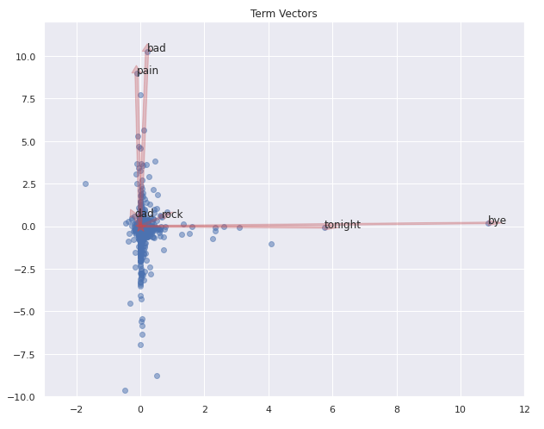
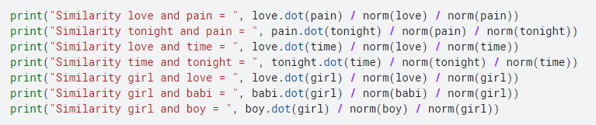
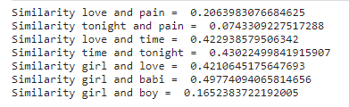

Results: Similarity between terms or songs

Slide 17
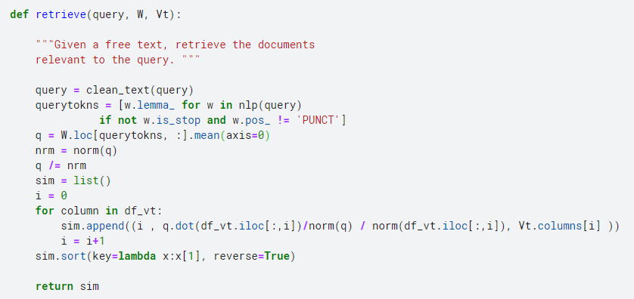
Results: Answer queries
Given a free text, retrieve the documents relevant to the query
Apply pre-processing to the query and represent it in the space of concepts
Calculate cosine similarity between the query and each document

Slide 18
Results: Evaluate the system
Use the "precision at K“ with K=5
Execute some queries and decide whether the retrieved documents are relevant or not by reading the text and looking at the key words of the query
The following queries have been used:
“love heart” → precision: 0.6
“happy party smile”→ precision: 0.8
“dark night”→precision: 0.6
“rock monster bad”→precision: 1
The average precision is 0.75

Slide 19
Conclusions: Possible Improvements
In the queries, only the terms contained in the dictionary can be used
To answer a query, the cosine similarity is calculated with all the documents
Data structure for the dictionary

Slide 20
References
Fahrettin Horasan, Hasan Erbay, Fatih Varçın, Emre Deniz, "Alternate Low-Rank Matrix Approximation in Latent Semantic Analysis", Scientific Programming, vol. 2019, Article ID 1095643, 12 pages, 2019. https://doi.org/10.1155/2019/1095643
Lectures from Mathematical Computing with Data – Portland State University web.pdx.edu/~gjay/teaching/mth271_2020/html/_CONTENTS.html
https://www.datacamp.com/community/tutorials/discovering-hidden-topics-python

Slide 21

Thank you for your attention

