Slide 1

Passport Mobility Analysis

Slide 2

Meet The Team
Ellis Porter
Isha Chaware
Xiang Li
Alexandra Turner
Julia Dettman

Slide 3


About
The Interactive Visa Requirement Map is a tool designed to simplify the process of understanding global travel restrictions and visa requirements. Its primary purpose is to provide travelers with an easy-to-use, visual representation of the visa requirements for different countries, indicating whether a visa is required, visa-free, not admitted, visa on arrival, or if an e-visa is required.

Slide 4
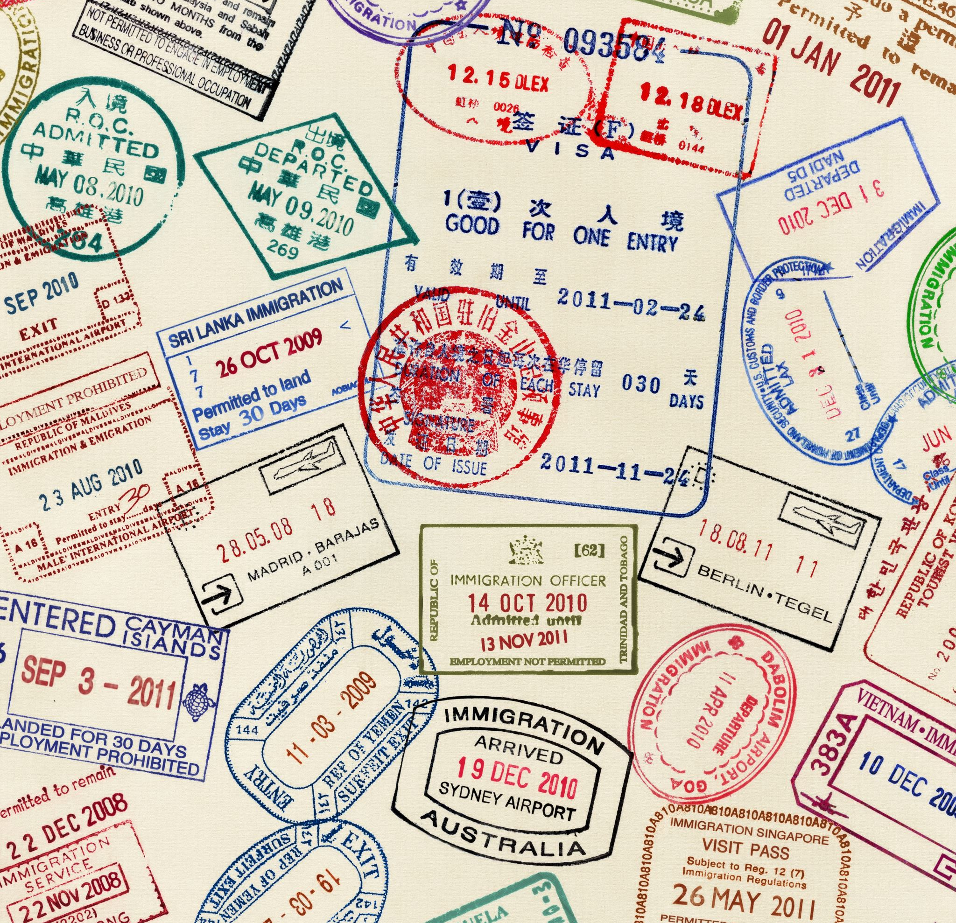
Fun Facts!
Passport Scarcity in North Korea: North Korean passports are extremely rare and are generally only issued to trusted government officials. The average citizen cannot freely travel internationally.
World's Most Powerful Passports: As of 2023, Japanese and Singaporean passports are considered the most powerful in the world, offering visa-free or visa-on-arrival access to a large number of countries.
Oldest Surviving Passport: The oldest surviving passport was issued in 1636 by Charles I of England. It's currently kept in the UK’s National Archives.

Slide 5

Entry Requirements – What’s the difference?
Visa-Free: The ability to enter a country without obtaining a Visa in advance.
E-Visa: An official document that permits people to enter and travel within a country
Visas-on-Arrival: Issues when the visitor arrives in a country. Travelers need not apply for a visa beforehand.
Visa Required: Travelers must apply for a visa to the country before actually travelling there.
No admission: Travelers cannot enter the country under any circumstance.

Slide 6

Database & Data cleaning
3 CSV files
Mapped iso 2 codes to country name
Cleaned data in Jupyter Notebook
Created a merged database file
Used PyMongo to load the geojson file onto flask app

Slide 7

Passports Index: Graphs Created
Top 10 countries by each requirement
Visa free
Visa on arrival
E visa

Slide 8
Flask App Visualizations
Interactive World Map
Interactive Pie Chart

Slide 9



Dependencies
PostgreSQL
PyMongo
Flask
Matplotlib
Psycopg2
Pandas
NumPy
D3
Leaflet
Plotly

Slide 10

Data Sources
https://www.naturalearthdata.com/ - where we found the country boundary data
https://github.com/ilyankou/passport-index-dataset - passport entry data
https://mapshaper.org/ - used to combine files into a geojson

Slide 11

Further Research
If we were to continue this project, we would like to see if there is a correlation between GDP and passport mobility. How does the financial state of a country affect access?
Regional outlook – break the data into sub-regions / continents. How does total access differ per continent?
Does vicinity have an impact? Are neighboring countries more likely to share the same passport mobility?
Political Spectrum – what impact does this have, if any?

