Slide 1

Summer school 2009
Multivariate analysis of genetic markers as a tool to explore the genetic diversity
Thibaut Jombart – Imperial College London
tjombart@imperial.ac.uk
Multivariate analysis of genetic markers
T. Jombart - 09/09/09
1

Slide 2

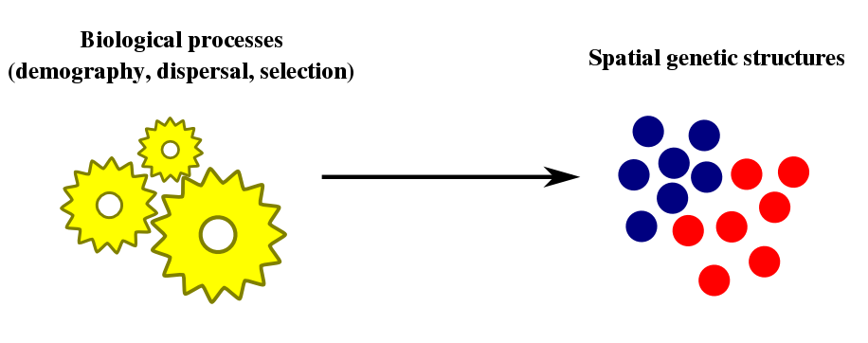
Why analysing genetic markers?
Multivariate analysis of genetic markers
T. Jombart - 09/09/09
2

Slide 3
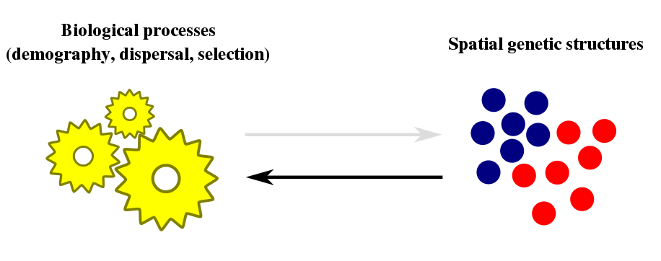
Why analysing genetic markers?
Identify genetic patterns to infer biological processes
structuring the biodiversity
Multivariate analysis of genetic markers
T. Jombart - 09/09/09
2

Slide 4
Genetic marker data
- Allele frequency
- Marker presence/absence
(Variables, Descriptors)
Data
matrix
- Individual
- Population
(Observations, Biological entities)
n
p
Summarise the genetic diversity among individuals / populations
Multivariate analysis of genetic markers
T. Jombart - 09/09/09
3

Slide 5
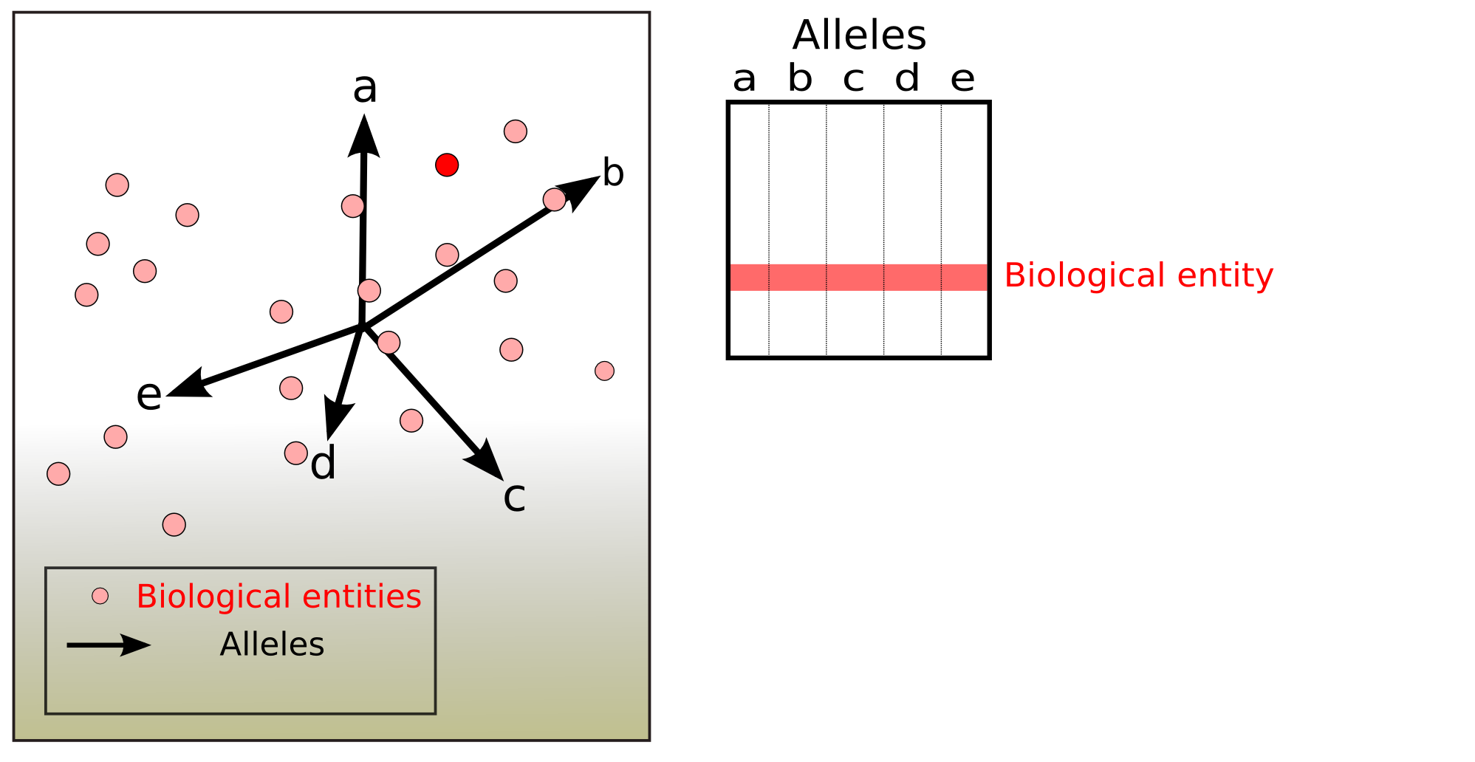
Multivariate analysis – rationale (1/2)
2
Multivariate analysis of genetic markers
T. Jombart - 09/09/09
4

Slide 6
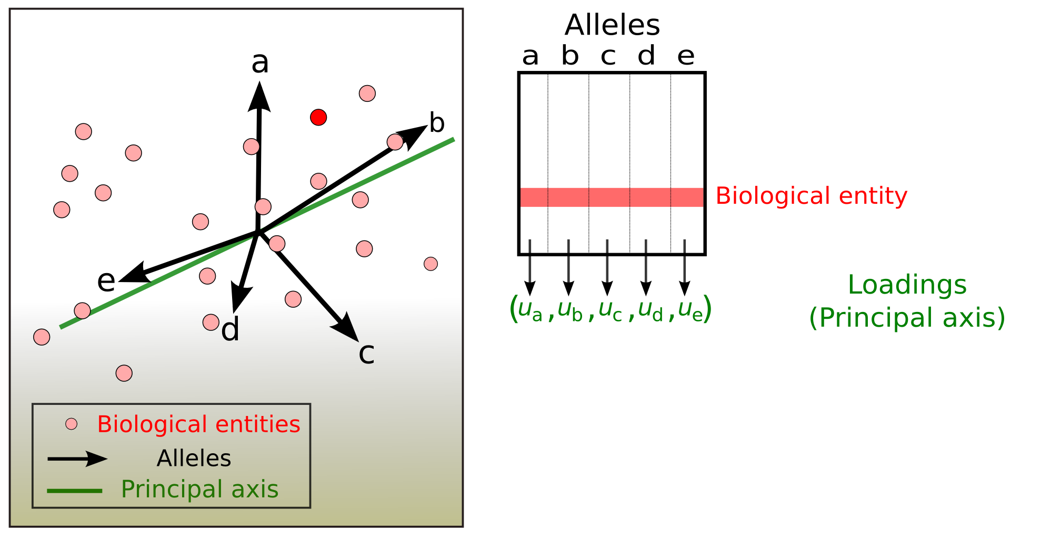
Multivariate analysis – rationale (1/2)
2
Multivariate analysis of genetic markers
T. Jombart - 09/09/09
4

Slide 7
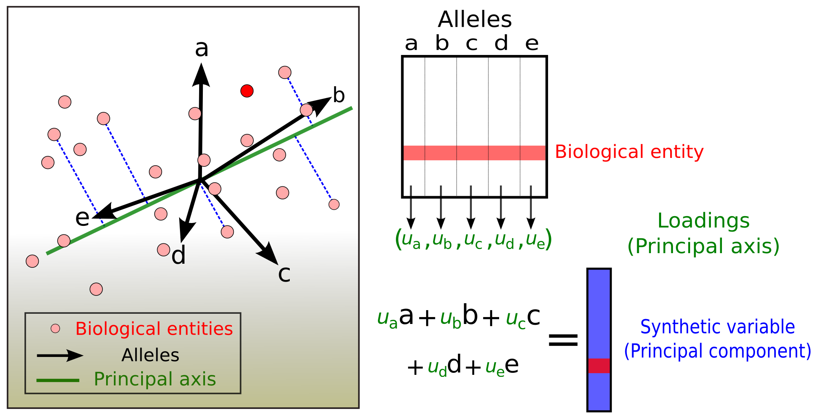
Multivariate analysis – rationale (1/2)
2
Summarise the genetic diversity among individuals / populations
Multivariate analysis of genetic markers
T. Jombart - 09/09/09
4

Slide 8
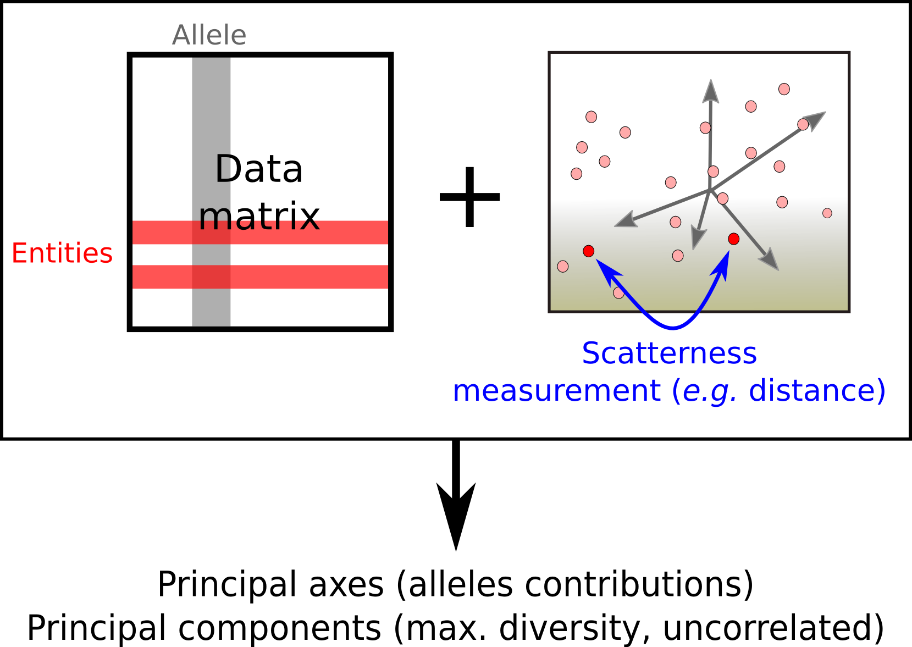
Multivariate analysis – rationale (2/2)
Multivariate analysis of genetic markers
T. Jombart - 09/09/09
5

Slide 9
Multivariate analyses: a large family
To name a few (used in genetics):
Principal Component Analysis (PCA)
    centred / not centred / fancy centring
    scaled / not scaled / fancy scaling
    transformed for compositional data
Principal Coordinates Analysis (PcoA),
aka (Metric) Multidimensional Scaling (MDS)
    many genetic distances
Correspondence Analysis (CA)
Discriminant Analysis (DA)
… (review in Jombart et al. 2009, Heredity 102, 330-341)
Multivariate analysis of genetic markers
T. Jombart - 09/09/09
6

Slide 10
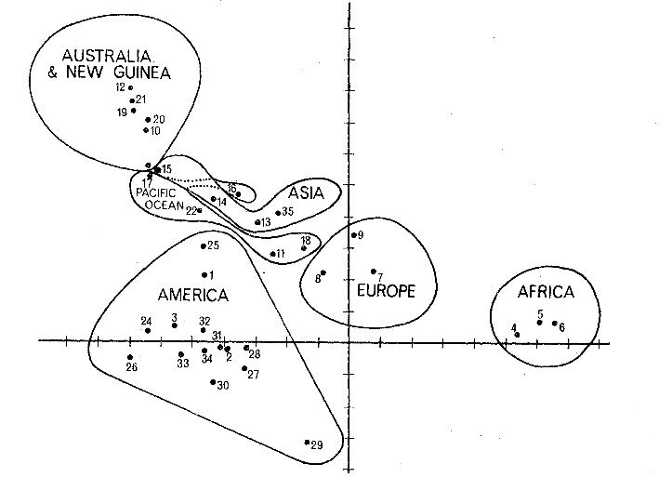
What to do with principal components?(1/3)
Get a picture of genetic diversity
HLA freq
Data
matrix
Principal axis 2
Populations
Populations
Principal axis 1
(Cavalli-Sforza 1966)
Multivariate analysis of genetic markers
T. Jombart - 09/09/09
7

Slide 11
What to do with principal components?(2/3)
Use as response/predictor in models
Allozymes
Data
matrix
Populations
=
+
+
Climate
Data
matrix
Populations
Genetic features
(Principal components)
Covariates
Environmental
variables
Residuals
(Mulley et al. 1979)
Multivariate analysis of genetic markers
T. Jombart - 09/09/09
8

Slide 12
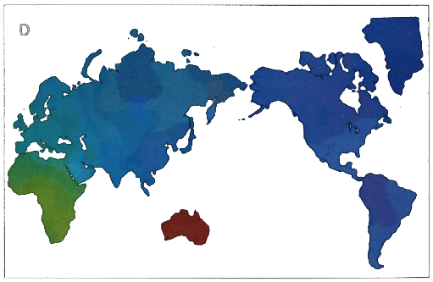
What to do with principal components?(3/3)
Make geographical maps of the genetic differentiation
HLA freq
xy
Data
matrix
Populations
Legend: principal components
PC 1
PC 2
PC3
(Cavalli-Sforza et al. 1993)
Multivariate analysis of genetic markers
T. Jombart - 09/09/09
9

Slide 13
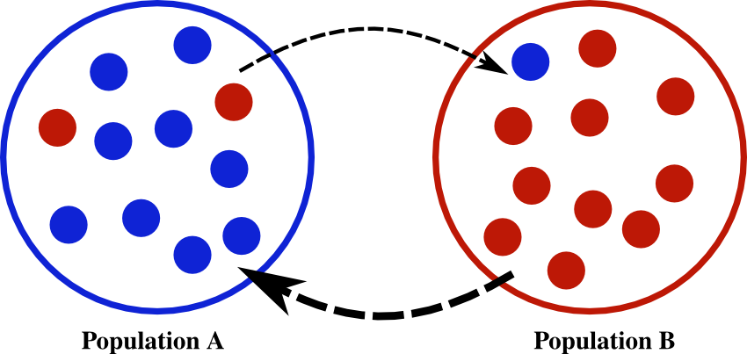
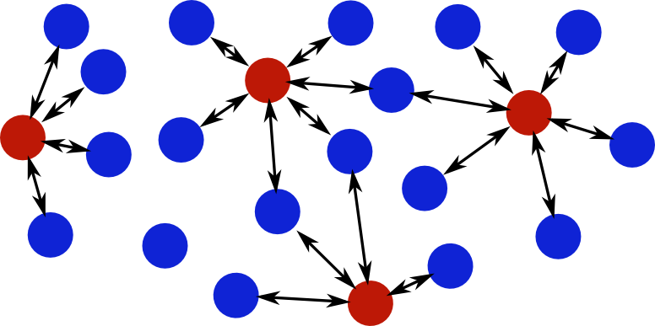
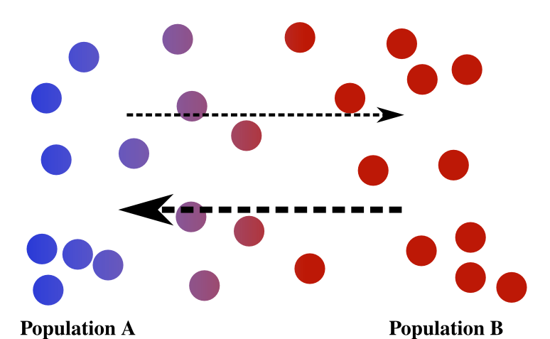
Why look for spatial genetic structures?
Most genetic models predict that genetic diversity should be spatially structured:
Island model
Isolation
by
distance
Inbreeding avoidance
Multivariate analysis of genetic markers
T. Jombart - 09/09/09
10

Slide 14
Taking spatial information into account
Usual multivariate methods do not use spatial information.
They can reveal `obvious' spatial patterns, but will overlook more subtle structures.
To seek spatial genetic structures, we must find the part of the genetic variability related to spatial proximity between individuals/populations.
Multivariate analysis of genetic markers
T. Jombart - 09/09/09
11

Slide 15
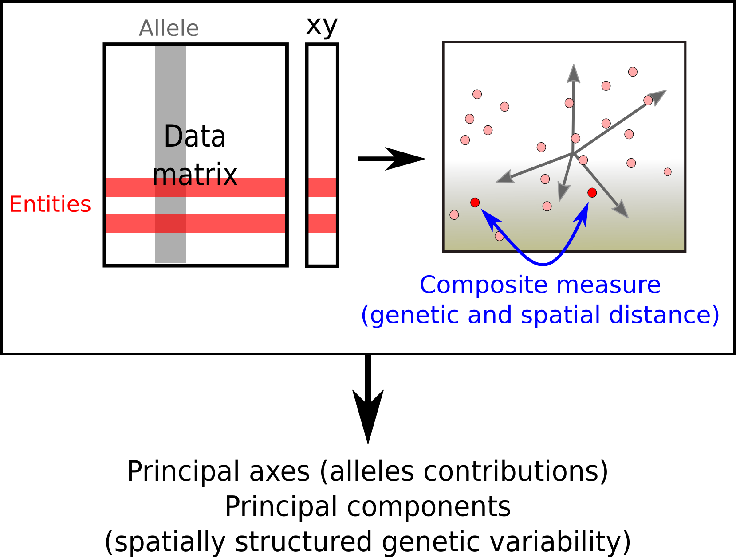
Spatial Principal Component Analysis (sPCA)
(Jombart et al. 2009)
Multivariate analysis of genetic markers
T. Jombart - 09/09/09
12

Slide 16
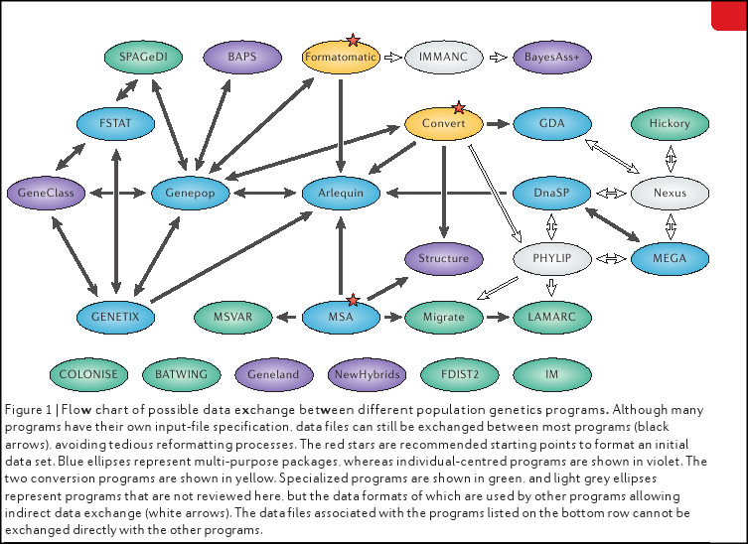
Population genetic software – the scary picture
(Excoffier & Heckel 2006)
`In a perfect world, research teams would be able to develop analysis tools to address their specific problem, but in practice they have to make their data fit the available tools, leading to obvious discrepancies between the initial goals and the results'
Multivariate analysis of genetic markers
T. Jombart - 09/09/09
13

Slide 17

Taking genetic markers into the field of (multivariate) statistics
Population genetic software:
very few multivariate methods
no plasticity
poor data interoperability
The software:
many multivariate methods
total plasticity
tons of statistic methods (tests, modeling, Monte-Carlo)
great graphics
great interoperability (e.g., GIS)
programming language
free software
Multivariate analysis of genetic markers
T. Jombart - 09/09/09
14

Slide 18
The adegenet package for (1/3)
(Jombart 2008)
Purpose:
take genetic markers into a suitable format
adapt multivariate methods to genetic markers
provide advanced data handling
implement novel methods (e.g., sPCA)
Multivariate analysis of genetic markers
T. Jombart - 09/09/09
15

Slide 19
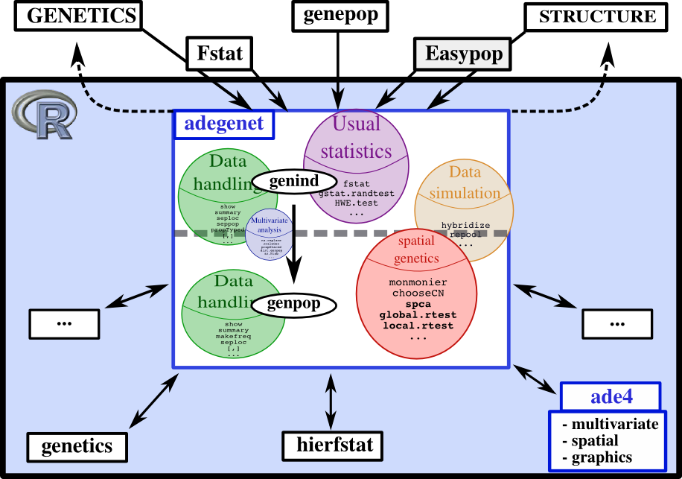
The adegenet package for (2/3)
Multivariate analysis of genetic markers
T. Jombart - 09/09/09
16

Slide 20
The adegenet package for (3/3)
Where to get information:
reference: Jombart (2008) Bioinformatics 24: 1403-1405
adegenet website: http://adegenet.r-forge.r-project.org/
adegenet forum: adegenet-forum@lists.r-forge.r-project.org
Here and now!
Multivariate analysis of genetic markers
T. Jombart - 09/09/09
17

