Slide 1
Microarray Informatics at the EBI
Alvis Brazma Group
BIOCEP Project
Karim Chine
BBSRC (UK) grant BB/E001653/1
Grant’s Principal Investigators: Wolfgang Huber, Misha Kapushesky

Slide 2
What do we need ?
Provide tools and frameworks for Bioconductor packages automatic exposure as Web Services
Provide a scalable, robust architecture for R integration within ArrayExpress Warehouse and Expression Profiler

Slide 3
State of the art
SJava and rJava/JRI
- Basic mapping via JNI of the R C API
TypeInfo
- Plug meta descriptions to R functions
RWebservices
- Generated Java Beans for basic R Types / S4 Classes
- Axis Web Services based on SJava and ActiveMQ
JavaGD
- R devices connection to Java (JGR)‏
Rserve
- TCP/IP interface to R

Slide 4
What is missing ?
High Level Java API for Accessing R
Stateful, Resuable, Remotable R Components
Scalable, Distributed, R Based Infrastructure
Safe multiple clients framework for components usage as a pool of indistinguishable Remote Resources
User friendly Interface for the remote resources creation, tracking and debugging

Slide 5
What is missing ?
Generated light-weight Java proxies for R Types / S4 Classes
On-demand mapping and deployment of R pacakges as RMI Components or as JAX-WS Web Services
Remotable R Graphics / Swing Components for R
Remote R components files exchange API
Semi-thick client (applet) for web based tools using R

Slide 6
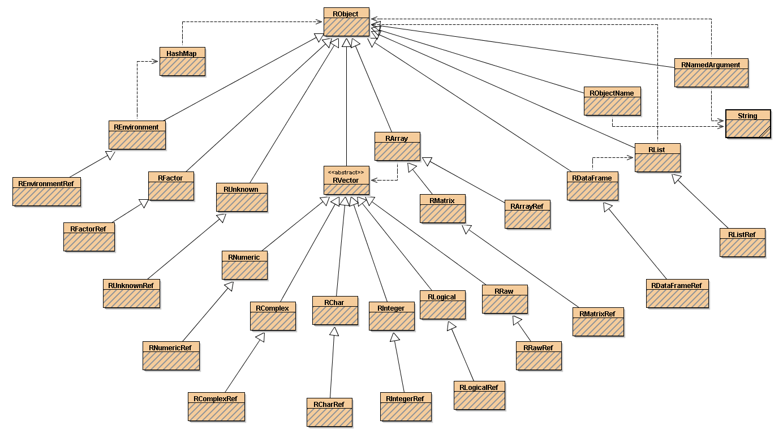
Standard R objects mapping to Java

Slide 7
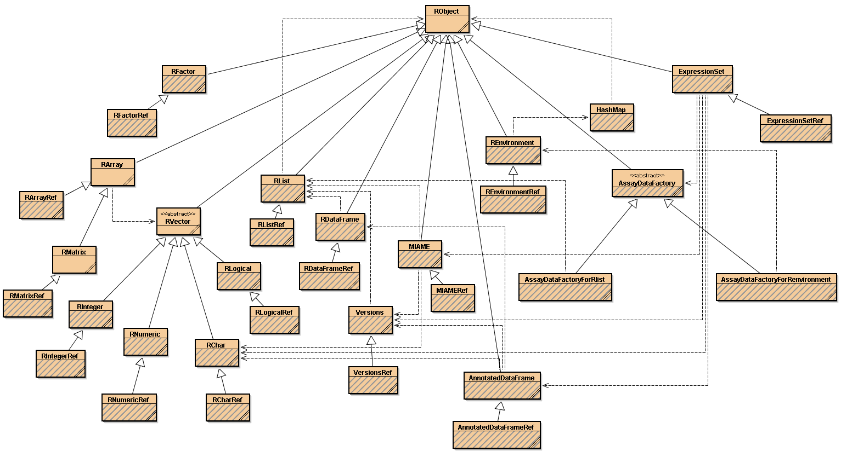
Generated beans for ExpressionSet
Generated Java Bean
Proxy Class

Slide 8
High Level API for Accessing R
public interface RServices extends ManagedServant {
public String evaluate(String expression) throws RemoteException;
...
public RObject call(String methodName, RObject... args) throws RemoteException;
...
public RObject callAsReference(String methodName, RObject... args) throws RemoteException;
...
public RObject evalAndGetObject(String expression) throws RemoteException;
...
public RObject evalAndGetObjectAsReference(String expression) throws RemoteException;
...
public RObject putObjectAndGetReference(RObject obj) throws RemoteException;
...
public void putObjectAndAssignName(RObject obj, String name) throws RemoteException;
...
public RPackage getPackage(String packageName) throws RemoteException;
...
public void setCallBack(RCallback callback) throws RemoteException;
...
public GDDevice newDevice(int w, int h) throws java.rmi.RemoteException;
...
public byte[] readWorkingDirectoryFileBlock(String fileName, long offset, int blocksize) ..
...
public String getStatus() throws RemoteException;
...
}

Slide 9
Remote Resource Pool Framework
Generic Standalone framework
Pooling of any RMI components and if combined with JNI of any library / open architecture
New Remote Object Registry based on Derby | Oracle | MySql
Three implementations available
- rmiregistry / mono-node / single client process
- rmiregistry / multinodes / single client process
- database ROR / multinodes / multiple client processes
User friendly interface for the remote resources creation, tracking and debugging, nodes and pools management

Slide 10
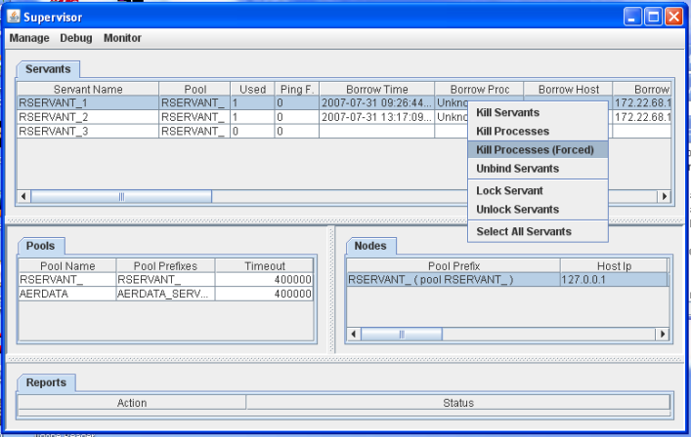
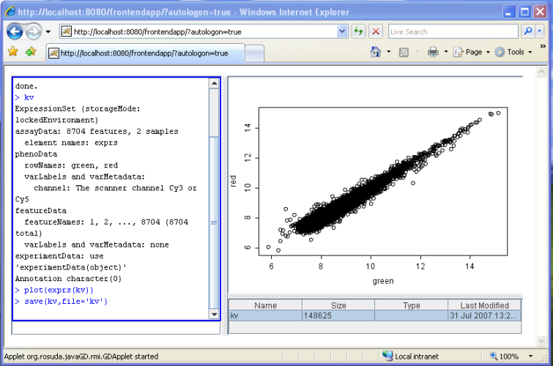
Architecture I
R
JVM
Supervisor
rJava / JRI
JavaGD
Object Export / Import Layer
mapping.jar
RServices API
RServices Skelton R packages skeltons
Client Application
Remote Objects Registry
Borrow R
Return R
Pooling framework
JVM
Web Browser ( java plugins ( applet ) )‏
Pooling framework
Pooling framework
Generated mapping
Tunneling Servlet
JAX-WS servlet/artifacts
.NET, Perl.. Application
Http Tunneling
SOAP
Tomcat

Slide 11
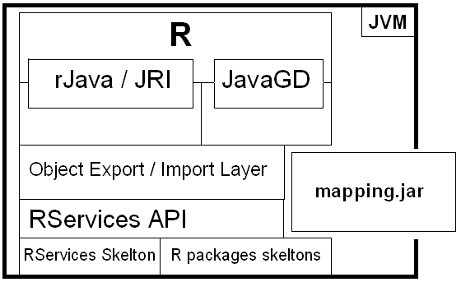
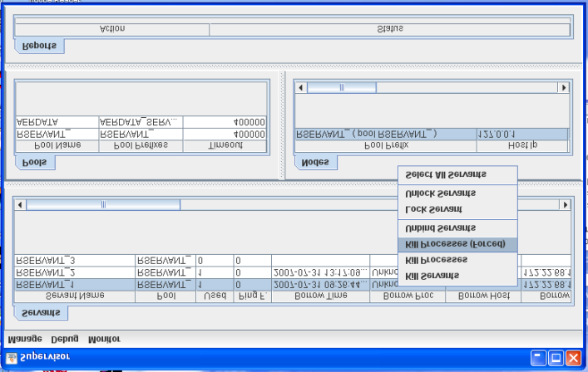
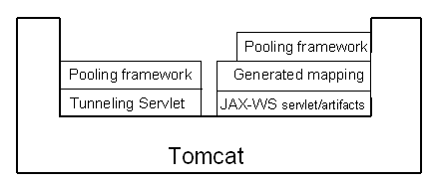
Architecture II
Remote Objects Registry
Node 1 : 64 bits machine / Linux
Node 2 : Windows XP
Node 3 : Mac OS

Slide 12
Parallel Computing
final double[][] m=..;
Future<Double>[] result=new Future[m.length];
ExecutorService exec = Executors.newFixedThreadPool(50);
for (int i=0; i<result.length; ++i) {
final double[] v=m[i];
result[i]= exec.submit(
new Callable<Double>() {
public Double call() throws Exception {
RServices r=null;
try {
r=(RServices)ServantProviderFactory.getFactory().getServantProvider().borrowServantProxy();
Rnumeric mean=(RNumeric)r.call("mean", new RNumeric(v));
return mean.getValue()[0];
} finally { ServantProviderFactory.getFactory().getServantProvider().returnServantProxy(r); }
}
});
}
while(true) {
int count=0; for (int i=0; i<result.length; ++i) if (result[i].isDone()) ++count; if (count==result.length) break;
Thread.sleep(100);
}
for (int i=0; i<result.length; ++i) System.out.println(result[i].get());

Slide 13
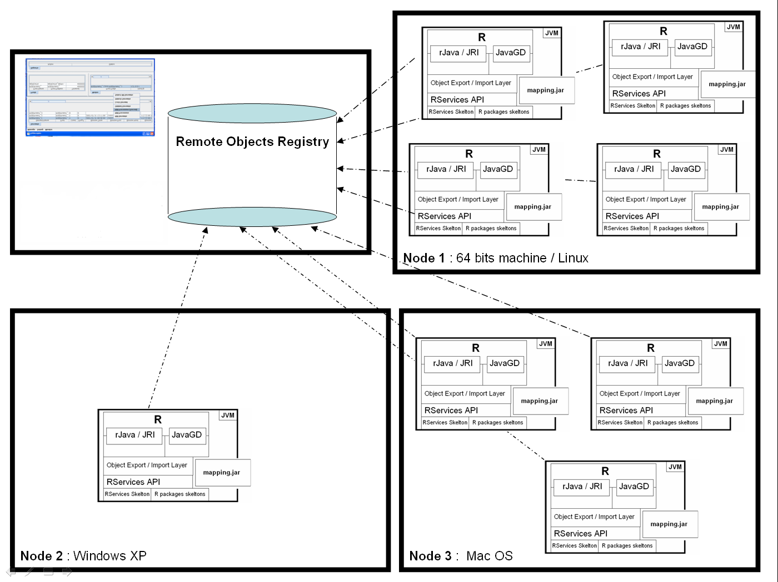
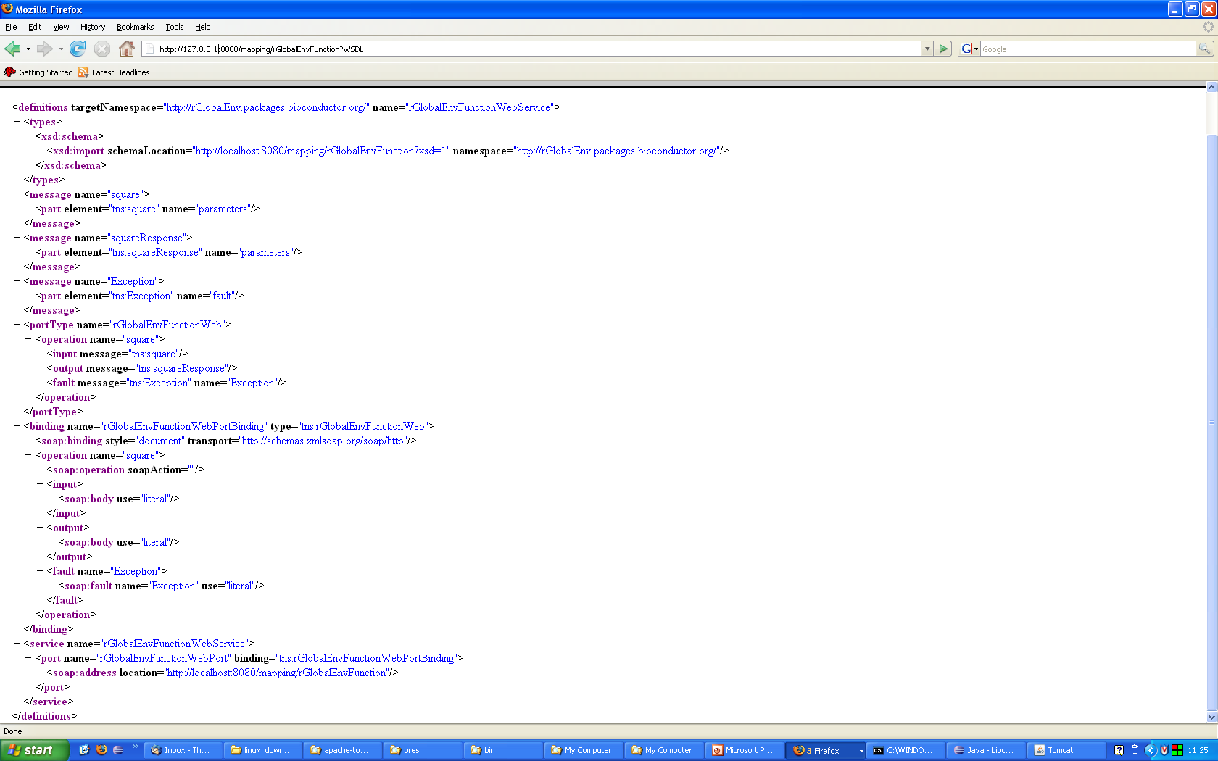
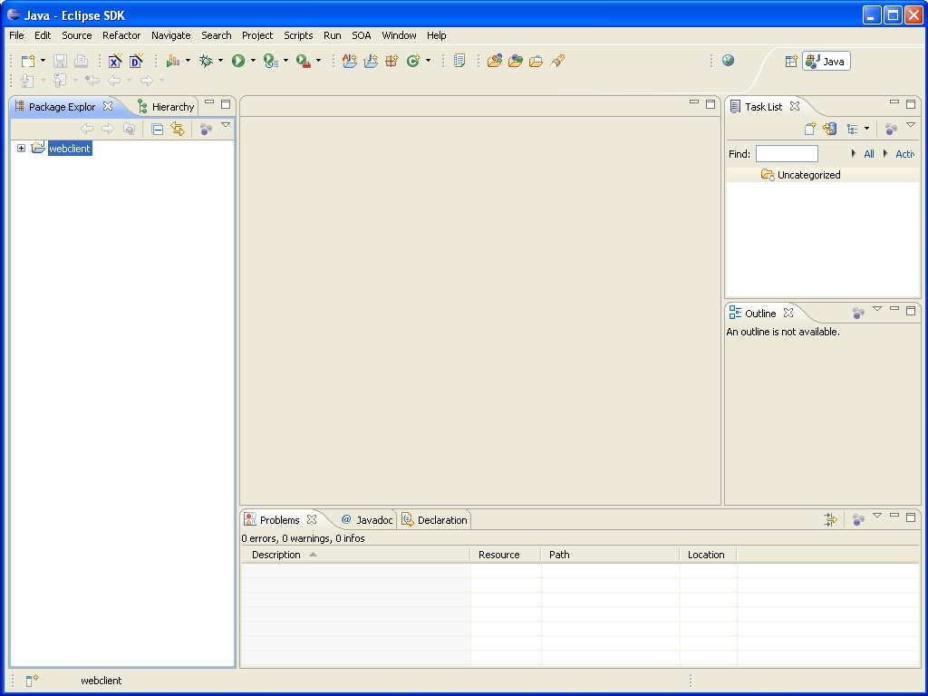
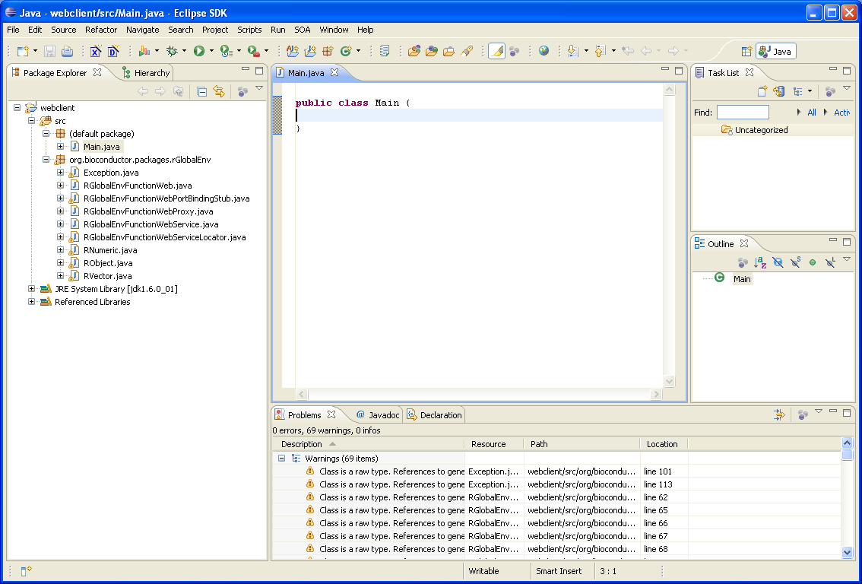
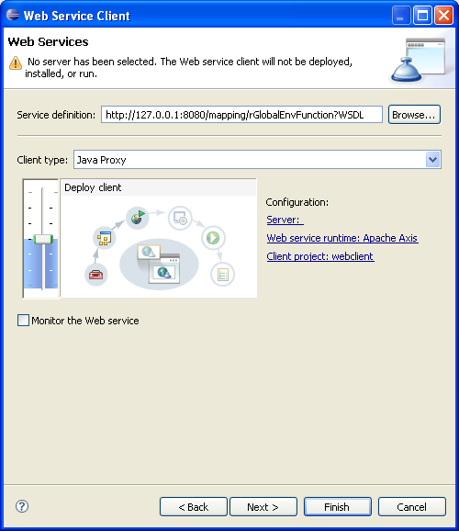
Web Services Generation
Script / globals.r
mapping.war
square ← function(x) {return(x^2) }
typeInfo(square) ← SimultaneousTypeSpecification(
TypedSignature(x = "numeric"), returnType = "numeric")‏
+ mapping.jar
+ pooling framework
+ R Java Bridge
+ JAX-WS
- Servlets
- Generated artifacts
ant demogen
Deploy
mapping.war
Script / rjmap.xml
tomcat
<rj>
<publish>
<functions> <function name="square" forWeb="true"/> </functions>
</publish>
<scripts> <initScript name="globals.r" embed="true"/> </scripts>
</rj>
WSDL
http://127.0.0.1:8080/mapping/rGlobalEnvFunction?WSDL
public static void main(String[] args) throws Exception {
RGlobalEnvFunctionWeb g=new
RGlobalEnvFunctionWebServiceLocator().getrGlobalEnvFunctionWebPort();
RNumeric x=new RNumeric(); x.setValue(new Double[]{6.0});
System.out.println(g.square(x).getValue()[0]);
}
Eclipse Web Service Client Generator
Client artifacts

Slide 14
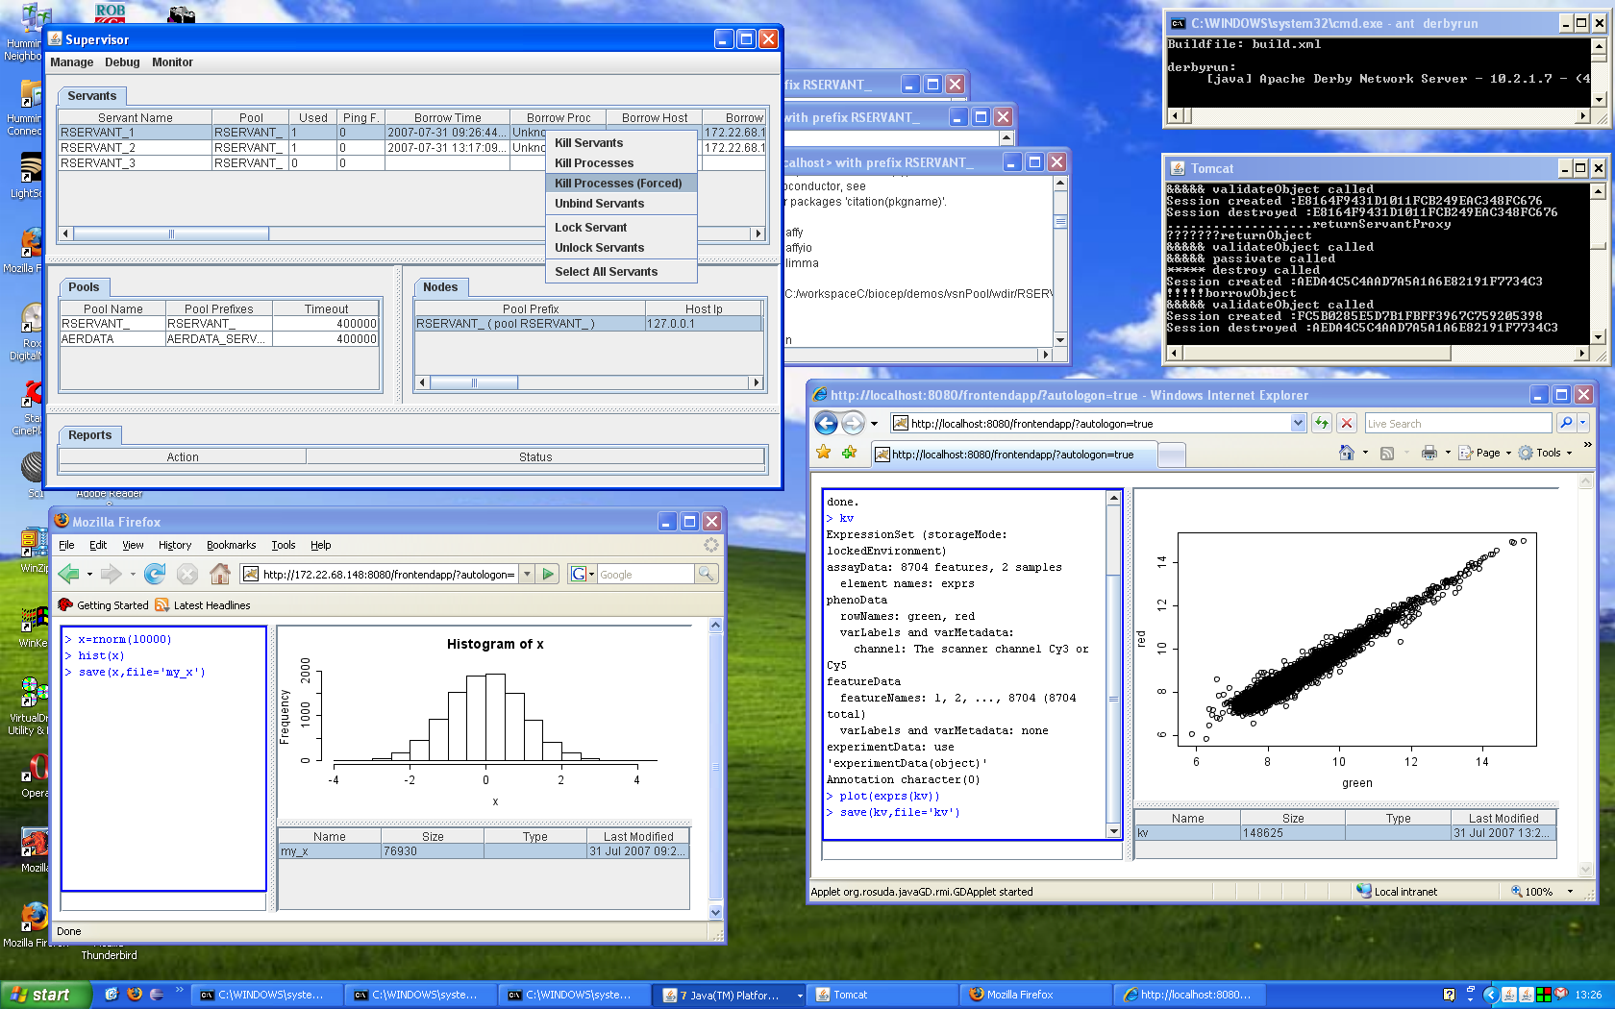
Virtualization of R
Distributed Infrastructure Supervisor
R Rmi Servants exported log
Derby Based Naming Server
R Servants View
Used Servants
Tomcat
Pools View
Infrastructure
Nodes View
Resizable Virtual
R Panel
Virtual file system
Virtualized R Applet Running inside Firefox
Virtual R Console
Virtualized R Applet Running inside Internet Explorer

Slide 15
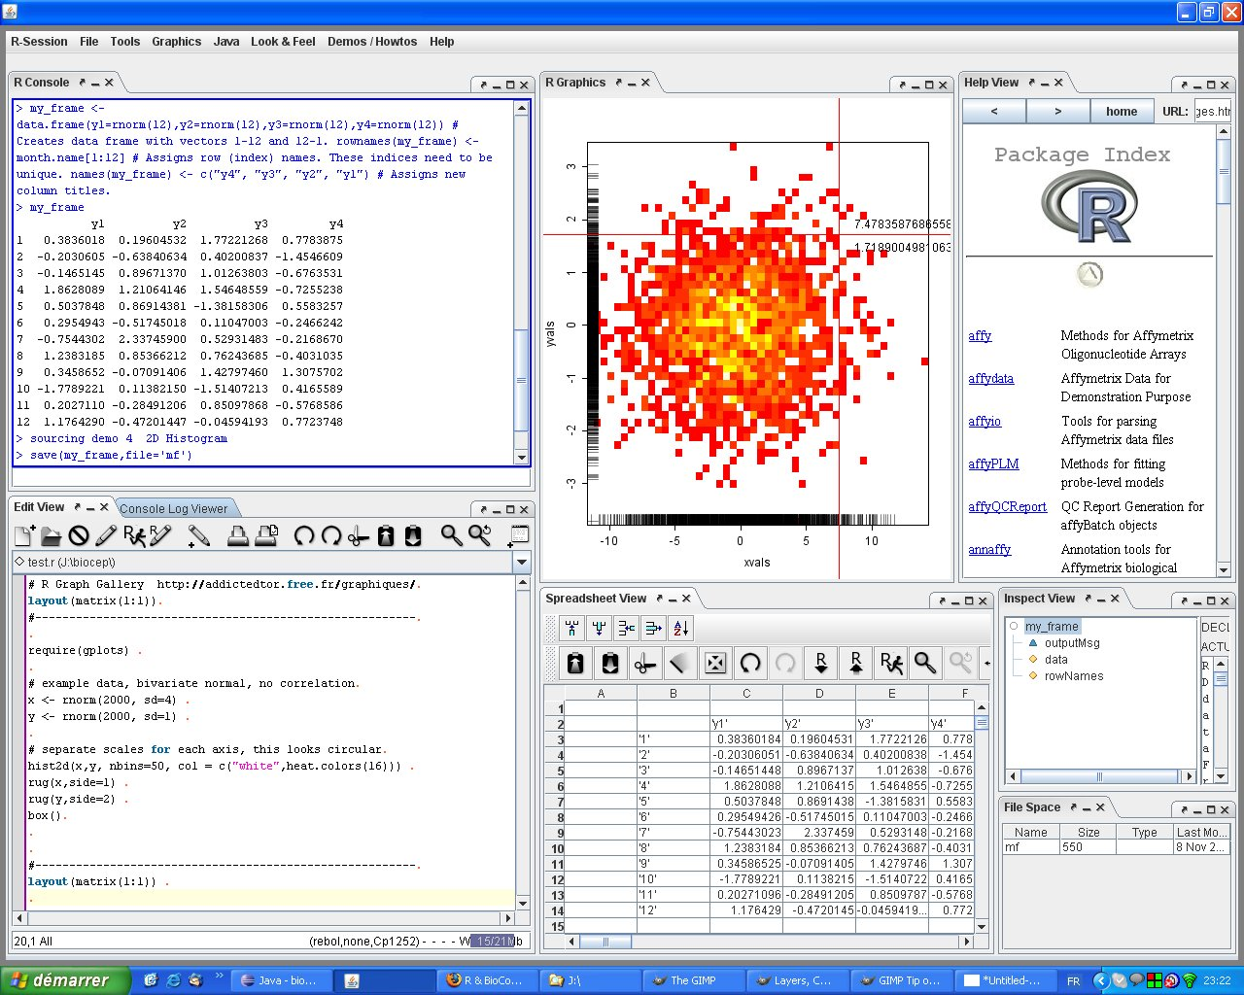
Virtual R Workbench

Slide 16
Acknowlegments
Misha Kapushesky
Wolfgang Huber
Alvis Brazma
Ugis Sarkans
Martin Morgan
Seth Falcon
Simon Urbanek

Slide 17
R O.O. Programming in a nutshell
S4 supports : objects / classes / inheritance / polymorhpism
Example
setClass("Point", representation(x="numeric", y="numeric"))‏
setClass( "StyledPoint", contains="Point", representation(style="integer") )‏
setGeneric("distance", function(p1,p2) standardGeneric("distance"))‏
setMethod("distance", signature("Point", "Point") ,
function(p1, p2) { sqrt( (p2@x-p1@x)^2 + (p2@y-p1@y)^2 ) })‏
O<-new ("Point", x=12,y=2); P<-new("Point", x=52, y=90)‏
distance(O,P)‏
Introspection functions
class(P) / getClass("Point“) / getSlots(“Point“) / ..
showMethods(class = "Point") / showMethods("distance") / isGeneric ("distance") / ..
extends("StyledPoint") / ..
Unions
setClass("Egg", representation(color="integer")); setClassUnion("Thing", c("Point","Egg"));

Slide 18
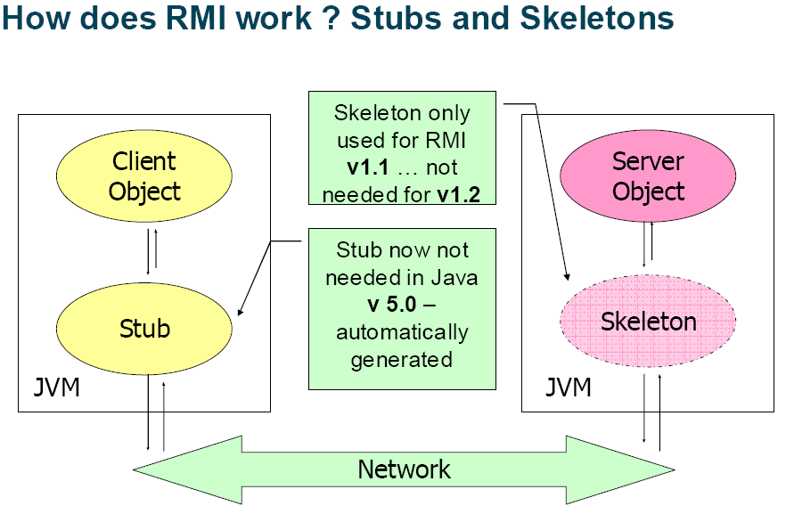
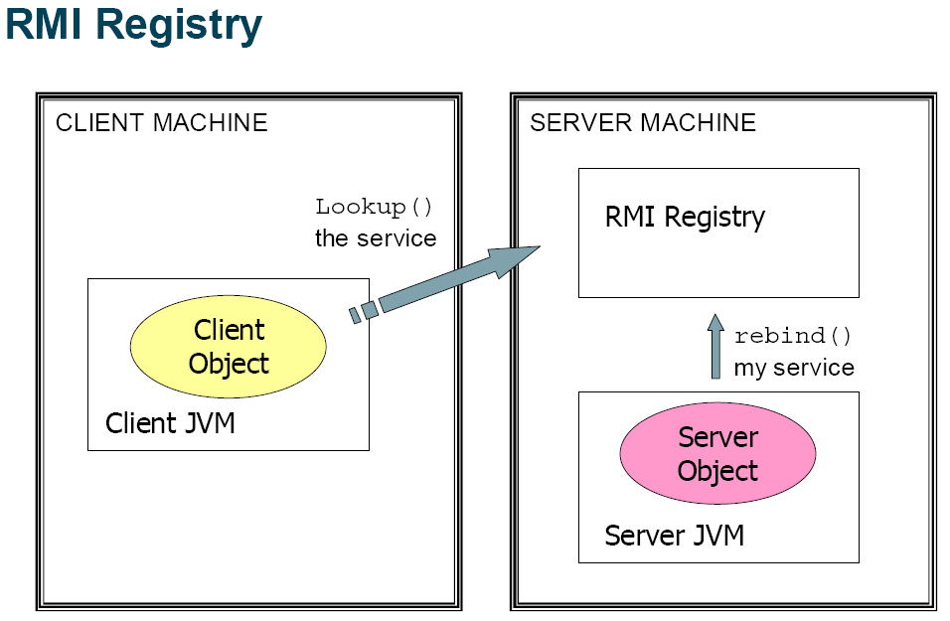
RMI in a nutshell

Slide 19
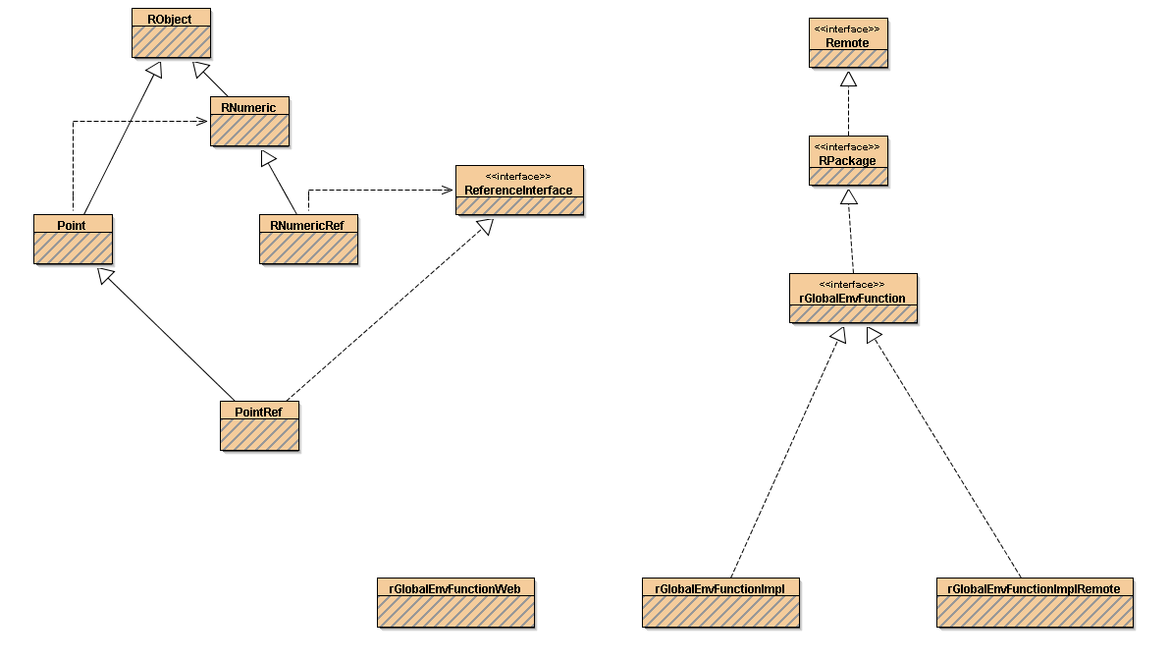
Functions Mapping
mapping.war
Script / globals.r
setClass("Point", representation(x="numeric", y="numeric"))‏
setGeneric("distance", function(p1,p2) standardGeneric("distance"))‏
setMethod("distance", signature("Point", "Point") , function(p1, p2) {
sqrt( (p2@x-p1@x)^2 + (p2@y-p1@y)^2 ) })‏
mapping.jar
rGlobalEnvFunction.class
ant demogen
rGlobalEnvFunction.R
rGlobalEnvFunctionImpl.class
Script / rjmap.xml
<rj>
<publish>
<functions><function name="distance" forWeb="true“ returnType="numeric"/></functions>
</publish>
<scripts> <initScript name="globals.r" embed="true"/> </scripts>
</rj>
...
rGlobalEnvFunctionImplRemote.class
RJB.jar
...
public interface rGlobalEnvFunction extends RPackage {
RNumeric distance(Point p0,Point p1) throws RemoteException
RNumeric distanceAsReference(Point p0, Point p1) throws ..}
Framework class ( RJB.jar )‏
Generated class ( mapping.jar )‏
Proxy class
@WebService
public class rGlobalEnvFunctionWeb { ..
R Global Environment « Package » Web Implementation Local Implementation RMI Object Implementation

Slide 20
-

Slide 21
Prerequisites
1. Checkout the EBI-Biocep project
public svn URL : https://svn.ebi.ac.uk/ma/branches/biocep/
login : ma-guest
password : CN85JIZ5
(README.txt contains the instructions to run the demos)‏
2. JDK 5 or 6 [Java SE 6 is required for JAX-WS Web Services]
- JAVA_HOME environment variable set to the installation root folder of the jdk
- PATH environment variable must include the jdk bin directory
3. ant >= 1.7.x installed
- ANT_HOME environment variable set to the installation root folder of ant
- PATH environment variable must include the ant bin directory
4. R >= 2.5.x installed
- R_HOME environment variable set to the installation root folder of R
- Bioconductor packages installed (only vsn & its dependencies for the demos)
- TypeInfo package installed
- rJava package installed
- JavaGD package installed
if you encounter problems installing rJava, check the following :
on Unix like systems : grep JAVA $R_HOME/Makeconf
→ if R is not using the right jdk set JAVA_HOME to the path of the right one
→ "R CMD javareconf“
→ install rJava

Slide 22
5. apache-tomcat-5.5.x installed
- TOMCAT_HOME environment variable set to the installation root folder of tomcat
6. apache derby 10.x installed
- DERBY_HOME environment variable set to the installation root folder of derby
Useful links :
Java SE: http://java.sun.com/javase/downloads/index.jsp
ant: http://ant.apache.org/bindownload.cgi
R: http://cran.r-project.org/
BioConductor : source("http://bioconductor.org/biocLite.R");biocLite()
R packages : biocLite(c('TypeInfo', 'rJava', 'JavaGD'))
tomcat : http://tomcat.apache.org/download-55.cgi
derby : http://db.apache.org/derby/derby_downloads.html

Slide 23
Deployement of a Virtualized R infrastructure
cd biocep/VirtualRWorkbench
ant clean
ant compile
(on windows only) : ant download.pstools
ant demogen
ant webcompile
ant demodeploy
ant –Dspawn=true derbyrun
ant demodb
ant tomcat.startup
new terminal (cd biocep/VirtualRWorkbench) ant demonode
new terminal (cd biocep/VirtualRWorkbench) ant demotop
new browser → type the URL : http://127.0.0.1/frontendapp/ (applet)‏
or http://127.0.0.1/frontendapp/jaws (Java Web Start)‏

Slide 24
Logon (click ok, Login Dialog)‏
In the console part of the R applet :
Create a normal distribution x<-rnorm(1000)‏
Plot it plot(x)‏
Draw the histogram of x hist(x)‏
Save x : save(x,file=‘x_data’)‏
Right-click on the file and save it to your local disk
Use an editor to create an R script on your local disk : ‘script.r’
Add any R commands to your script
Right click on the working directory area of the R applet and copy the script you’ve created there
Source your script : source(‘script.r’)‏
Bring the supervisor window up front to have it simultaniously visible with the applet
Type logoff, notice the changes on the supervisor
Type logon, (ok) notice the changes on the supervisor

Slide 25
type data(kidney)‏
type jk<-justvsn(kidney)‏
plot the expression of jk
right-click on the console log area and copy the Java Serialization of jk to your disk (jk.ser) [can be used directly by java code]
right-click on the console area and push the Java Serialization (jk.ser) to R, name the
target variable jk2
plot the expression of jk2 plot(exprs(jk2))

Slide 26
Project Home:
http://www.ebi.ac.uk/microarray-srv/frontendapp/
R Workbench installation link
http://www.ebi.ac.uk/microarray-srv/frontendapp/rworkbench.jnlp
Contacts:
Karim Chine
Email : kchine@ebi.ac.uk
Phone : + 44 (0) 1223 492 597
Misha Kapushesky
Email : ostolop@ebi.ac.uk
Phone : +44 (0)1223 494 647

Slide 27




