Slide 1
analysis of luminophore profiles using R
overview:
- luminophores and other sediment mixing tracers
- a very general model of bioturbation
- the biodiffusion model
- problems with the biodiffusion model
- other approaches to bioturbation modelling
- transition matrix model
- data analysis
- model fitting
- MCMC

Slide 2
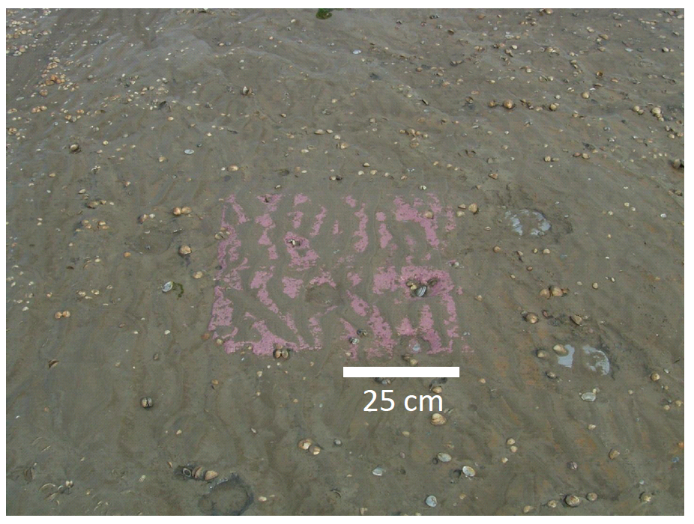
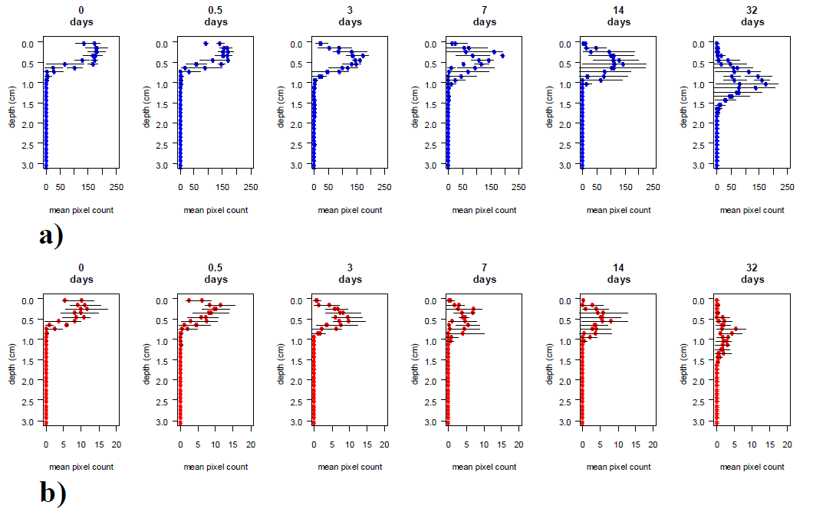
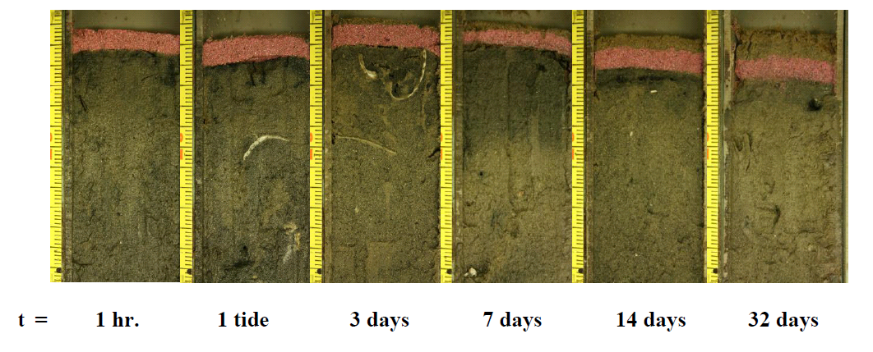
analysis of luminophore profiles using R
luminophores and other sediment mixing tracers
- tracers used for quantifying bioturbation:
- radionuclides: ²³⁴Th, ²¹⁰Pb, ¹³⁷Cs
- chlorophyll
- glass beads
- luminophores
- fluorescent particles, plastics or dyed sediment grains
- available in different colors
- can be sieved in order to obtain a certain range of grain size
- manual counting or by means of image analysis
- can be used in flat aquaria or in combination with SPI

Slide 3
analysis of luminophore profiles using R
a very general bioturbation model
- discrete in time and space
- particles jump between different positions on the lattice
- Chapman-Kolmogorov equation
- transfer coefficient aij
- matrix notation
- law of the large numbers
m
m+1
i-1
i
i+1

Slide 4
analysis of luminophore profiles using R
the biodiffusion model
- a special case of the general model
- particles can only move to neighbouring layers
- movement is isotropic
- rate of change in layer i
- discrete version of the biodiffusion model
m
m+1
i-1
i
i+1

Slide 5
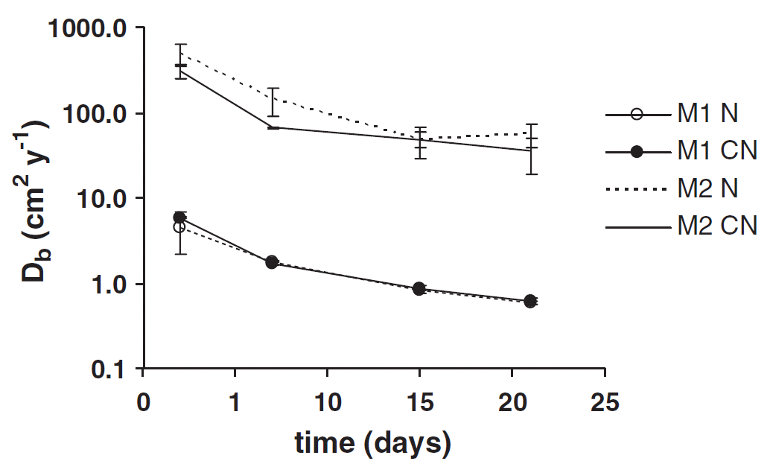
analysis of luminophore profiles using R
problems with the biodiffusion model
- assumption not valid in most benthic systems: movements are often larger than the
length scale which is needed to accurately model biogeochemical processes
- lack of fit
- DB values depend on the length of an experiment
- age dependent mixing
from Fernandes
et al. (2006)

Slide 6
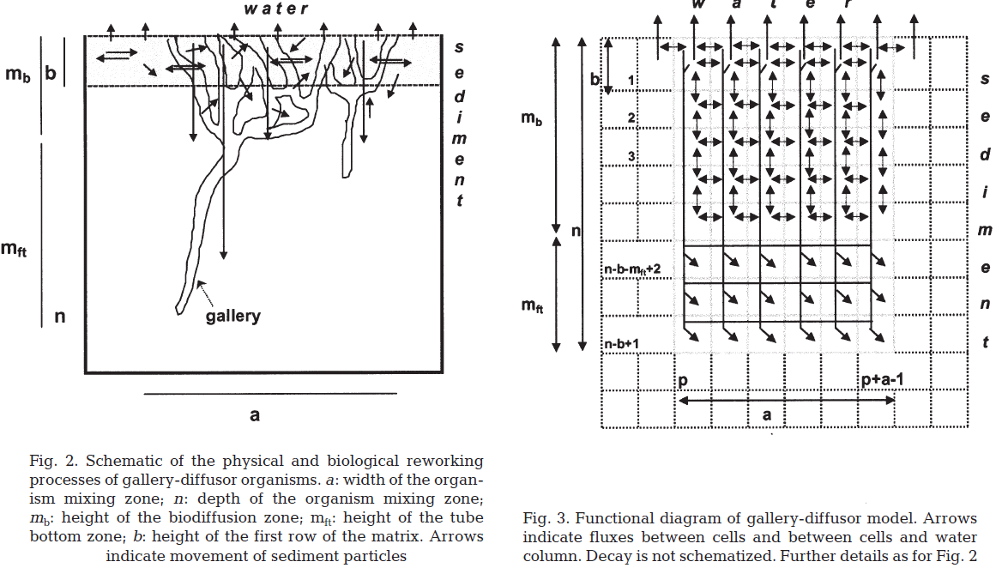
analysis of luminophore profiles using R
other approaches to bioturbation modelling
- the functional approach
- many parameters, only applicable in very specific situations
from François
et al. (2002)

Slide 7
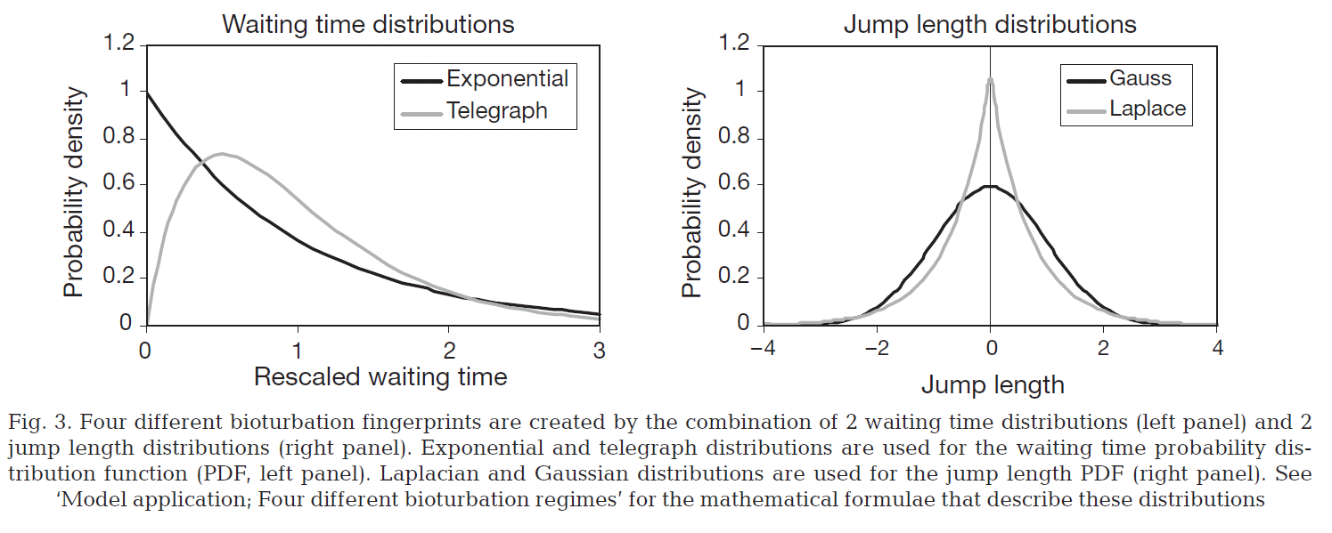
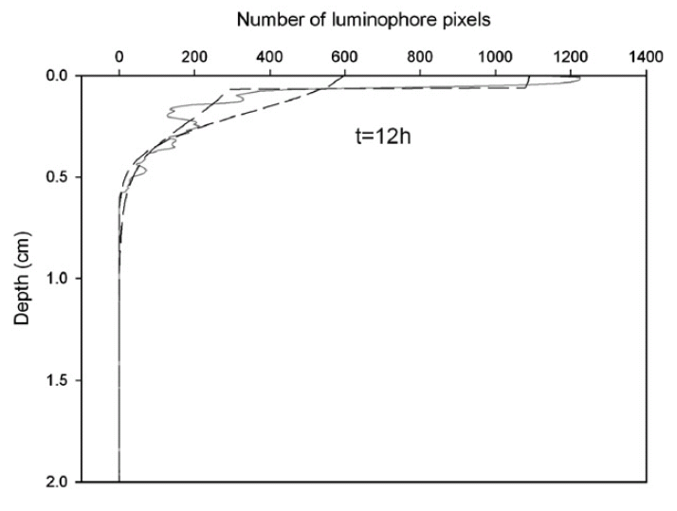
analysis of luminophore profiles using R
other approaches to bioturbation modelling
- continuous-time random-walk (CTRW)
- does a very good job at fitting luminophore profiles
- not easy to implement
from Meysman
et al. (2008)
from Maire
et al. (2007)

Slide 8
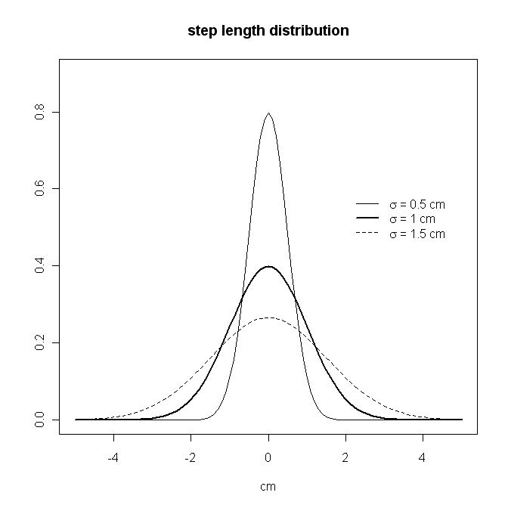
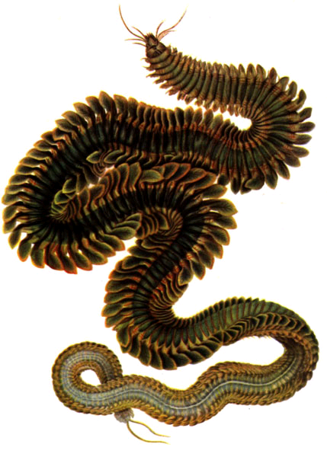
analysis of luminophore profiles using R
a matrix-transition model based on CTRW parameters
- stepping is supposed to be a Poisson process, with average waiting time τ
- the step length distribution is supposed to be Gaussian, with square root variance σ

Slide 9
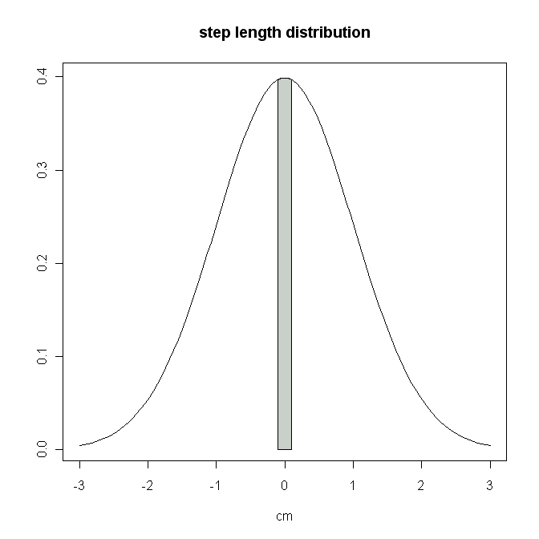
analysis of luminophore profiles using R
a matrix-transition model based on CTRW parameters
- the step length distribution is integrated over the intervals defined by the model grid
1,1
1,2
1,3
1,4
1,5
1,6
1,7
1,8
1,9
1,10
2,1
2,2
2,3
2,4
2,5
2,6
2,7
2,8
2,9
2,10
dx

Slide 10
analysis of luminophore profiles using R
a matrix-transition model based on CTRW parameters
- the step length distribution is integrated over the intervals defined by the model grid
1,1
1,2
1,3
1,4
1,5
1,6
1,7
1,8
1,9
1,10
2,1
2,2
2,3
2,4
2,5
2,6
2,7
2,8
2,9
2,10
dx

Slide 11
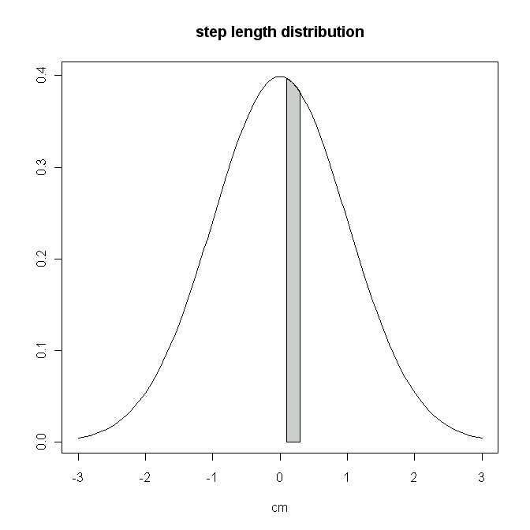
analysis of luminophore profiles using R
a matrix-transition model based on CTRW parameters
- the step length distribution is integrated over the intervals defined by the model grid
1,1
1,2
1,3
1,4
1,5
1,6
1,7
1,8
1,9
1,10
2,1
2,2
2,3
2,4
2,5
2,6
2,7
2,8
2,9
2,10
dx

Slide 12
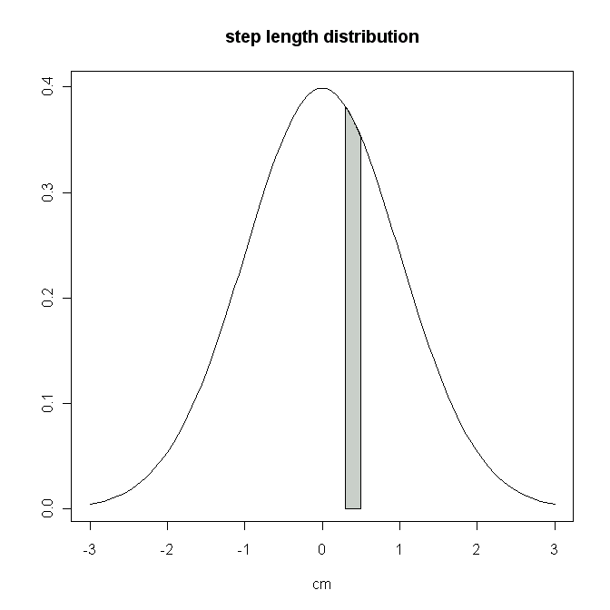
analysis of luminophore profiles using R
a matrix-transition model based on CTRW parameters
- the step length distribution is integrated over the intervals defined by the model grid
1,1
1,2
1,3
1,4
1,5
1,6
1,7
1,8
1,9
1,10
2,1
2,2
2,3
2,4
2,5
2,6
2,7
2,8
2,9
2,10
dx

Slide 13
analysis of luminophore profiles using R
a matrix-transition model based on CTRW parameters
- reflective boundary
- correction for the waiting time
1,1
1,2
1,3
1,4
1,5
1,6
1,7
1,8
1,9
1,10
2,1
2,2
2,3
2,4
2,5
2,6
2,7
2,8
2,9
2,10
3,1
3,2
3,3
3,4
3,5
3,6
3,7
3,8
3,9
3,10
4,1
4,2
4,3
4,4
4,5
4,6
4,7
4,8
4,9
4,10
5,1
5,2
5,3
5,4
5,5
5,6
5,7
5,8
5,9
5,10
...

Slide 14
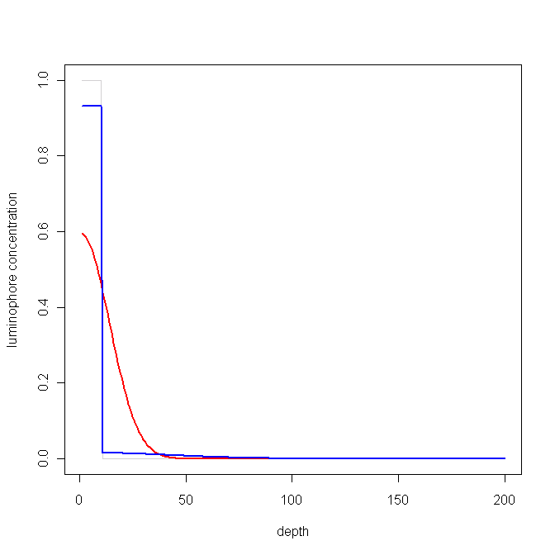
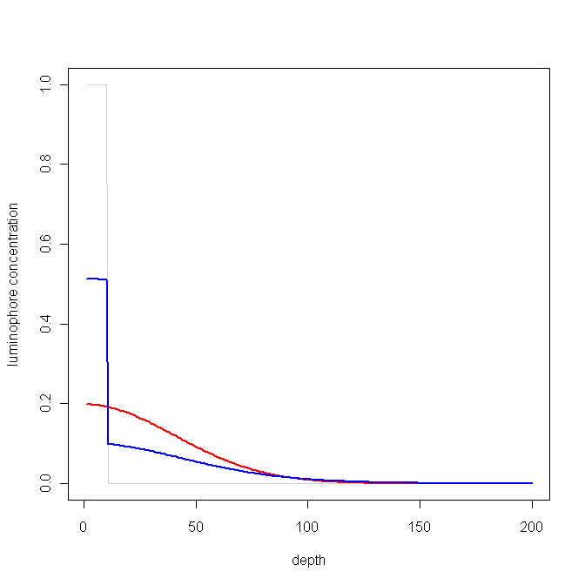
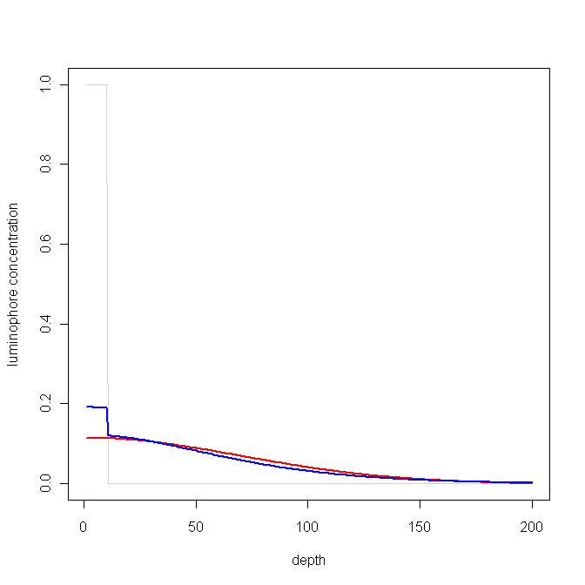
analysis of luminophore profiles using R
a matrix-transition model based on CTRW parameters
- behaves as expected
σ = 2 cm, τ = 10 d
1 day
10 days
30 days

Slide 15
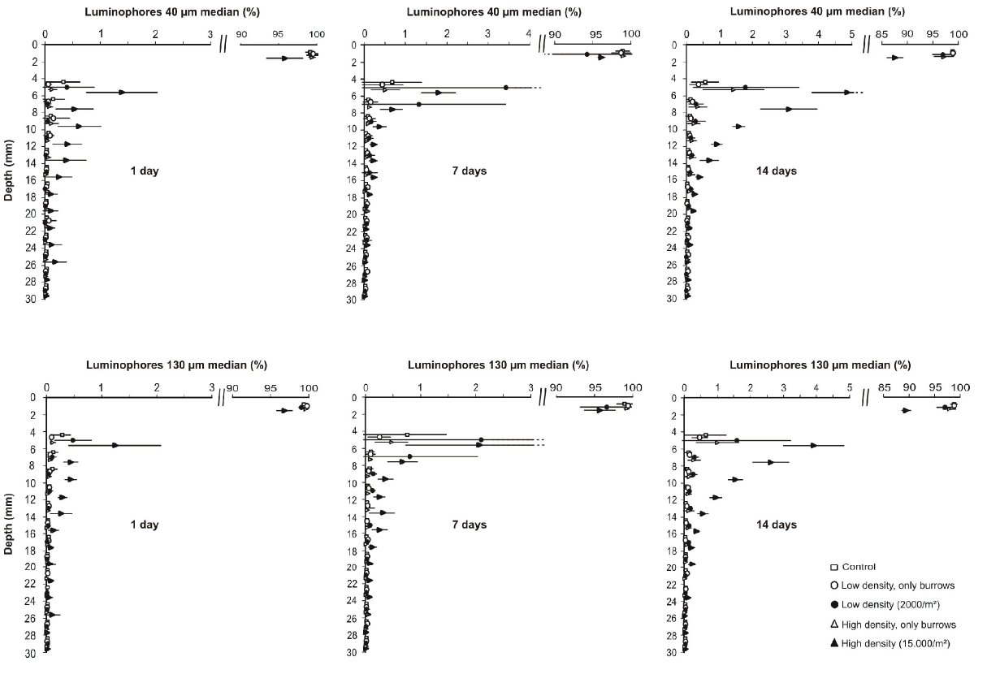
analysis of luminophore profiles using R
a matrix-transition model based on CTRW parameters

Slide 16
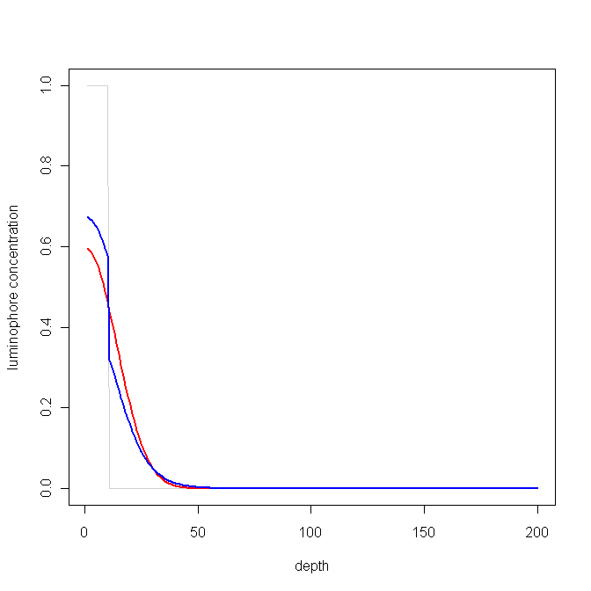
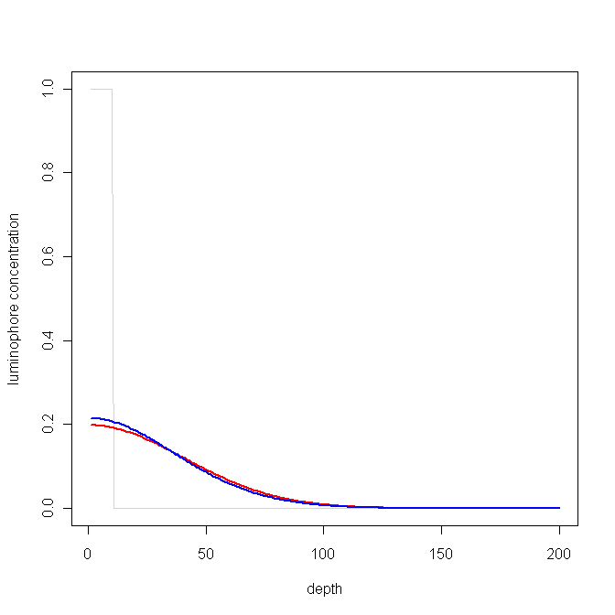
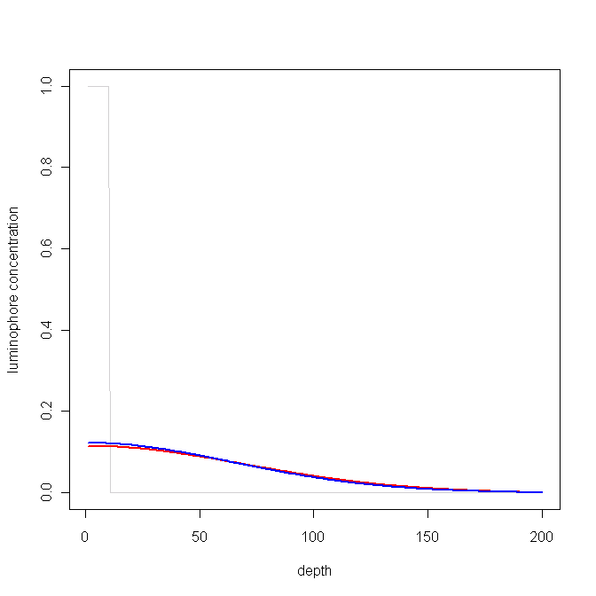
analysis of luminophore profiles using R
a matrix-transition model based on CTRW parameters
- behaves as expected
σ = 0.5 cm, τ = 0.625 d
1 day
10 days
30 days

Slide 17
analysis of luminophore profiles using R
a matrix-transition model based on CTRW parameters
- behaves as expected
σ = 2 cm, τ = 10 d
1 day
10 days
30 days

Slide 18
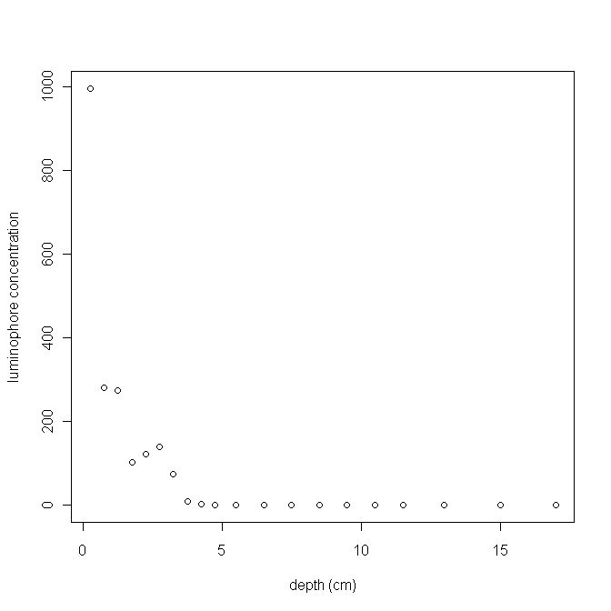
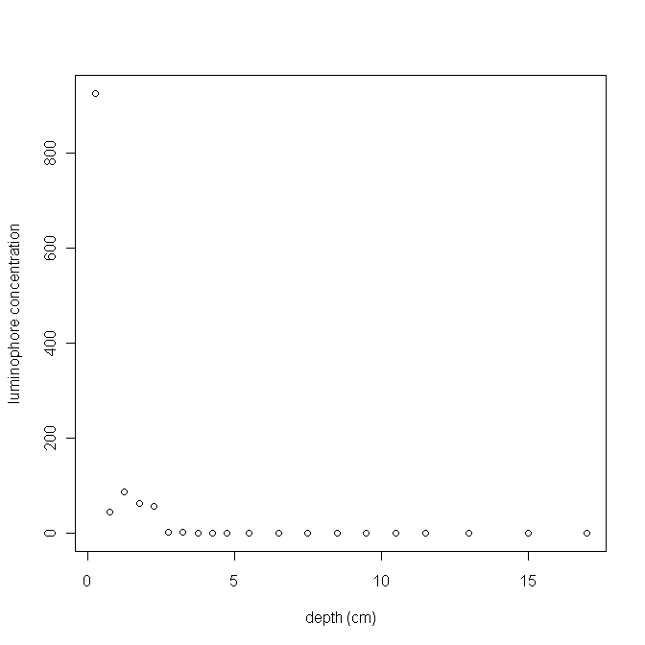
analysis of luminophore profiles using R
data analysis
- package FME: sensitivity analysis, model fitting, Monte Carlo Markov Chain (MCMC)
- data: luminophore profiles, 14 days experiment with macrofauna
profile 1
profile 2

Slide 19
analysis of luminophore profiles using R
data analysis
- step 1: fitting the diffusive model, using sum of squared residuals and sum of weighted
squared residuals
profile 1

Slide 20
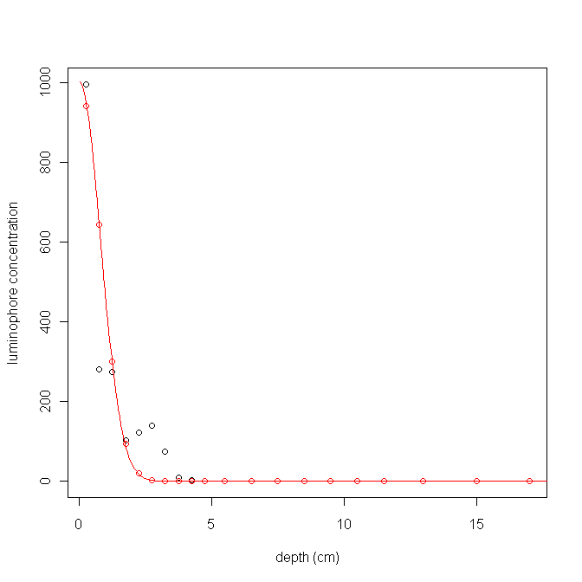
analysis of luminophore profiles using R
data analysis
- step 1: fitting the diffusive model, using sum of squared residuals and sum of weighted
squared residuals
profile 1
SSR: 0.019 cm² d⁻¹

Slide 21
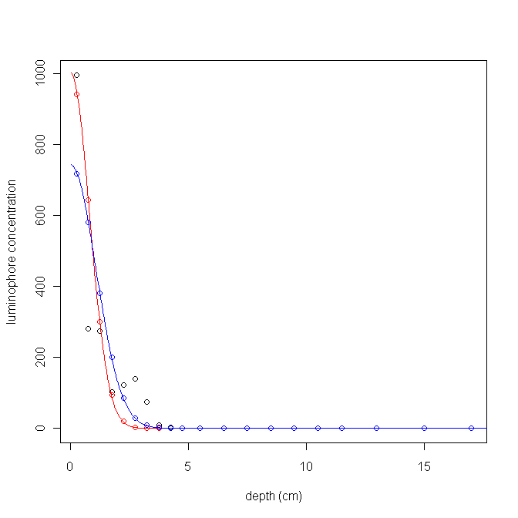
analysis of luminophore profiles using R
data analysis
- step 1: fitting the diffusive model, using sum of squared residuals and sum of weighted
squared residuals
profile 1
SSR: 0.019 cm² d⁻¹
SWSR: 0.038 cm² d⁻¹

Slide 22
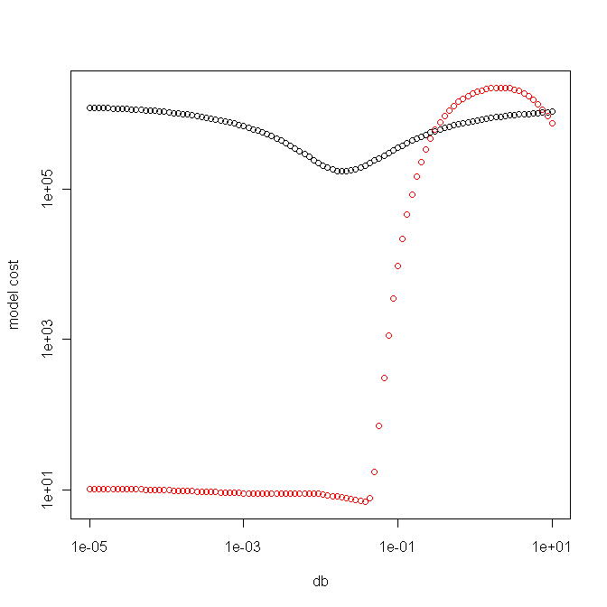
analysis of luminophore profiles using R
data analysis
- step 1: fitting the diffusive model, using sum of squared residuals and sum of weighted
squared residuals
profile 1
SSR: 0.019 cm² d⁻¹
SWSR: 0.038 cm² d⁻¹

Slide 23

analysis of luminophore profiles using R
data analysis
- step 1: fitting the diffusive model, using sum of squared residuals and sum of weighted
squared residuals
profile 2

Slide 24
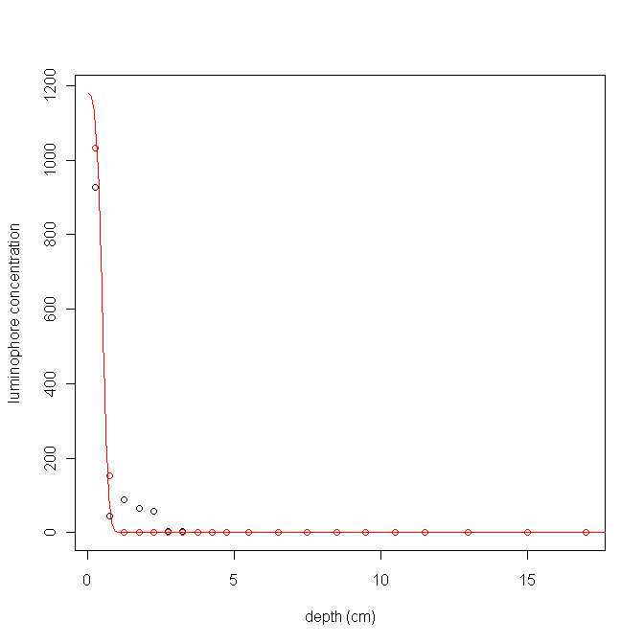
analysis of luminophore profiles using R
data analysis
- step 1: fitting the diffusive model, using sum of squared residuals and sum of weighted
squared residuals
profile 2
SSR: 0.0009 cm² d⁻¹

Slide 25
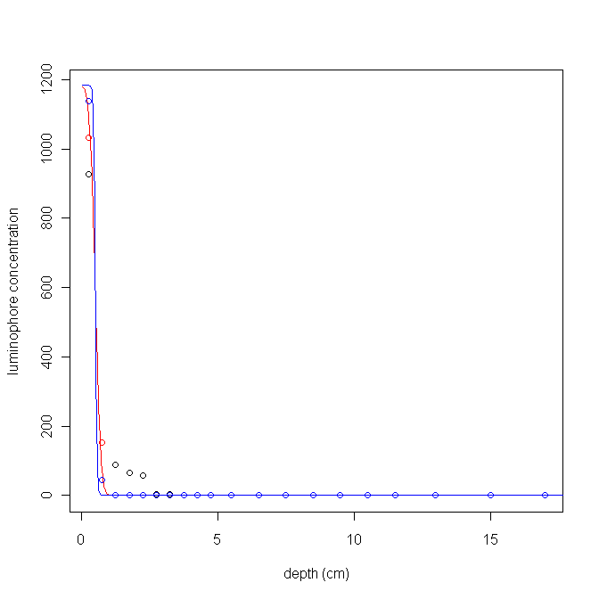
analysis of luminophore profiles using R
data analysis
- step 1: fitting the diffusive model, using sum of squared residuals and sum of weighted
squared residuals
profile 2
SSR: 0.0009 cm² d⁻¹
SWSR: 0.0001 cm² d⁻¹

Slide 26
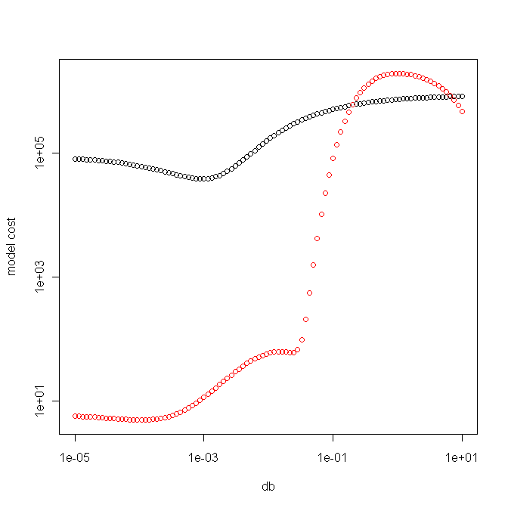
analysis of luminophore profiles using R
data analysis
- step 1: fitting the diffusive model, using sum of squared residuals and sum of weighted
squared residuals
profile 2
SSR: 0.0009 cm² d⁻¹
SWSR: 0.0001 cm² d⁻¹

Slide 27
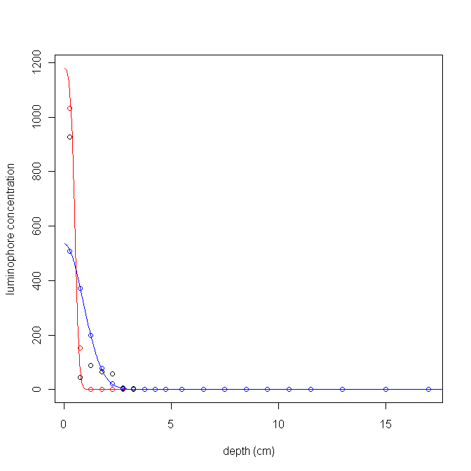
analysis of luminophore profiles using R
data analysis
- step 1: fitting the diffusive model, using sum of squared residuals and sum of weighted
squared residuals
profile 2
SSR: 0.0009 cm² d⁻¹
SWSR: 0.0001 cm² d⁻¹
SWSR(b): 0.025 cm² d⁻¹

Slide 28
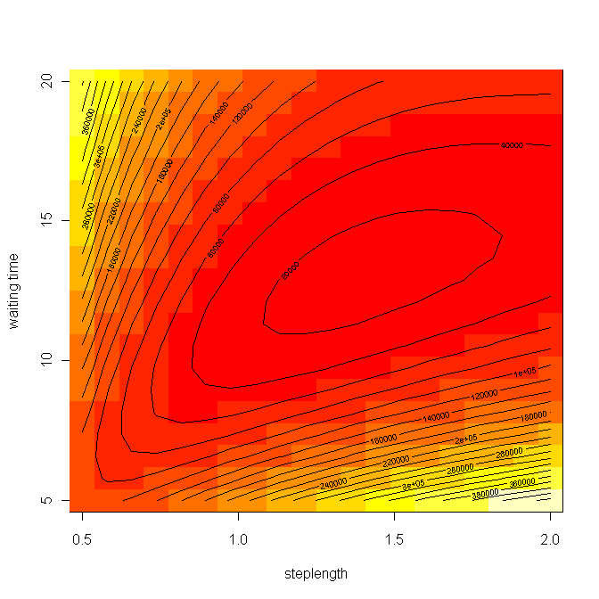
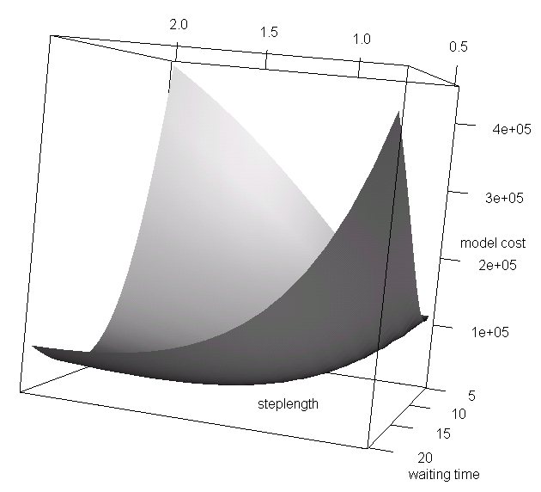
analysis of luminophore profiles using R
data analysis
- step 2: fitting the nonlocal model

Slide 29
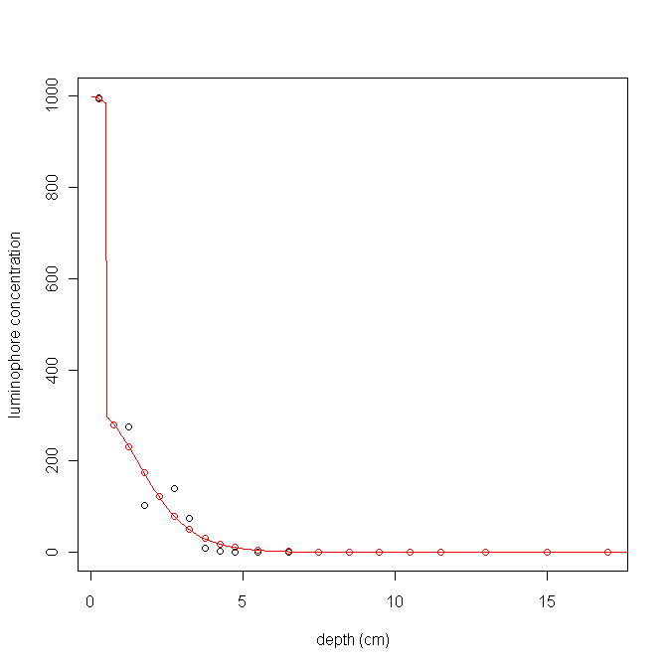
analysis of luminophore profiles using R
data analysis
- step 2: fitting the nonlocal model
profile 1
SSR: 0.019 cm² d⁻¹
SWSR: 0.038 cm² d⁻¹
σ = 1.4 cm
τ = 13 d
DB,nl = 0.075 cm² d⁻¹

Slide 30
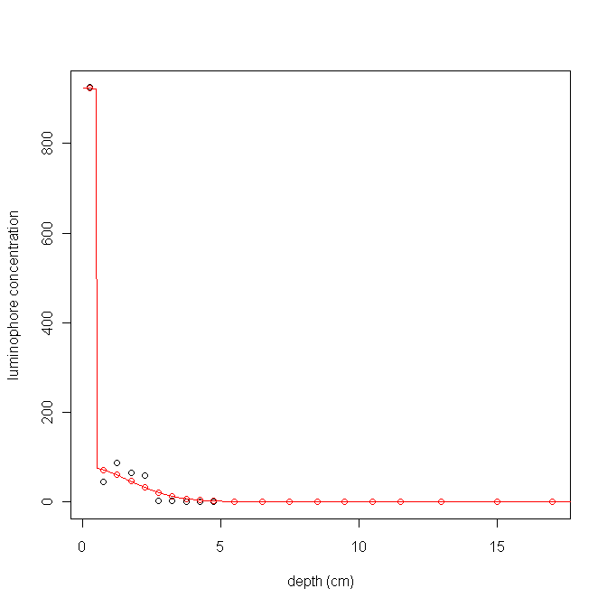
analysis of luminophore profiles using R
data analysis
- step 2: fitting the nonlocal model
profile 2
SSR: 0.0009 cm² d⁻¹
SWSR: 0.0001 cm² d⁻¹
σ = 1.6 cm
τ = 41.5 d
DB,nl = 0.031 cm² d⁻¹
(again underestimation)

Slide 31
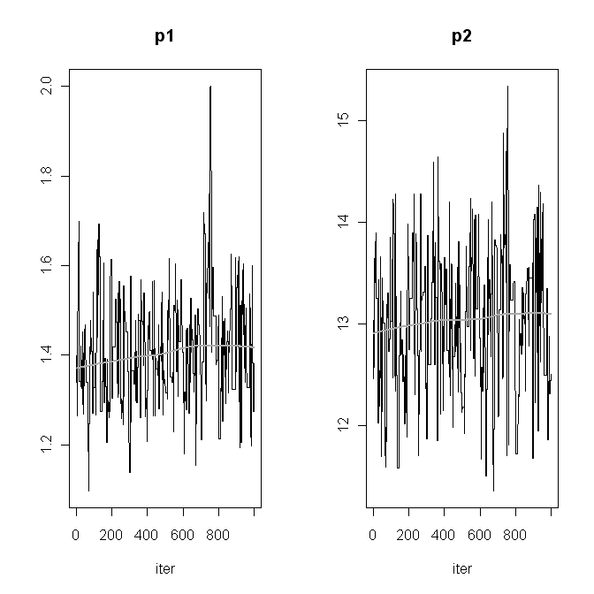
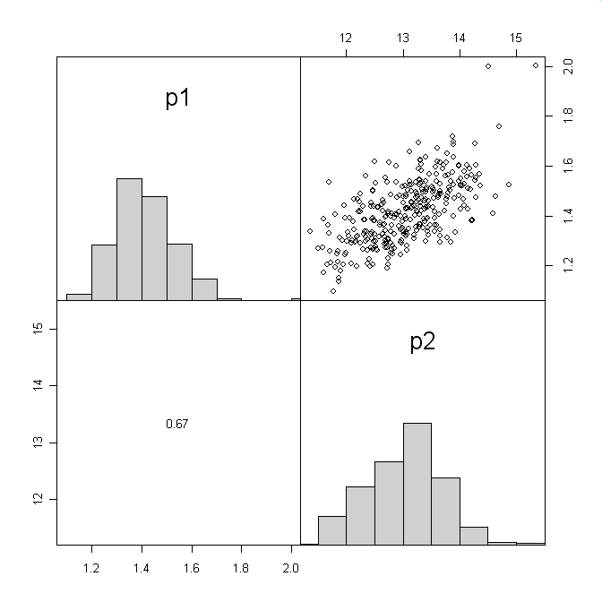
analysis of luminophore profiles using R
data analysis
- step 3: Monte Carlo Markov Chain (MCMC) using the nonlocal model
profile 1

Slide 32
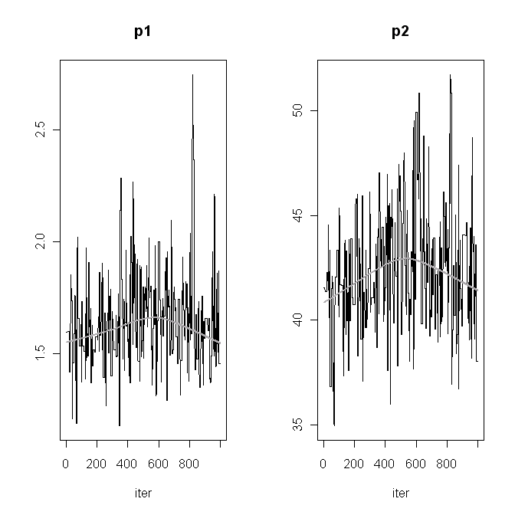
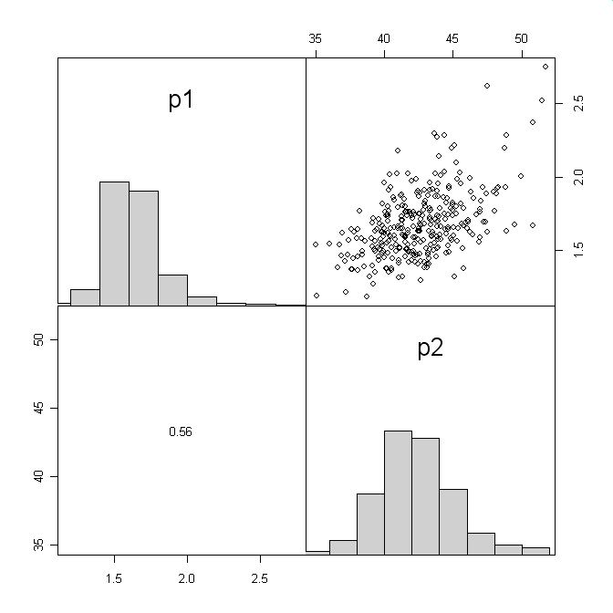
analysis of luminophore profiles using R
data analysis
- step 3: Monte Carlo Markov Chain (MCMC) using the nonlocal model
profile 2

Slide 33
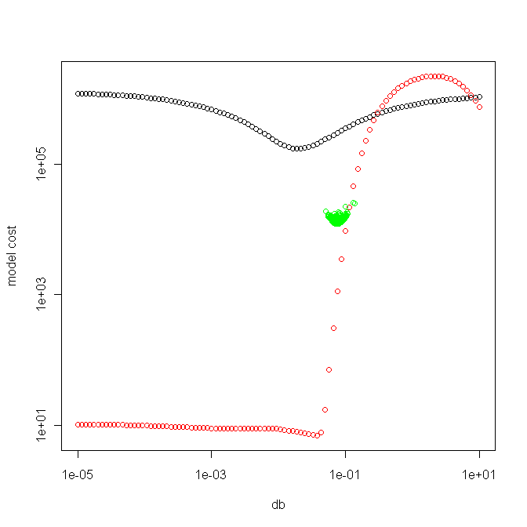
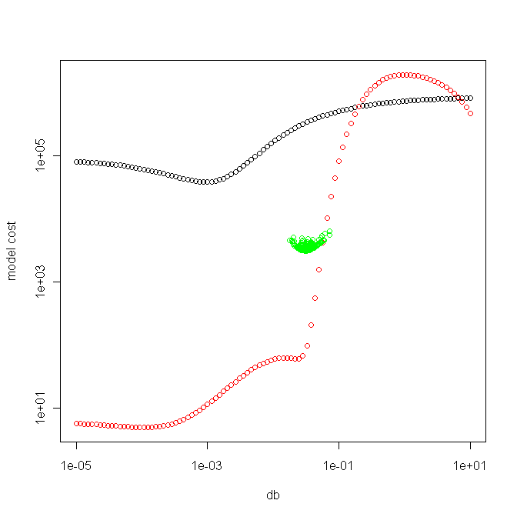
analysis of luminophore profiles using R
data analysis
- step 3: Monte Carlo Markov Chain (MCMC) using the nonlocal model

Slide 34
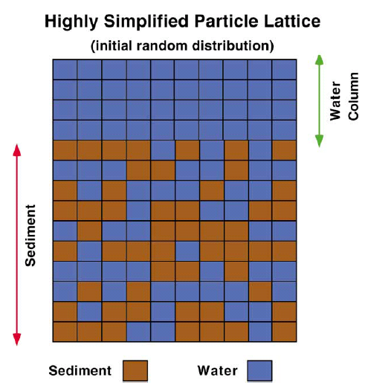
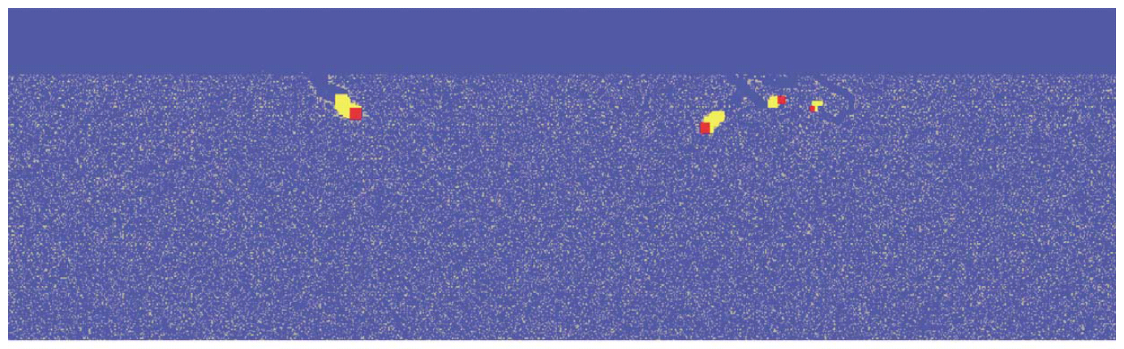
analysis of luminophore profiles using R
further testing?
- applying the model on artificial data
- LABS: Lattice-Automaton Bioturbation Simulator
- particle waiting times and jump lengths are known exactly
- different experiment durations and tracer half-lifes
from Choi et al. (2002)

Slide 35
analysis of luminophore profiles using R
conclusions
- a simple nonlocal model of bioturbation fits luminophore profiles considerably better
- easy to implement
- provides information on both the type of mixing and the intensity
- a single DB,nl value can be calculated
- (probably) independent of experiment duration
- (probably) independent of tracer half-life
- can be used in a biodiffusion model provided the time scale is large enough

Slide 36


