Slide 1

DierckxSpline: An R Package For Minimal Knot Splines
Sundar Dorai-Raj
Spencer Graves
July 29, 2007

Slide 2
Agenda
Splines in R
FITPACK Routines
Univariate Splines
  Smoothing splines
  Least square splines
  Free knot splines
The DierckxSpline package for R
Examples
Software Status and Extensions

Slide 3
Splines in R
Many algorithms have been improved since Dierckx
  Better free knot selection algorithms
  Applications for functional data analysis
Purpose of the package is to make available Dierckx FITPACK functions
  Univariate splines
  Free knot splines
  Bivariate splines
R lacks a comprehensive spline package
  spline, smooth.spline functions in ‘stats’ package
  Several packages
    splines – Spline package for B-splines
    fda – Functional Data Analysis
    ssr – Spline Smoothing Regression
    sspline – smoothing spline package
  No splines package supporting free knots or constrained splines

Slide 4
Dierckx FITPACK
The FITPACK library is available in Fortran from NETLIB
http://www.netlib.org/dierckx
Includes
  Code to accompany Curve and Surface Fitting with Splines
  Examples and data
  Currently R package interfaces with approximately half of the provided functions
Not to be confused with commercial FITPACK library http://www.netlib.org/fitpack
Dierckx, P. (1993). Curve and Surface Fitting with Splines. Oxford Science Publications, New York.

Slide 5
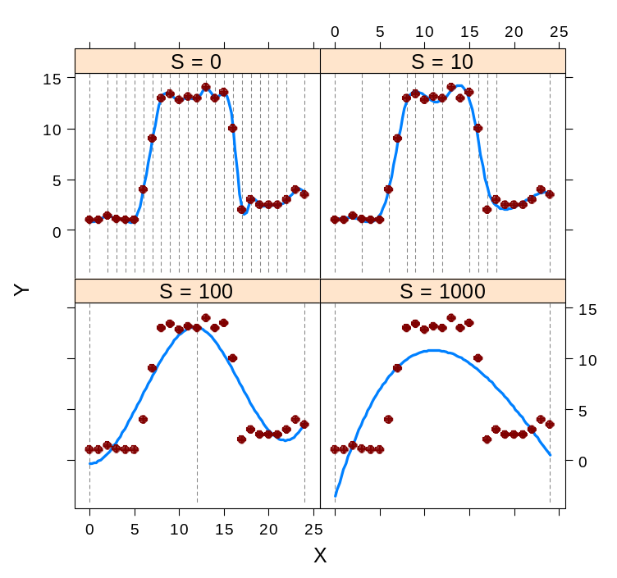
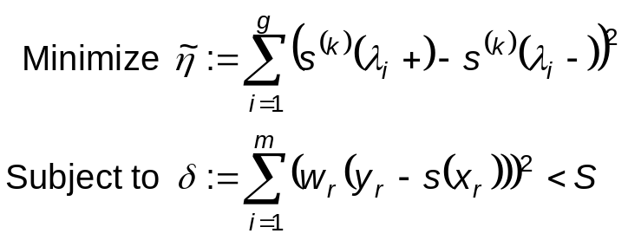
Smoothing Splines
Given
  Data: (x_{r}, y_{r}), r = 1, …, m
  Constraints: a ≤ x_{r} ≤ x_{r+1} ≤ b
  Weights: w_{r}
Goal
  Determine spline s(x) on [a, b]
  Degree: k
  Knots: a = λ₀, λ₁, …, λ_{g}, λ_{g+1} = b
Unconstrained minimization
  where S is some user-specified smoothing parameter
  Increase S → increase smoothing
ss <- list()
s <- c(0, 10, 100, 1000)
for(i in seq(s)) {
ss[[i]] <- curfit(x, y,
s = s[i], method = "ss")
}
Vertical lines are knot placements

Slide 6
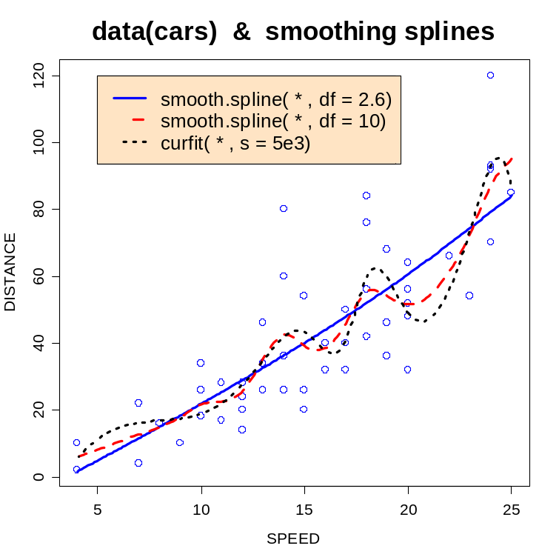
Comparison To smooth.spline
R has smooth.spline which is a competing function for smoothing splines
## example from ?smooth.spline
## This example has duplicate points, so avoid cv = TRUE
cars.spl.0 <- smooth.spline(cars$speed, cars$dist, df=2.6)
cars.spl.1 <- smooth.spline(cars$speed, cars$dist, df = 10)
cars.spl.2 <- curfit(cars$speed, cars$dist, s = 5e3)
smooth.spline uses cross validation or equivalent degrees of freedom to determine the amount of smoothing
curfit constrains the model deviance

Slide 7
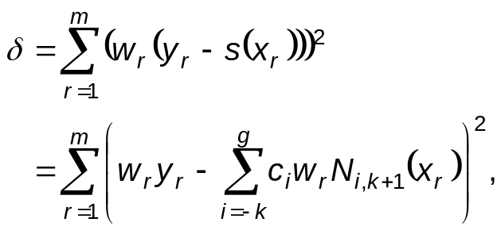
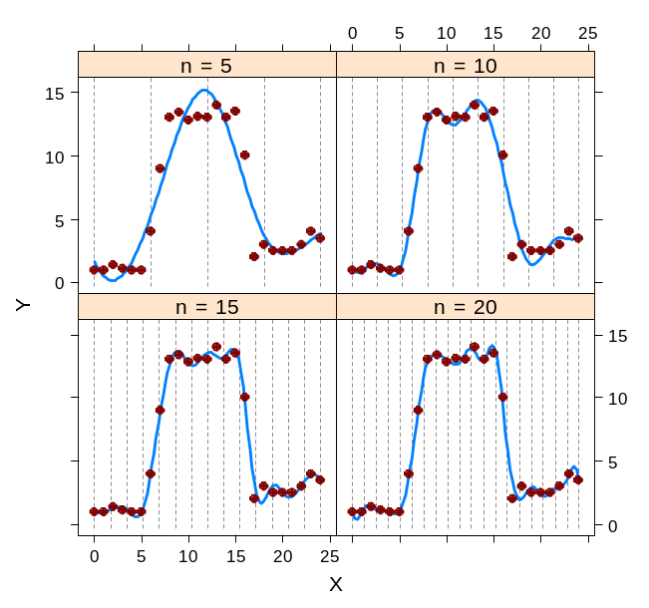
Least Squares Splines With Fixed Knots
Fixed knots
  a = λ₀, λ₁, …, λ_{g}, λ_{g+1} = b
Minimize
where N_{i,k+1} are B-splines of degree k and c_{i} are the B-spline coefficients of s(x)
Knots are user-determined
  There is no known R equivalent
  R function spline places a knot at each observation
n <- c(5, 10, 15, 25)
ls <- list()
for(i in seq(n)) {
kn <- seq(0, 24, len = n[i])
ls[[i]] <- curfit(x, y,
method = "ls", knots = kn)
}
Vertical lines are knot placements

Slide 8
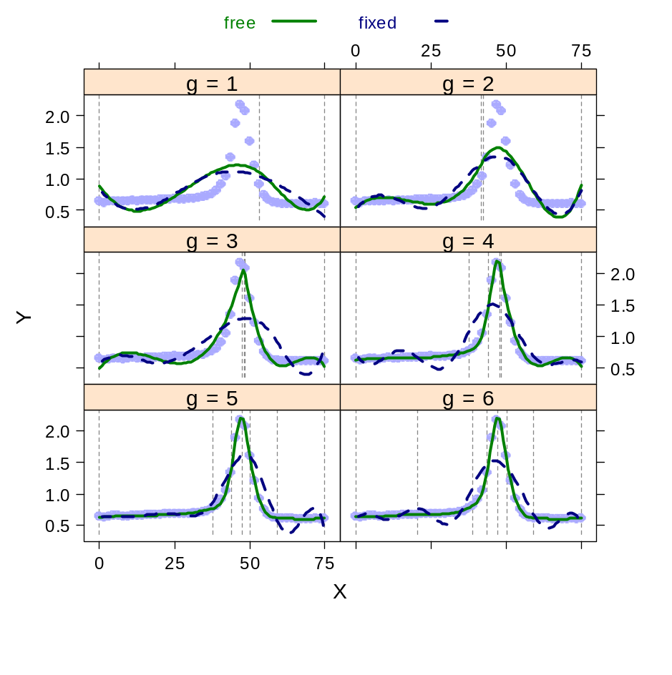
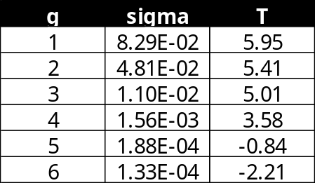
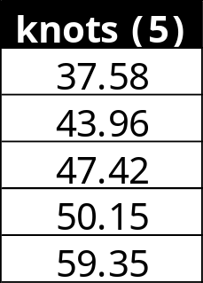
Least Squares Splines with Variable Knots
data(titanium)
r <- curfit.free.knot(titanium$x2,
titanium$y, g = 10, eps = 5e-4)
Titanium data (de Boors and Rice, 1968)
  Dierckx (1993) for optimizing number of knots
  We use optim to minimize the residual sums of squares
Optimal solution uses 5 interior knots
Plots include both fixed equally-spaced knots (dashed) and free knots (solid)

Slide 9
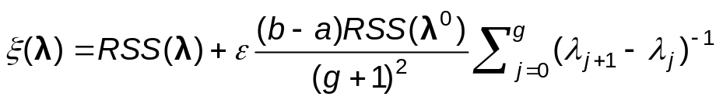
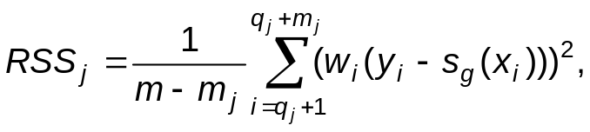

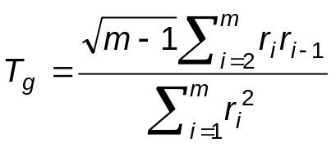
Selecting An Appropriate Number Of Knots
Algorithm described by Dierckx (1993)
  Supply starting value of λ₁⁰ = (a + b)/2 for the first knot, where a = min(x) and b = max(x)
  Determine λ by minimizing a penalized RSS with user-defined ε and g = length(λ)
  For j = 0, 1, 2, …, g, determine the region between knots with the largest RSS
  where
  Add a new knot at the midpoint of λ_{j} and λ_{j+1} where RSS_{j} is maximized
Stopping criteria
  Number of optimal knots g is determined by the first T_{g} < 0

Slide 10
The DierckxSpline Package
Package Functions
  Includes interfaces for computing univariate splines
  FORTRAN for modeling bivariate
Examples and data included
  Data
    De Boor and Rice (1968) titanium
    Dierckx (1980) volumetric moisture content
    Soudan and Dierckx (1979) knee flexion-extension during walking
    Additional data extracted from FITPACK
  demo(DierckxSpline)
    Includes examples with data discussed
  vignette(DierckxSpline)
    Provides more details on the spline fitting and algorithms
    Includes relevant sections from DierckxSpline (1993)

Slide 11
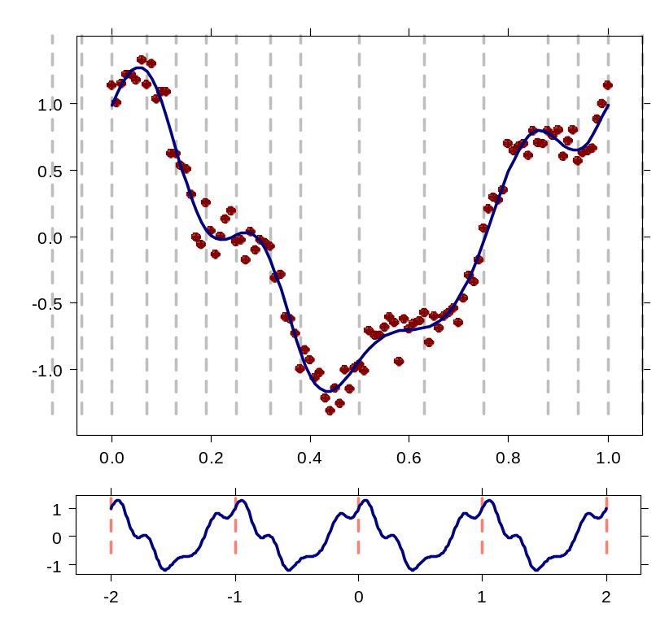
Example #1 – Smoothing With Periodic Splines
Quintic periodic smoothing spline
  Penalty: 90
  Periodic: s(a) == s(b)
## periodic
set.seed(42)
n <- 100
r <- 1:n
x <- 0.01 * (r - 1)
e <- rnorm(n, 0, 0.1)
s2 <- var(e)
w <- rep(1/s2, n + 1)
y <- cos(2*pi*x) + 0.25*sin(8*pi*x) + e
x <- c(x, 1)
y <- c(y, y[1])
kn <- seq(0.01, 0.99, length = 12)
f1 <- percur(x, y, w, method = "ss",
s = 90, k = 5)

Slide 12
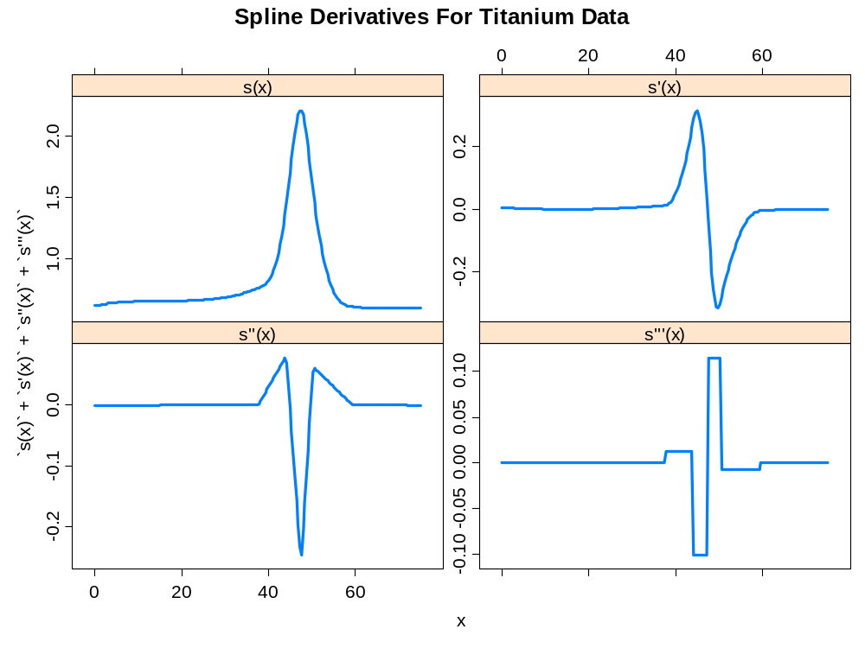
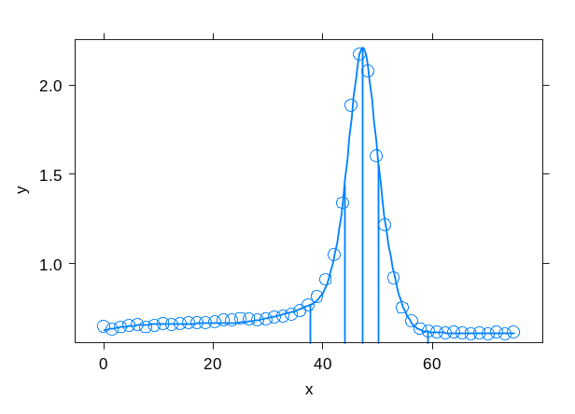
Example #2 – Differentiation With Free Knot Splines
Obtain analytical spline derivatives with deriv function
  Derivatives available from 0 (fitted spline value) to k (spline order)
data(titanium)
r <- curfit.free.knot(titanium$x2,
titanium$y, g = 10, eps = 5e-4)
xyplot(r, show.knots = TRUE)
dr <- sapply(0:3, deriv,
expr = r, at = titanium$x2)
cubic spline
quadratic spline
step function
linear spline

Slide 13
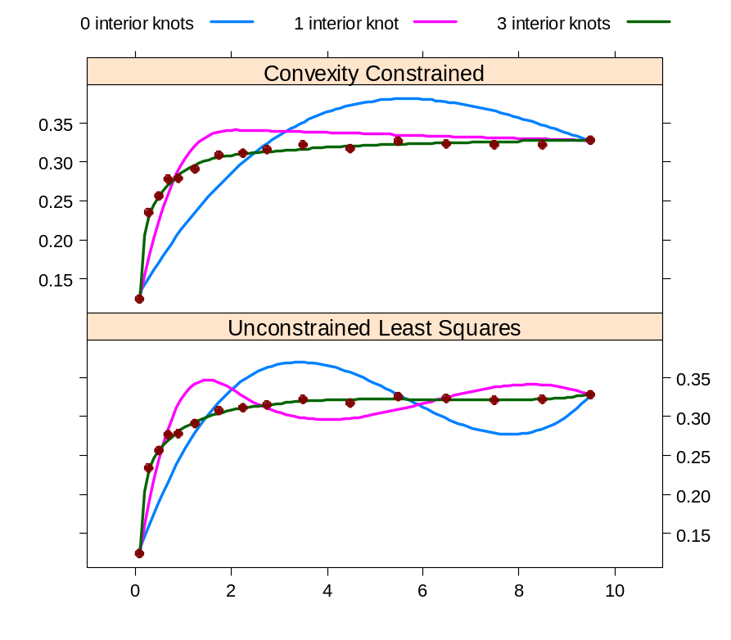
Example #3 – Splines With Convexity Constraints
Volumetric moisture content data (Dierckx 1980)
  Force convex constraints for all data points
## convexity contstraints
data(moisture)
f1 <- with(moisture,
concon(x, y, w, v, s = 0.2))
f2 <- update(f1, s = 0.04)
f3 <- update(f1, s = 0.0002)
g1 <- with(moisture,
curfit(x, y, w, method = "ls",
knots = knots(f1)))
g2 <- update(g1, knots = f2)
g3 <- update(g1, knots = f3)

Slide 14
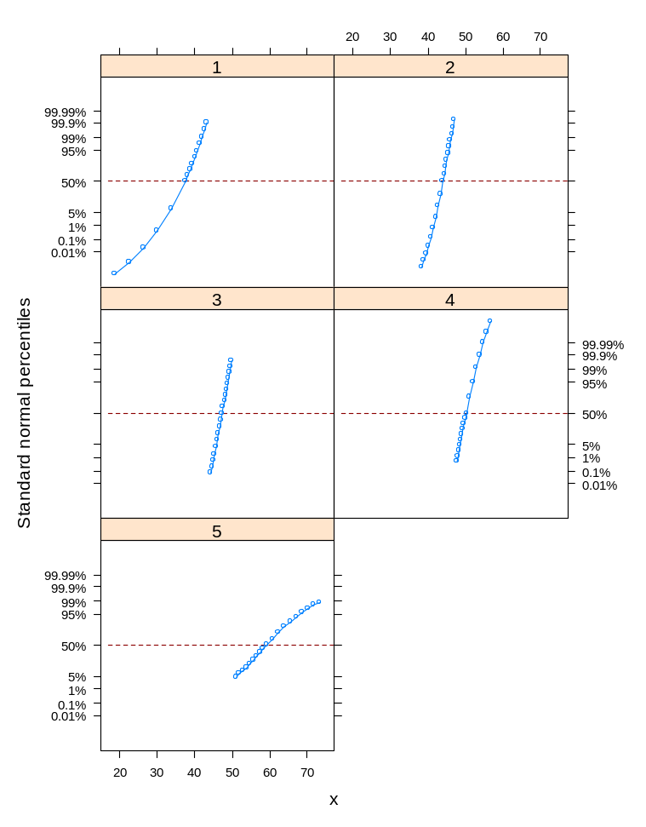
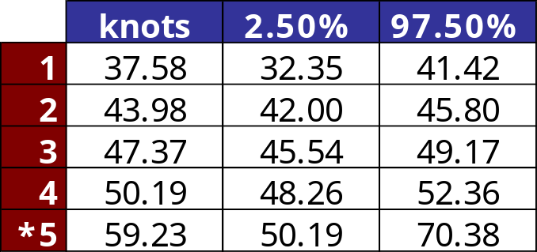
Example #4 – Profile Likelihood
Profiling the likelihood provides confidence intervals on knot placement
data(titanium)
r <- curfit.free.knot(titanium$x2,
titanium$y, g = 10, eps = 5e-4)
pro <- confint(profile(r))
xyplot(pro)
Lower bound for knot 5 is not achievable

Slide 15
Software Status And Extensions
Available for download from CRAN after JSM 2007
  Contact the author for bug reports and coding help
Create interfaces for remaining FITPACK routines
Enhanced plotting for 3d splines with lattice

