Slide 1
Introduction to Management Strategy Evaluation
Policy and Scientific Advice Frameworks
Examples
  North Sea Cod
  Generic HCRs
  North Sea Flatfish
  Mediterranean Swordfish
  Herring meta-populations
MSE Framework

Slide 2
Changing Policy Needs
A move away from short-term reactive management to long-term strategic planning because of commitments to
Precautionary Approach
      Precaution should increase with uncertainty about stock status, so that the less you know the less you fish.
World Summit on Sustainable Development (WSSD)
      Recovery of stocks to MSY by 2015
Ecosystem Based Approach to Fisheries Management (EBFM)
      Progressive implementation of an ecosystem-based approach
Notes:
Fishery models provide an important tool for management since it is infeasible to carry out large scale management experiments at sea, for example to work out whether it is better to close part of the North Sea or to increase mesh size in certain fisheries to ensure cod recovery.
Models are therefore used to help managers answer such 'what if' questions before implementing changes.
However, models may not be able to capture all the uncertainty that exists with respect to the stocks and the fishery, and some critics consider that models may never be sufficiently well developed to be used to fine tune fishery management decisions.
This Snapshot will present a variety of examples of how Cefas are using modelling techniques to evaluate different fisheries management strategies.

Slide 3
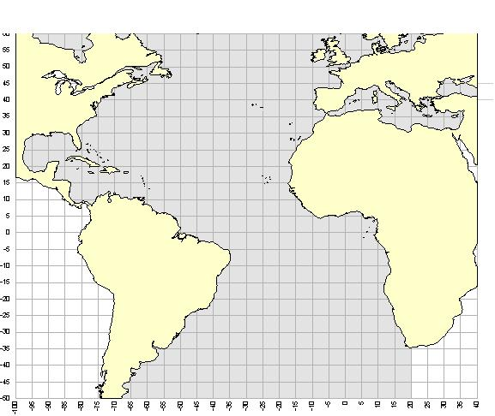
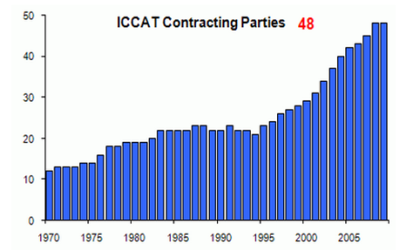
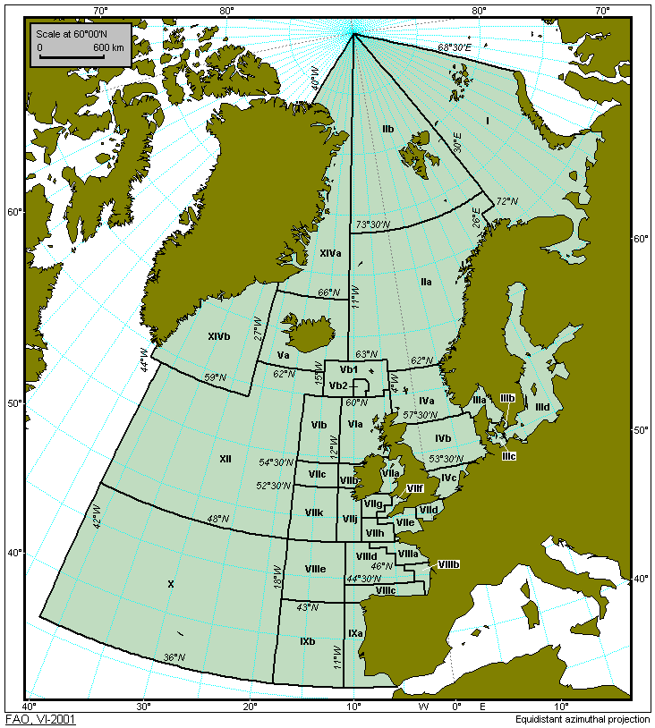
ICCAT, ICES & Management
ICCAT is a Regional Fisheries Management Organisation (RFMO) responsibile for the management of Atlantic tunas.
ICCAT is composed of 48 contracting parties or CPCs with a secretariat based in Madrid http://www.iccat.int
ICES is an intergovernmental
organisation that provides advice for governments and commissions
EU, Norway, Iceland, Faroes, Greenland & Russia manage stocks in the North East Atlantic and ask ICES to provide scientific advice.

Slide 4
ICCAT
Responsible for the management of populations of tuna and tuna-like fishes found in the Atlantic Ocean and Mediterranean
    Main objective is to ensure maintenance of the populations of tuna and tuna-like fishes in the Convention area at levels which will permit the maximum sustainable catch
    Development and implementation of ecosystem-based fisheries management
    Capacity building
Notes:
Fishery models provide an important tool for management since it is infeasible to carry out large scale management experiments at sea, for example to work out whether it is better to close part of the North Sea or to increase mesh size in certain fisheries to ensure cod recovery.
Models are therefore used to help managers answer such 'what if' questions before implementing changes.
However, models may not be able to capture all the uncertainty that exists with respect to the stocks and the fishery, and some critics consider that models may never be sufficiently well developed to be used to fine tune fishery management decisions.
This Snapshot will present a variety of examples of how Cefas are using modelling techniques to evaluate different fisheries management strategies.

Slide 5
EU & CFP
Common Fisheries Policy (CFP) requires long-term management and recovery plans taking into account
    Conservation status of stocks
    Biological characteristics
    Characteristics of the fisheries
    Economic impact
As part of this process there has been
    A move away from ad-hoc management to the development of Harvest Control Rules (HCRs) under which both long-term goals and ways to reach them are pre-defined.
    A movement towards regionalisation and devolution of power away from the centre
    A change from a single species to ecosystem based management and
    Increasing demands for scientific knowledge, tools and understanding of social processes.
Notes:
Fishery models provide an important tool for management since it is infeasible to carry out large scale management experiments at sea, for example to work out whether it is better to close part of the North Sea or to increase mesh size in certain fisheries to ensure cod recovery.
Models are therefore used to help managers answer such 'what if' questions before implementing changes.
However, models may not be able to capture all the uncertainty that exists with respect to the stocks and the fishery, and some critics consider that models may never be sufficiently well developed to be used to fine tune fishery management decisions.
This Snapshot will present a variety of examples of how Cefas are using modelling techniques to evaluate different fisheries management strategies.

Slide 6
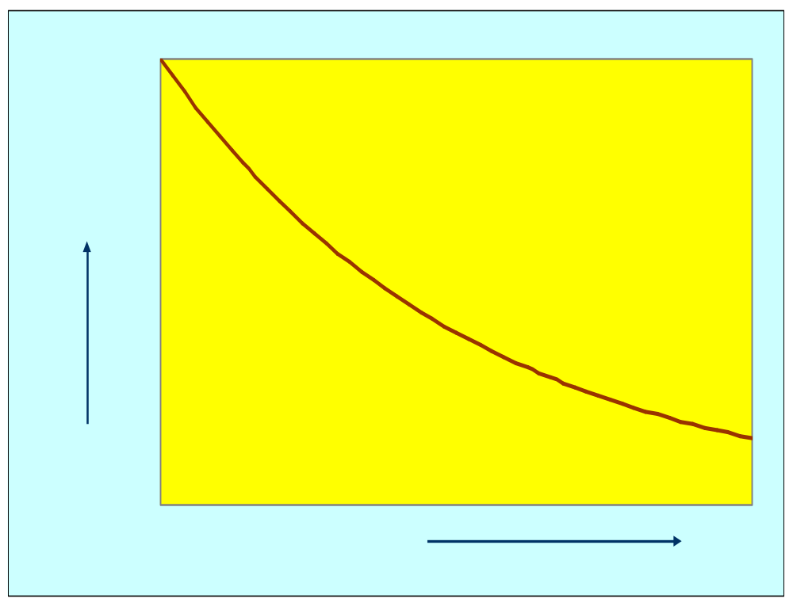
Traditional Scientific Advice
Fish stock
Regulation
Blim
Bpa
Fishing
Mortality
HCR
Spawning Stock

Slide 7
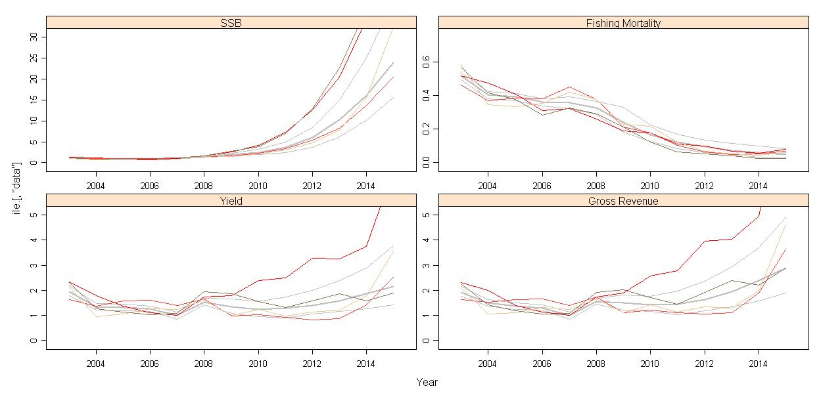
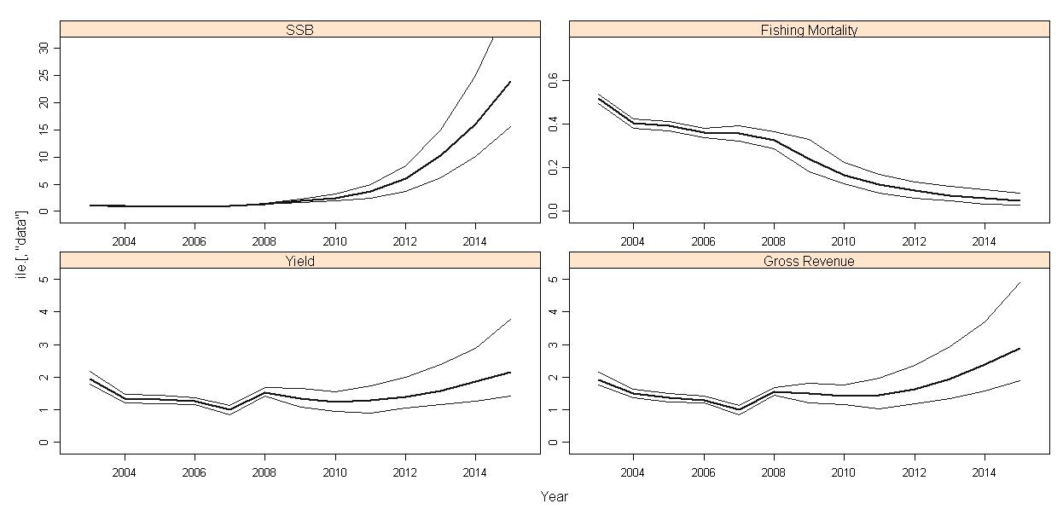
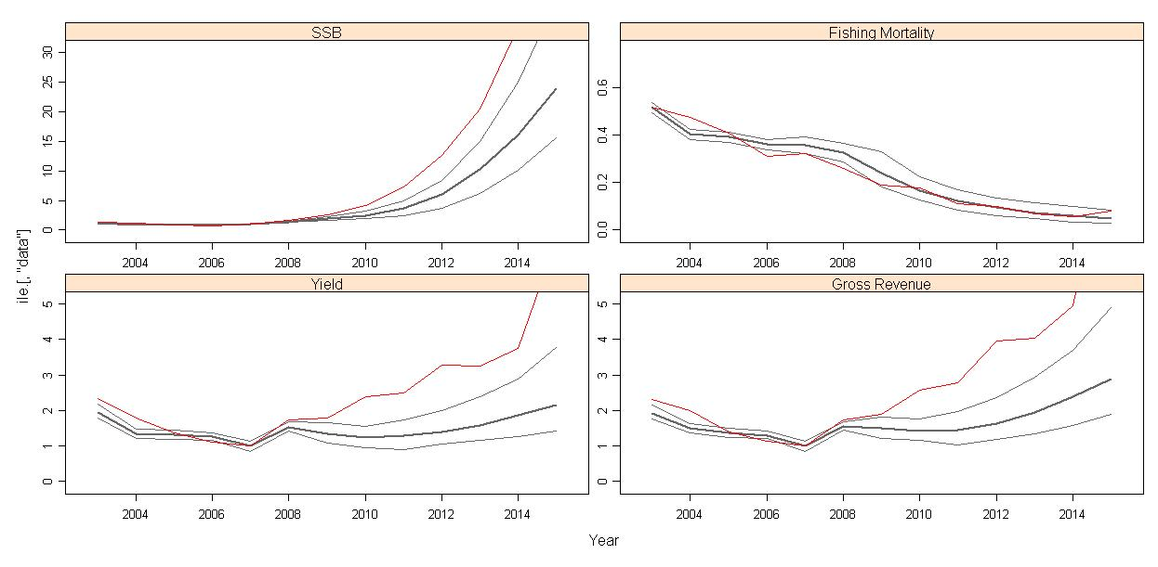
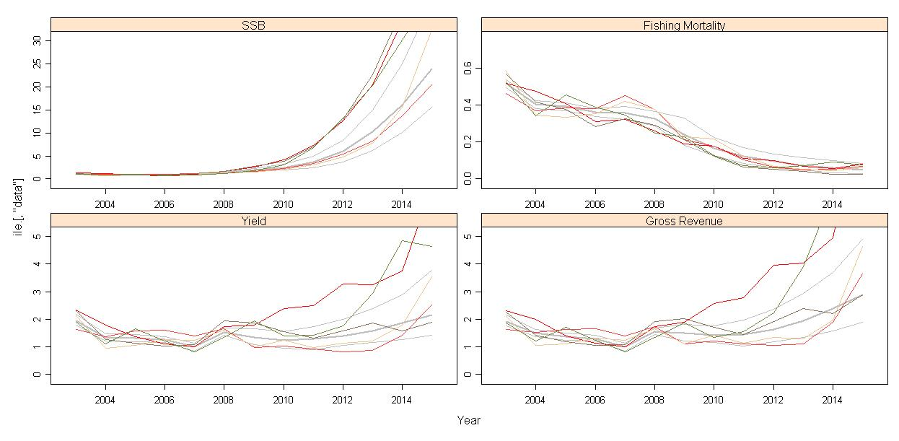
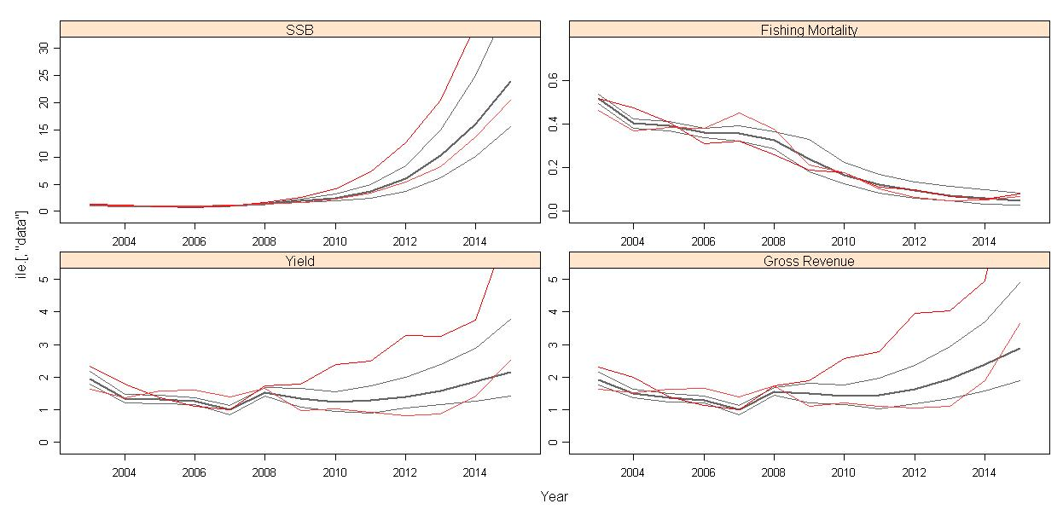
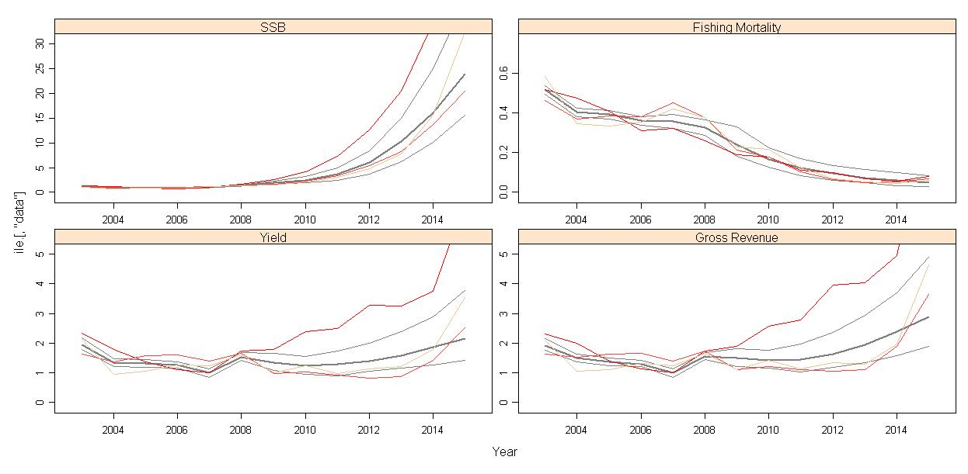
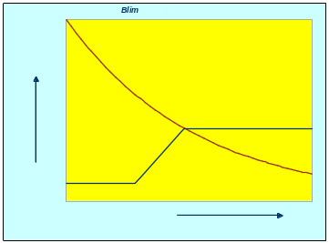
North Sea Cod Recovery Plan
A run-off between two alternative proposals,
Norway
EU
If SSB<Bpa
F_{y+1}=0.85F_{y}
If SSB<Blim
F_{y+1}=0.75F_{y}

Slide 8
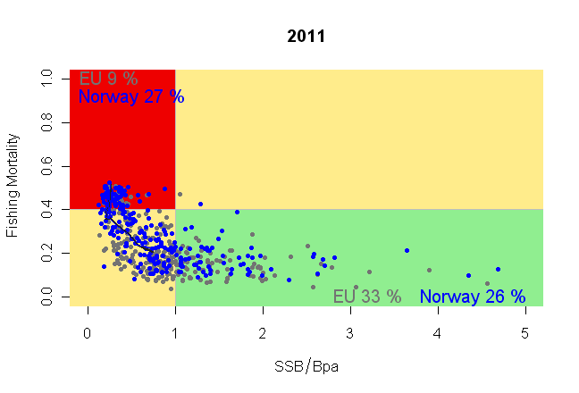
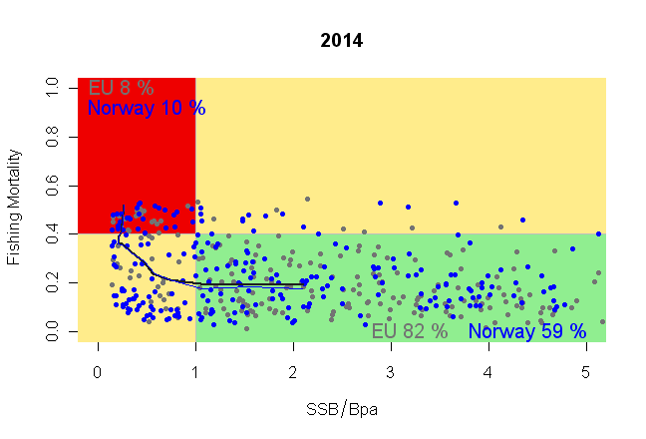
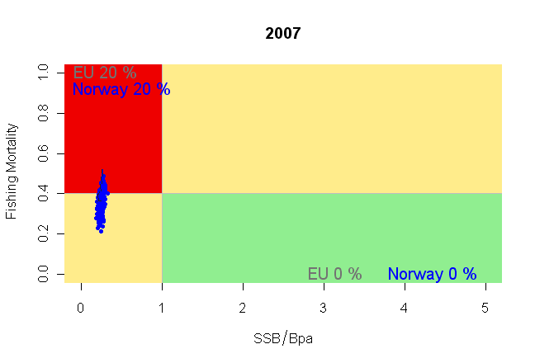
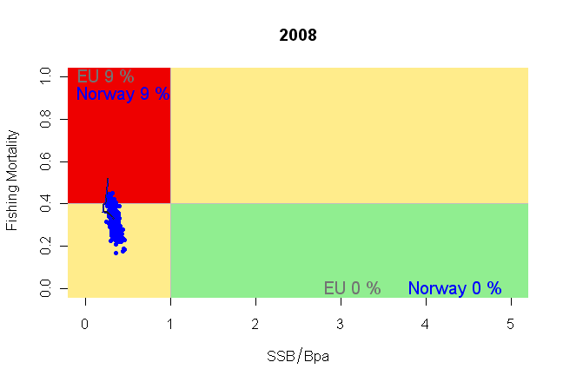
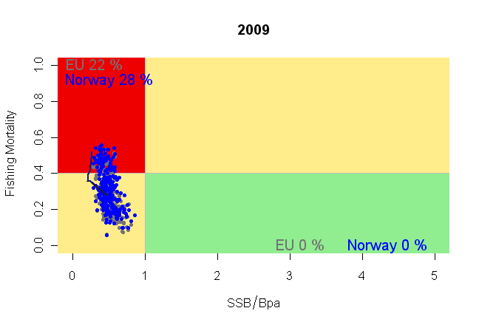
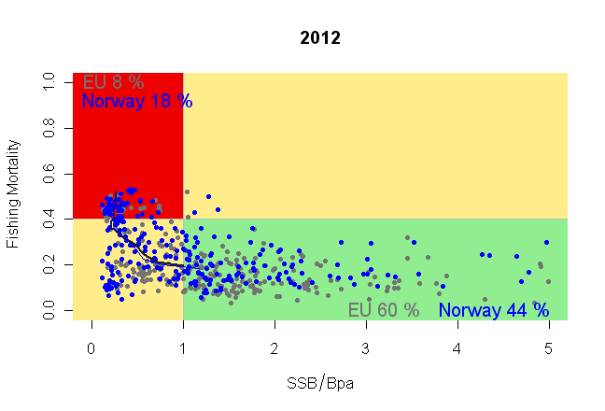
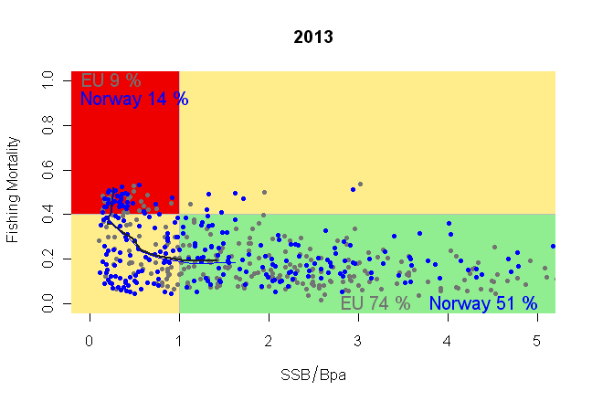
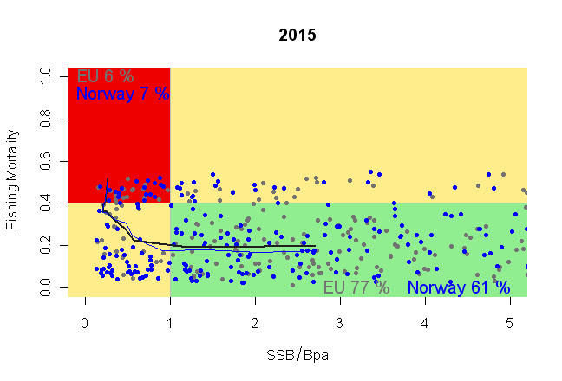
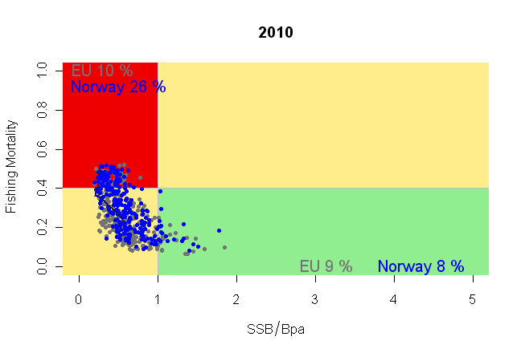
North Sea Cod Recovery Plan
A run-off between two alternative proposals,
Norway
EU
If SSB<Bpa
F_{y+1}=0.85F_{y}
If SSB<Blim
F_{y+1}=0.75F_{y}

Slide 9
Generic Management Plans
  STECF WORKING GROUP ON EVALUATION OF "POLICY STATEMENT" HARVEST RULES.
  The European Commission asked the STECF to evaluate HCRs for setting TACs based on ICES stock assessments and forecasts. An main objective of was is to provide stability (i.e. 15% TAC rule) for the industry but the HCRs also had to be evaluate with respect to associated risks for the stocks and the fisheries, in terms of the future development of
    “spawning biomass, and associated risks of transgressing biological reference points.”
    “yield, and associated risks”
  The SG was requested to conduct Management Strategy Evaluation (MSE) using an Operating Model/Management Procedure approach
1) Set target F
F_{y}=max(F_{sq},F_{0.1})
2) Check F limit
if F_{y} > Fpa then set F_{y} = F_{p} and stimate TAC_{y}
3) Check SSB limit
if SSB_{y+1}<B_{pa} then re-estimate TAC_{y} so that SSB_{y+1} = B_{pa}
4) Check catch stability
if TAC_{y} ≤ (1- α)TAC_{y -1} then TAC_{y} = (1- α)TAC_{y-1} else
if TAC_{y} ≥ (1+  α)TAC_{y-1} then TAC_{y} = (1+  α)TAC_{y-1}
5) Check for stock collapse and implement recovery plan
If SSB_{y} < B_{pa} and SSB_{y+1} <= SSB_{y} then re-estimate TAC_{y} so SSB_{y+1} = SSB_{y}
6) If impossible close fishery
if SSBy+1 < SSBy even if F=0.0 then set F = 0.01.
7) Check for rise in F
if Fy > Fsq then set Fy = Fsq and re-estimate TACy
Notes:
Fishery models provide an important tool for management since it is infeasible to carry out large scale management experiments at sea, for example to work out whether it is better to close part of the North Sea or to increase mesh size in certain fisheries to ensure cod recovery.
Models are therefore used to help managers answer such 'what if' questions before implementing changes.
However, models may not be able to capture all the uncertainty that exists with respect to the stocks and the fishery, and some critics consider that models may never be sufficiently well developed to be used to fine tune fishery management decisions.
This Snapshot will present a variety of examples of how Cefas are using modelling techniques to evaluate different fisheries management strategies.

Slide 10
Fisheries System
Traditional Scientific Advice
Fish stock
Regulation
Fishing Industry
Management Strategy Evaluation
& Bio-economic models

Slide 11
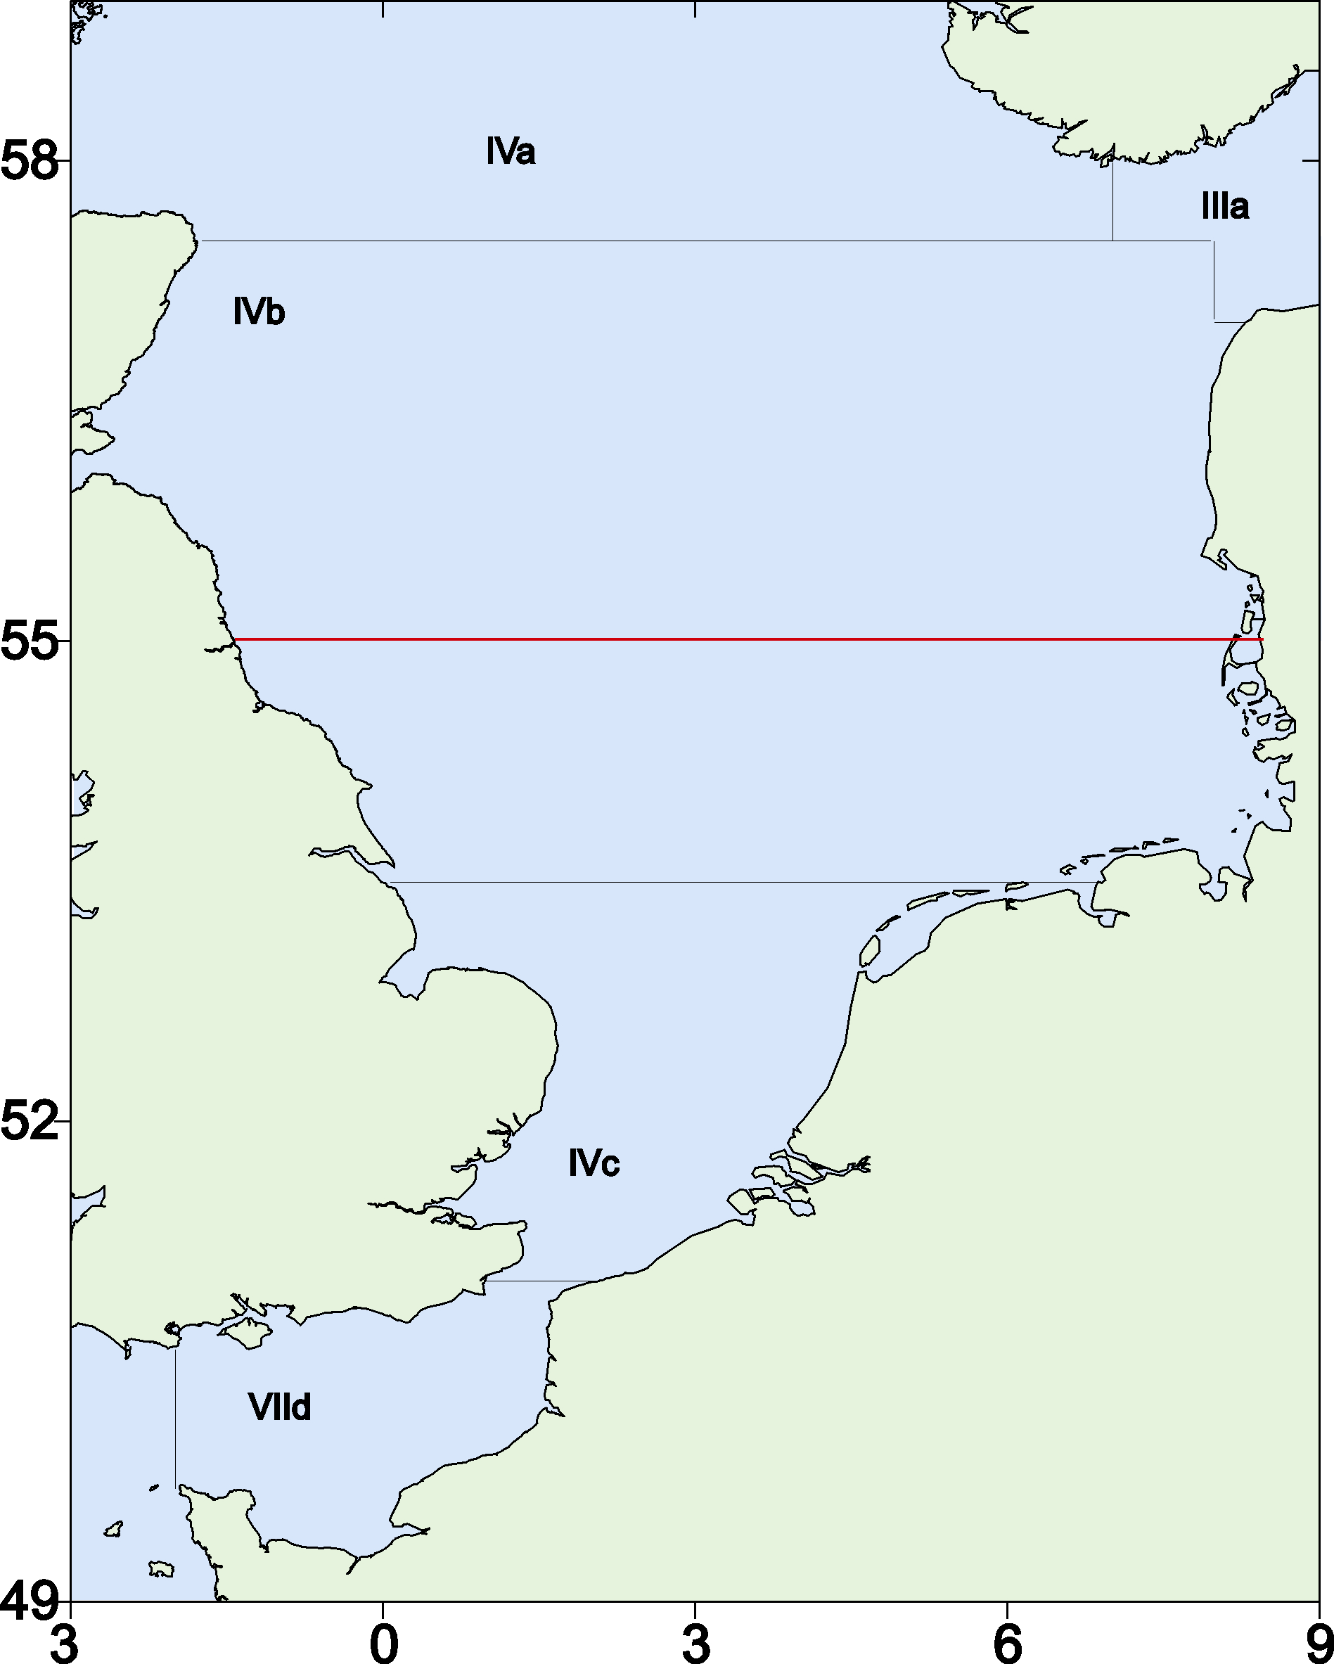
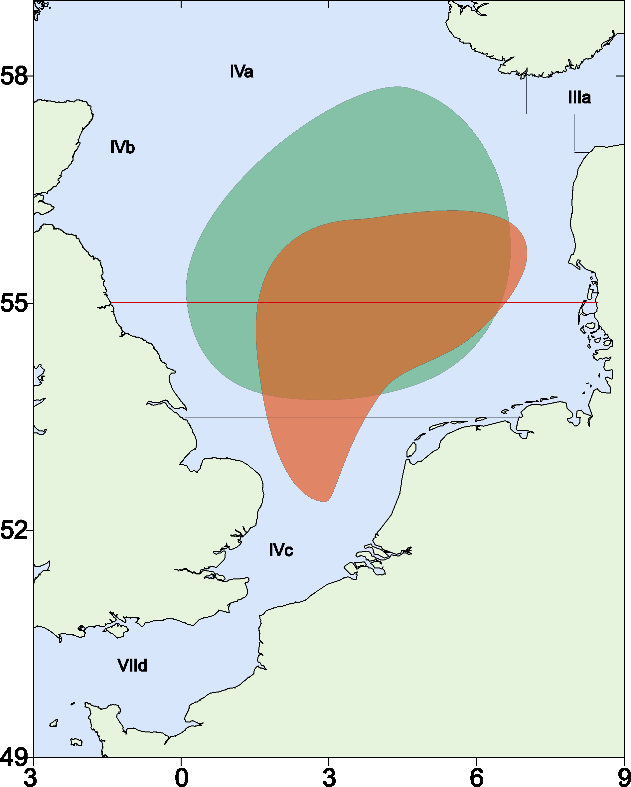
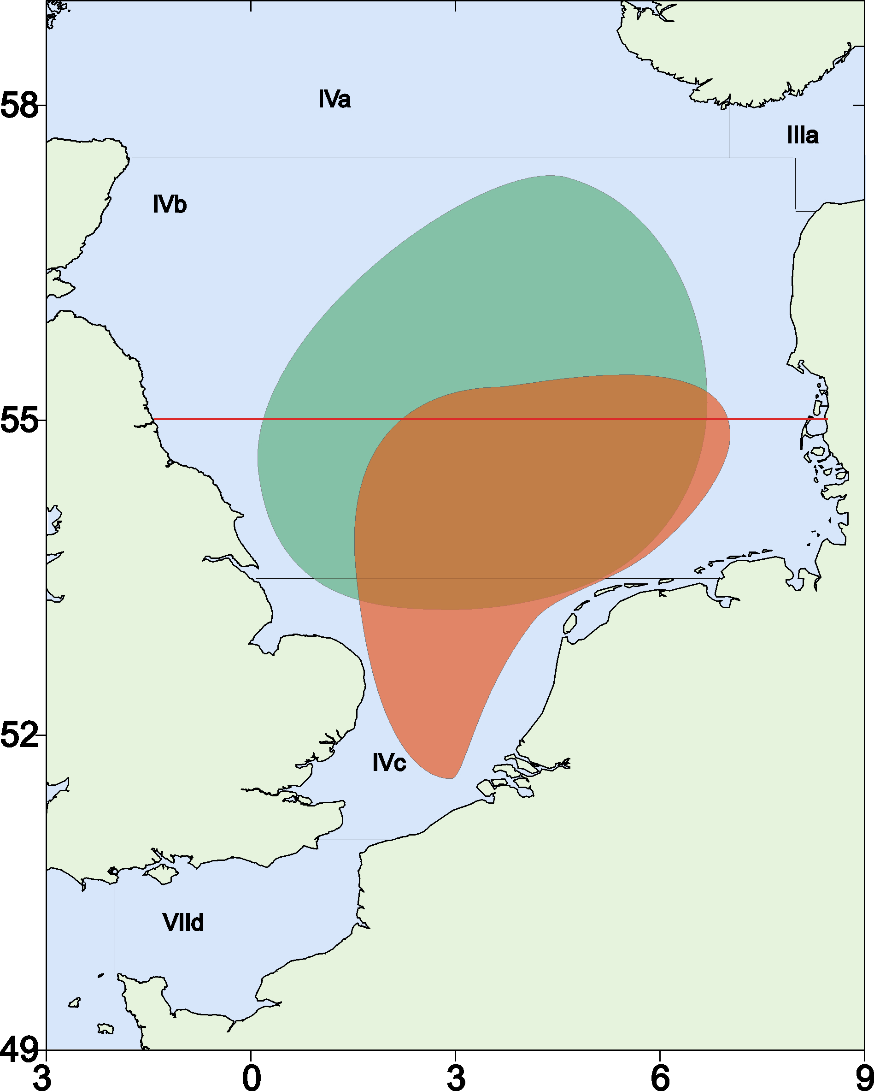
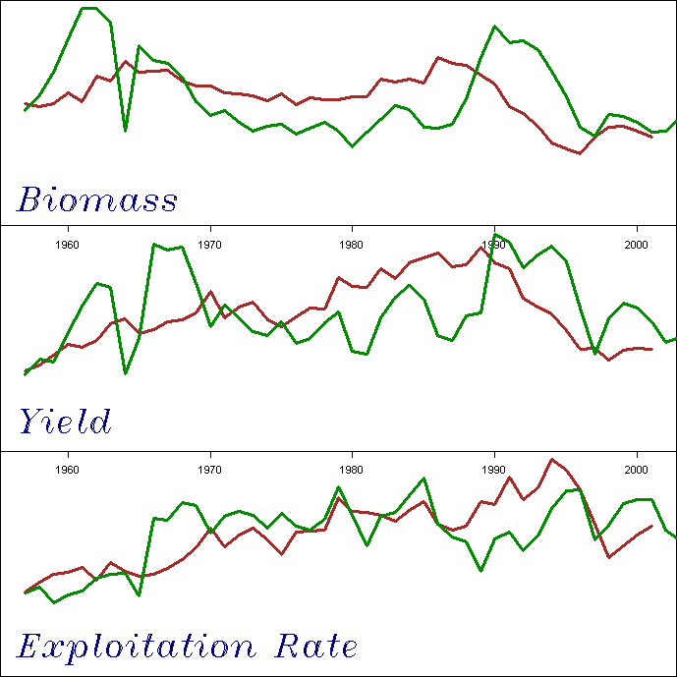
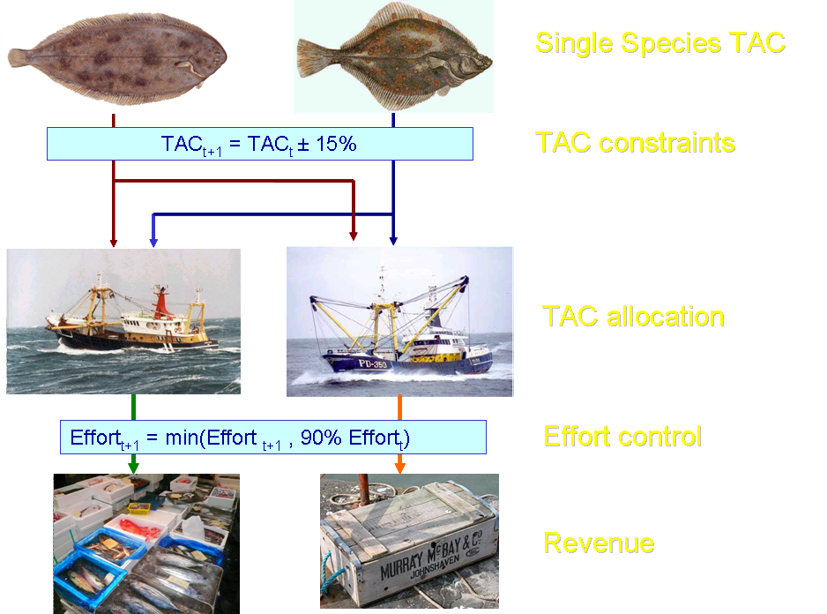
North Sea Flatfish Management Plan
Management plan for mixed North Sea flatfish fisheries
TAC,
Effort and
Area based management
Notes:
Fishery models provide an important tool for management since it is infeasible to carry out large scale management experiments at sea, for example to work out whether it is better to close part of the North Sea or to increase mesh size in certain fisheries to ensure cod recovery.
Models are therefore used to help managers answer such 'what if' questions before implementing changes.
However, models may not be able to capture all the uncertainty that exists with respect to the stocks and the fishery, and some critics consider that models may never be sufficiently well developed to be used to fine tune fishery management decisions.
This Snapshot will present a variety of examples of how Cefas are using modelling techniques to evaluate different fisheries management strategies.

Slide 12
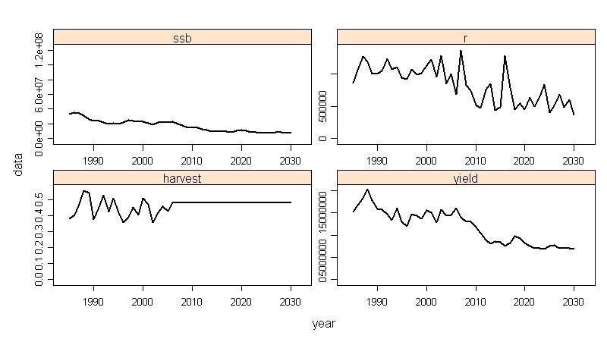
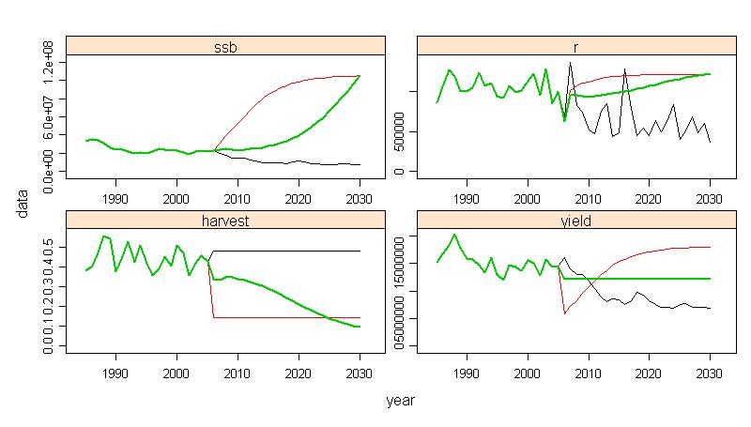
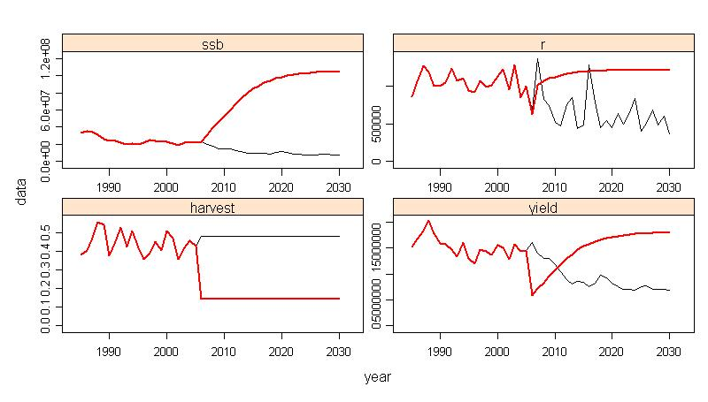
Mediterranean Swordfish
If two policies have same biological but differing economic impacts, then there might be a preferred economic option e.g.
    days at sea, fleet reduction or closures?
Fishers respond to changes in economic incentives, and management changes incentive structures so also changes behaviour
An evaluation of Mediterranean swordfish management to recover stock to BMSY
A variety of management plans were evaluated to try and recover the stock to BMSY by 2030;
red shows the expected outcome for a constant fishing mortality strategy and
green for a constant catch strategy.

Slide 13
Core fisheries system
Fish stock
Regulation
Fishing Industry
Consumers
Risk & Governance

Slide 14
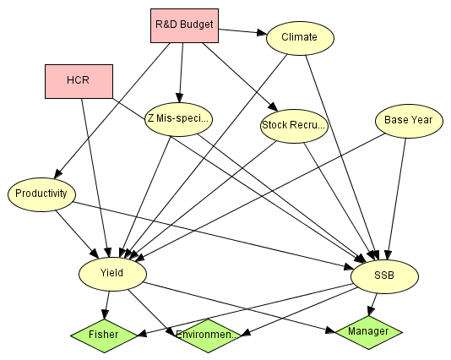
Decision networks
To compare the consequences of alternative actions and the trade-offs between management objectives for different stakeholders
Controls
Processes
Utility Functions

Slide 15
Precautionary Approach
    Management advice must comprehensively take into account uncertainties and associated risks
    e.g. due to
        Process Error; due to natural variability
        Model Error; fish don’t know the theory of VPA
        Estimation Error; Even if they did, doesn’t mean we’d get a good fit
        Observation Error; Imperfect information
        Implementation Error; regulations not working as expected
Notes:
Fishery models provide an important tool for management since it is infeasible to carry out large scale management experiments at sea, for example to work out whether it is better to close part of the North Sea or to increase mesh size in certain fisheries to ensure cod recovery.
Models are therefore used to help managers answer such 'what if' questions before implementing changes.
However, models may not be able to capture all the uncertainty that exists with respect to the stocks and the fishery, and some critics consider that models may never be sufficiently well developed to be used to fine tune fishery management decisions.
This Snapshot will present a variety of examples of how Cefas are using modelling techniques to evaluate different fisheries management strategies.

Slide 16
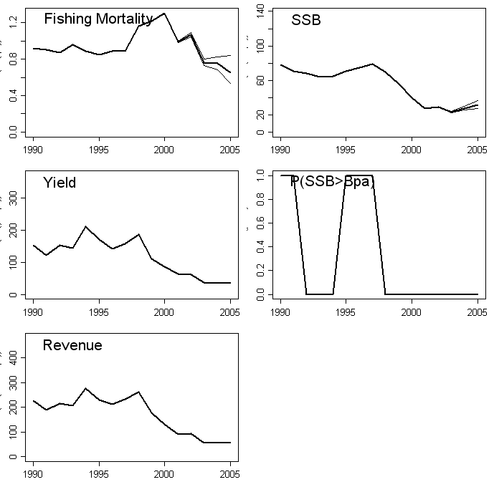
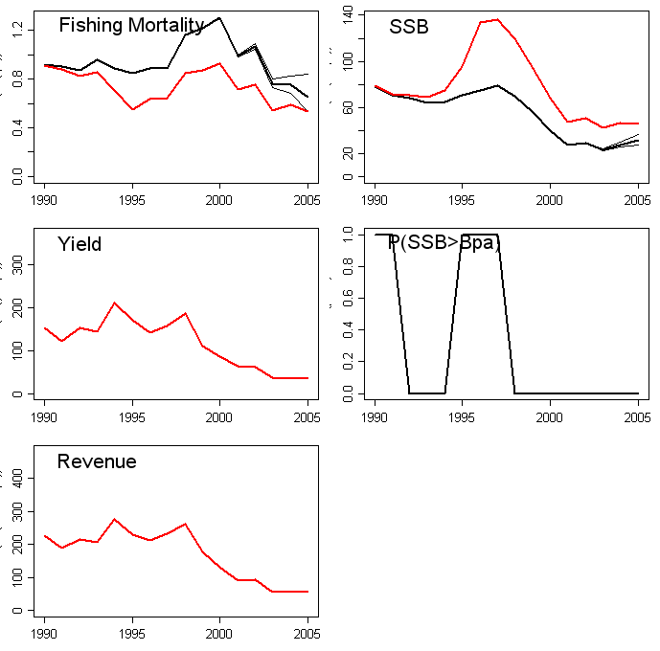
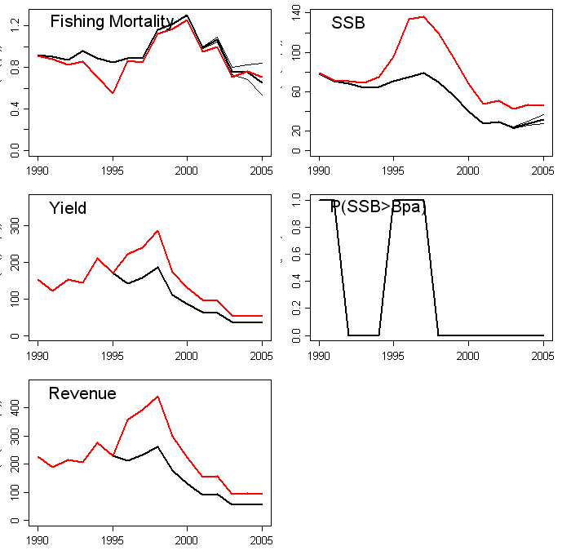
Uncertainty in Dynamics
  The ICES assessment for North Sea estimate bias due to difference in signal between catch & CPUE and assumes its due to misreporting
  But does it result from increased natural mortality, discarding or misreported landings?
  Depending on the hypothesis the perception of the stock and the economic performance of the fleets change
Misreporting?
Increased M?

Slide 17
Management Strategy Evaluation
Not used to set quotas but to work out whether
we should be setting quotas at all
Hypotheses
Biological
Economic
Fleet behaviour
Stock/Fleet
Dynamics
The “Fishery”
The “Fishery”
Data
Alternatives
Measures
The “Fishery”
Management
Measures
Management

Slide 18
Management Strategy Evaluation
OPERATING MODEL
Represents the “true” dynamics of the system against which performance will be measured
MANAGEMENT PROCEDURE
Assess status of stock and set management options depending upon perceived status of fishery stock(s)
MODEL CONDITIONING
Not used to set quotas but to work out whether
we should be setting quotas at all!
Management decision stage
Fleet dynamics
FLFleet
IMPLEMENTATION MODEL
FLEcon
Management procedure
FLHCR
Biological reference points (e.g. MSY)
FLBRP
INITIAL CONDITIONS
Hypotheses
Biological
Economic
Fleet behaviour
Stock/Fleet
Dynamics
SUMMARY STATISTICS
Used to evaluate performance of management procedures against objectives.
Population biology
Assessment procedure
Stock dynamics
FLBiol
OBSERVATION ERROR MODEL
Generation of data on fishery and stocks.
FLOEM
Perceived stock
FLStock
Stock assessment (e.g. VPA)
FLAssess
The “Fishery”
The “Fishery”
Auxiliary information
(e.g. tuning indices)
FLIndices
Alternatives
Measures
Stock processes
e.g. Recruitment
FLSR
Data
Assessment assumptions
The “Fishery”
Management
Measures
Management

Slide 19
Lumping or splitting?
How to best manage and assess a meta-population?

Slide 20
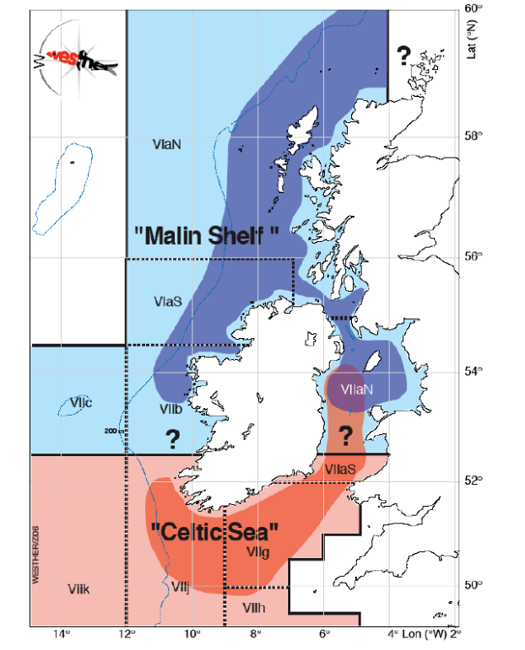
Western Herring Stocks
1
TAC 1
TAC 2
2
3
TAC 3
4
TAC 4

Slide 21
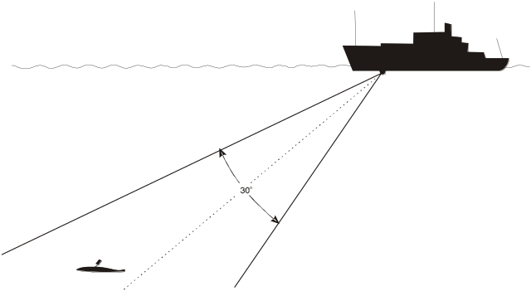
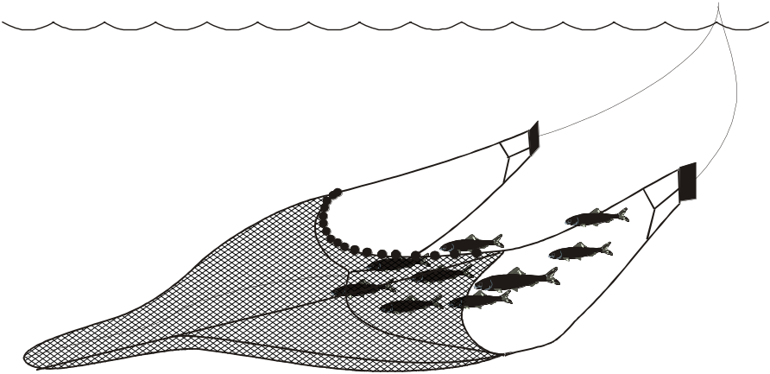
Simulation Framework
VPA
assessment
1
2
3
4
F

Slide 22
Lumping or splitting?
In an ideal world best would be to assess the populations separately. If a VPA is used in the assessment that would imply:
  To survey the populations individually (at spawning time) and
  to separate them in the catch.
If that was not possible target F will have to be set low not to overexploit individual components.
Potential ways of assessment and management need to be evaluated considering trade-offs between yield and risk of stock collapse.

Slide 23
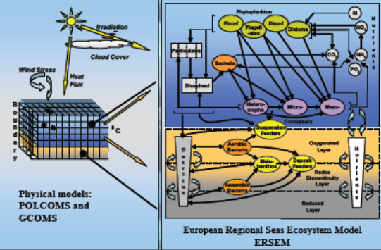





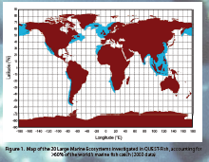
Linking it all together
Understanding & predicting :
the effects of climate change and human impacts on marine ecosystems
human dependence on ecosystems for a sustainable future
Physical environment
Fisheries management
Biodiversity
Socio-economics
Notes:
Gaining experience outside specialism /career grouping/ exerting influence over wider base

