Slide 1


R and FLR
Iago Mosqueira

Slide 2
Goals
Getting ready
How is FLR built?
Looking into R packages
S4 classes and OOP
Using FLCore
Some useful language issues
Use of compiled code in FLR

Slide 3
Getting ready
R 2.10 @ cran.r-project.org
FLR packages
Editor
SVN
Data

Slide 4
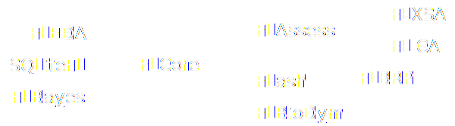
How is FLR actually built?
R packages

Slide 5
How is FLR actually developed?
R packages
Website & mailing lists
Source code in SVN server
Nightly builds at R-Forge (Unix, Windows, Mac)
Released packages at flr-project.org/R
    install.packages(repos=”http://flr-project.org/R”)
bugs.flr-project.org

Slide 6
Looking into R packages
./R
./man
./src
./tests
DESCRIPTION
NAMESPACE
NEWS

Slide 7
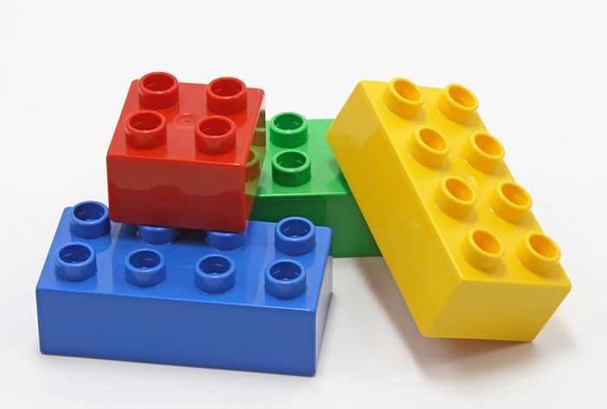
S4 classes and OOP
Classes
Methods
Instances – objects
Constructors
Accessors – encapsulation
Inheritance

Slide 8
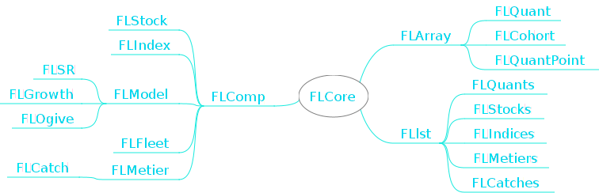
FLR S4 class inheritance

Slide 9
Computational statistics to be aware of, or why does sqrt(2)^2 != 2
(sqrt(2)^2) == 2
  all.equal()
  .Machine$double.eps (2.22046e-16)
  R FAQ 7.31
Recycling rule
  a <- rep(NA, 10)
  b <- 1:3
  a[1:10] <- b

Slide 10
Lazy evaluation
  f <­ function(a, b=log(a))
  {
    a*b
  }
f <­ function(a, b=c)
  {
c = log(a)
a*b
}

Slide 11
Lexical scoping
> c <­ 2
foo <­ function(a, b)
{
return(a + b * c)
}
> foo(1,2)

Slide 12
Lexical scoping
> c <­ 2
foo <­ function(a, b)
{
return(a + b * c)
}
> foo(1,2)
[1] 5

Slide 13
Use of compiled code
C, C+, F77, F90
C calling convention
Ideally with gcc compiler (MinGW in windows)
Speed vs. transparency
Impossible to do without C/C++
S4 classes mapped to C++
ADMB, GSL, ...

