Slide 1


"Management Strategy Evaluation (including FLR)"
Laurence Kell, ICCAT
Iago Mosqueira, Cefas

Slide 2
Goals
Review the structure and process of a management simulation
Get acquainted with the FLR suite
Explore uncertainty in data, models and assumptions
Experience the possibilities of R as a platform
Discuss merits and shortcomings of MSE and FLR
See how to contribute to FLR

Slide 3


Slide 4


Slide 5
Themes
MON: Introduction to R & FLR
TUE: Modeling biological populations
WED: Stock status, Harvest Control Rules & Management Procedures
THU: Building operating models
FRI: Translating models into advice (inc. economics)

Slide 6
Papers
MON: Kell et al, 2007; Schnute et al, 2007
TUE: Hilborn & Stokes, 2010
WED: Mantzouni et al., 2010
THU: Rochet & Rice, 2009; Butterworth et al, 2010
FRI: Charles, 2005; Punt & Allison, 2007

Slide 7
Logistics
Work in pairs
Network
Timetable
Coffee & Lunch
Icebreaker, today @ 7pm
Dinner, on Thursday
O Berbés, on Tuesday/Wednesday
Feedback

Slide 8
Timetable
AM
  09.00 - 11.00 Lectures
  11.00 - 11.30 Coffee break
  11.30 - 13.00 Tutorials
PM
  14:30 - 16:00 Lectures/Tutorials
  16:00 - 16:30 Coffee break
  16:30 - 18:30 Assignment

Slide 9
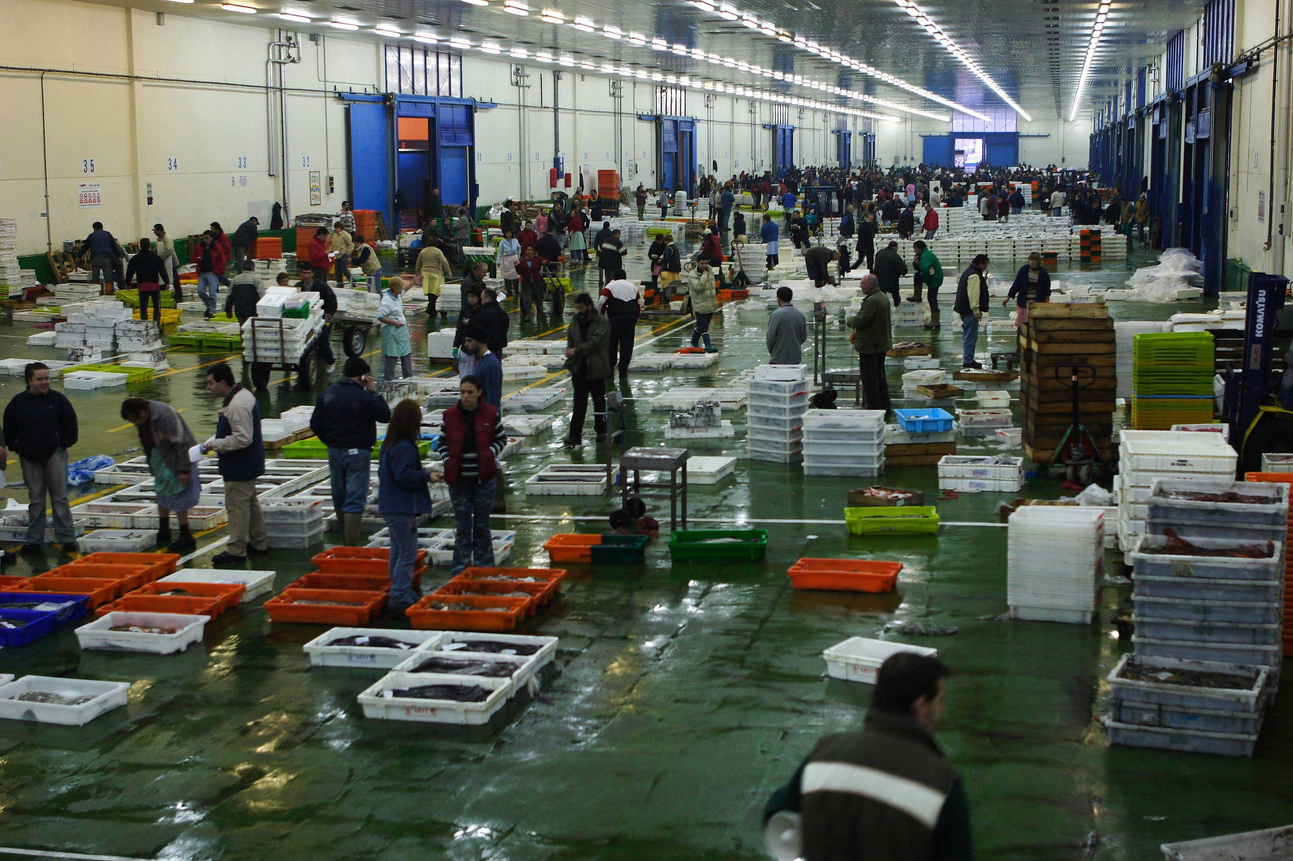

Slide 10
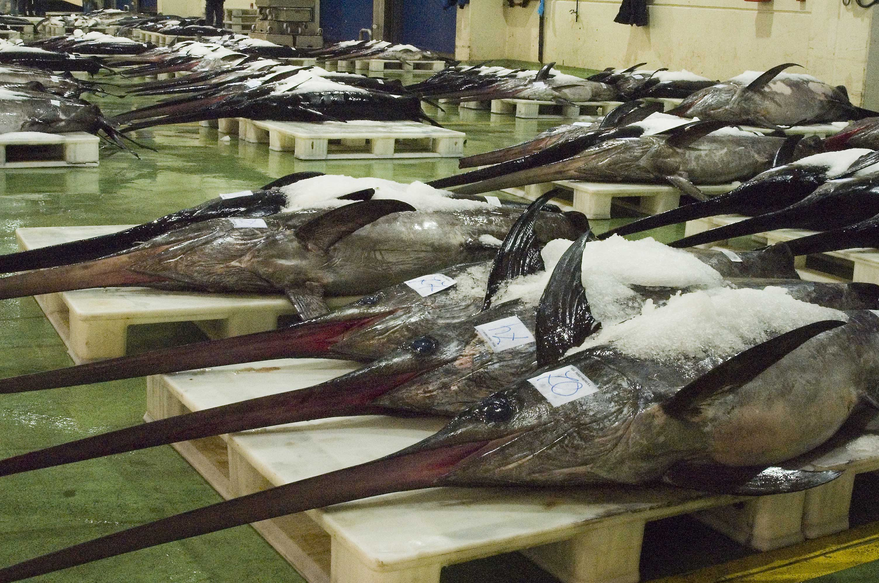

Slide 11
Laurie Kell
ICCAT Secretariat
ICES Study Group on Risk Assessment
IWC, previously head of UK scientific delegation
Coordinator of various EU projects on MSE
Involved with STECF in developing management plans under CFP

Slide 12
Iago Mosqueira
Systems Modeling @ Fisheries Laboratory LWT
Ecology @ UEA, Norwich
Imperial College London
Tropical tuna @ AZTI Tecnalia
WPTT IOTC
Involved in various EU projects on MSE
FLR

Slide 13
Monday
AM
  Welcome
  Presentation - Intro to MSE
  Presentation - The R language and FLR
  Tutorial - Installation and FLCore
PM
  Tutorial - Installation and FLCore (cont.)
  Assignment - Loading data, plotting, building objects

