Slide 1
Summary of Talk
Policy and Scientific Advice Frameworks
Management Examples
  North Plaice
  Bluefin Cites
  Cod
Future directions

Slide 2
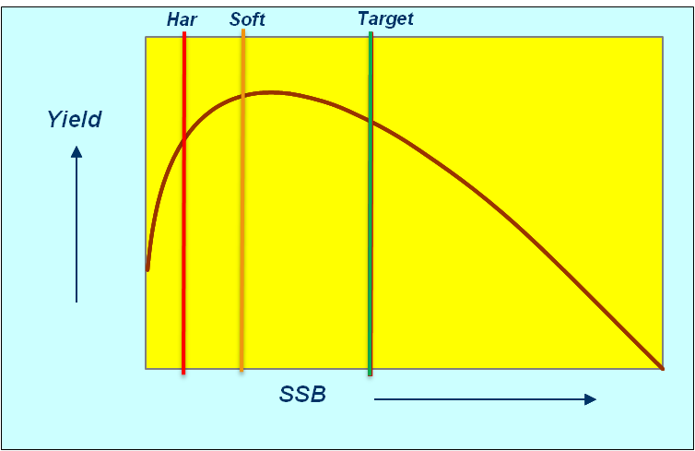
Biomass Reference Points
Formal management strategies tend to be built around three key biomass reference points:
    Targets about which the stock is meant to fluctuate
    Soft limits below which a formal rebuilding plan be put in place,and
    Hard limits where directed fishing should stop

Slide 3
Management Frameworks
Using of biomass reference points
    PFMC groundfish management plan, 40% of B₀ is the target, 25% of B₀ is the soft limit and formal definition of being overfished, and 10% of B₀ is the hard limit.
    Australia, the target defaults to 1.2 x B_{MSY} (or 48% B₀ ); the hard limit is half MSY (20% B₀ )
    ICES have B_{PA} & B_{LIM} Set on a stock by stock basis
    ICCAT Have B_{MSY} as a target.
    CITES Bluefin evaluations used current SSB as a percentage of B₀ or B_{Max}
Notes:
Fishery models provide an important tool for management since it is infeasible to carry out large scale management experiments at sea, for example to work out whether it is better to close part of the North Sea or to increase mesh size in certain fisheries to ensure cod recovery.
Models are therefore used to help managers answer such 'what if' questions before implementing changes.
However, models may not be able to capture all the uncertainty that exists with respect to the stocks and the fishery, and some critics consider that models may never be sufficiently well developed to be used to fine tune fishery management decisions.
This Snapshot will present a variety of examples of how Cefas are using modelling techniques to evaluate different fisheries management strategies.

Slide 4
Examples
Using of biomass reference points
    North Sea plaice, advice provided by ICES and managed under EU Norway agreements
    Bluefin Tuna managed by ICCAT
    Cod stocks, advice provided by ICES, managed by EU, Norway, Faroes, Iceland
Notes:
Fishery models provide an important tool for management since it is infeasible to carry out large scale management experiments at sea, for example to work out whether it is better to close part of the North Sea or to increase mesh size in certain fisheries to ensure cod recovery.
Models are therefore used to help managers answer such 'what if' questions before implementing changes.
However, models may not be able to capture all the uncertainty that exists with respect to the stocks and the fishery, and some critics consider that models may never be sufficiently well developed to be used to fine tune fishery management decisions.
This Snapshot will present a variety of examples of how Cefas are using modelling techniques to evaluate different fisheries management strategies.

Slide 5
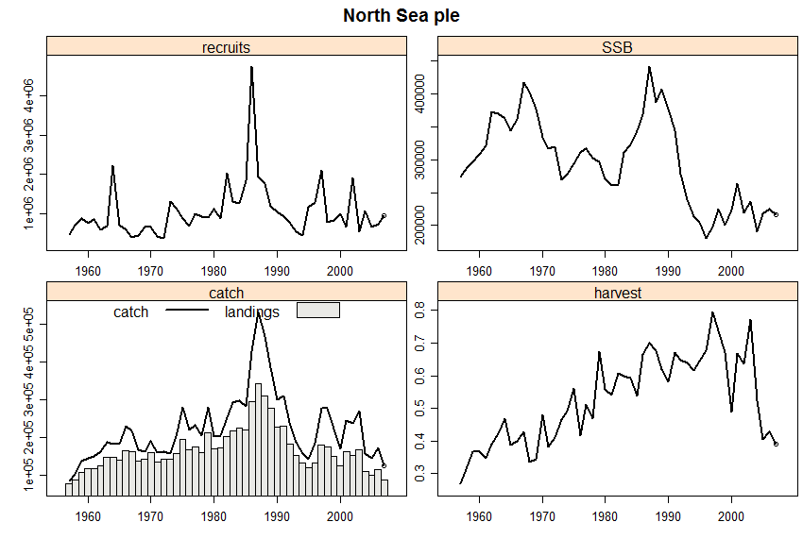
North Sea Plaice
Biomass limits
    B_{LIM} B_{loss} = 160 000 t, the lowest observed biomass in 1997 as assessed in2004
    B_{PA} Approximately 1.4 B_{lim}
>data(ple4)
>plot(ple4)
Notes:
Fishery models provide an important tool for management since it is infeasible to carry out large scale management experiments at sea, for example to work out whether it is better to close part of the North Sea or to increase mesh size in certain fisheries to ensure cod recovery.
Models are therefore used to help managers answer such 'what if' questions before implementing changes.
However, models may not be able to capture all the uncertainty that exists with respect to the stocks and the fishery, and some critics consider that models may never be sufficiently well developed to be used to fine tune fishery management decisions.
This Snapshot will present a variety of examples of how Cefas are using modelling techniques to evaluate different fisheries management strategies.

Slide 6
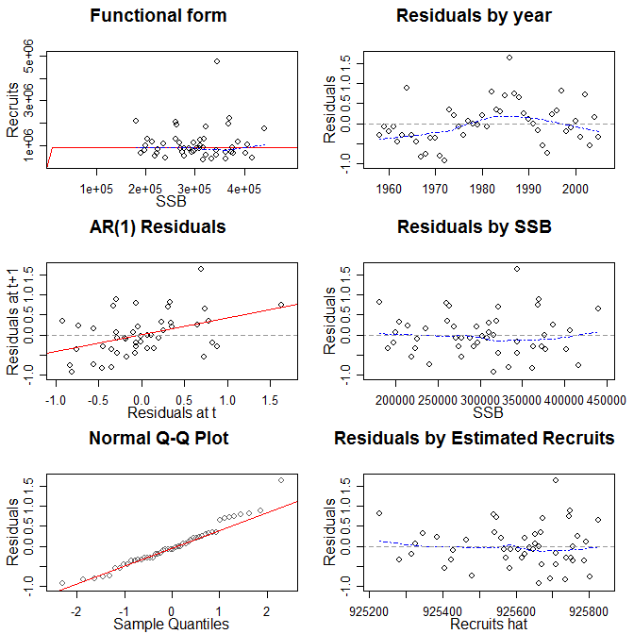
Stock Recruitment Relationship
Beverton & Holt
Best fit
    Constant recruitment?
    Some autocorrelation
    Year effect?
>pleSR<-as.FLSR(ple4)
>model(pleSR)<-bevholt()
>pleSR<-fmle(pleSR)
>plot(pleSR)
Notes:
Fishery models provide an important tool for management since it is infeasible to carry out large scale management experiments at sea, for example to work out whether it is better to close part of the North Sea or to increase mesh size in certain fisheries to ensure cod recovery.
Models are therefore used to help managers answer such 'what if' questions before implementing changes.
However, models may not be able to capture all the uncertainty that exists with respect to the stocks and the fishery, and some critics consider that models may never be sufficiently well developed to be used to fine tune fishery management decisions.
This Snapshot will present a variety of examples of how Cefas are using modelling techniques to evaluate different fisheries management strategies.

Slide 7

Stock Recruitment Relationship
Beverton & Holt
Autocorrelation
    Better fit?
>model(pleSR)<-bevholtAR1()
>pleSR<-fmle(pleSR)
>plot(pleSR)
Notes:
Fishery models provide an important tool for management since it is infeasible to carry out large scale management experiments at sea, for example to work out whether it is better to close part of the North Sea or to increase mesh size in certain fisheries to ensure cod recovery.
Models are therefore used to help managers answer such 'what if' questions before implementing changes.
However, models may not be able to capture all the uncertainty that exists with respect to the stocks and the fishery, and some critics consider that models may never be sufficiently well developed to be used to fine tune fishery management decisions.
This Snapshot will present a variety of examples of how Cefas are using modelling techniques to evaluate different fisheries management strategies.

Slide 8
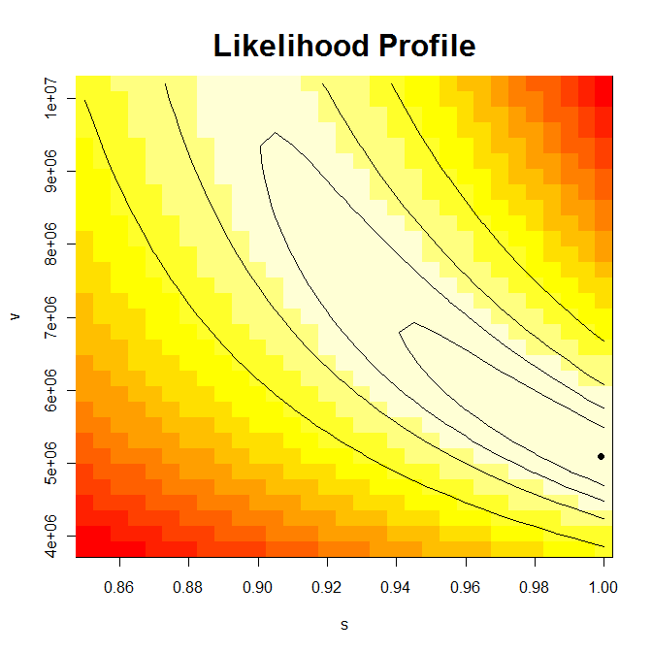
Stock Recruitment Relationship
Constant recruitment?
    Looks like B0 is not well estimated
    Steepness is >0.85
>profile(pleSR)
Notes:
Fishery models provide an important tool for management since it is infeasible to carry out large scale management experiments at sea, for example to work out whether it is better to close part of the North Sea or to increase mesh size in certain fisheries to ensure cod recovery.
Models are therefore used to help managers answer such 'what if' questions before implementing changes.
However, models may not be able to capture all the uncertainty that exists with respect to the stocks and the fishery, and some critics consider that models may never be sufficiently well developed to be used to fine tune fishery management decisions.
This Snapshot will present a variety of examples of how Cefas are using modelling techniques to evaluate different fisheries management strategies.

Slide 9
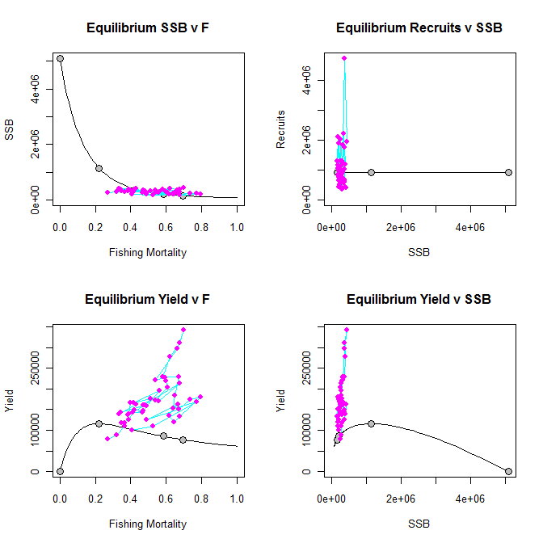
Reference Points
Beverton & Holt
    B₀
    B_{MSY}
    B_{PA}
    B_{LIM}
> pleBRP<-FLBRP(ple4,sr=pleSR)
> pleBRP<-brp(pleBRP)
> plot(pleBRP,obs=T)
Notes:
Fishery models provide an important tool for management since it is infeasible to carry out large scale management experiments at sea, for example to work out whether it is better to close part of the North Sea or to increase mesh size in certain fisheries to ensure cod recovery.
Models are therefore used to help managers answer such 'what if' questions before implementing changes.
However, models may not be able to capture all the uncertainty that exists with respect to the stocks and the fishery, and some critics consider that models may never be sufficiently well developed to be used to fine tune fishery management decisions.
This Snapshot will present a variety of examples of how Cefas are using modelling techniques to evaluate different fisheries management strategies.

Slide 10
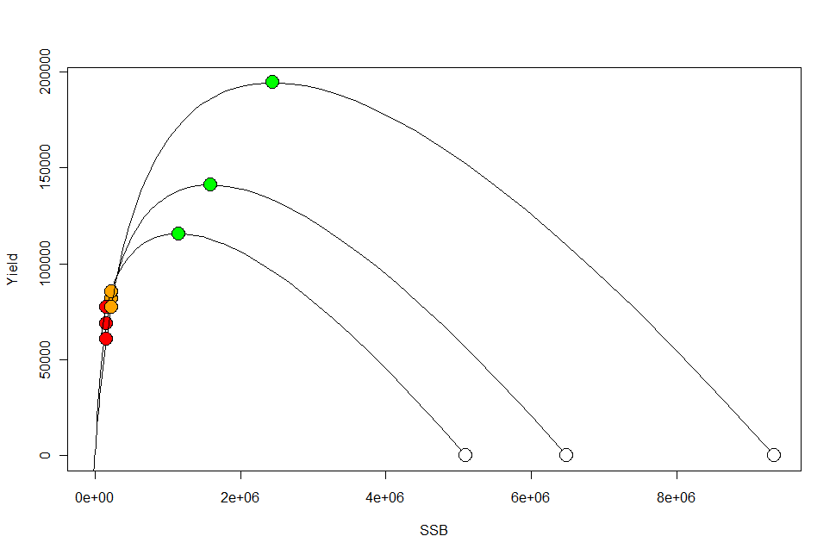
Reference Points & Steepness
Beverton & Holt
    B₀
    B_{MSY}
    B_{PA}
    B_{LIM}
> magic()
Notes:
Fishery models provide an important tool for management since it is infeasible to carry out large scale management experiments at sea, for example to work out whether it is better to close part of the North Sea or to increase mesh size in certain fisheries to ensure cod recovery.
Models are therefore used to help managers answer such 'what if' questions before implementing changes.
However, models may not be able to capture all the uncertainty that exists with respect to the stocks and the fishery, and some critics consider that models may never be sufficiently well developed to be used to fine tune fishery management decisions.
This Snapshot will present a variety of examples of how Cefas are using modelling techniques to evaluate different fisheries management strategies.

Slide 11
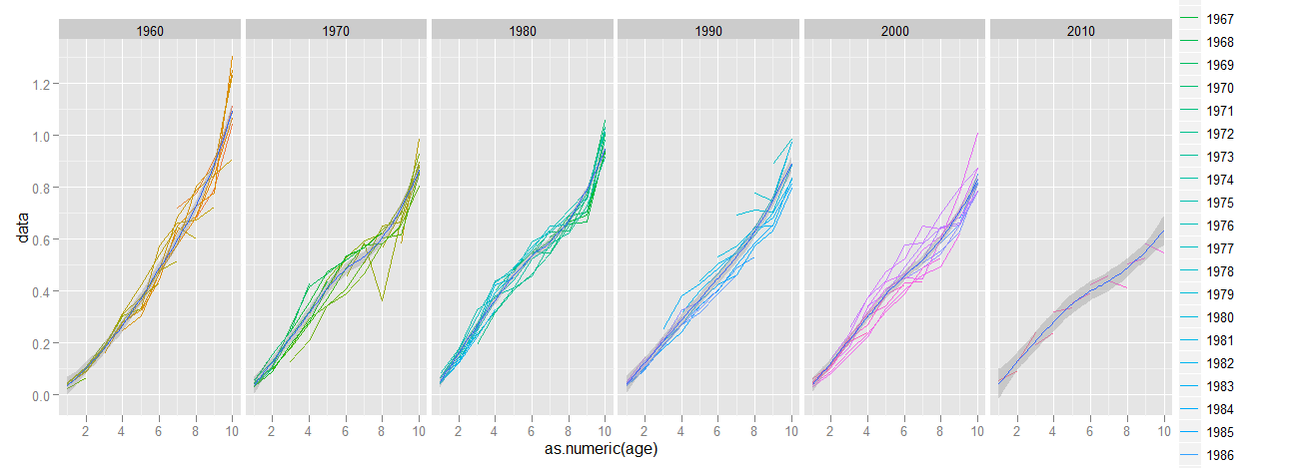
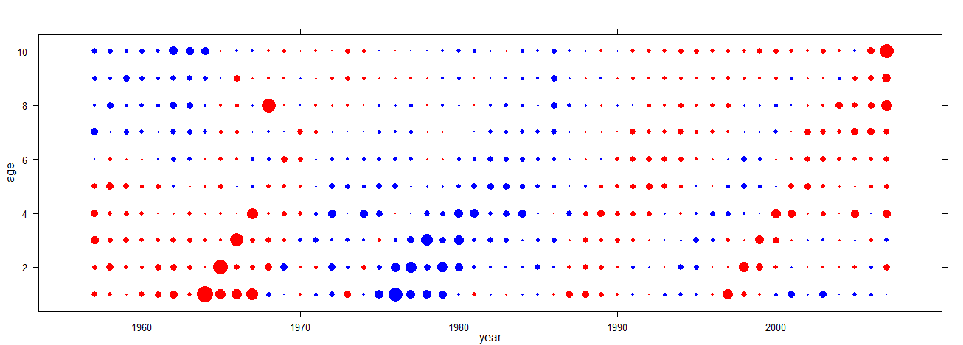
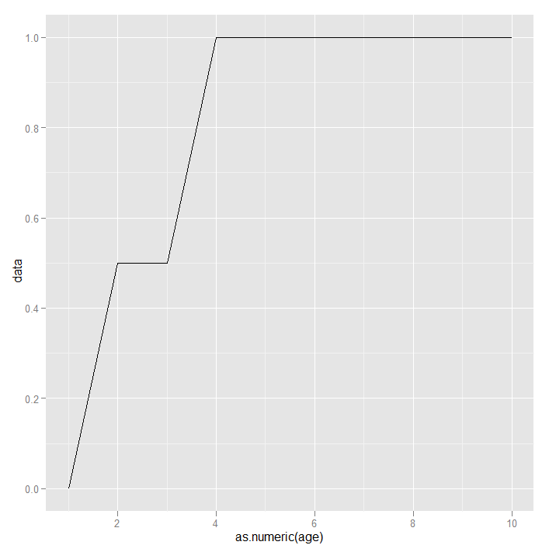
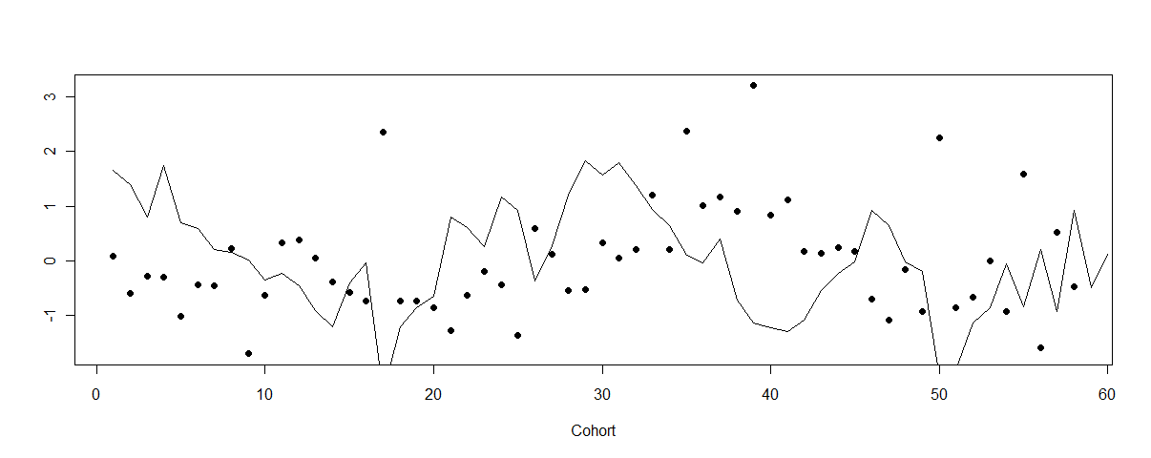
Biology
Growth & Maturity
Autocorrelation
    Mass-at-age
    Cohort effects
    Linked with Recruitment?
    Maturity
Notes:
Fishery models provide an important tool for management since it is infeasible to carry out large scale management experiments at sea, for example to work out whether it is better to close part of the North Sea or to increase mesh size in certain fisheries to ensure cod recovery.
Models are therefore used to help managers answer such 'what if' questions before implementing changes.
However, models may not be able to capture all the uncertainty that exists with respect to the stocks and the fishery, and some critics consider that models may never be sufficiently well developed to be used to fine tune fishery management decisions.
This Snapshot will present a variety of examples of how Cefas are using modelling techniques to evaluate different fisheries management strategies.

Slide 12
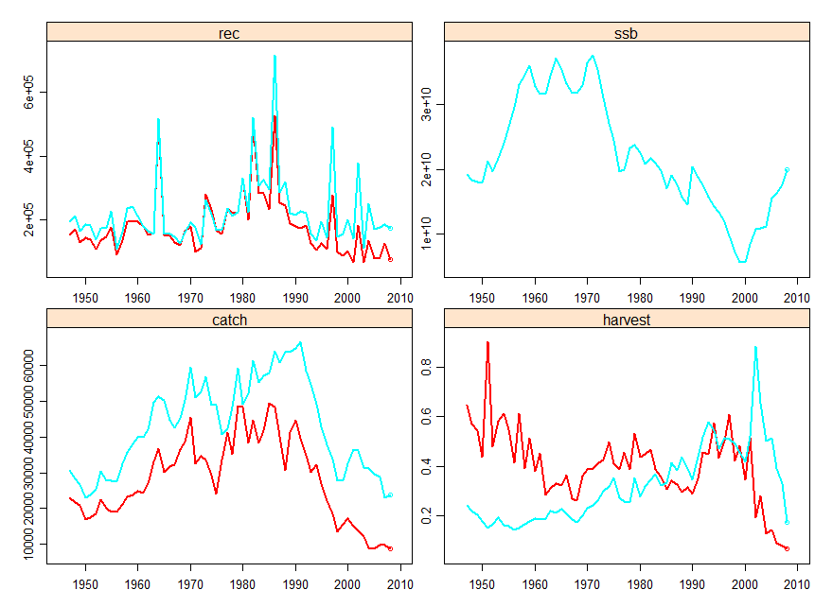
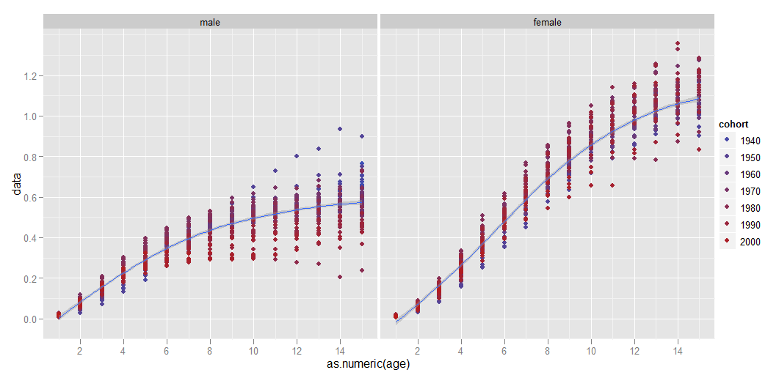
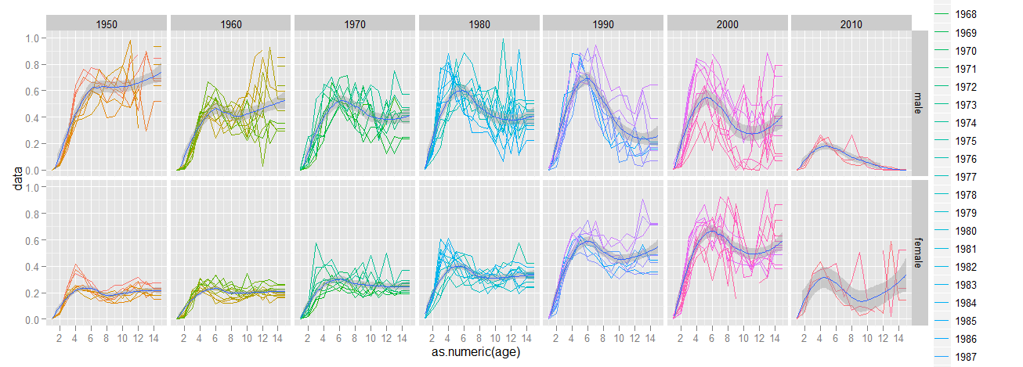
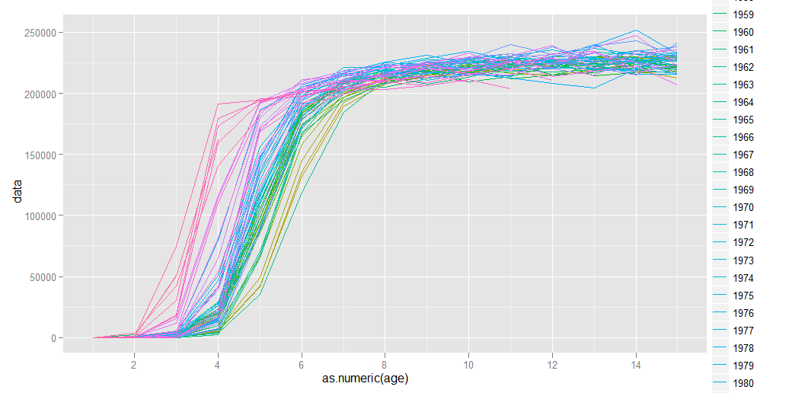
Sexual Dimorphism
Males & Females
Year Effects
    Growth
    Maturity
    Selectivity
> magic()
Notes:
Fishery models provide an important tool for management since it is infeasible to carry out large scale management experiments at sea, for example to work out whether it is better to close part of the North Sea or to increase mesh size in certain fisheries to ensure cod recovery.
Models are therefore used to help managers answer such 'what if' questions before implementing changes.
However, models may not be able to capture all the uncertainty that exists with respect to the stocks and the fishery, and some critics consider that models may never be sufficiently well developed to be used to fine tune fishery management decisions.
This Snapshot will present a variety of examples of how Cefas are using modelling techniques to evaluate different fisheries management strategies.

Slide 13
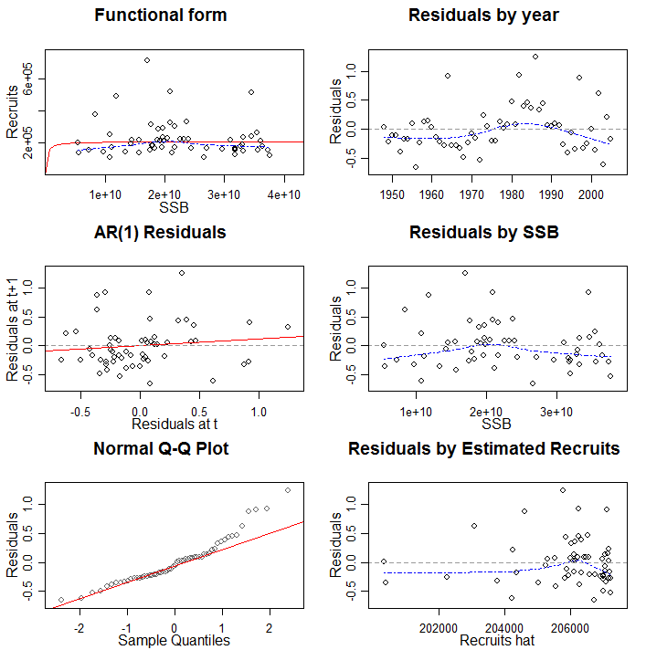
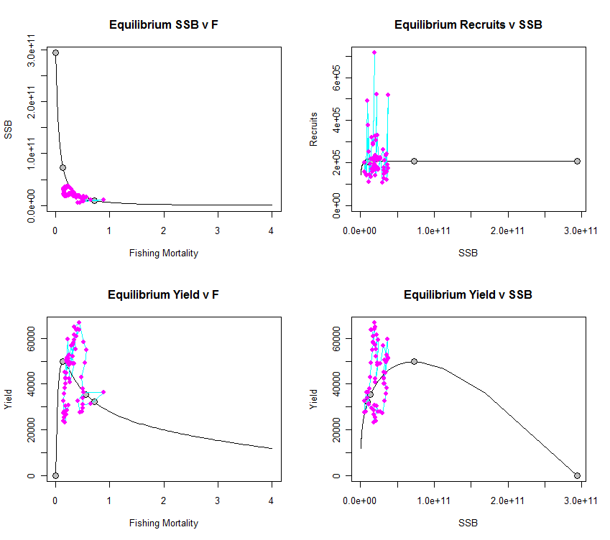
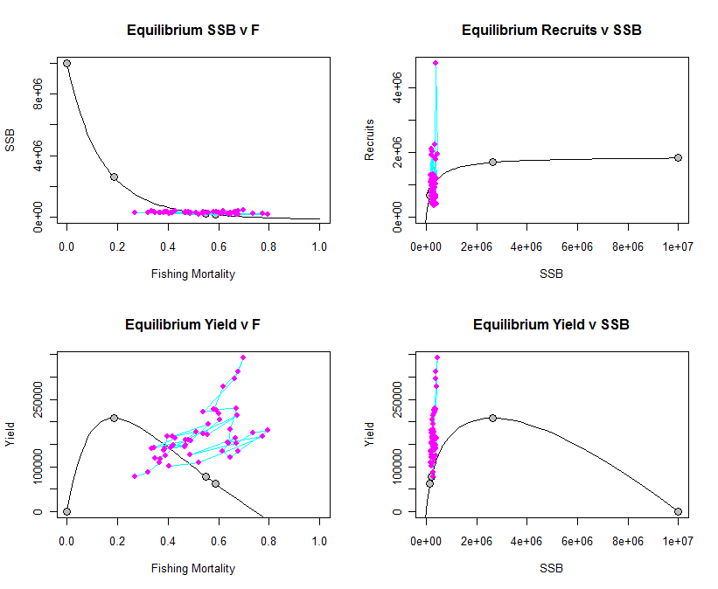
Reference Points & Steepness
Beverton & Holt
Autocorrelation
    Stock recruitment?
    Reference points
    Year effect?
> magic()
Notes:
Fishery models provide an important tool for management since it is infeasible to carry out large scale management experiments at sea, for example to work out whether it is better to close part of the North Sea or to increase mesh size in certain fisheries to ensure cod recovery.
Models are therefore used to help managers answer such 'what if' questions before implementing changes.
However, models may not be able to capture all the uncertainty that exists with respect to the stocks and the fishery, and some critics consider that models may never be sufficiently well developed to be used to fine tune fishery management decisions.
This Snapshot will present a variety of examples of how Cefas are using modelling techniques to evaluate different fisheries management strategies.

Slide 14
Cites Bluefin Evaluations
“A general guideline for a marked historical extent of decline is a percentage decline to 5%-30% of the baseline, depending on the biology and productivity of the species. Productivity is the maximum percentage growth rate of a population. It is a complex function of reproductive biology, fecundity, individual growth rates, natural mortality, age at maturity and longevity. More-productive species tend to have high fecundity, rapid individual growth rates and high turnover of generations.”
Application of decline for commercially exploited aquatic species for CITES is stated as follow
“In marine and large freshwater bodies, a narrower range of 5-20% is deemed to be more appropriate in most cases, with a range of 5-10% being applicable for species with high productivity, 10-15% for species with medium productivity and 15-20% for species with low productivity. Nevertheless some species may fall outside this range. Low productivity is correlated with low mortality rate and high
productivity with high mortality. One possible guideline for indexing productivity is the natural mortality rate, with the range 0.2-0.5 per year indicating medium productivity.”
Notes:
Fishery models provide an important tool for management since it is infeasible to carry out large scale management experiments at sea, for example to work out whether it is better to close part of the North Sea or to increase mesh size in certain fisheries to ensure cod recovery.
Models are therefore used to help managers answer such 'what if' questions before implementing changes.
However, models may not be able to capture all the uncertainty that exists with respect to the stocks and the fishery, and some critics consider that models may never be sufficiently well developed to be used to fine tune fishery management decisions.
This Snapshot will present a variety of examples of how Cefas are using modelling techniques to evaluate different fisheries management strategies.

Slide 15
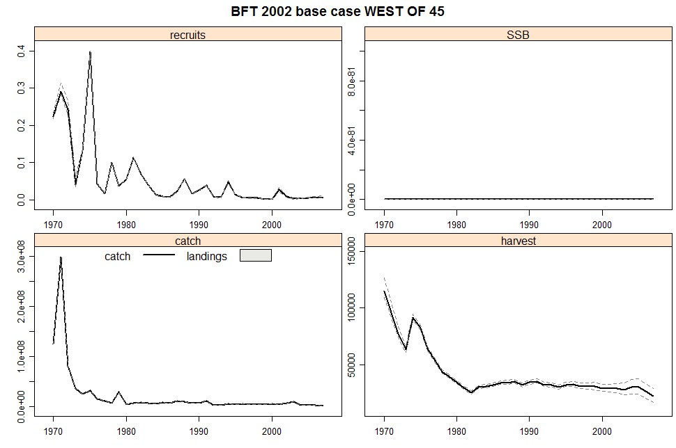
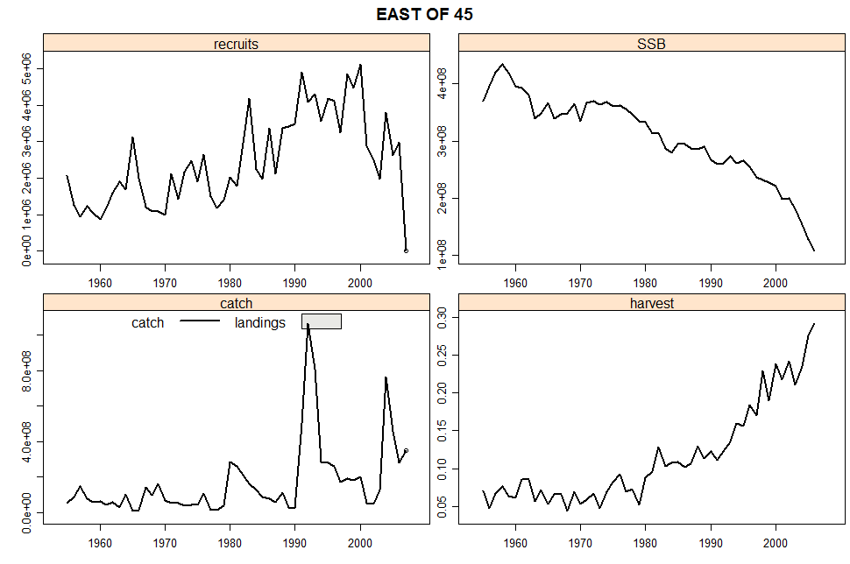
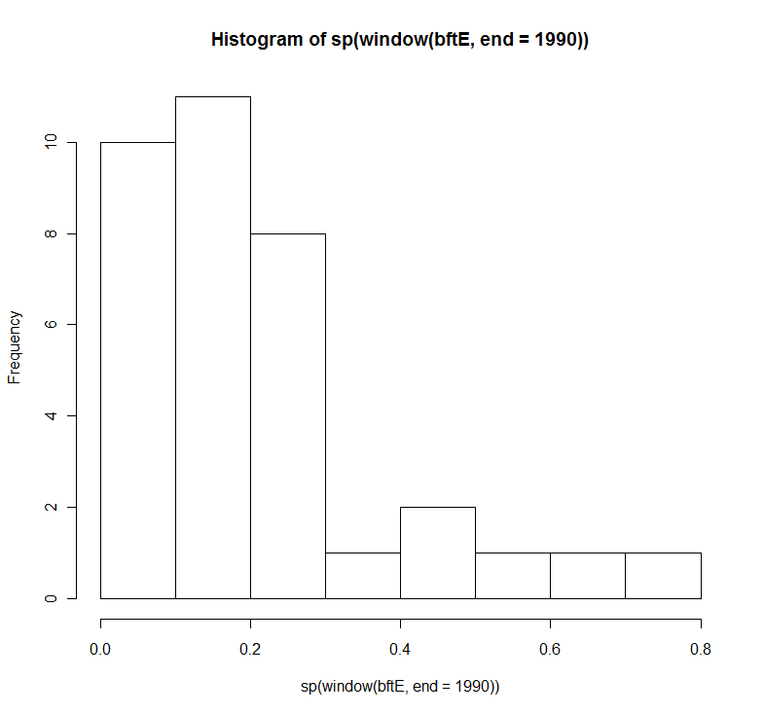
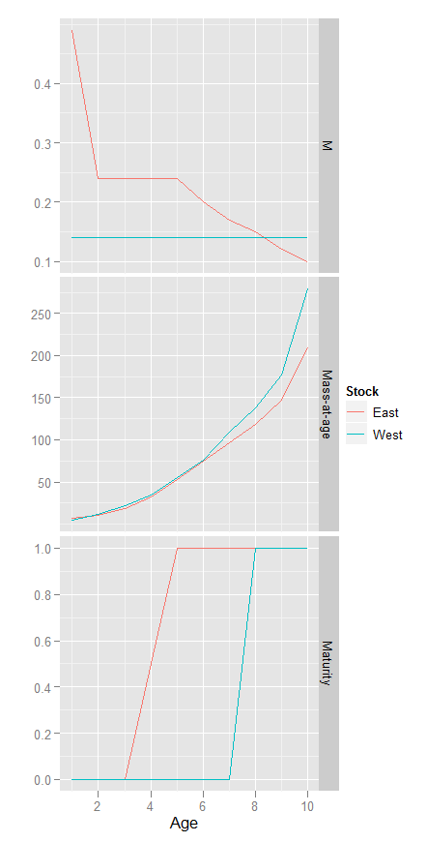
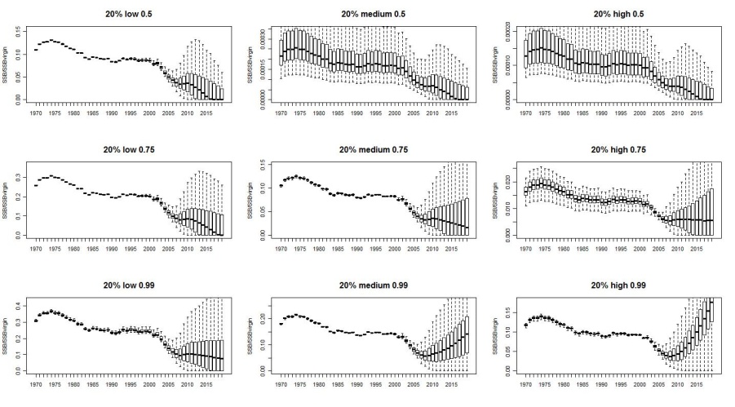
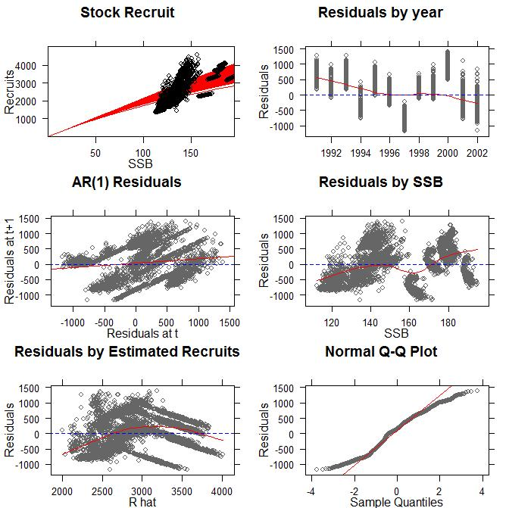
Bluefin
Stocks
    Historic status
    Biological characteristics
    Productivity
Notes:
Fishery models provide an important tool for management since it is infeasible to carry out large scale management experiments at sea, for example to work out whether it is better to close part of the North Sea or to increase mesh size in certain fisheries to ensure cod recovery.
Models are therefore used to help managers answer such 'what if' questions before implementing changes.
However, models may not be able to capture all the uncertainty that exists with respect to the stocks and the fishery, and some critics consider that models may never be sufficiently well developed to be used to fine tune fishery management decisions.
This Snapshot will present a variety of examples of how Cefas are using modelling techniques to evaluate different fisheries management strategies.

Slide 16
Bluefin
Stocks
    Stock Recruit
    Projections
Notes:
Fishery models provide an important tool for management since it is infeasible to carry out large scale management experiments at sea, for example to work out whether it is better to close part of the North Sea or to increase mesh size in certain fisheries to ensure cod recovery.
Models are therefore used to help managers answer such 'what if' questions before implementing changes.
However, models may not be able to capture all the uncertainty that exists with respect to the stocks and the fishery, and some critics consider that models may never be sufficiently well developed to be used to fine tune fishery management decisions.
This Snapshot will present a variety of examples of how Cefas are using modelling techniques to evaluate different fisheries management strategies.

Slide 17
Meta-analyses & Priors
Blah, blah, ...
Blah
    Blah
    Blah
Notes:
Fishery models provide an important tool for management since it is infeasible to carry out large scale management experiments at sea, for example to work out whether it is better to close part of the North Sea or to increase mesh size in certain fisheries to ensure cod recovery.
Models are therefore used to help managers answer such 'what if' questions before implementing changes.
However, models may not be able to capture all the uncertainty that exists with respect to the stocks and the fishery, and some critics consider that models may never be sufficiently well developed to be used to fine tune fishery management decisions.
This Snapshot will present a variety of examples of how Cefas are using modelling techniques to evaluate different fisheries management strategies.

