Slide 1

Management Strategy Evaluation
Laurie Kell
  Population Dynamics Expert ICCAT Secretariat, Madrid
  Previous worked at the Fisheries Laboratory, Lowestoft England when FLR was developed.

Slide 2
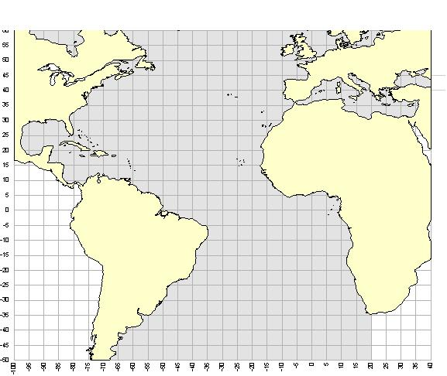
ICCAT
Responsible for the management of populations of tuna and tuna-like fishes found in the Atlantic Ocean and Mediterranean
    Main objective is to ensure maintenance of the populations of tuna and tuna-like fishes in the Convention area at levels which will permit the maximum sustainable catch
    Future of ICCAT involves discussion of Implementing a Precautionary Approach and Ecosystem-Based Fisheries Management
    Capacity building for all of us to meet these challenges of future policy needs
Notes:
Fishery models provide an important tool for management since it is infeasible to carry out large scale management experiments at sea, for example to work out whether it is better to close part of the North Sea or to increase mesh size in certain fisheries to ensure cod recovery.
Models are therefore used to help managers answer such 'what if' questions before implementing changes.
However, models may not be able to capture all the uncertainty that exists with respect to the stocks and the fishery, and some critics consider that models may never be sufficiently well developed to be used to fine tune fishery management decisions.
This Snapshot will present a variety of examples of how Cefas are using modelling techniques to evaluate different fisheries management strategies.

Slide 3
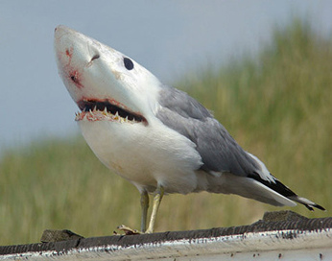
Changing Policy Needs
A move away from short-term reactive management to long-term strategic planning because of
Precautionary Approach
      Precaution should increase with uncertainty about stock status, so that the less you know the less you fish.
World Summit on Sustainable Development (WSSD)
      Recovery of stocks to MSY by 2015
Ecosystem Based Approach to Fisheries Management (EBFM)
      Progressive implementation of an ecosystem-based approach
Notes:
Fishery models provide an important tool for management since it is infeasible to carry out large scale management experiments at sea, for example to work out whether it is better to close part of the North Sea or to increase mesh size in certain fisheries to ensure cod recovery.
Models are therefore used to help managers answer such 'what if' questions before implementing changes.
However, models may not be able to capture all the uncertainty that exists with respect to the stocks and the fishery, and some critics consider that models may never be sufficiently well developed to be used to fine tune fishery management decisions.
This Snapshot will present a variety of examples of how Cefas are using modelling techniques to evaluate different fisheries management strategies.

Slide 4
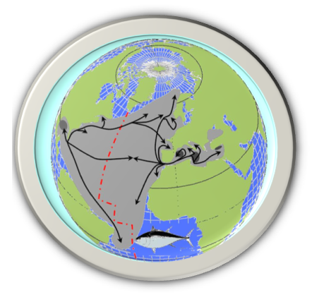

Atlantic Bluefin Tuna

Slide 5
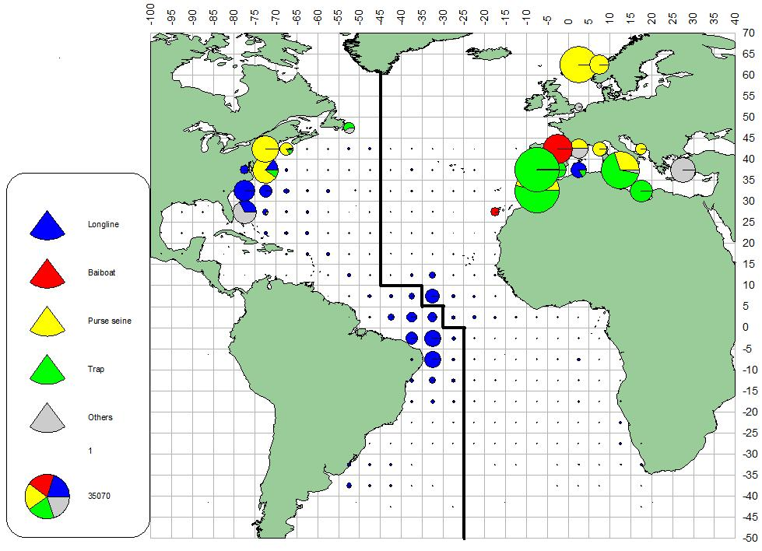
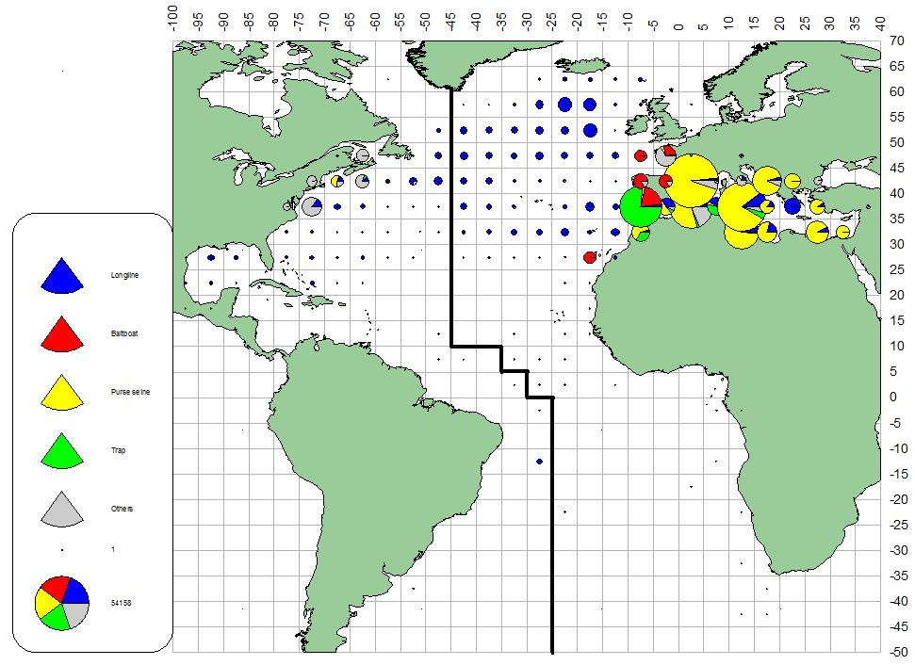
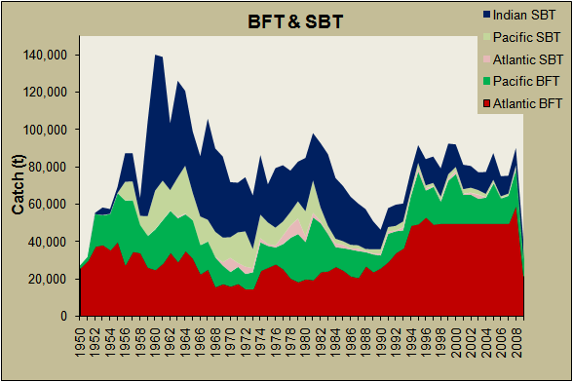
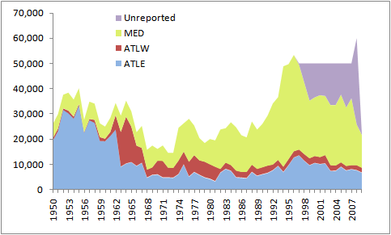
Bluefin Catch Tendencies
1960’s
~26,500t/y
2000’s
>50,000t/y
Recent decrease in the catch has mostly occurred in the Mediterranean Sea, probably in response to the rebuilding plan and control enforcement since 2008
However, the 2008 & 2009 catch estimates do not account for potential IUU catch
More than half the BFT & SBT & more than 2/3 of world total BFT production through 2009 comes from the ICCAT Convention area from which most catch is made in the Med.
The mix of fisheries involved in harvesting Atlantic BFT has changed, resulting in different impacts on juvenile and spawning age classes (and harvest potentials) as markets developed.

Slide 6
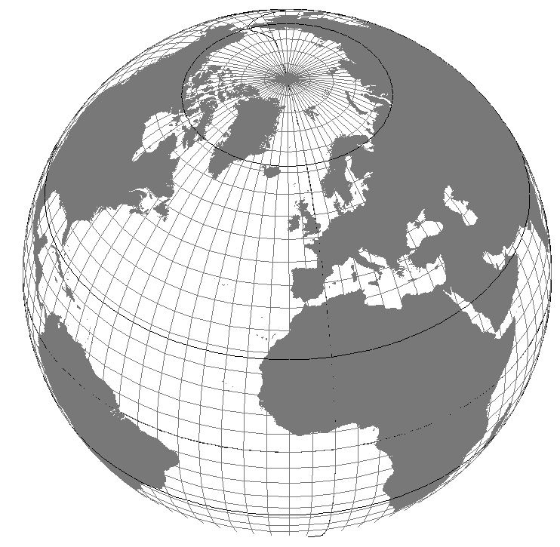
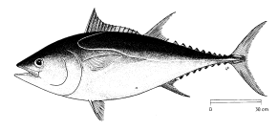
BFT BIOLOGY
Widely distributed: Throughout North Atlantic and Mediterranean.
Highly migratory: complex movements
Restricted spawning: shows fidelity to spawning areas in Mediterranean and Gulf of Mexico. Small spatial and temporal window (April-June in restricted areas).
Long-lived: > 40 years
Late maturing: 4 years (~ 25 kg) in Med. and 9 years (~ 145 kg) in Gulf of Mexico, but ...
Likely to be more susceptible to exploitation than many other tunas

Slide 7
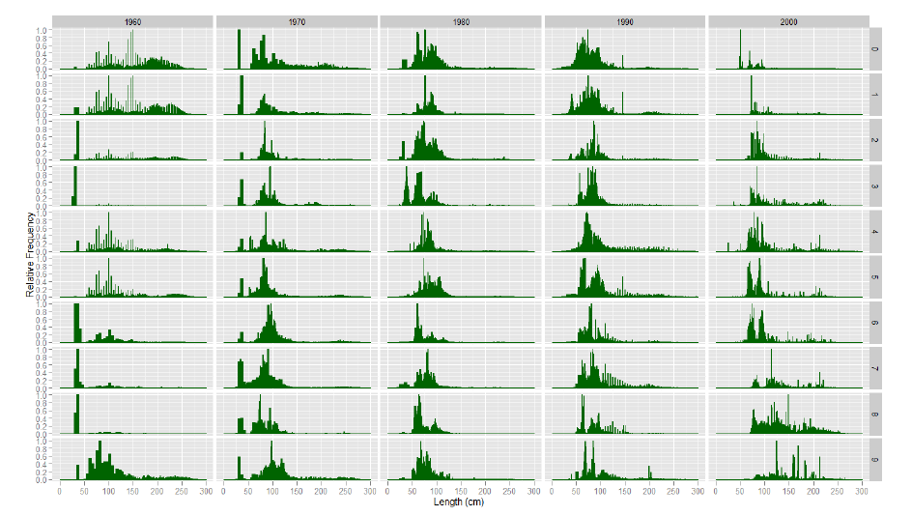
East Catch Data
But CAS and CAA remains poor and not trustworthy due to high level of substitutions and inadequate samples
For these reasons, stock assessments since 2006 have investigated various approaches, which make different assumptions about these data
Time is needed to develop other alternative approaches, such as envisioned in the GBYP

Slide 8
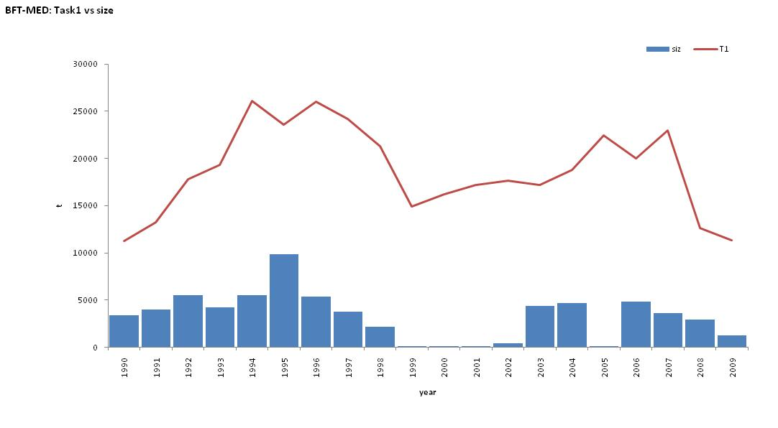
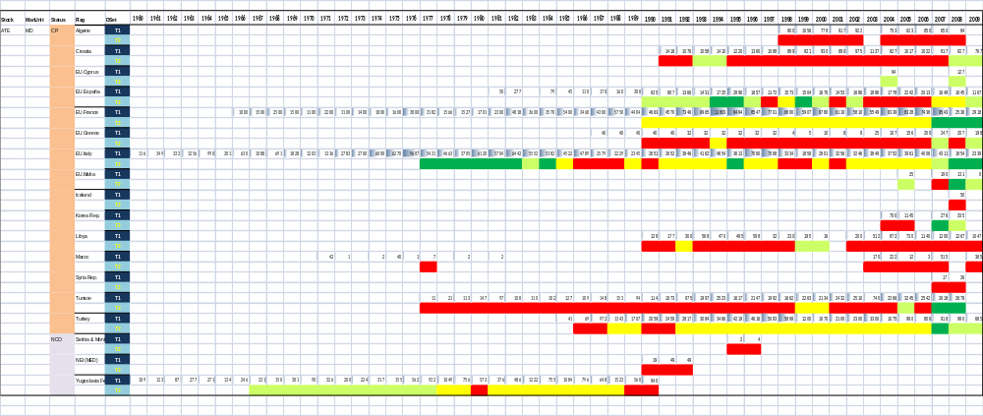
Data Improvements

Slide 9
EBFT New information
Conventional and electronic tagging experiments in both the East Atlantic and Mediterranean provide confirmation of high residency in the Med.
Aerial surveys in 2009 and 2010 indicated higher abundance and/or concentration in the Western Mediterranean than a decade ago
Genetic analyses tend to confirm population structure within the Mediterranean
Studies about the occurrence of spawning in cages
Large amount of biometric studies on wild as well as farmed BFT
Updated and new (historical) CPUE indices (but still lacking Med. PS)
In addition, we have the first results from the GBYP: aerial surveys on Mediterranean spawners & data mining
This year we hope to start tagging
And looking at new assessment and modelling approaches

Slide 10
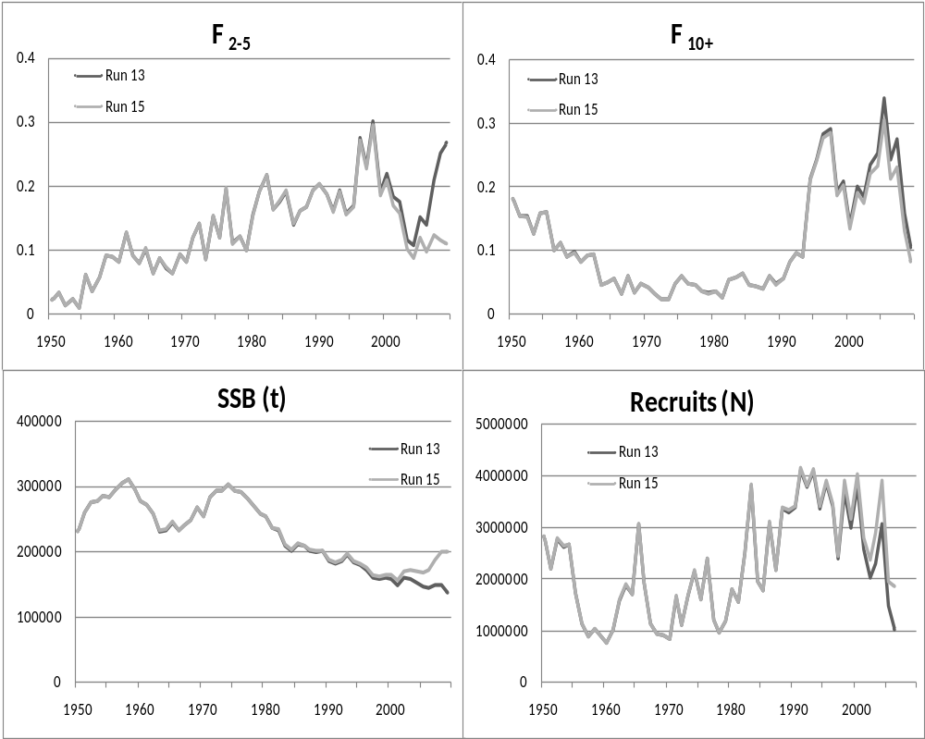
E BFT Asssessment Outcomes
Recent SSB
has shown signs of increase/stabilization in some assessment while it continues to decline for others
F₁₀₊ has declined in recent years
F₂₋₅ more uncertain
and higher variability
Recruitment
is variable, but was higher on average in 1990s

Slide 11
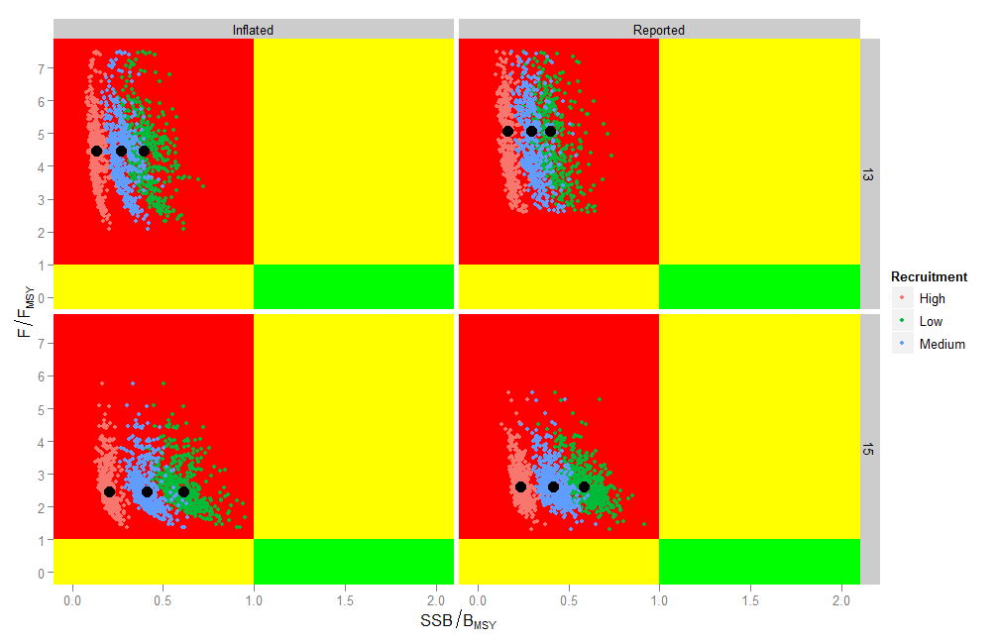
How Certain is the Current
EBFT Stock Status Evaluation?
While there remain considerable unquantified uncertainties,
it appears that:
BFTE stock status has improved since the last assessment, but has some way to go before being considered consistent with Convention Objectives
Needs confirmation by more intensive research and future analyses such as anticipated by the GBYP

Slide 12
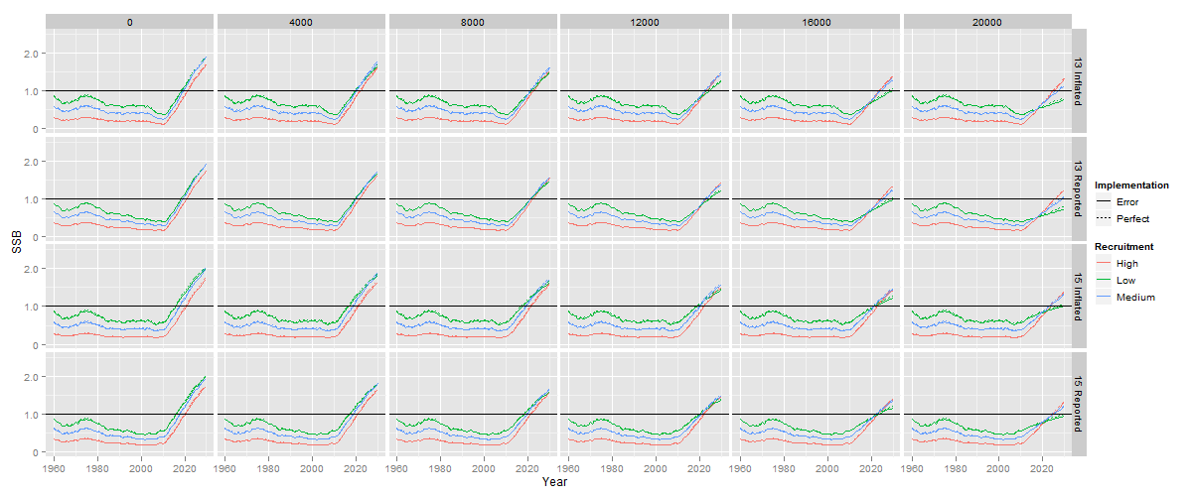
EBFT Outlook
24 scenarios against TAC of 0 to 20,000 t
Good News: The stock is projected to increase over the projection period in all cases

Slide 13
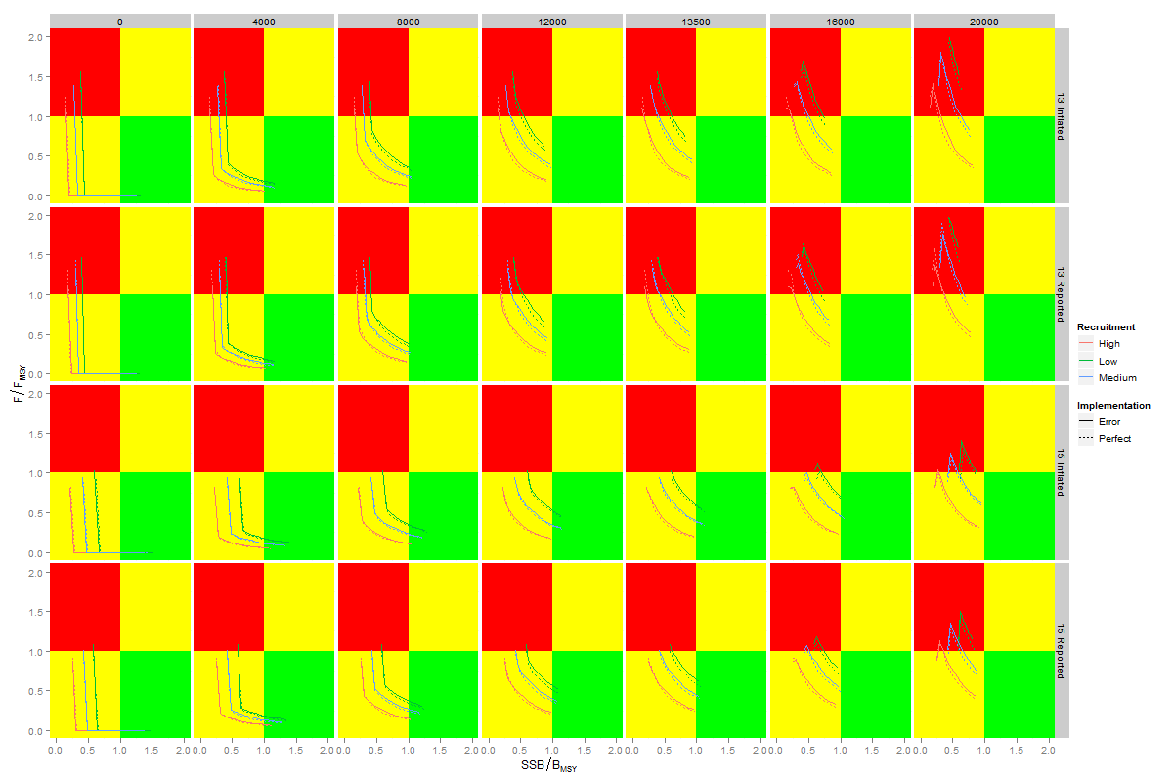
EBFT Outlook
However,
Not all achieve the Rebuilding Plan Objective within the Commission’s rebuilding time frame: the probability of success depends on many factors, but higher catch results in higher risk of failure
Projections are subject to high uncertainties, not all of which are quantified: incorporation of additional uncertaintie into the analysis could change estimates of rebuilding probability

Slide 14
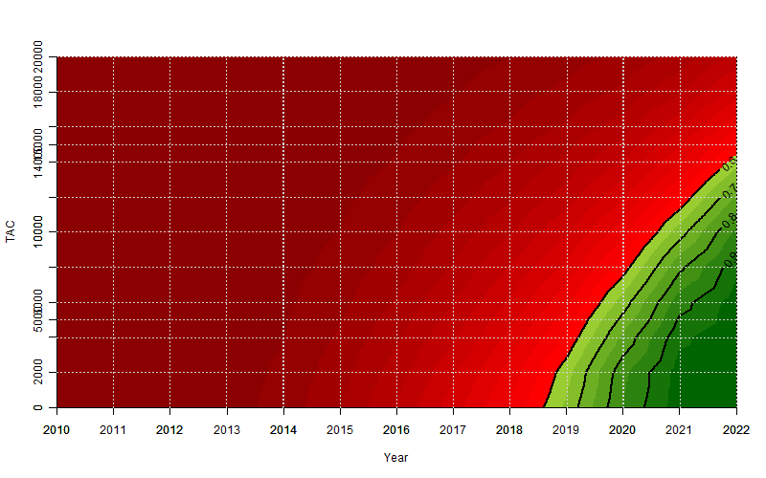
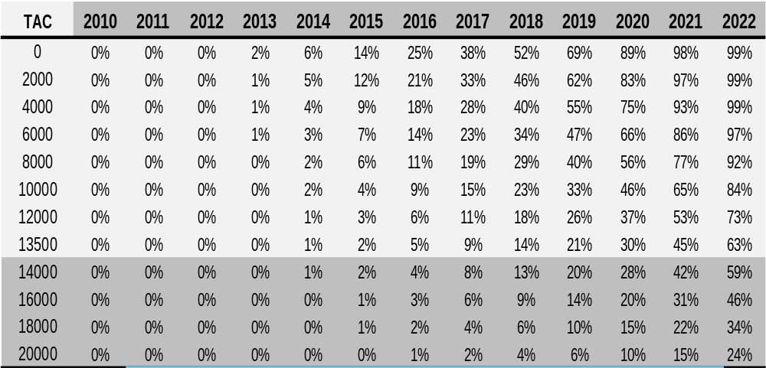
EBFT Outlook – what are the odds?
Rebuilding Plan, Probability of success if TACs are adhered to, considering quantified uncertainties
Rebuilding of BFTE to SSB_{MSY} proxy level with a probability of at least 60% could be achieved by:
Mid 2019 with a TAC = 0 t
Mid 2022 with current TAC (13,500 t)
Mid 2023 or later with a TAC >14,000 t

Slide 15
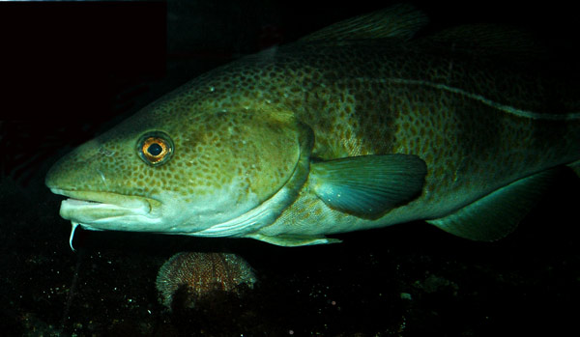
North Sea Cod

Slide 16
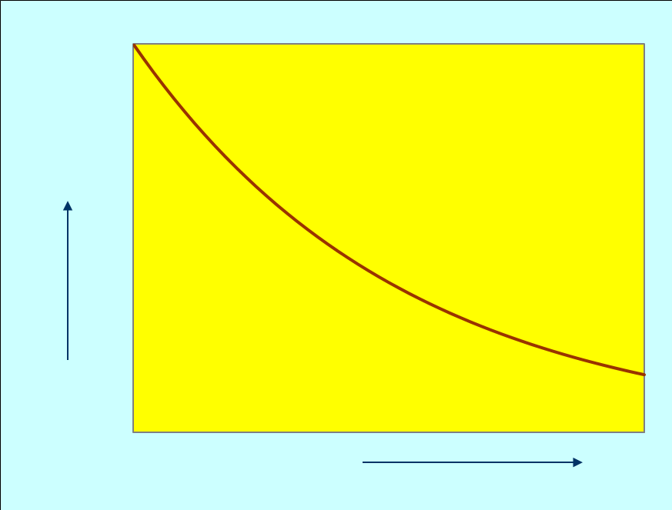
ICES Scientific Advice
Fish stock
Regulation
Blim
Bpa
Fishing
Mortality
HCR
Spawning Stock

Slide 17
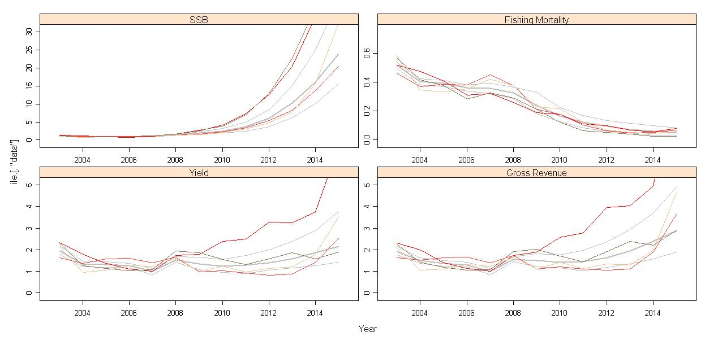
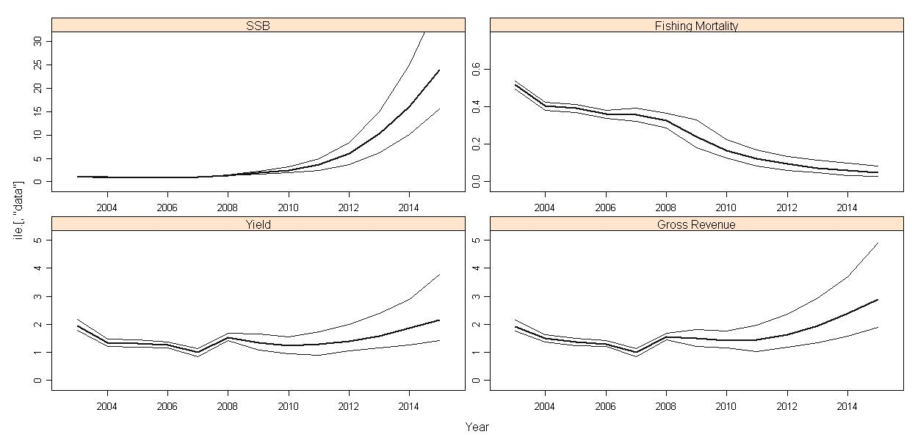
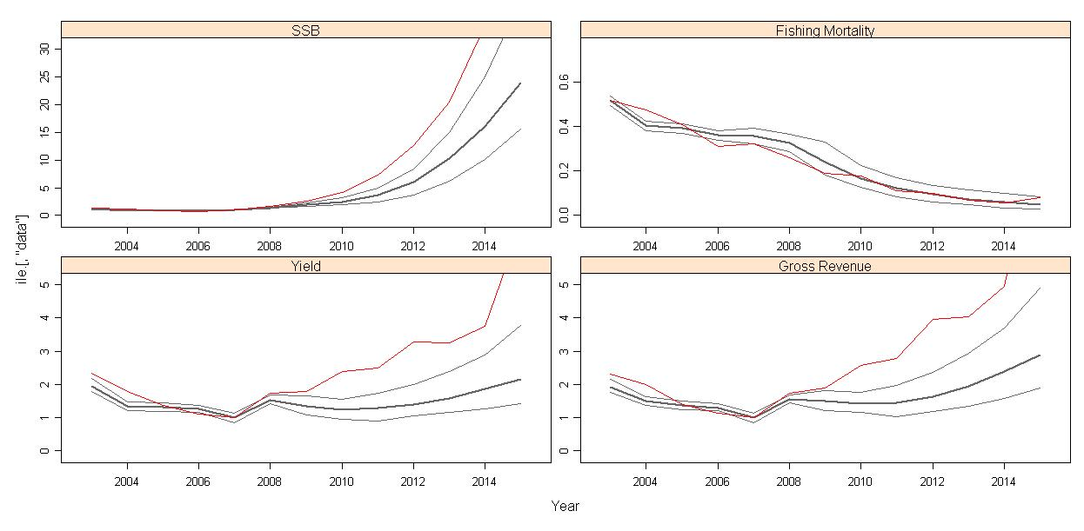
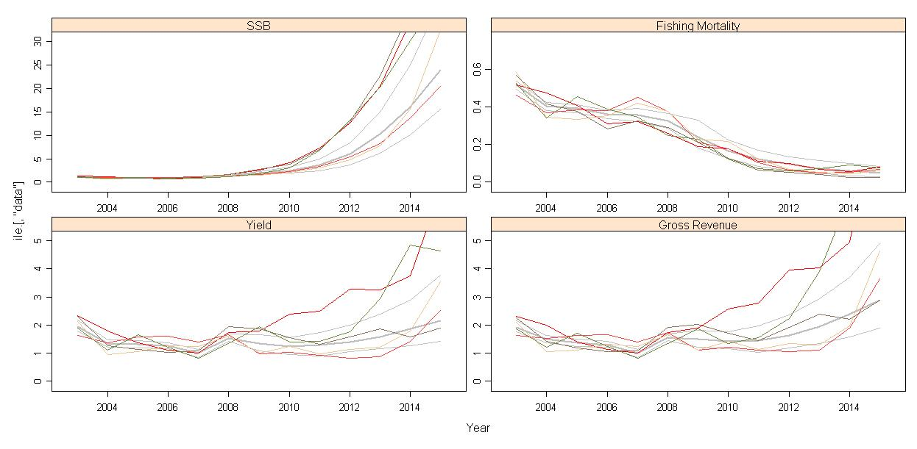
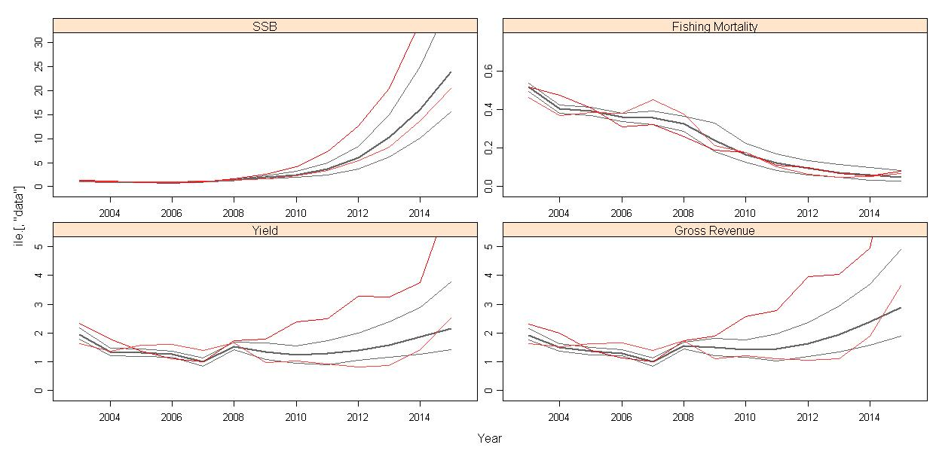
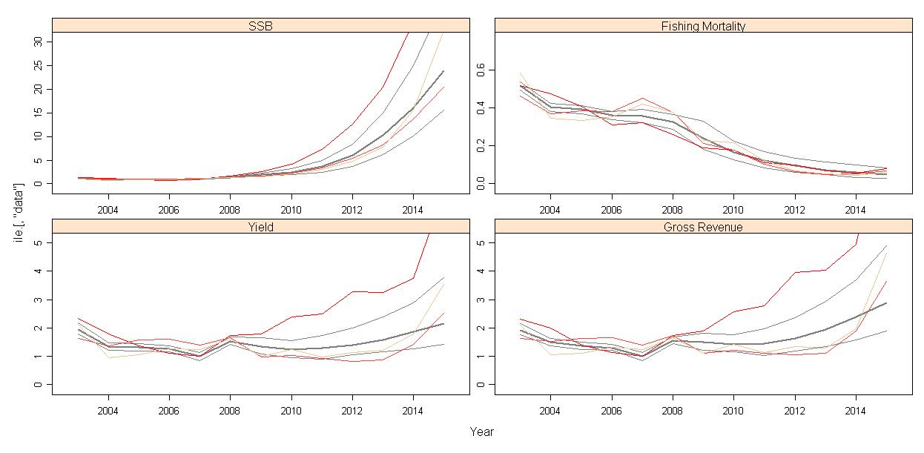
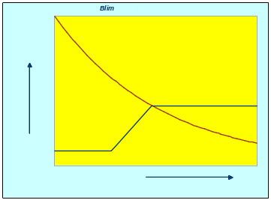
North Sea Cod Recovery Plan
A run-off between two alternative proposals,
Norway
EU
If SSB<Bpa
F_{y+1}=0.85F_{y}
If SSB<Blim
F_{y+1}=0.75F_{y}

Slide 18
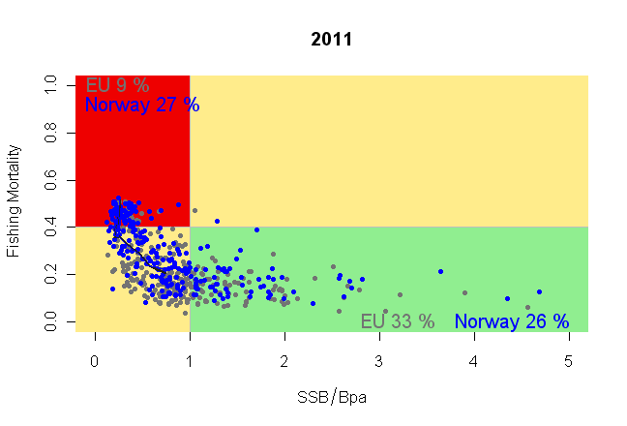
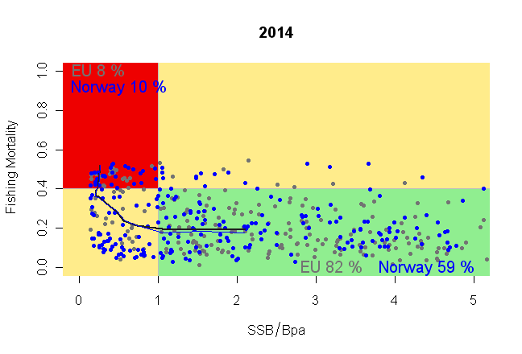
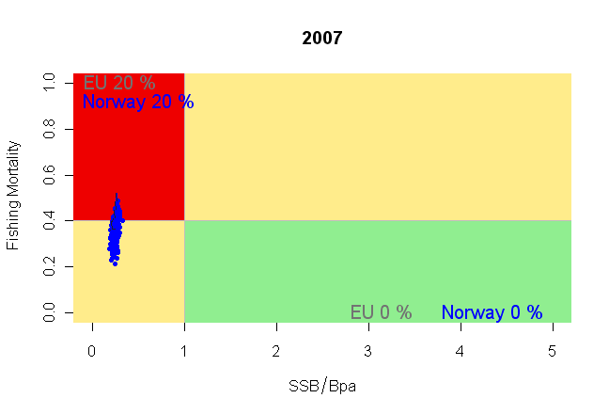
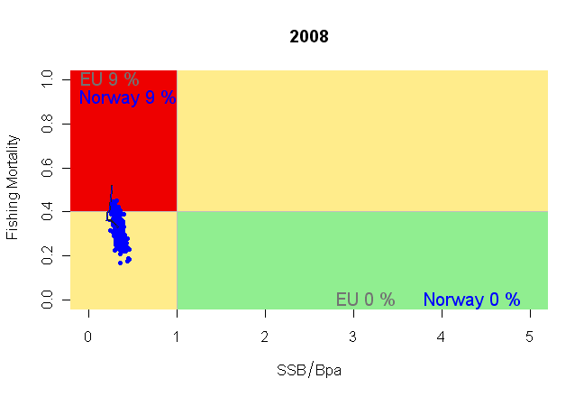
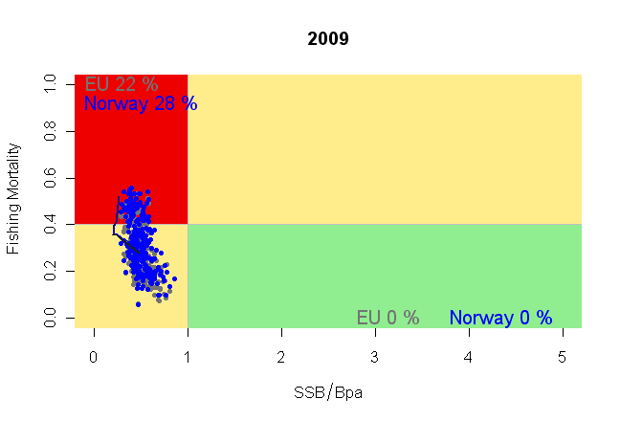
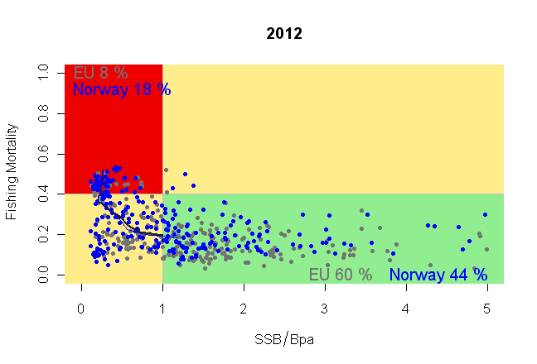
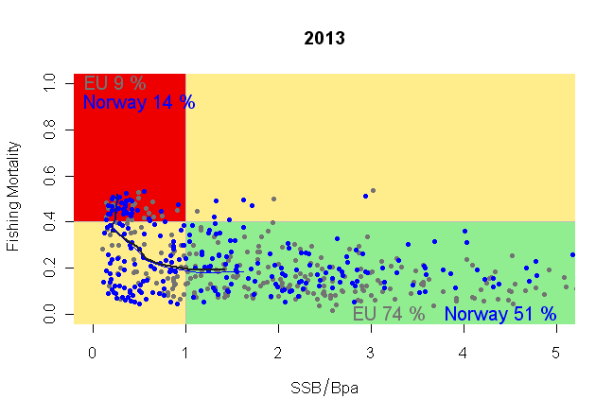
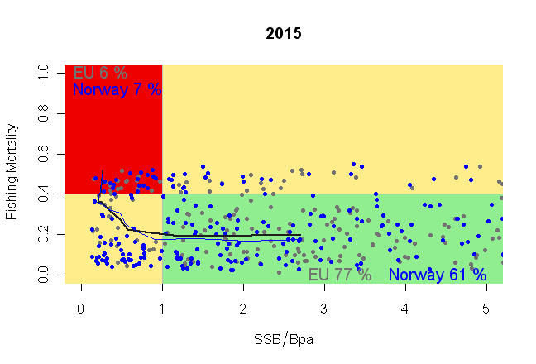
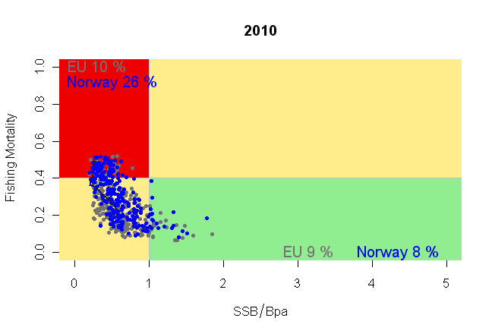
North Sea Cod Recovery Plan
A run-off between two alternative proposals,
Norway
EU
If SSB<Bpa
F_{y+1}=0.85F_{y}
If SSB<Blim
F_{y+1}=0.75F_{y}

Slide 19
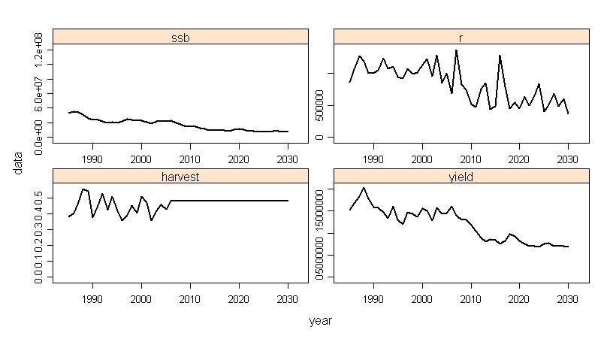
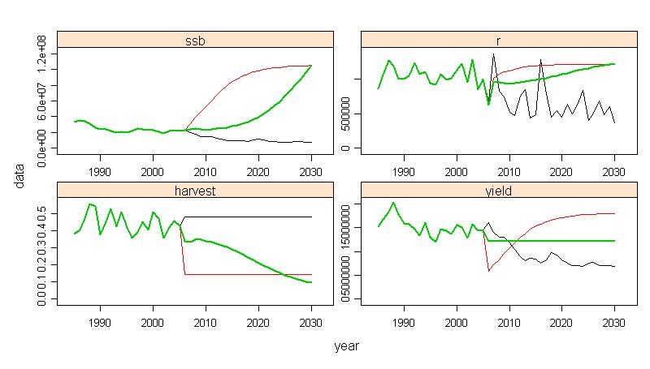
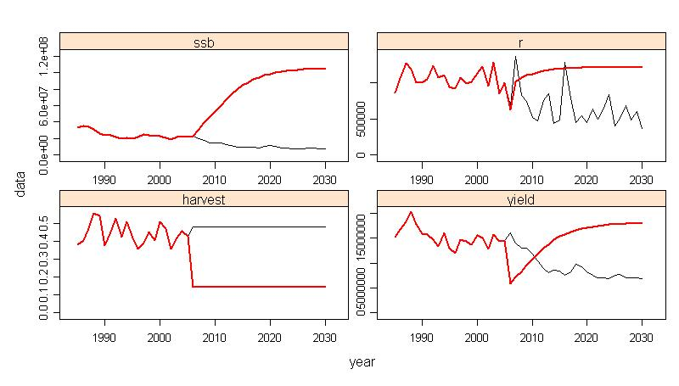
Mediterranean Swordfish
If two policies have same biological but differing economic impacts, then there might be a preferred economic option e.g.
    days at sea, fleet reduction or closures?
Fishers respond to changes in economic incentives, and management changes incentive structures so also changes behaviour
An evaluation of Mediterranean swordfish management to recover stock to BMSY
A variety of management plans were evaluated to try and recover the stock to BMSY by 2030;
red shows the expected outcome for a constant fishing mortality strategy and
green for a constant catch strategy.

Slide 20
Precautionary Approach
    Management advice must comprehensively take into account uncertainties and associated risks
    e.g. due to
        Process Error; due to natural variability
        Model Error; fish don’t know the theory of VPA
        Estimation Error; Even if they did, doesn’t mean we’d get a good fit
        Observation Error; Imperfect information
        Implementation Error; regulations not working as expected
Notes:
Fishery models provide an important tool for management since it is infeasible to carry out large scale management experiments at sea, for example to work out whether it is better to close part of the North Sea or to increase mesh size in certain fisheries to ensure cod recovery.
Models are therefore used to help managers answer such 'what if' questions before implementing changes.
However, models may not be able to capture all the uncertainty that exists with respect to the stocks and the fishery, and some critics consider that models may never be sufficiently well developed to be used to fine tune fishery management decisions.
This Snapshot will present a variety of examples of how Cefas are using modelling techniques to evaluate different fisheries management strategies.

Slide 21
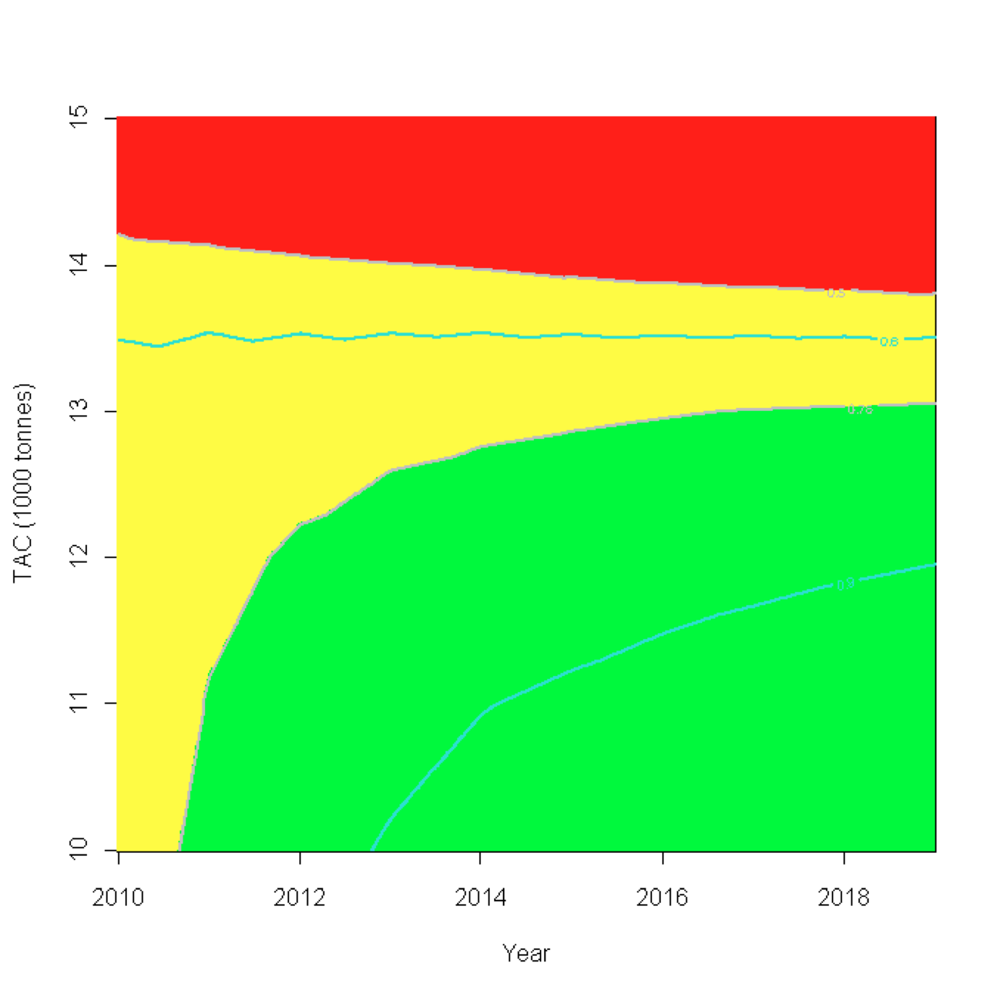
Kobe Strategy Matrix
Probability of the stock not becoming overfished (B>BMSY) and not undergoing overfishing (F<FMSY) for different constant catch levels over time.
< 50%, worse than a coin toss
50 - 75%, coin toss to 3 out of 4
>75% better than 3 out of 4

Slide 22
Management Strategy Evaluation
Not used to set quotas but to work out whether
we should be setting quotas at all
Hypotheses
Biological
Economic
Fleet behaviour
Stock/Fleet
Dynamics
The “Fishery”
The “Fishery”
Data
Alternatives
Measures
The “Fishery”
Management
Measures
Management

Slide 23
Management Strategy Evaluation
OPERATING MODEL
Represents the “true” dynamics of the system against which performance will be measured
MANAGEMENT PROCEDURE
Assess status of stock and set management options depending upon perceived status of fishery stock(s)
MODEL CONDITIONING
Not used to set quotas but to work out whether
we should be setting quotas at all!
Management decision stage
Fleet dynamics
FLFleet
IMPLEMENTATION MODEL
FLEcon
Management procedure
FLHCR
Biological reference points (e.g. MSY)
FLBRP
INITIAL CONDITIONS
Hypotheses
Biological
Economic
Fleet behaviour
Stock/Fleet
Dynamics
SUMMARY STATISTICS
Used to evaluate performance of management procedures against objectives.
Population biology
Assessment procedure
Stock dynamics
FLBiol
OBSERVATION ERROR MODEL
Generation of data on fishery and stocks.
FLOEM
Perceived stock
FLStock
Stock assessment (e.g. VPA)
FLAssess
The “Fishery”
The “Fishery”
Auxiliary information
(e.g. tuning indices)
FLIndices
Alternatives
Measures
Stock processes
e.g. Recruitment
FLSR
Data
Assessment assumptions
The “Fishery”
Management
Measures
Management

Slide 24
