Slide 1

Applying Frequency Analysis Techniques to Predict Extreme Weather Conditions
Ryan McKenna, Vivek K. Pallipuram,
And Michela Taufer
Global Computing Lab
Computer and Information Sciences
University of Delaware

Slide 2
Statement of Work
“ This project aims to develop computational tools to predict the likelihood of extreme weather occurrences from big climate data. To this end, we adapt the existing frequency analysis tools that are used to model event occurrences in large computer clusters”

Slide 3
Background: What is Frequency Analysis?
Frequency analysis is a statistical method that allows us to predict how often a certain event occurs
Frequency analysis has been used to model and predict:
Rainfall patterns
CPU usage patterns in clusters
Adapt cumulative distribution function (CDF) to predict extreme occurrences, e.g., weather conditions

Slide 4
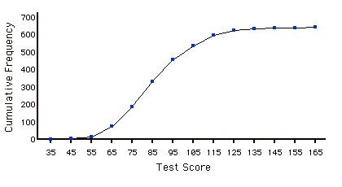
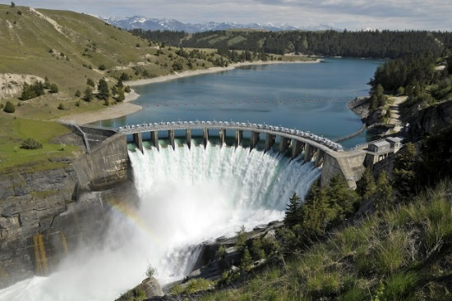
Modeling Rainfall and Design Discharges
Used in hydrology to model rainfall and design discharges in dams
CDF of previous data enables preventative measures
Prevent flooding!
Freq. of Exceedance
Past Rainfall

Slide 5
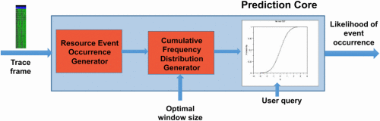
Modeling Idle Resources
Frequency analysis has been used to predict idle event occurrences in clusters
Predictive information is used by scheduler to maximize CPU utilization

Slide 6
From Performance ….
“Predict the occurrence of idle CPUs by collecting and benchmarking data from cluster nodes and
using a prediction window on the order of minutes “

Slide 7
… to Weather Prediction
“Predict the occurrence of extreme weather conditions by collecting and benchmarking data from geographical locations and using a prediction window on the order of days/months”

Slide 8
Performance on Cluster
TO
Weather in Region
Collect trace files for cluster nodes
Gather data for geographical region
Define a window of idle event occurrences
Define a prediction window of events
Count idle resource events in the window
Count the extreme
events in the window
Obtain CDF
Obtain CDF
Obtain likelihood of idle event occurrences
Obtain likelihood of extreme events
Notes:
This slide was previously Slide 10. Previous bullets saved under:
We adapt the technique to predict event occurrences in DAG-based workflows
We model commonly occurring events (e.g., computation, communication, and idle resource instances) as ….
PUT THE CREATIVE IDEA

Slide 9
Key Questions
How should we define an extreme weather condition?
E.g., extreme hot or low temperature
How do we determine which geographical locations to study?
What should the granularity of the weather measurements be (monthly, daily, hourly)?

Slide 10
Defining Extreme Weather Conditions
We are interested in predicting events such as abnormal rainfall, low/high pressure, and extreme temperature within a specified region
Example of extreme weather condition can be the temperature that is above or below a certain predetermined threshold
This threshold is determined from historical data
This threshold is a function of time period (e.g., day time, month, season)

Slide 11
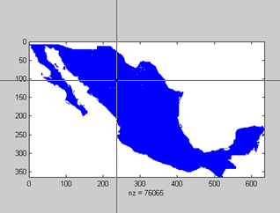
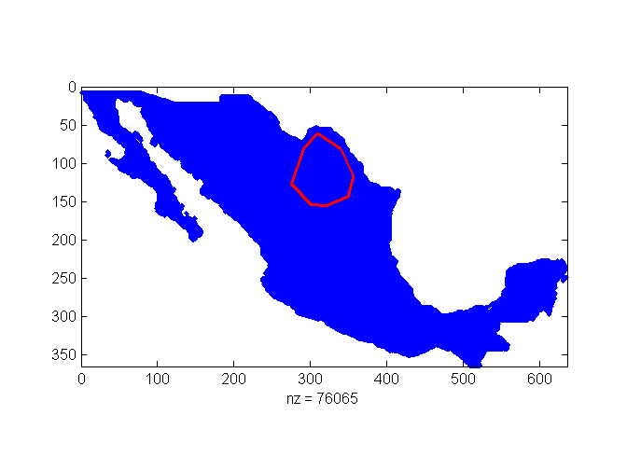
Defining Regions of Interest
Regions are supplied by the user through a clickable interface
Example: a geographical region is determined from ANY convex polygon
Regions can be also chosen to focus on specific areas including but not limited to coastline, desert, mountain range, etc. (Future work)

Slide 12
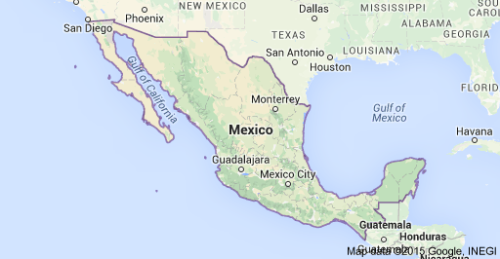
Defining Regions of Interest
The selection of a region can be integrated with Google maps
Interact with map showing terrain

Slide 13
Sampling Granularity
Datasets can include different granularities from annual or monthly to weekly or daily
Currently we work on monthly data, but daily data would be ideal
Frequency analysis can make more accurate predictions with finer grained data

Slide 14
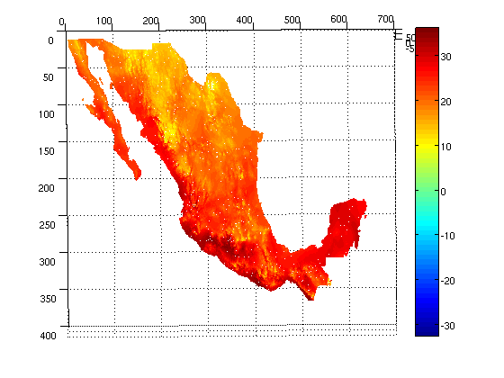
Snapshot of Current Dataset
Matrix of temperatures indexed by normalized coordinates
Temperatures are in Celsius
One set of measurements for each month between 2001-2010

Slide 15
Analysis Workflow
Select Region of Interest
Identify Extreme Condition
Annotate Data
Apply Frequency Analysis
Predictions

Slide 16
Workflow: Select Region of Interest
Select the region of interest by filtering the points in the 2D matrix associated to the region
Select proper granularity (number of samples in the time window)
Implementation:
For each sample, remove unmeasured values
Flatten 2D matrix of selected data to an unordered set of temperatures
Select Region of Interest
Identify Extreme Conditions
Annotate Data
Apply Frequency Analysis
Predictions

Slide 17
Workflow: Identify Extreme Condition
Group data by month across 10 year window (2001-2010)
Build empirical temperature distributions for each month
Decide thresholds for extreme temperature conditions
Thresholds are function of the month
Use top five percentile for upper extreme condition
Use bottom five percentile for lower extreme condition
Select Regions of Interest
Identify Extreme Condition
Annotate Data
Apply Frequency Analysis
Predictions
16

Slide 18
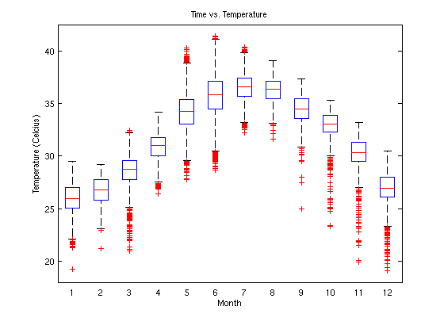
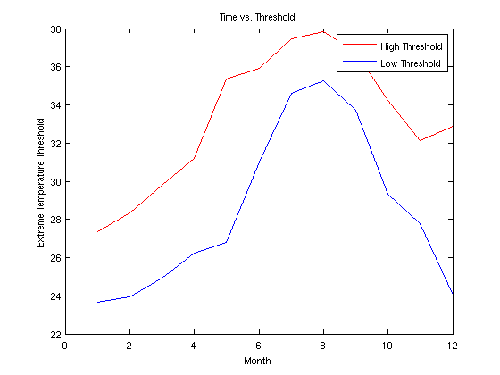
Workflow: Identify Extreme Condition
Temperatures above the red line are classified as extremely high
Temperatures below the blue line are classified as extremely low

Slide 19
Workflow: Annotate Weather Data
Annotate temperature measurements as extremely high, extremely low or normal for every instance of time
A temperature is considered extreme if it exceeds the threshold calculated on the previous slide
Use the annotated data for the frequency analysis
Select Region of Interest
Identify Extreme Condition
Annotate Weather Data
Apply Frequency Analysis
Predictions
18

Slide 20
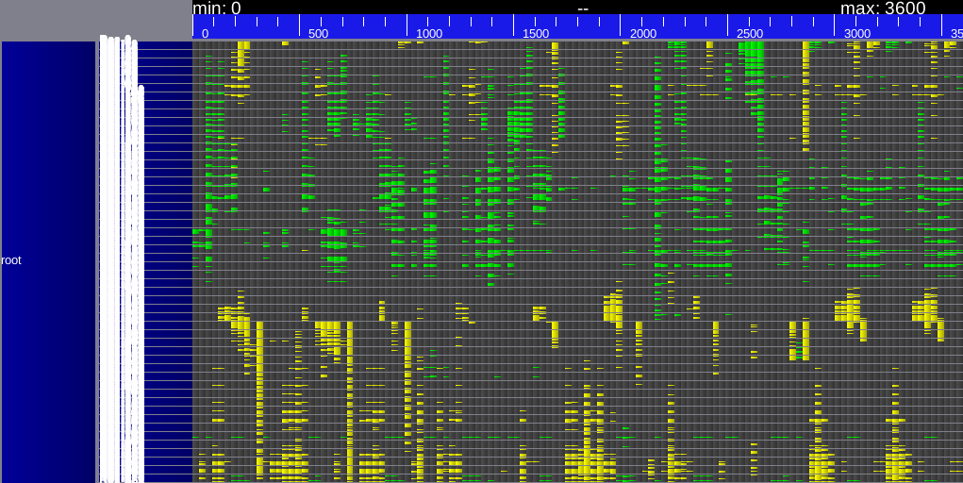
Snapshot of Annotated Data
Data is visualized by performance analysis tool
Extreme Low→ Green
Extreme High → Yellow
Normal → Gray
Horizontal → Time (monthly)
Vertical → Coordinates (unordered)
Visual shows signs of periodicity

Slide 21
Workflow: Frequency Analysis
Select Region of Interest
Need more data
Daily granularity would be ideal
Pool data for a single month, and build a CDF
The random variable is the proportion of the region that was in an extreme temperature state
CDF is used to make predictions about future extreme temperature conditions
Identify Extreme Condition
Annotate Data
Apply Frequency Analysis
Predictions
20

Slide 22
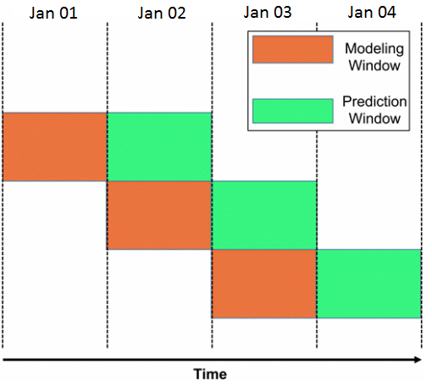

Workflow: Frequency Analysis
21

Slide 23

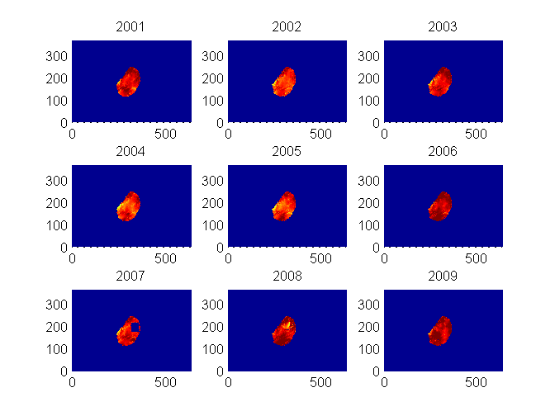
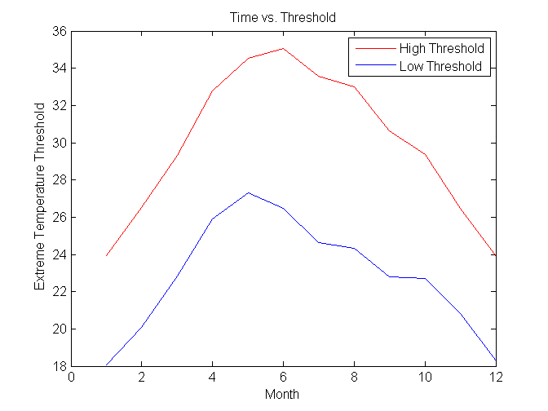
Data Extraction and Extreme Event Classification
June (2001-2009)

Slide 24
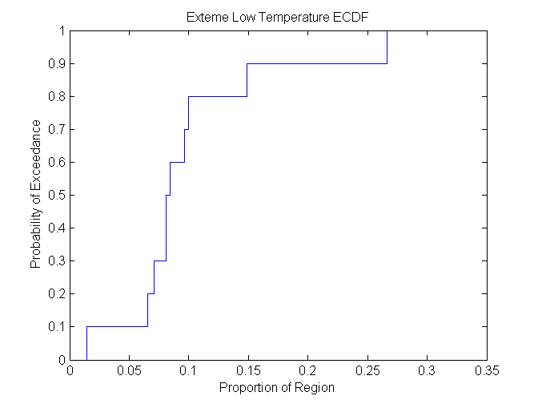
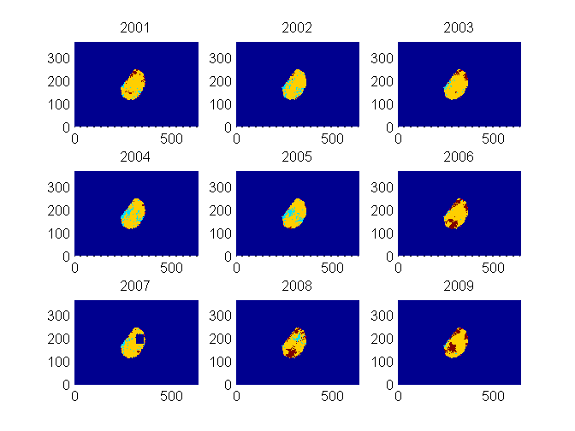
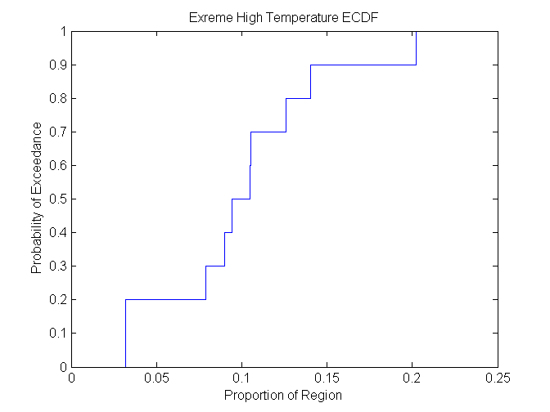
Mapping Data and Building Distributions
Red -> Hot
Yellow -> Normal
Light Blue -> Cold
Dark Blue -> Unmeasured
June (2001-2009)
23

Slide 25
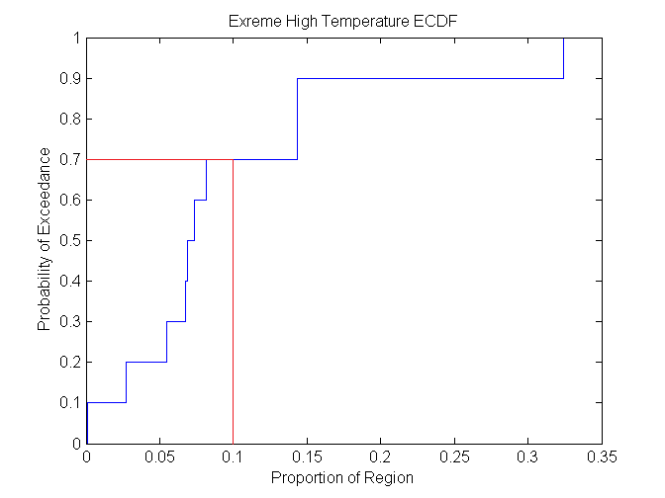
Workflow: Questions and Answers
Select Region of Interest
Q: What is the probability that 10% of this region will experience extremely hot temperatures on any given day in June?
A: 70%
Identify Extreme Condition
Annotate Data
Apply Frequency Analysis
Predictions
24

Slide 26
Workflow: More Questions
This tool can be slightly modified to answer other interesting questions as well:
What is the expected proportion of this region that will exceed 90 degrees today?
What is the probability that 25 percent of this region will exceed 80 degrees today?
What is the expected temperature at any point within the region?
How often will the temperature exceed 75 degrees in at least half the region?
Select Region of Interest
Identify Extreme Condition
Annotate Data
Apply Frequency Analysis
Predictions
25

Slide 27
Future Work
Increase granularity by obtaining more data.
Predict recurrence period of extreme temperature events.
Predict other weather related events such as low/high pressure, low/high rainfall, etc.

