Slide 1

Applying Frequency Analysis Techniques to Predict Extreme Weather Conditions
Ryan McKenna, Vivek K. Pallipuram,
And Michela Taufer
Global Computing Lab
Computer and Information Sciences
University of Delaware

Slide 2
Statement of Work
“ This project aims to develop computational tools to predict the likelihood of extreme weather occurrences from big climate data. To this end, we adapt the existing frequency analysis tools that are used to model event occurrences in large computer clusters”

Slide 3
Contributions

Slide 4
Background: What is Frequency Analysis?
Frequency analysis is a statistical model that allows us to predict how often a certain event occurs
Frequency analysis has been used to model and predict:
  Rainfall patterns
  CPU usage patterns in clusters
Adapt cumulative distribution function (CDF) to predict extreme occurrences, e.g., weather conditions

Slide 5
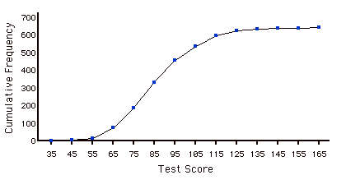
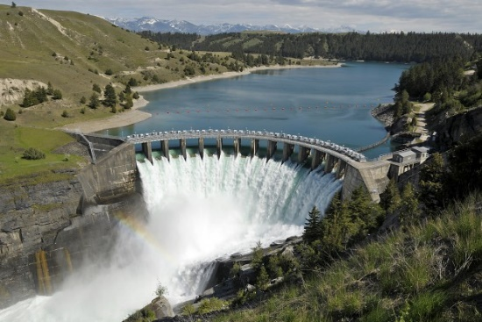
Modeling Rainfall and Design Discharges
Used in hydrology to model rainfall and design discharges in dams
  CDF of previous data enables
  preventative measures
  Prevent flooding!
Freq. of Exceedance
Past Rainfall

Slide 6
Modeling Idle Resources
From talk

Slide 7
From Performance ….
“Predict the occurrence of idle CPUs by collecting and benchmarking data from cluster nodes and
using a prediction window on the order of minutes “

Slide 8
… to Weather Prediction
“Predict the occurrence of extreme weather conditions by collecting and benchmarking data from geographical locations and using a prediction window on the order of days/months”

Slide 9
Performance on Cluster
TO
Weather in Region
Collect trace files for cluster nodes
Gather data for geographical region
Define a window of idle event occurrences
Define a prediction window of events
Count idle resource events in the window
Count the extreme
events in the window
Obtain CDF
Obtain CDF
Obtain likelihood of idle event occurrences
Obtain likelihood of extreme events
Notes:
This slide was previously Slide 10. Previous bullets saved under:
We adapt the technique to predict event occurrences in DAG-based workflows
We model commonly occurring events (e.g., computation, communication, and idle resource instances) as ….
PUT THE CREATIVE IDEA

Slide 10
Key Questions
How should we define an extreme weather condition?
  E.g., extreme hot or low temperature
How do we determine which geographical locations to study?
What should the granularity of the weather measurements be (monthly, daily, hourly)?

Slide 11
Defining Extreme Weather Conditions
We are interested in predicting events such as abnormal rainfall, low/high pressure, and extreme temperature within a specified region
Example of extreme weather condition can be the temperature that is above or below a certain predetermined threshold
  This threshold is determined from historical data
  This threshold is a function of time period (e.g., day time, month, season)

Slide 12
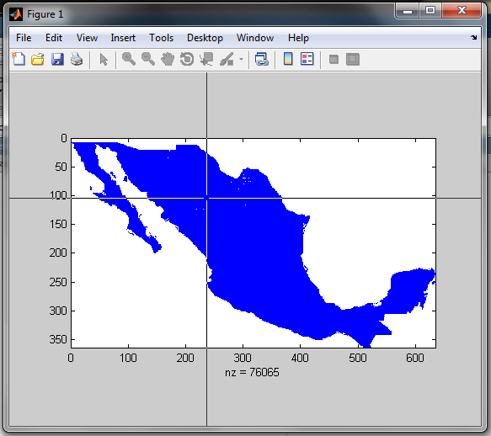
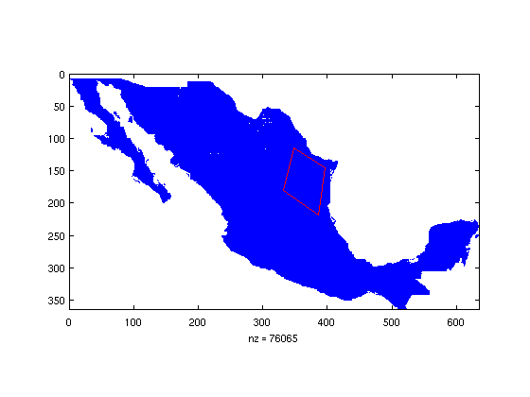
Defining Regions of Interest
  Regions are supplied by the user through a clickable interface
    Example: a geographical region is determined from ANY convex polygon
  Regions can be also chosen to focus on specific areas including but not limited to coastline, desert, mountain range, etc.

Slide 13
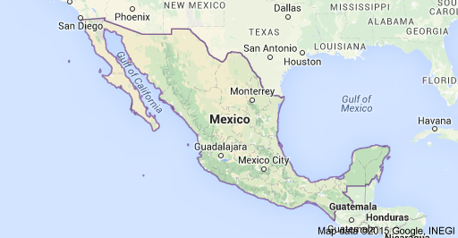
Defining Regions of Interest
The selection of a region can be integrated with Google maps
  Interact with map showing terrain

Slide 14
Sampling Granularity
Datasets can include different granularities from annual or monthly to weekly or daily
  Currently we work on monthly data, but daily data would be ideal
Frequency analysis can make more accurate predictions with finer grained data

Slide 15
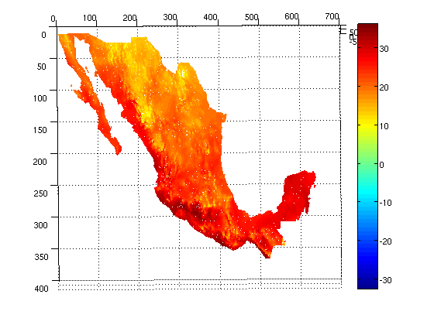
Snapshot of Current Dataset
Matrix of temperatures indexed by normalized coordinates
Temperatures are in Celsius
One set of measurements for each month between 2000-2010
  Monthly granuality

Slide 16
Analysis Workflow
Select Region of Interest
Identify Extreme Condition
Annotate Data
Apply Frequency Analysis
Predictions

Slide 17
Workflow: Select Region of Interest
Select the region of interest by filtering the points in the 2D matrix associated to the region
Select proper granularity (number of samples in the time window)
Implementation:
  For each sample, remove unmeasured values
  Flatten 2D matrix of selected data to an unordered set of temperatures
Select Region of Interest
Identify Extreme Conditions
Annotate Data
Apply Frequency Analysis
Predictions

Slide 18
Workflow: Identify Extreme Condition
Group data by month across 11 year window (2000-2010)
Build empirical temperature distributions for each month
Decide thresholds for extreme temperature conditions
  Thresholds are function of the month
  Use top five percentile for upper extreme condition
  Use bottom five percentile for lower extreme condition
Select Regions of Interest
Identify Extreme Condition
Annotate Data
Apply Frequency Analysis
Predictions

Slide 19
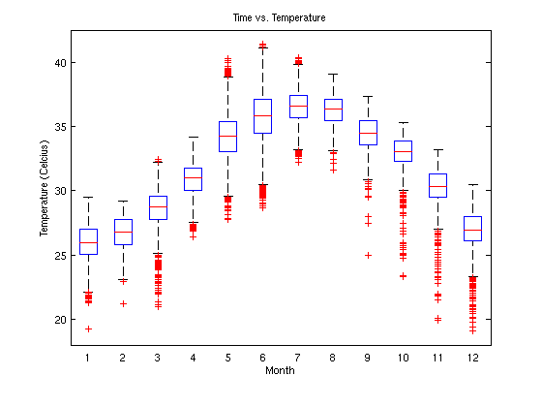
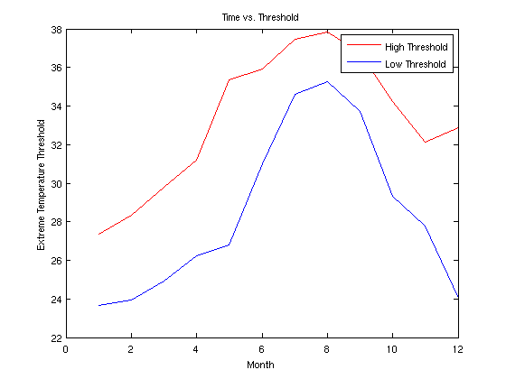
Workflow: Identify Extreme Condition
Temperatures above the red line are classified as extremely high
Temperatures below the blue line are classified as extremely low

Slide 20
Workflow: Annotate Weather Data
Annotate temperature measurements as extremely high, extremely low or normal for every instance of time
  A temperature is considered extreme if it’s the value calculated on the previous slide
Use the annotated data for the frequency analysis
Select Region of Interest
Identify Extreme Condition
Annotate Weather Data
Apply Frequency Analysis
Predictions

Slide 21
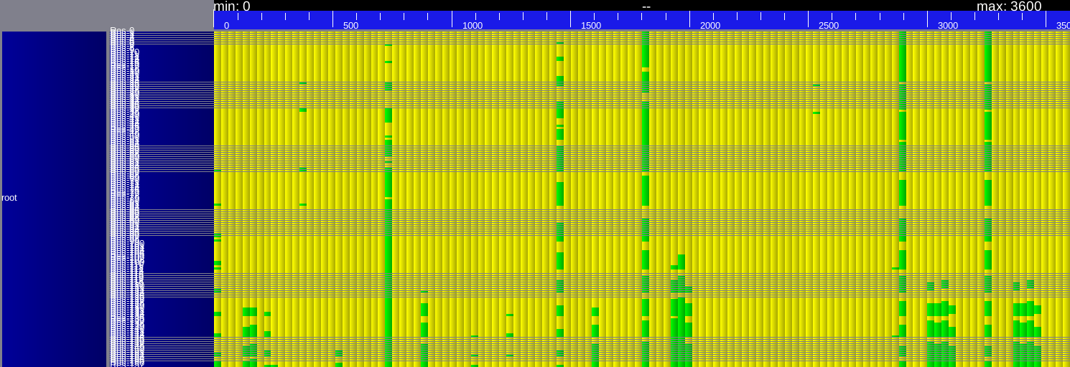
Snapshot of Annotated Data
Data is visualized by performance analysis tool
  Extreme High → Green
  Normal → Yellow
  Horizontal → Time (monthly)
  Vertical → Coordinates (unordered)
Visual shows signs of periodicity

Slide 22
Workflow: Frequency Analysis
Select Region of Interest
Need more data
  Daily granularity would be ideal
Pool data for a single month, and build a CDF
  The random variable is the proportion of the region that was in an extreme temperature state
CDF is used to make predictions about future extreme temperature conditions
Identify Extreme Condition
Annotate Data
Apply Frequency Analysis
Predictions

Slide 23
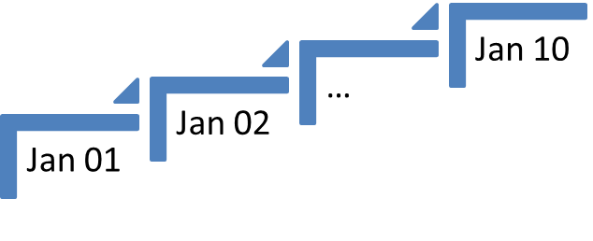

Workflow: Frequency Analysis
Select Region of Interest
Identify Extreme Condition
Annotate Data
Apply Frequency Analysis
Predictions

Slide 24
Workflow: Frequency Analysis
Select Region of Interest
  Questions this model can answer:
  Q: What will be the average tempearature this month?
  Q: What is the probability that the high temperature today is above 90 degrees?
  Q: What is the probability that 50% of this region will exceed a temperature of 80 degrees today?
Identify Extreme Condition
Annotate Data
Apply Frequency Analysis
Predictions

Slide 25
Future Work
Increase granularity by obtaining more data.
Predict recurrence period of extreme temperature events.
Predict other weather related events such as low/high pressure, low/high rainfall, etc.

