Slide 1
Installation instructions of R, Rstudio and opm on Windows

Slide 2
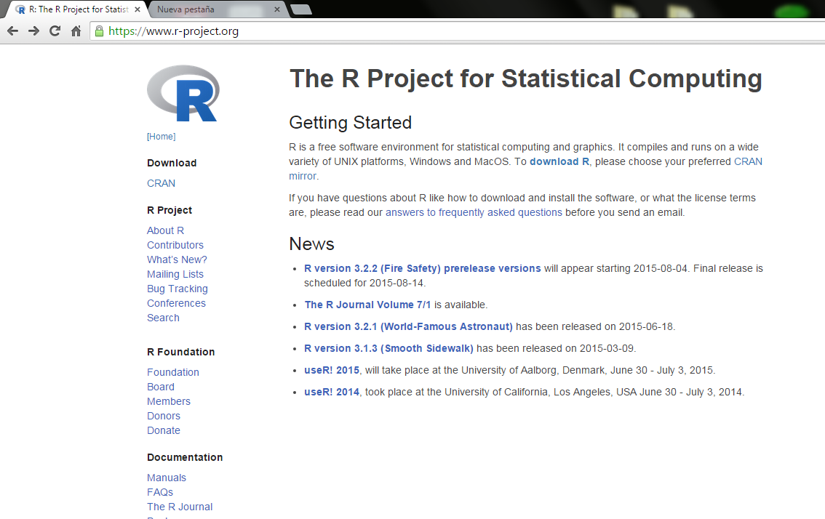
1. R installation
Download the package from this link:
https://www.r-project.org/

Slide 3
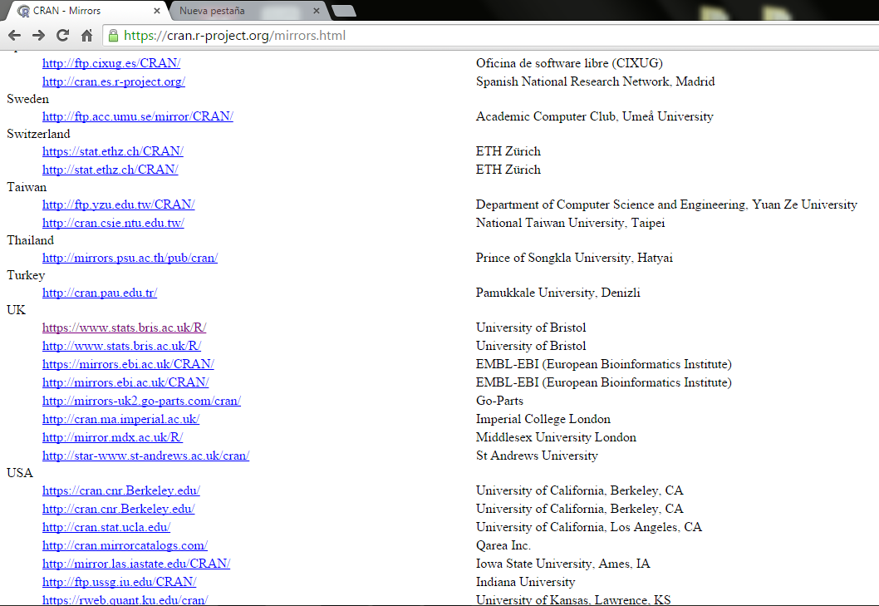
Choose you preferred CRAN mirror according to your location
1. R installation

Slide 4
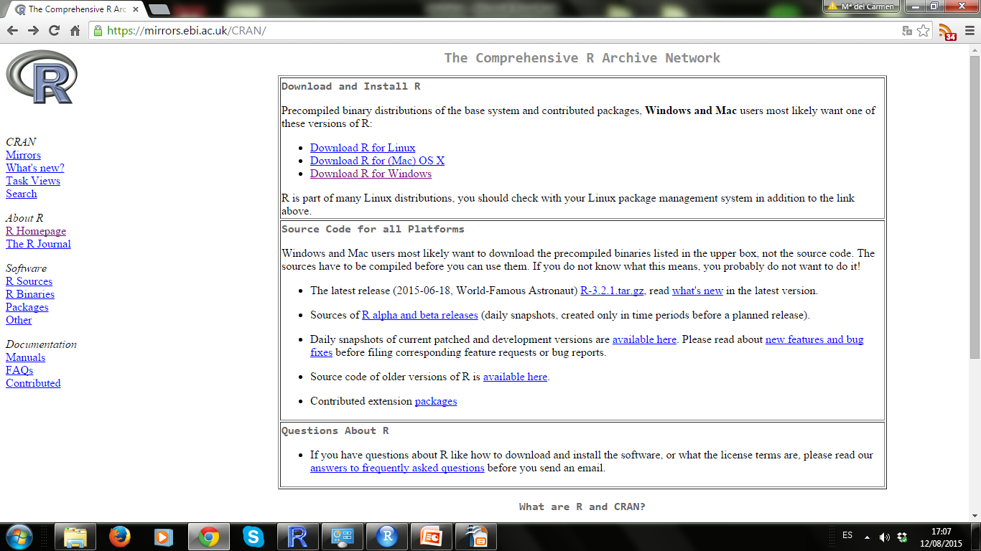
Download R for Windows
1. R installation

Slide 5
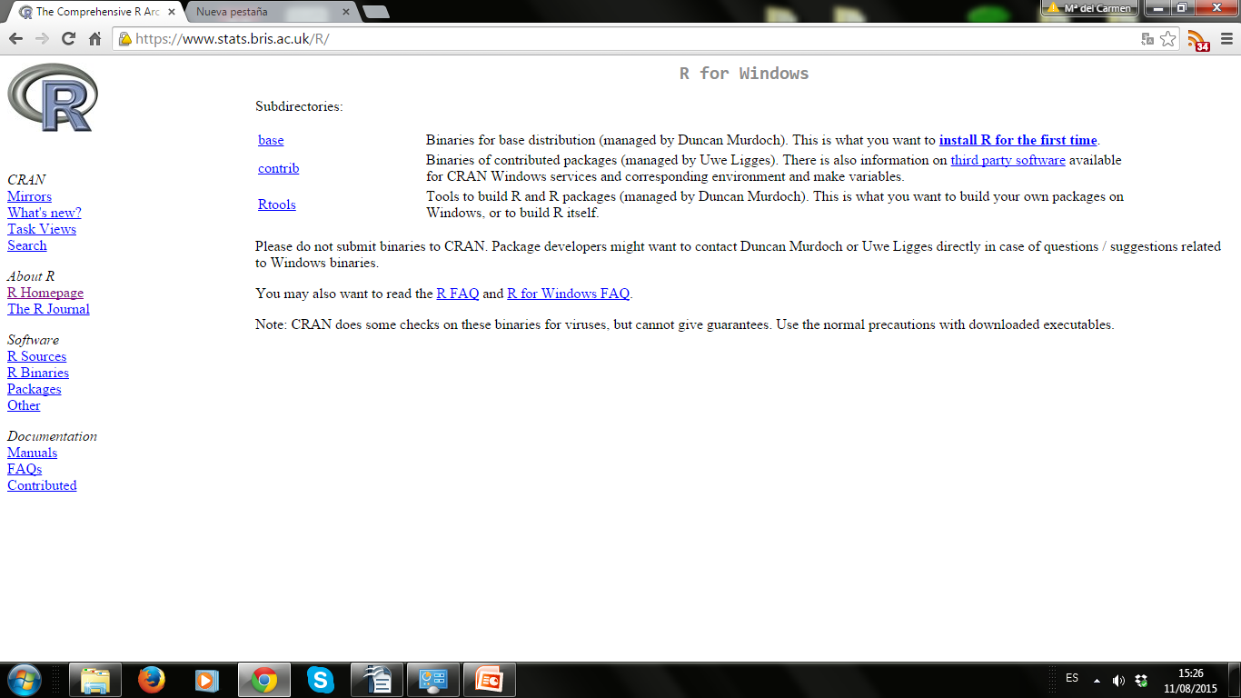
Click in install R for the first time
1. R installation

Slide 6
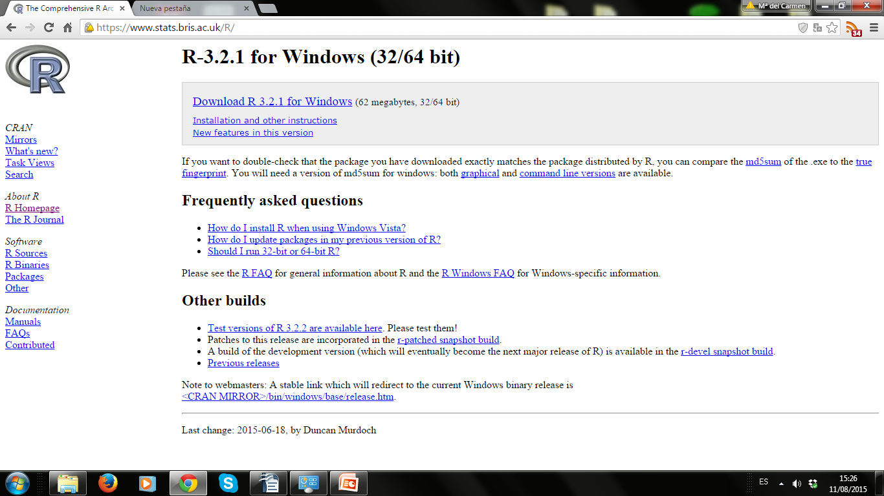
Download newest version for Windows
1. R installation

Slide 7
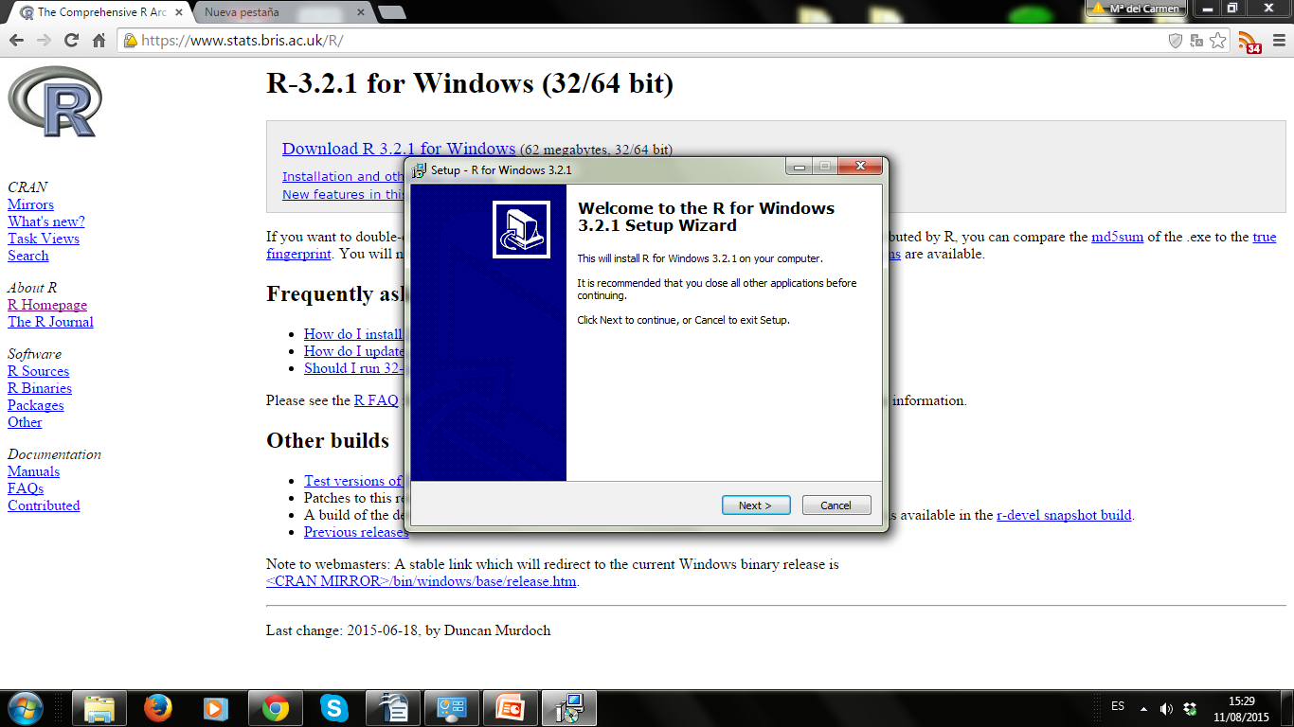
1. R installation
Follow the instructions to install it.
Please note that you will either need administrator privileges or have to choose your home directory as location for the installation.

Slide 8
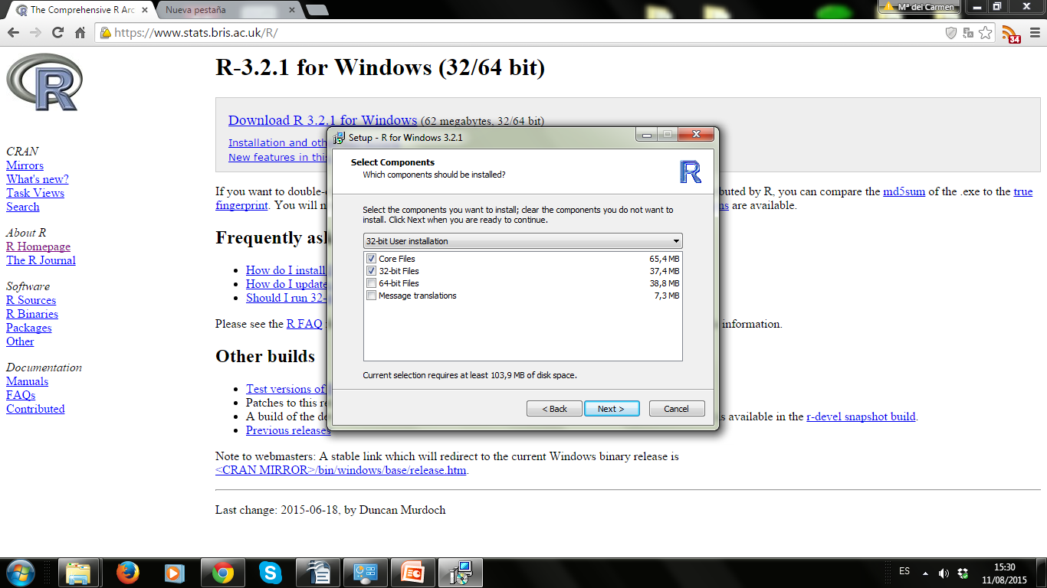
1. R installation
Use 32-bit version for 32-bit Windows but 64-bit version for 64-bit Windows

Slide 9
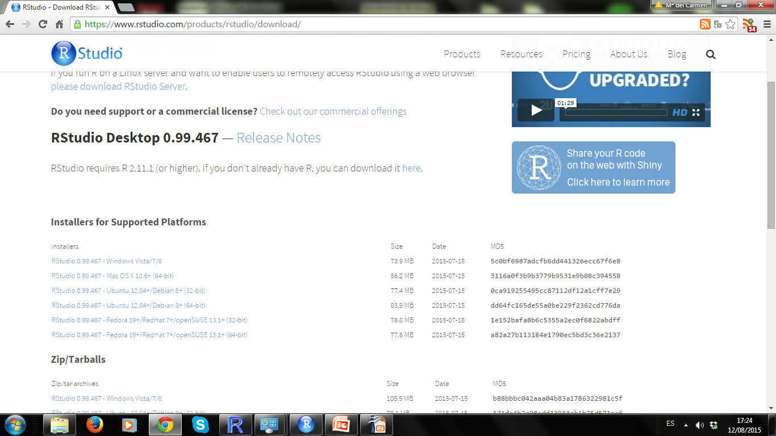
2. RStudio installation
Download the package from this link and follow the instructions:
https://www.rstudio.com/products/rstudio/download/

Slide 10
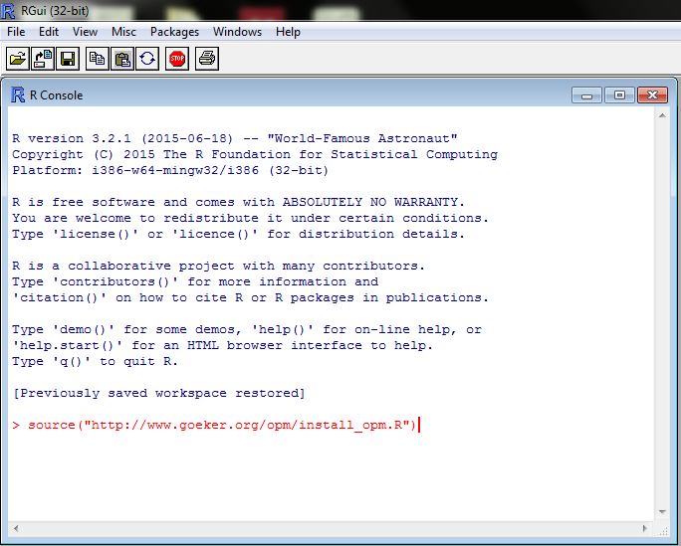
3. opm installation
Open R or RStudio and enter at the prompt: source("http://www.goeker.org/opm/install_opm.R")
Then press return.

Slide 11
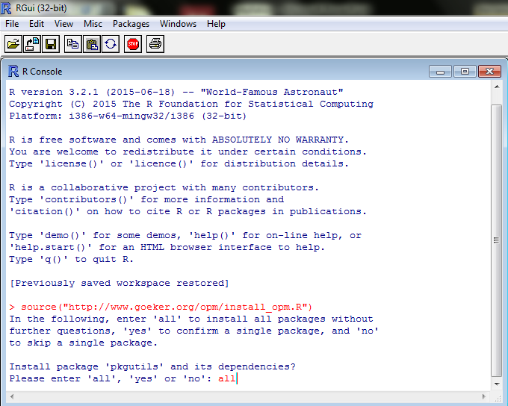
3. pkgutils/opm installation
R will ask you if you want to install all the dependencies. Please enter all.

Slide 12
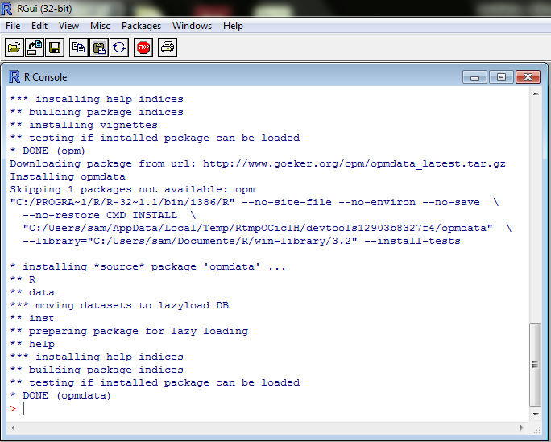
3. pkgutils/opm installation
The installation might take a while. Please be patient.

