Slide 1
(Very) few notes on using Rstudio
Maria del Carmen Montero Calasanz
Lea A. I. Vaas
Benjamin Hofner
Markus Göker

Slide 2

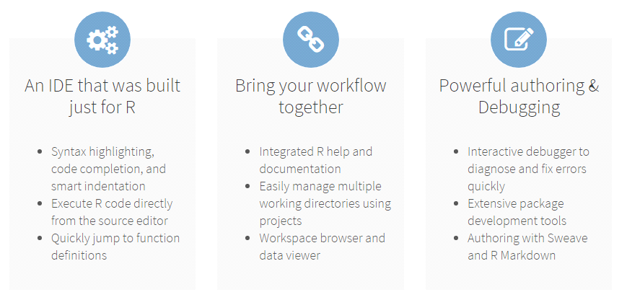
Why use Rstudio ?
http://www.rstudio.com/
RStudio is an integrated development environment (IDE) for R.

Slide 3
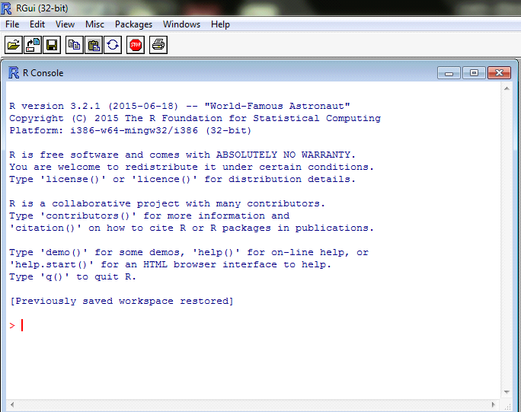
This is plain R

Slide 4
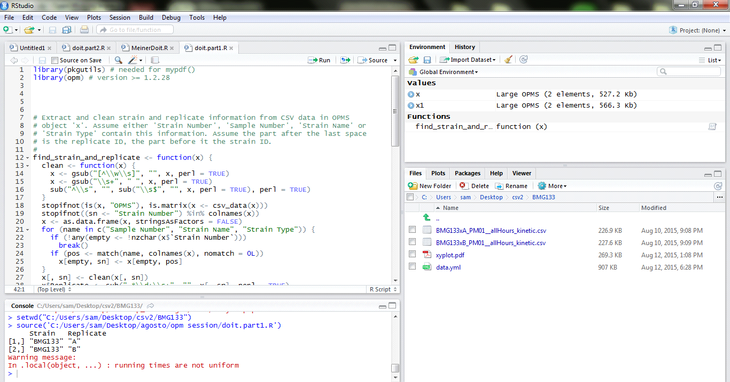
This is Rstudio

Slide 5
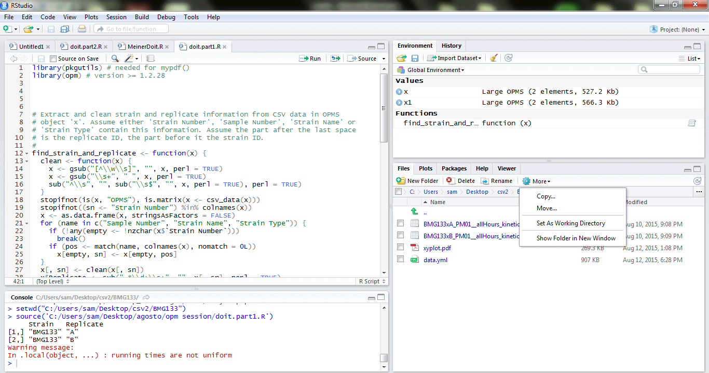
Working with files

Slide 6
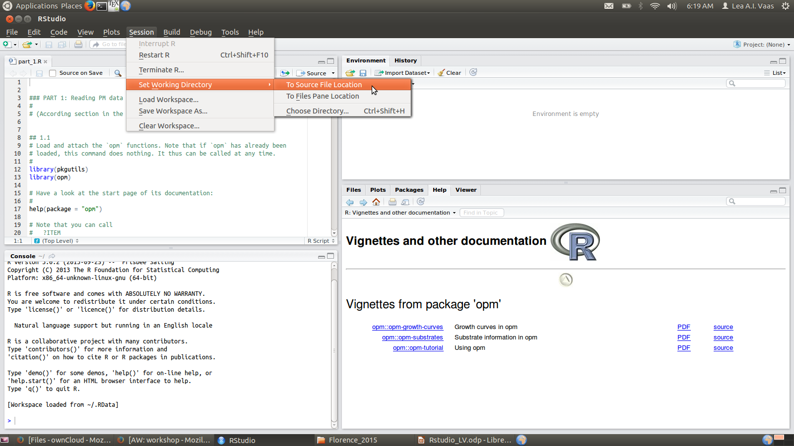
Setting the working directory

Slide 7
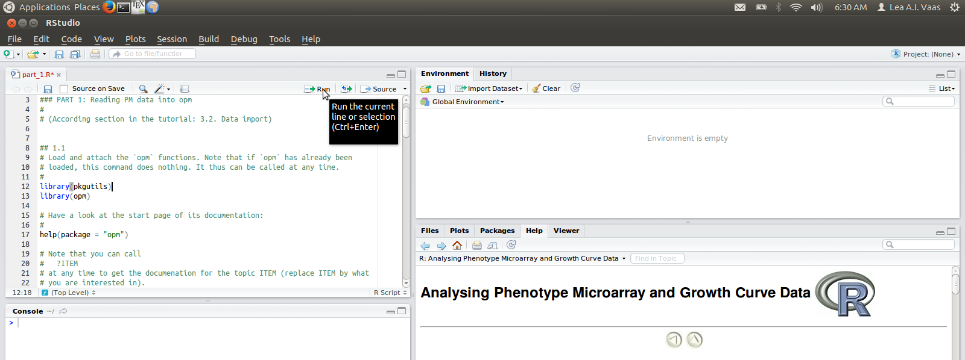
Executing R commands
Execute only the line the cursor currently is in:
  Ctrl + Enter
  or press “run” button
  (cursor then automatically jumps to the next line)

Slide 8
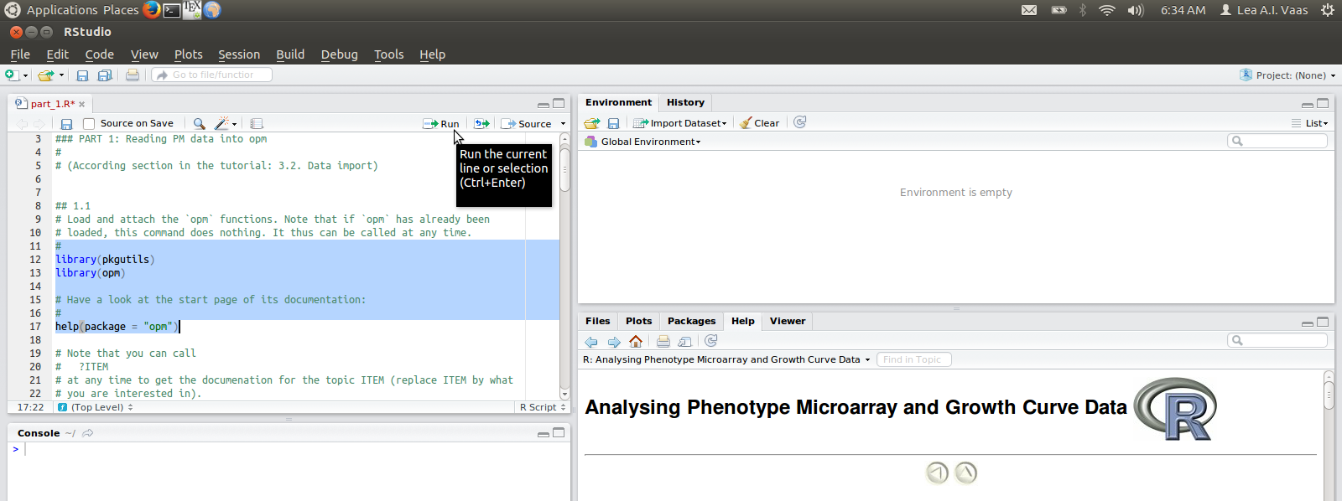
Executing R commands
Execute several lines:
  mark the lines and push Ctrl + Enter or the “run” button
  (cursor does not move)

Slide 9
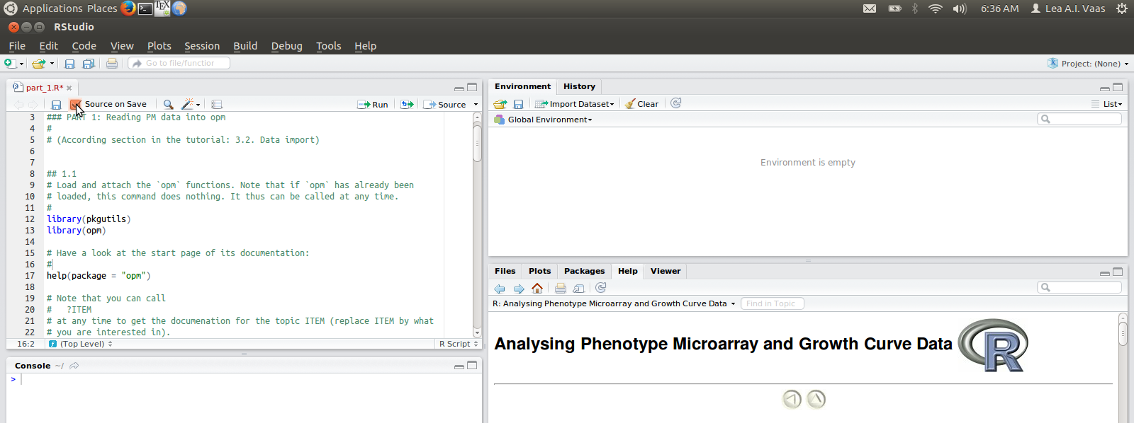
Executing R commands
Execute a complete script:
  push the “source” button OR tick box “Source on Save” on the Script tab, then click the save button

Slide 10
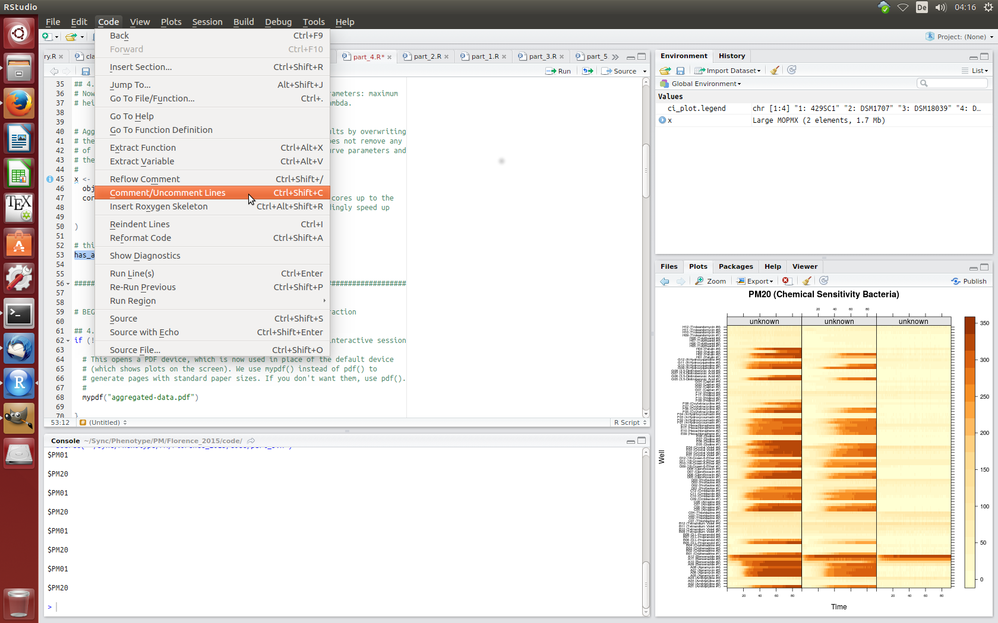
(Un-)comment lines
Anyhing after “#” is not executed
  press Ctrl+Shift+C to enter a comment or deactivate lines of code (or to activate them again)

