Slide 1
MVC
View
Model
Controller
servlet
Client
Server
Html(JSP, ASP.NET,…)
Java, C#,…
<input type="text" name=“account" />
Account ac=new Account()
SUBMIT

Slide 2
AJAX
Client
Server
$http({ method: "post", //or "get" data: model, //params:{id:1,name:"abc"} url: "/url" }).then(function (response) { return response.data; }, function myError(errResponse) { return errResponse; });
Html
JavaScript
Request

Slide 3
Angular
AngularJS
Angular
1
JavaScript
2+
TypeScript
app.js
homeCtrl.js
homeService.js
home.html
app.module.ts
app.component.spec.ts
app.component.ts
app.component.html
app.component.css

Slide 4

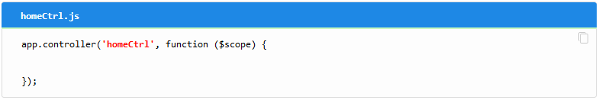
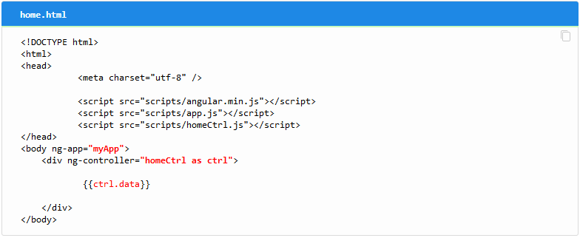
File Structure

Slide 5
AngularJS
Controller
Html
JavaScript
($scope)
<input type="text" ng-model="model_1" />
<input type="text" ng-model="model_2" />
app.controller('homeCtrl', function ($scope) { var self = this;
self.model_1 = 123;
self.model_2 = 'ABC';
}

