Slide 1
Biological Background
Monitoring gene expression helps understand the cellular mechanisms for all biological processes.
Microarray technology allows measuring expression levels of thousands of genes simultaneously.
Important applications for pharmaceutical research include:
  Determine regulatory and metabolic pathways
  Identify potential biomarkers and targets
  Determine mechanism of action and toxicity
  Evaluate / predict safety

Slide 2
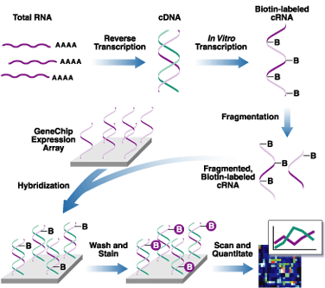
Biological Background
Procedure of Microarray Experiment
Figure source: affymetrix.com

Slide 3


How many chips do you need?
Gene expression experiments are expensive:
  ~ $2,000 per chip for Affymetrix experiments.
  Data analysis takes considerable time.
? How many chips are needed for reliable results without wasting money and time?
➔Estimate sample size before experiments!
  What is a robust and simple statistical method?

Slide 4
Proposed Method by Warnes & Li
Estimate per gene standard deviation from existing studies
Assume standard 2-sample t-tests with pooled variance on each gene
Control multiple-testing error via:
  Bonferroni adjustment (strong control of family-wise Type I error)
  OR
  Control FDR (false discovery rate = expected false positives among significant tests) (Benjamini and Hochberg, 1995)

Slide 5
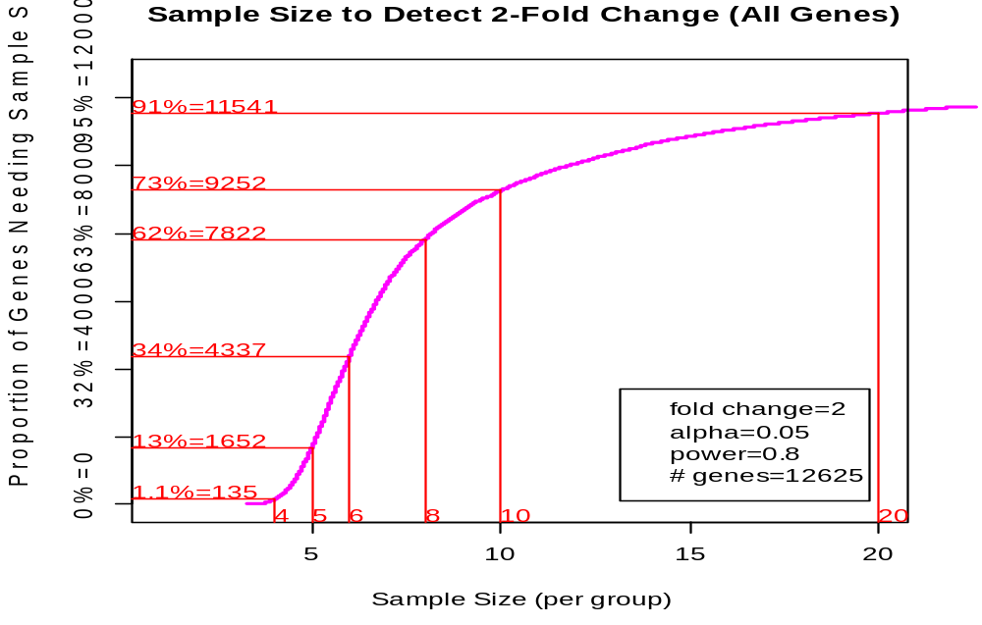
Proposed Method by Warnes & Li
Compute sample size separately for each gene
Summarize via cumulative plots
Sample Size to detect 2-fold change
Prop’n of genes needing s.size ≤ n
Sample Size / group

Slide 6
Simulation Study
Check performance of proposed method under
  Violation of assumptions:
    Equal variance
    Independent observations
  Changes to:
    Proportions of genes with true difference
    Minimum effect sizes
    Multiple comparison method
in order to
  Investigate the effects of different influencing factors
  Provide a practical guide for sample size selection.

Slide 7
Simulation Study: Flow Chart
Specify simulation variables; Sample standard deviations and covariance matrices from real data
Generate 1 sample
Generate many samples
Estimate σ²_{g} based on generated samples
Perform t-test for each sample
Estimate power based on proposed method
Pool test results to calculate true power
Compare results for several sample sizes and give recommendation

Slide 8

Computing Challenges
Simulation needs computations for:
192 set of variables
X 986 set of samples
= 189,312 sample sets, each with
400,000 observations
➔ 120 days of computation with ~895 MHz Intel CPU
Fortunately: Independent sample sets make this an “Embarrassingly parallel” problem
➔ parallel/cluster computers are very efficient

Slide 9

How to speed up the computation?
PVM (Parallel Virtual Machine)
  Tasks are allocated to many abstract computer nodes.
  Dynamic message passing and communication allow the cooperation between different computer nodes.
  Computations are much faster!
  4 months → 1 week
Time for processes
Computer Nodes

Slide 10
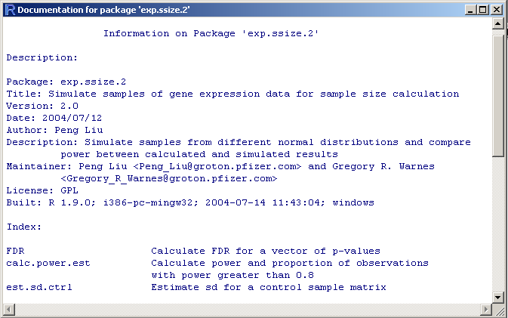
Computer Coding with R
Built a R package for simulation study

Slide 11
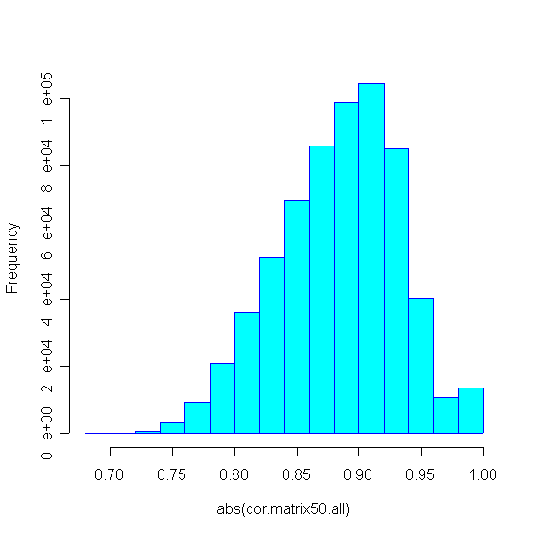
Observations
Gene expression data are highly correlated
  In this data set, each gene is highly correlated with
  at least 50 other genes:
Histogram of top 50 correlation coefficients for each gene
abs(correlation coefficient)

Slide 12
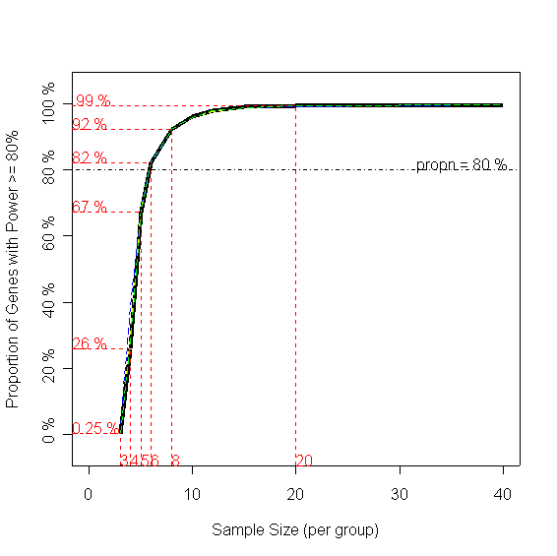
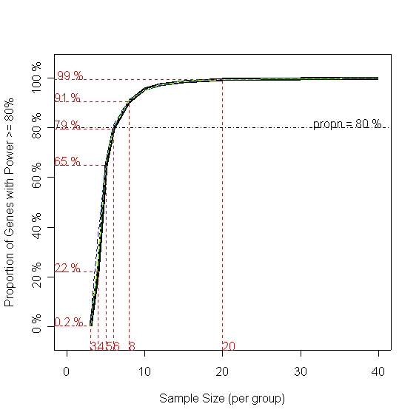
Results: Proportion of dependent observations
Black: Simulation Colors: Estimation
All genes are indep.
All genes are dependent.
Prop’n with power ≥80%
Sample Size / group
Sample Size / group
Sample Size / group
Sample Size / group
→ No effect on estimate quality

Slide 13
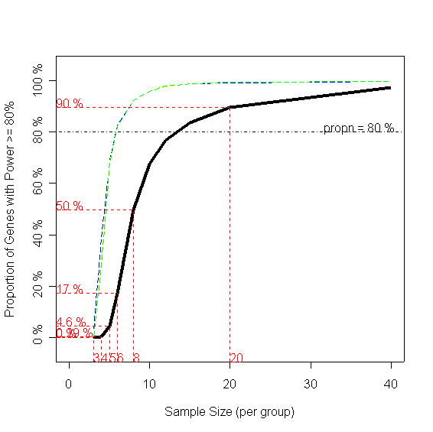
Results: Variance ratio between treatments
Black: Simulation Colors: Estimation
Var ratio = 1
Var ratio = 10
Prop’n with power ≥80%
Sample Size / group
Sample Size / group
→ Large effect on estimate quality

Slide 14
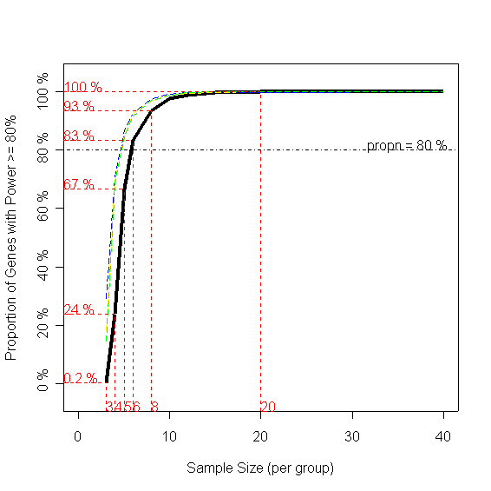
Results: Proportion of truly changed genes
Black: Simulation Colors: Estimation
All genes are diff. expressed.
5% genes are diff. expressed.
Prop’n with power ≥80%
Sample Size / group
Sample Size / group
→ Small effect on estimate quality

Slide 15
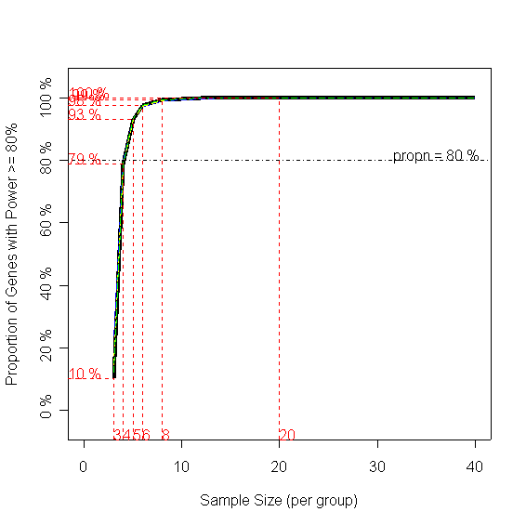
Results: Minimum effect size
Black: Simulation Colors: Estimation
2-fold change
4-fold change
Prop’n with power ≥80%
Sample Size / group
Sample Size / group
→ No effect on estimate quality

Slide 16
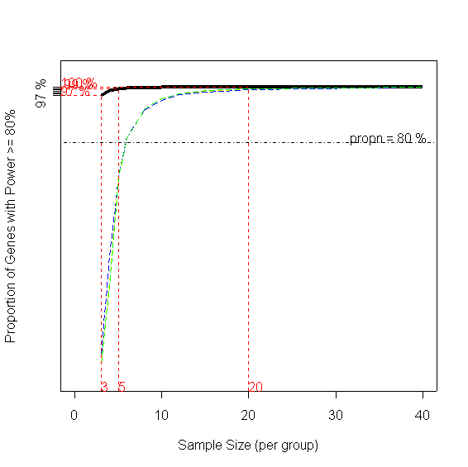
Results: multiple comparison method
Black: Simulation Colors: Estimation
Bonferroni adjustment
FDR
Prop’n with power ≥80%
Sample Size / group
Sample Size / group
→ Large effect on estimate quality

Slide 17
Summary of Results
Variable | Effect | Details | Comments
Proportion of dependent observations | little |  | Current method works well here
Var ratio between two treatments | large | Large var.ratio → small power | Sample size estimator needs to account for this
Prop’n of true diff. expressed genes | little |  | Current method works well here
Minimum effect size | mild | Large delta → large power | Current method works well here
Multiple Comparison Method | large | FDR → large power | Use FDR instead of Bonferroni

Slide 18
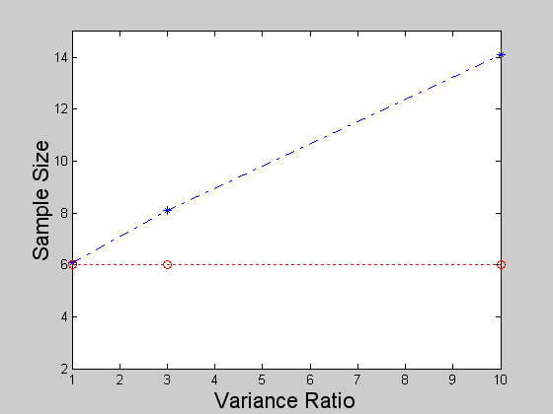
Results: Example of Sample Size Guide Table
For minimum effect size = 1 (2-fold change), all genes are from dependent groups, using Bonferroni method
True sample size based on simulation
 | Proportion of genes with true differential expression
var. ratio | 1 | 0.5 | 0.1 | 0.05
1 | 6.1 | 5.8 | 6.1 | 6.0
3 | 8.1 | 8.0 | 8.0 | 7.9
10 | 14.1 | 14.1 | 16.6 | 14.2
Estimated sample size = 6.0

Slide 19
References
Methodology
  Chow SC , Shao J, Wang H (2003). Sample Size Calculation in Clinical Research. Marcel Dekker
  Benjamini Y, and Hochberg Y (1995) Controlling the false discovery rate: a practical and powerful approach to multiple testing. J. Roy. Statist. Soc. B, 57, 289–300.
R Software: www.r-project.org
Parallel Computing with R:
  Rossini AJ, Tierney L, and Li N (2003) Simple Parallel Statistical Computing in R. UW Biostatistics Working Paper series, paper 193 http://www.bepress.com/uwbiostat/paper193/
Me
  Department of Biological Statistics & Computational Biology, Cornell University, Ithaca, NY

Slide 20
Acknowledges
Supervisor:
  Gregory R. Warnes
Computing facilities:
  Nitin Jain, JC Lawrence
  David P. Dean, Gautam Bhola
  CIT Helpdesk Staff
General help:
  Members of Non-Clinical Statistics

